Slide 1
From the history of Mixed Hypergraph Coloring
Vitaly Voloshin
Troy University
USA

Slide 2
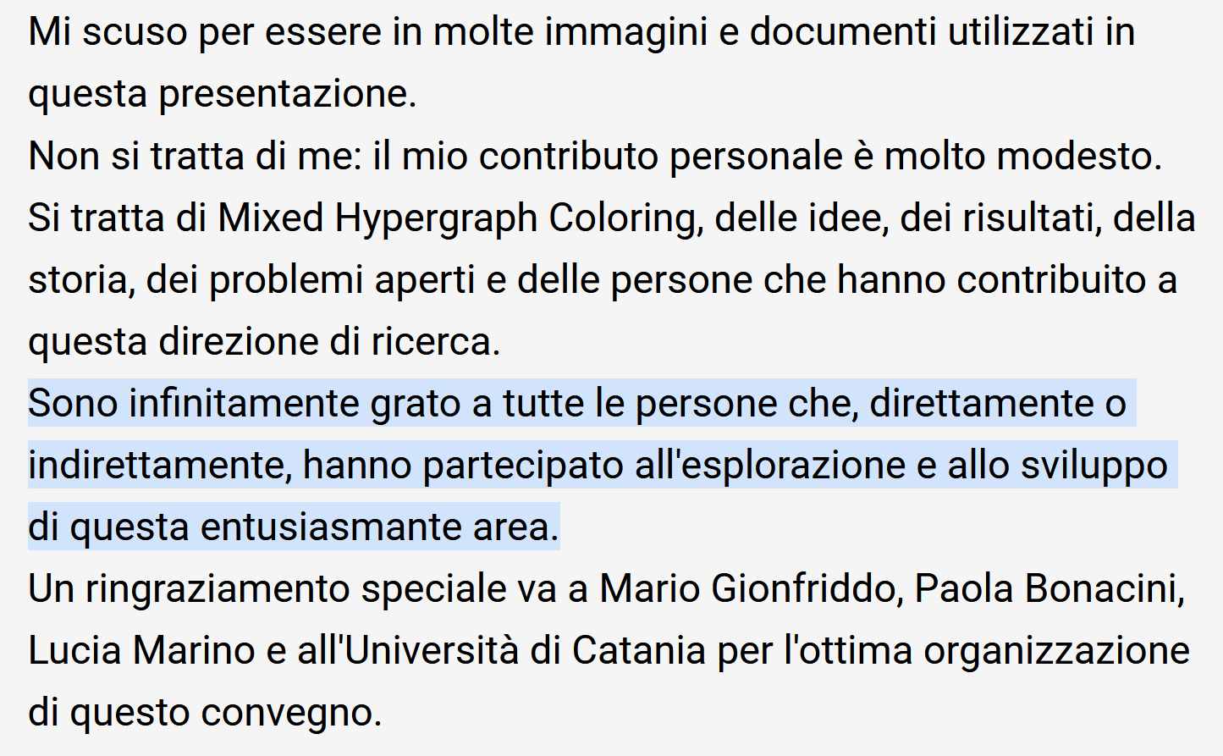
My apologies and thanks…
I apologize for being in many pictures and papers used in this presentation.
It is not about me: my personal contribution is very modest.
It is about Mixed Hypergraph Coloring, the ideas, results, history, open problems and people who contributed to this direction of research.
I am infinitely grateful to all people who directly or indirectly participated in exploring and developing this exciting area.
My special thanks go to Mario Gionfriddo, Paola Bonacini, Lucia Marino and the University of Catania for excellent organization of this conference.

Slide 3
The country of origin, moldova

Slide 4
From a village (Berlinti) to a big city, Chisinau, 1971

Slide 5
Alexander Zykov, 1922-2013
my supervisor

Slide 6
Alexander Zykov, 1922-2013
Working in Moldova 1975-1982

Slide 7
Zykov’s places

Slide 8
Alexander Zykov in 1983

Slide 9
The very origin…manuscript of 1979
43 years ago, today…
One step aside from discovery
of the most general
colorablility problem!

Slide 10
Lower and upper chi and uc: 1979

Slide 11
First chromatic spectra, 1979
USSR had to collapse
to make me to resume research
in MHC in 1991

Slide 12
The very first MHC publication: 1993

Slide 13
Mixed Hypergraph:
Mixed hypergraph is a triple H=(X,C,D), where X is the vertex set, C and D are the families of subsets of X, each subset of size ≥ 2.
Every member of C is called C-edge and every member of D is called D-edge.
Monochromatic = all of the same color
Polychromatic=rainbow=all of distinct colors
Bi-edge = C-edge And D-edge

Slide 14
Proper λ-coloring of H=(X, C, D) is a mapping of X into the set of colors {1,2,…λ} such that:
Each C-edge has at least 2 vertices of a Common color (not rainbow=not polychromatic);
Each D-edge has at least 2 vertices of Distinct colors (not monochromatic).
“C” stands for Common color and
“D” stands for Distinct colors.

Slide 15
Proper λ-coloring strict i-coloring
lower χ and upper χ chromatic numbers
feasible partition feasible set S(H)
chromatic spectrum:
R(H) = (r₁, r₂, …, r_{n}) = (0,…,0,r_{χ},…,r_{χ},0,…,0)
r$i$ = the number of feasible partitions into $i$ classes

Slide 16
The main paper of my life…

Slide 17
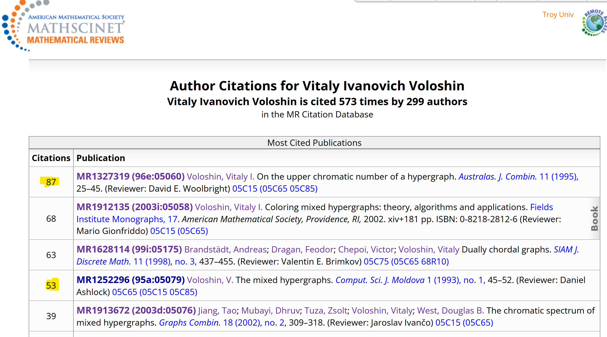
AMS Citations today

Slide 18
The following new properties of colorings have been discovered since the introduction of mixed hypergraphs in 1993. They are not possible in classic colorings:​
Uncolorability​
Unique colorability (combinatorial memory)​
Hypergraph perfection​
Phantom vertices​
Redundant edges​
Unavoidable re-coloring in greedy algorithm for the maximum number of colors​
Gaps in the chromatic spectrum​
New polynomials that are chromatic​

Slide 19
286 MHC publications at least

Slide 20
Chromatic polynomials:
Classic | Mixed hypergraph
Degree: n | Degree: upper chromatic number
Leading coefficient: 1 | Leading coefficient: any natural number
Chromatic spectrum: continuous | Chromatic spectrum: may be broken
Any vertex/edge visible | Invisible vertices/edges
Never 0 | 0 for uncolorable mixed hypergraphs

Slide 21
Uncolorable planar mixed hypergraph …

Slide 22
What was carved in stone since 1912, has changed in 1993!
Adjacent vertices in a graph
colored with the same color:
Tip of an iceberg = C-edge

Slide 23
Invisible=phantom vertices in mixed hypergraph
Chromatic polynomial the same as for K_5:
P(λ)= λ(λ -1)(λ -2)(λ -3)(λ -4)
spectrum : R(H)=(0,0,0,0,1,0,0)
χ = χ = 5

Slide 24
Paul ErdŐs

Slide 25
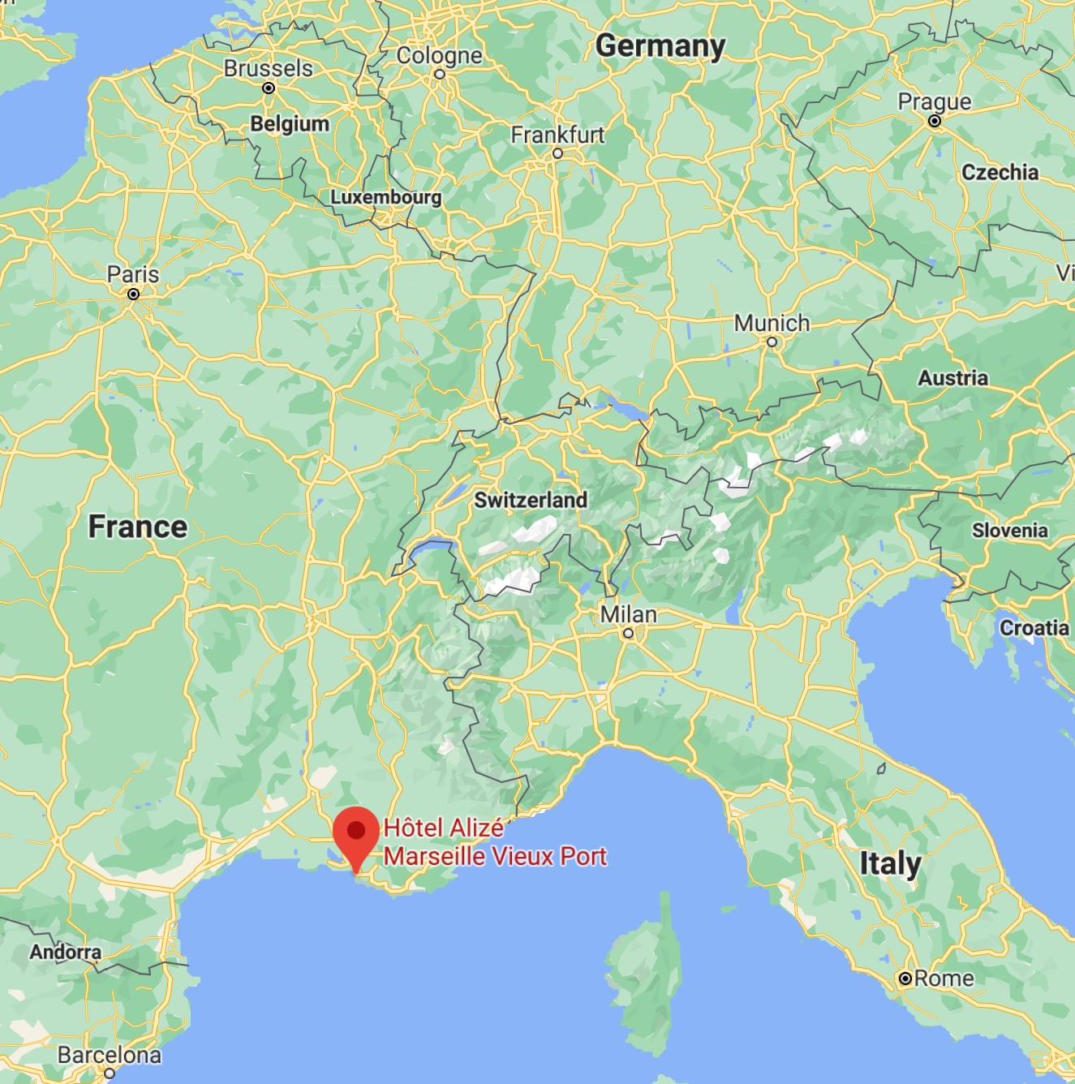
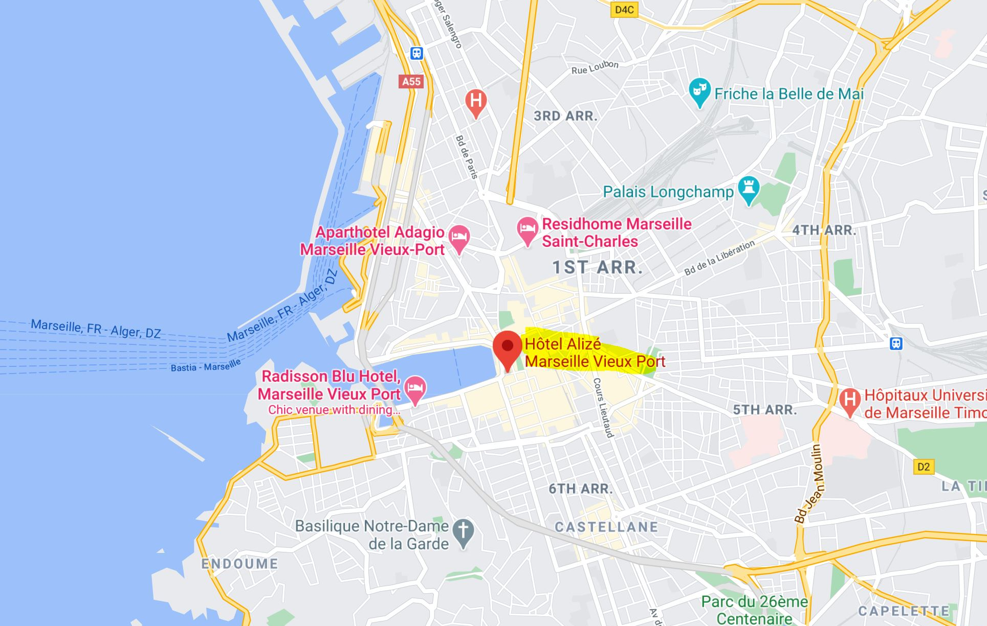
MARSEILLE, 1995 the most unknown contributor to mhc

Slide 26
At that time WE had erdŐs instead of… google…
November 16, 1993
Dear Professor Voloshin,
I just got your interesting paper yesterday. Your approach was certainly new to me and it leads to many interesting new problems. I will
think about them and let you know if I get anywhere….

Slide 27
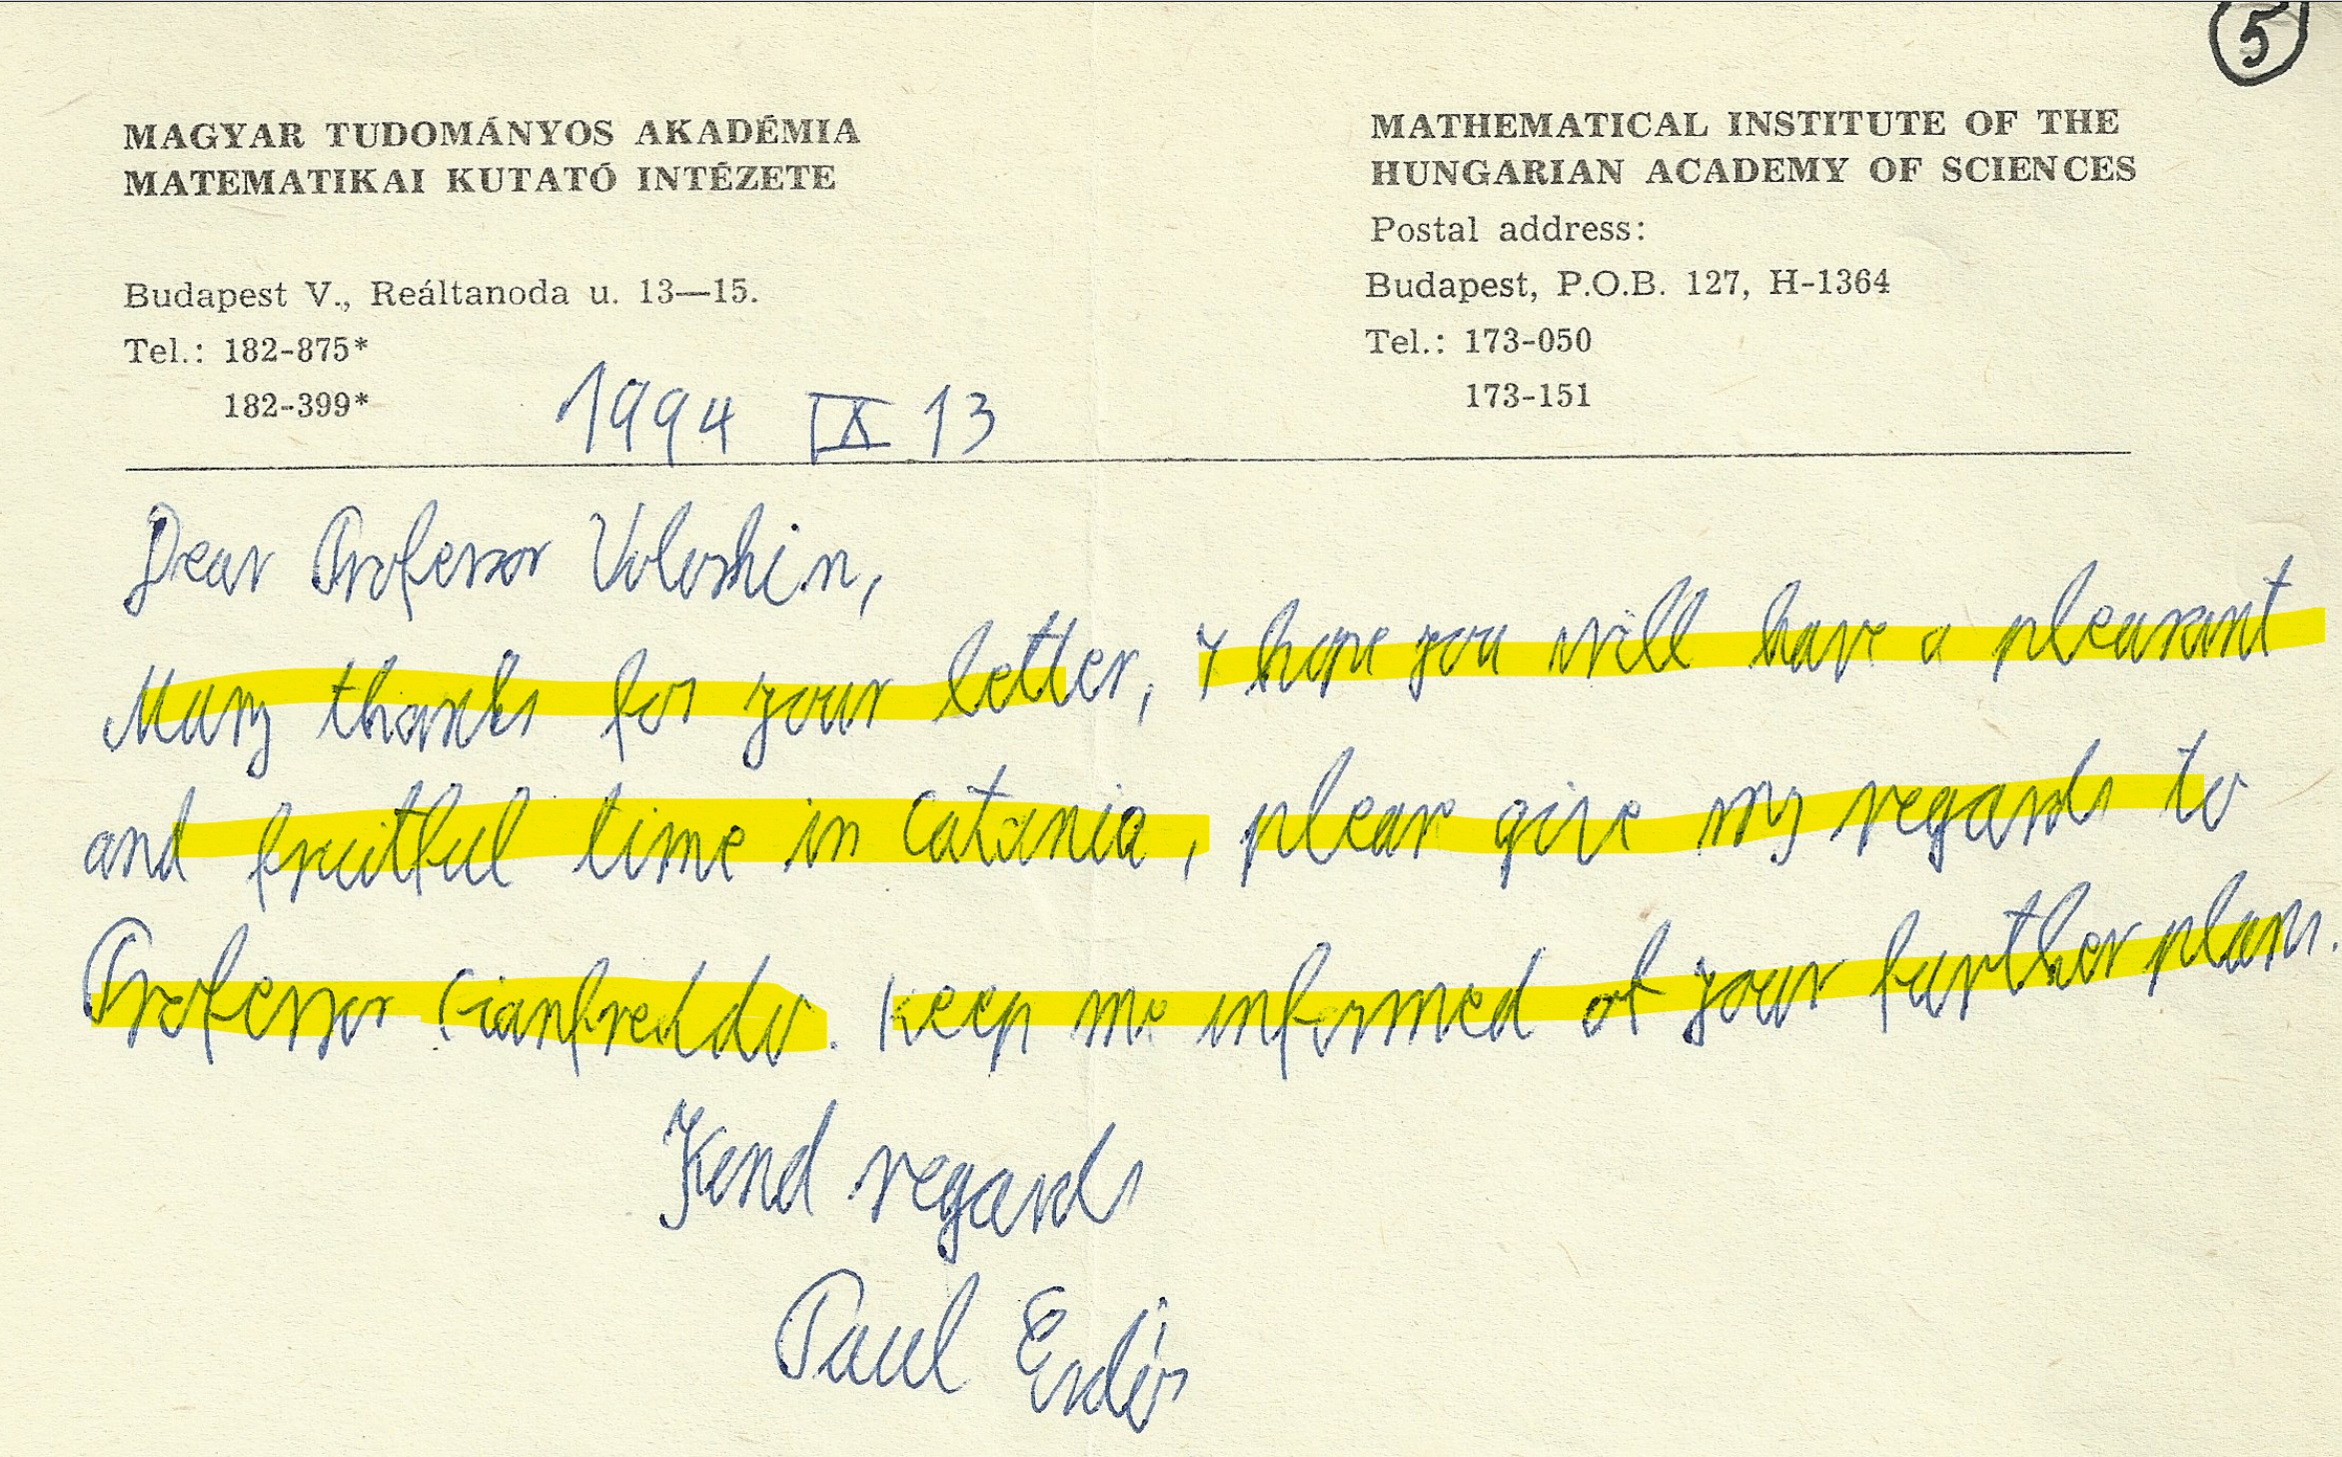
Letter 5, September 13, 1994
Dear Professor Voloshin,
Many thanks for your letter, I hope you will have a pleasant and fruitful time in Catania, please give my regards to Professor Gionfriddo. Keep me informed of your further plans.
Kind regards,
Paul ErdŐs

Slide 28
Please excuse this disorderly letter, my pen and
my eyes are both bad - I can get a better pen
but have difficulties about getting better eyes.

Slide 29
Marseille, france, 1995
Who is the author of the word “hypergraph”?
To be lucky =
to be in the right place at the right time and
just say one word!

Slide 30
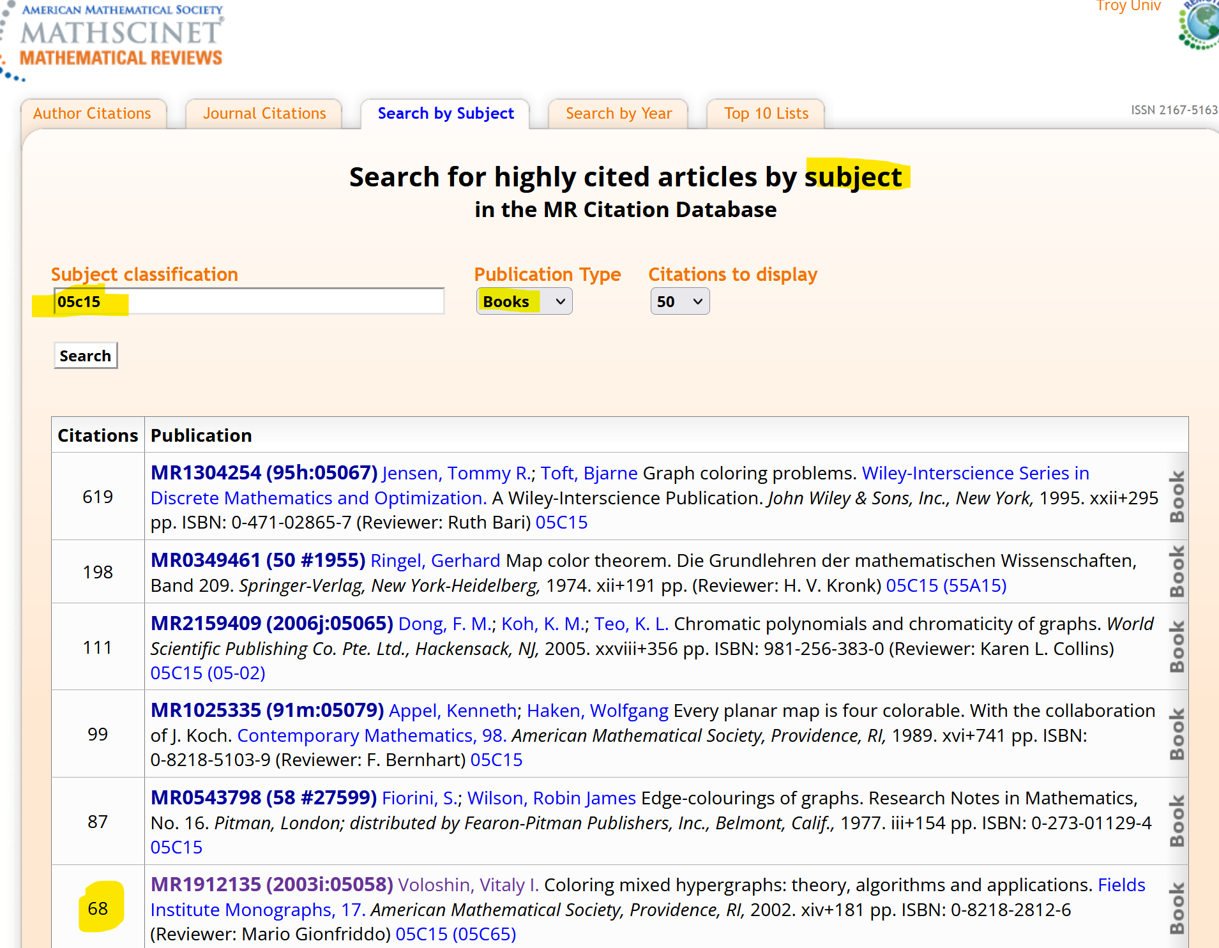
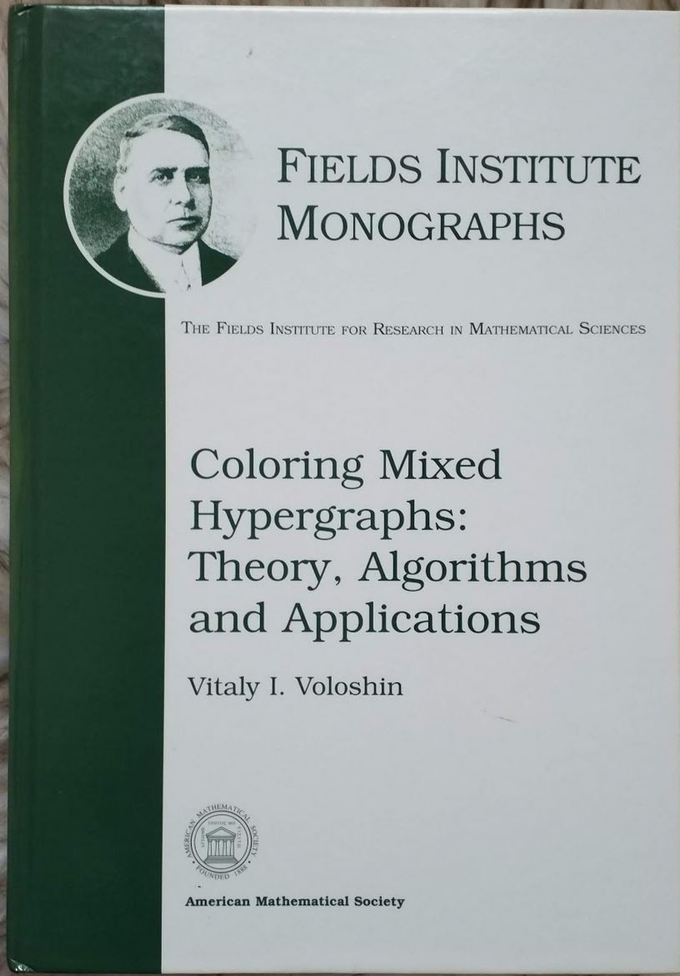

Slide 31
Mario Gionfriddo

Slide 32
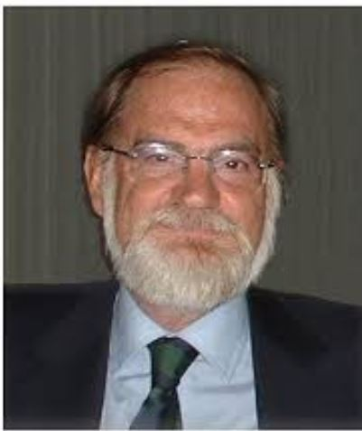
cnr grants 1993-2001
Catania – international center
of research

Slide 33
With curt Lindner, chris Rodger and shen hao. Catania, 1994

Slide 34
With Mario gionfriddo , 2009

Slide 35
WITH ROBIN WILSON, SALVATORE MILICI, MARIO GIONFRIDDO AND GAETANO QUATTROCCHI (CATANIA, 2003)

Slide 36
WITH GIOVANNI LO FARO AND MARIO GIONFRIDDO (PERUGIA, 2012)

Slide 37
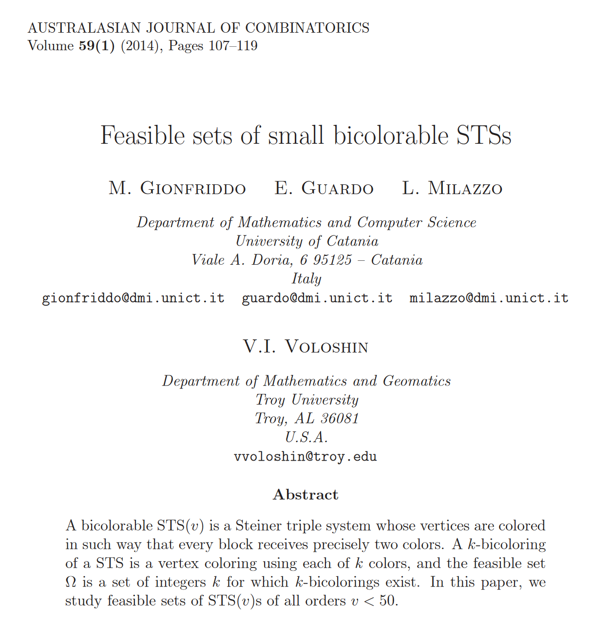
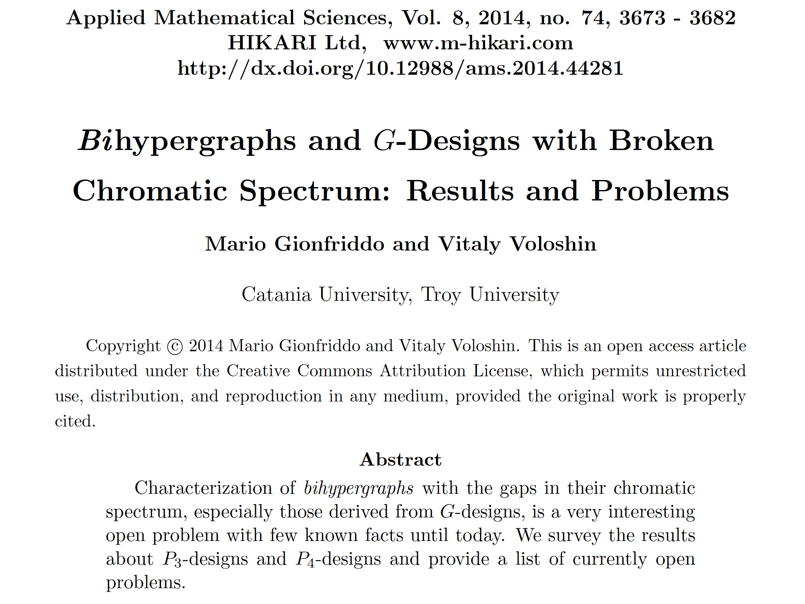
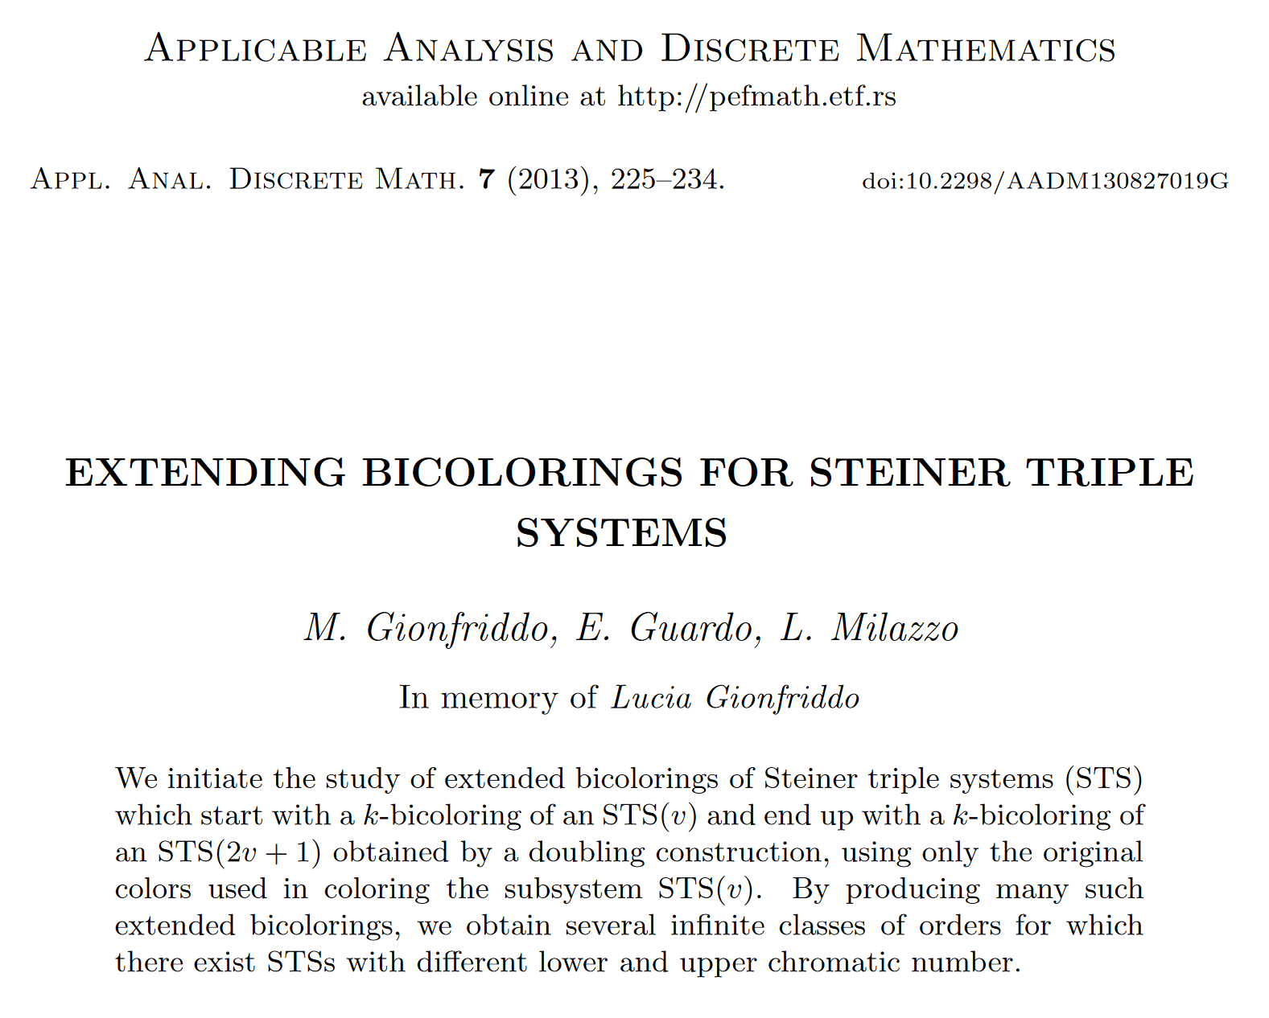
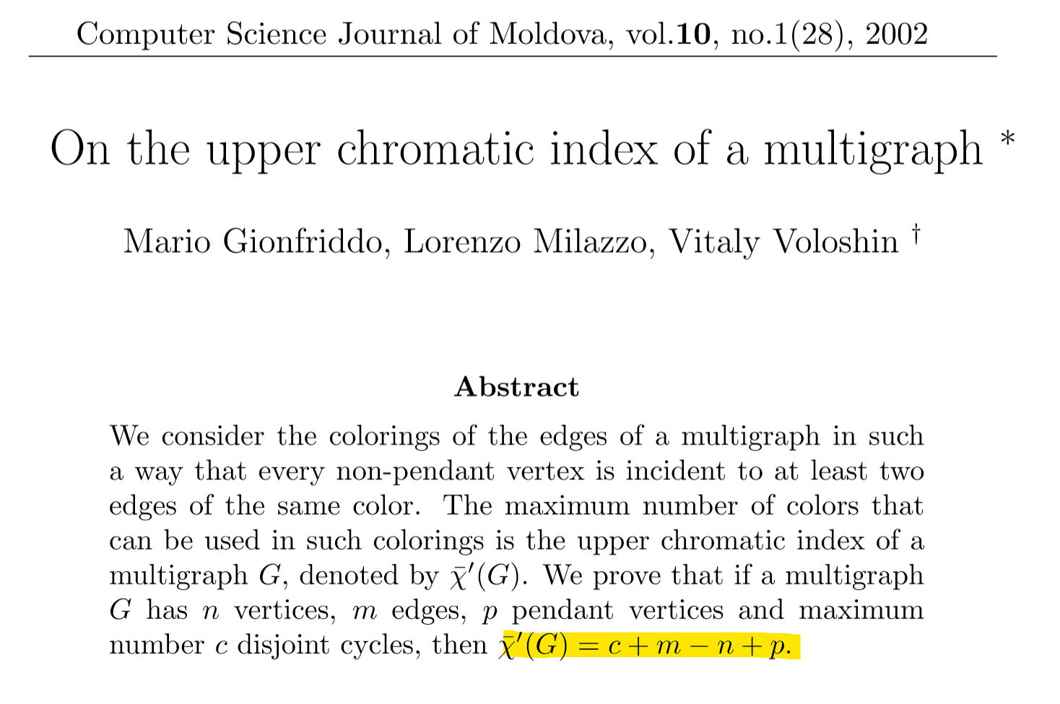

Slide 39
Lucia Gionfriddo and Lorenzo Milazzo

Slide 40
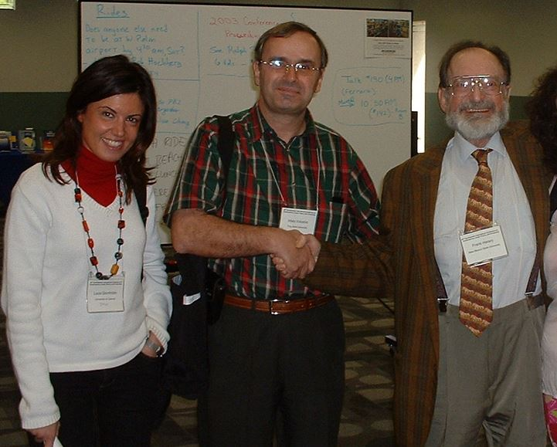
WITH FRANK HARARY AND LUCIA GIONFRIDDO (BOCA RATON, usa, 2004) Bulletin of the ICA, 2002,

Slide 41
7 points and 9 triples with the gap at 3
B
B
A
6
5
7
Starting points =key to proof
1
2
3
4
A
B
A
B
2-coloring: ABABBBA

Slide 42
4-coloring, the gap at 3
Starting
points
4-coloring: AABBCDC
R(H)=(0,12,0,3,0,0,0)

Slide 43
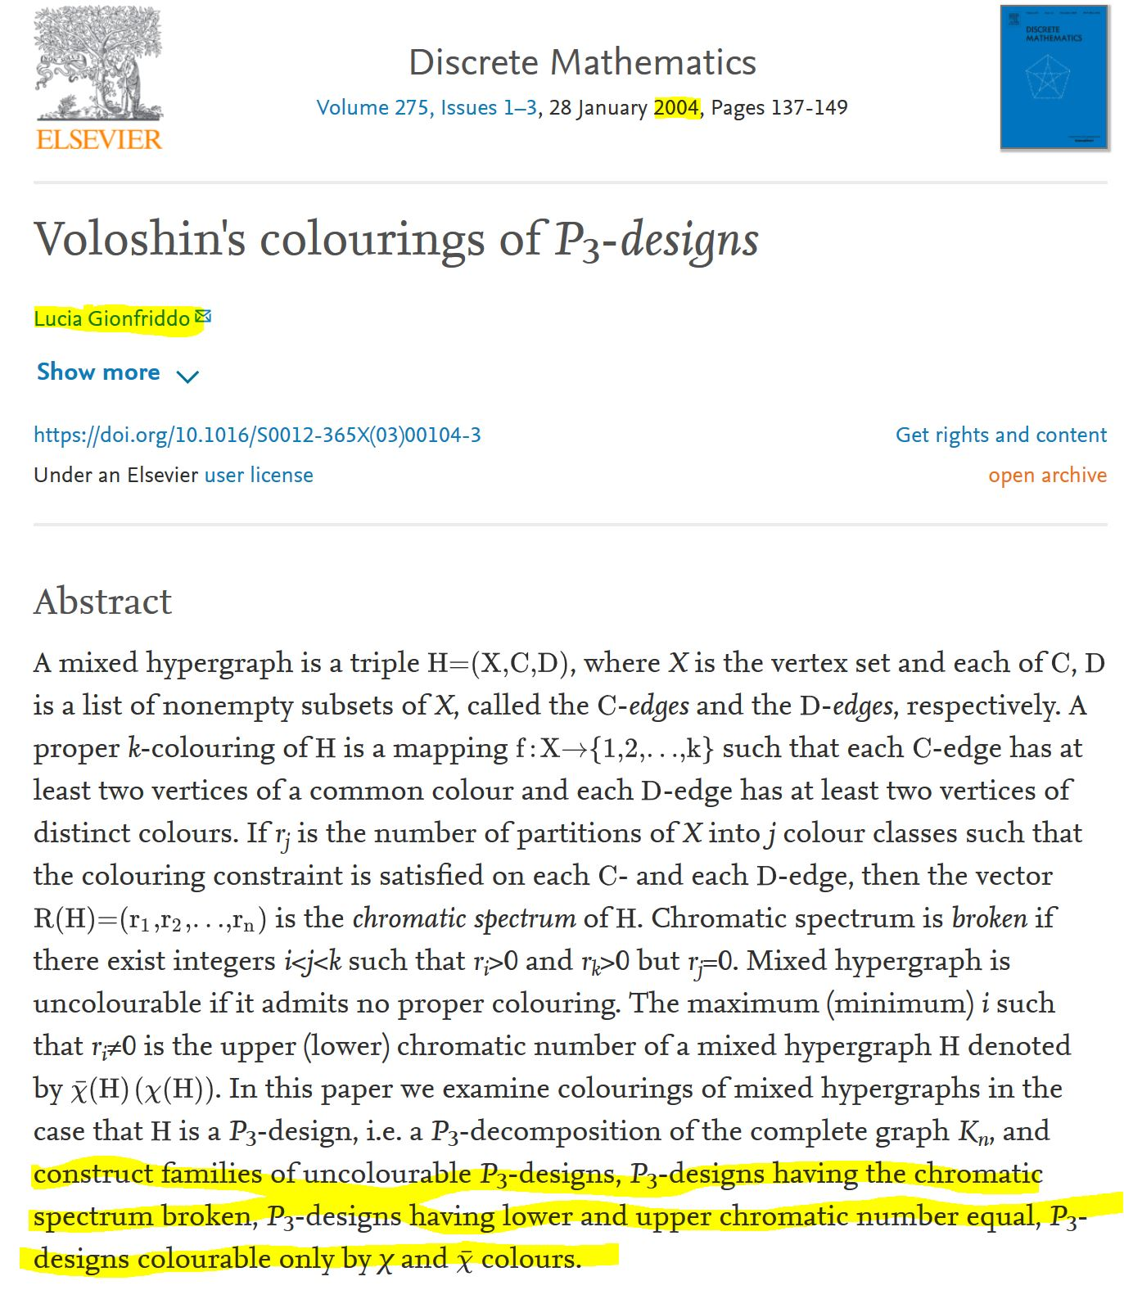

Slide 45
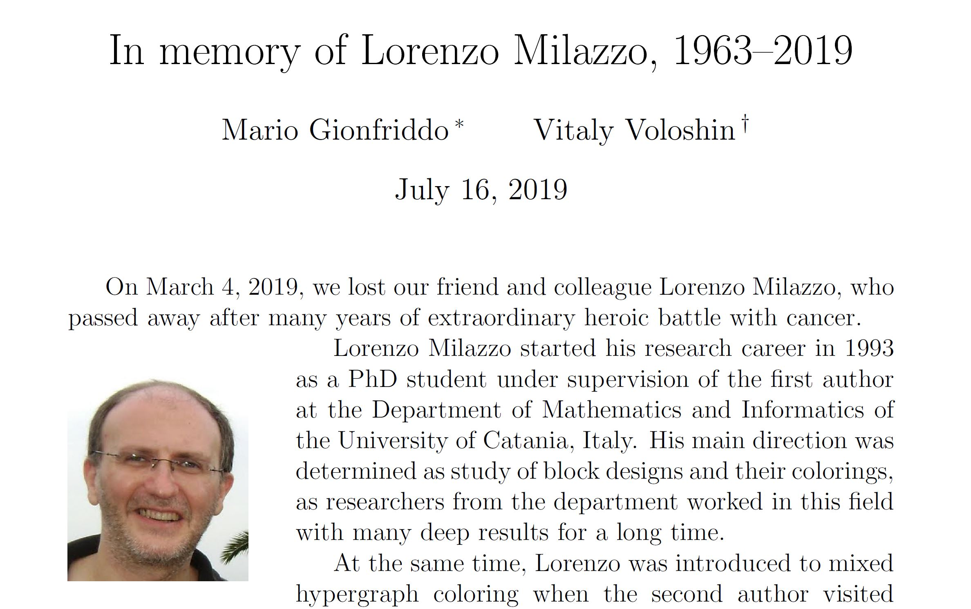
WITH LORENZO MILAZZO CATANIA, 2007

Slide 46
ZafFerana, 2007

Slide 47
Vadim Vizing, 1937-2017
my PhD thesis reviewer

Slide 48
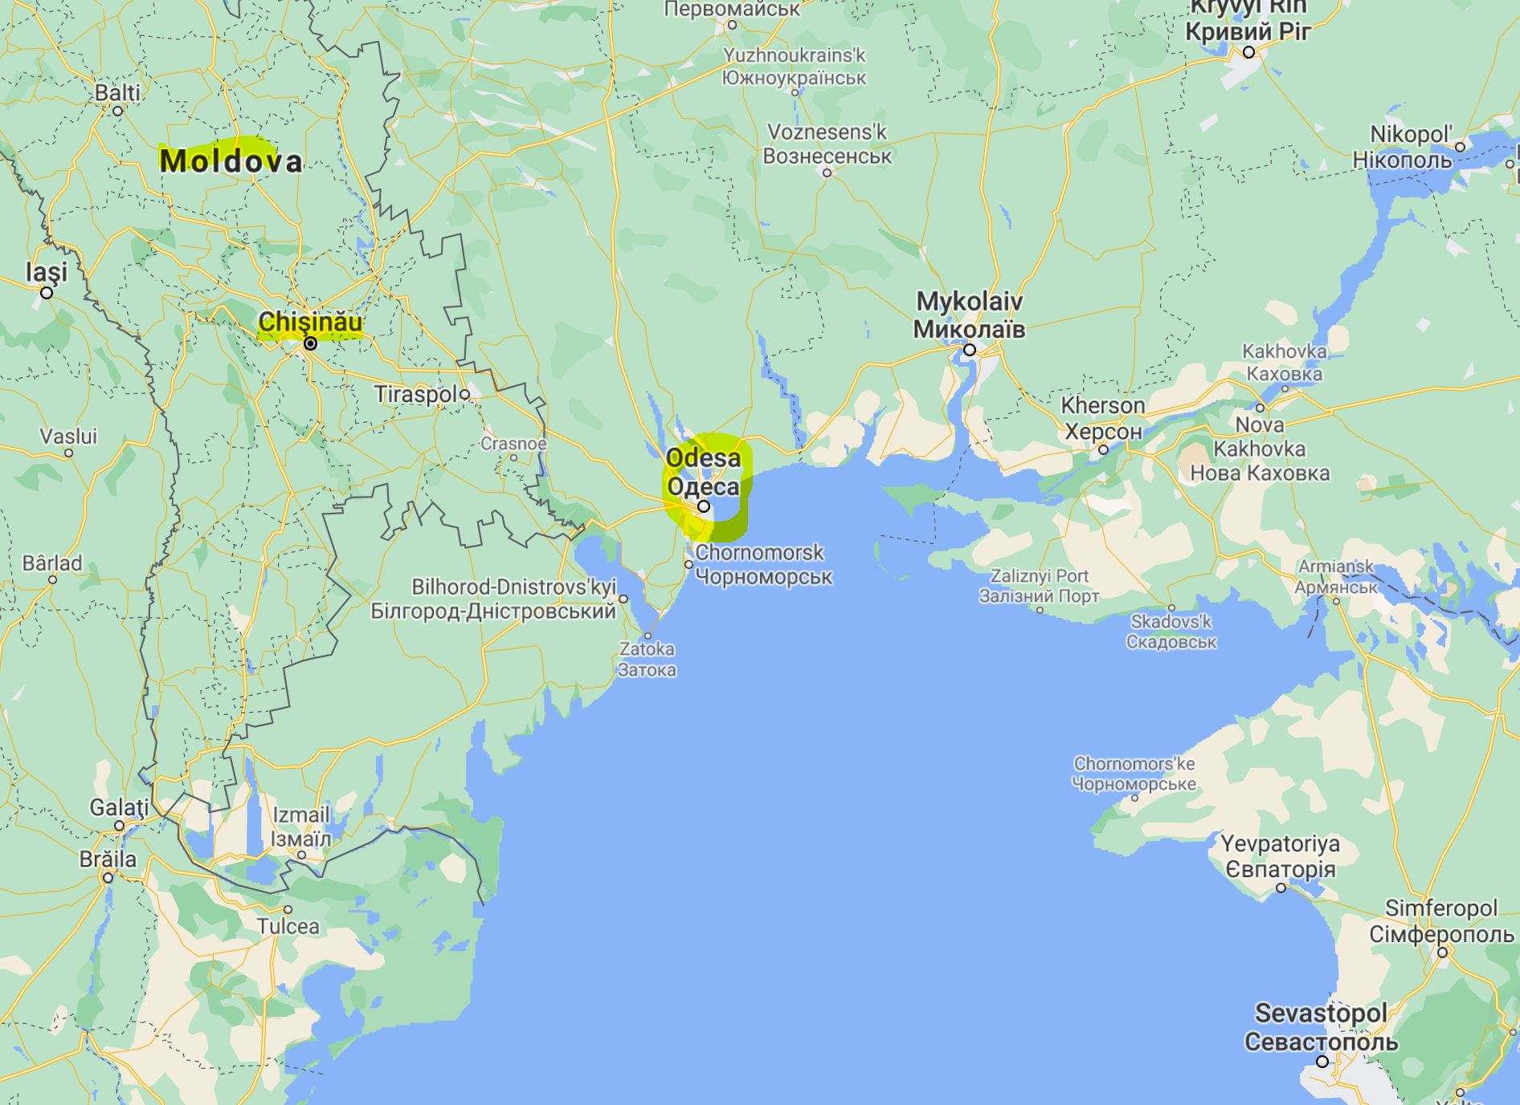
With Vadim Vizing (Odessa, Ukraine, 9/11/2001)

Slide 49
With Vadim vizing and alexander zykov (Odessa, Ukraine, 9/11/2001)

Slide 50
New! With VIZING and ZYKOV, 9/11/2001

Slide 51
New! Odessa seminar 2001

Slide 52
WHO are these guys?

Slide 53
Curt Lindner
Alex Rosa

Slide 54
With Lorenzo Milazzo, curt Lindner and alex rosa (Catania, 2009)

Slide 55
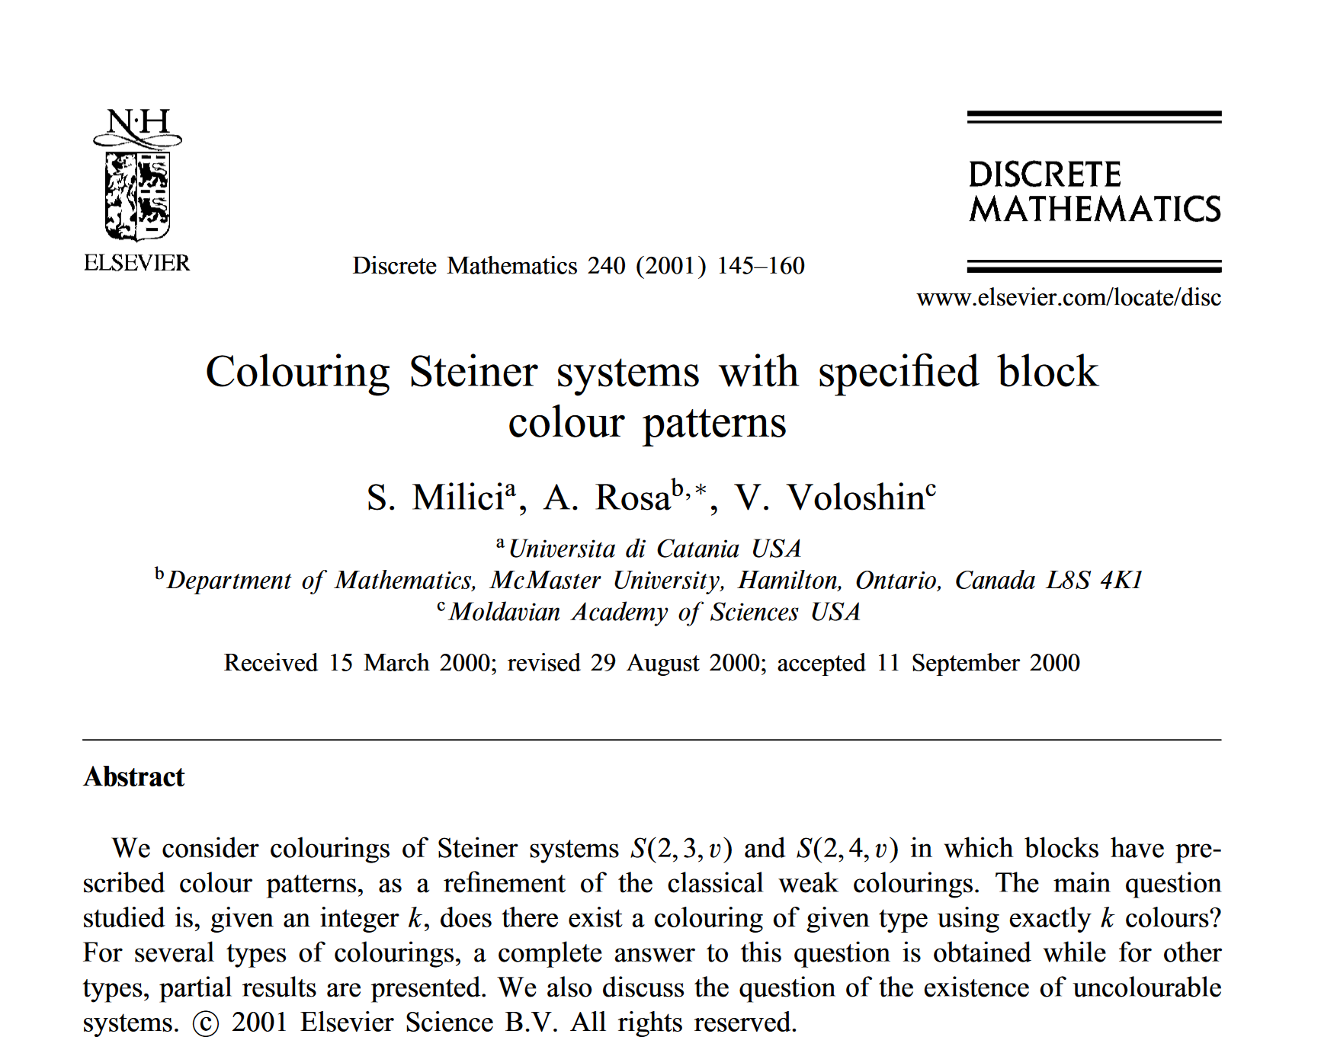
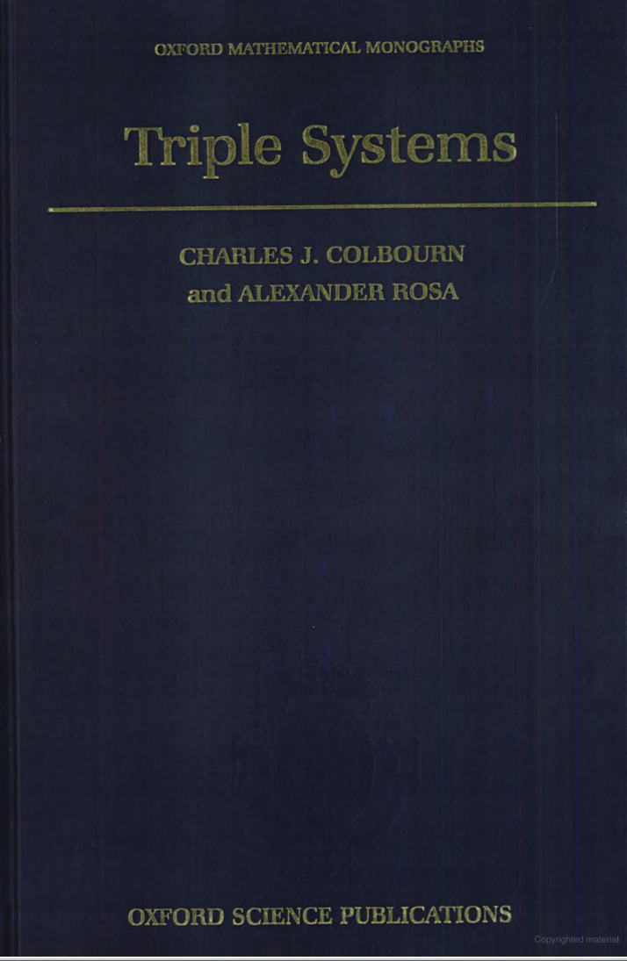
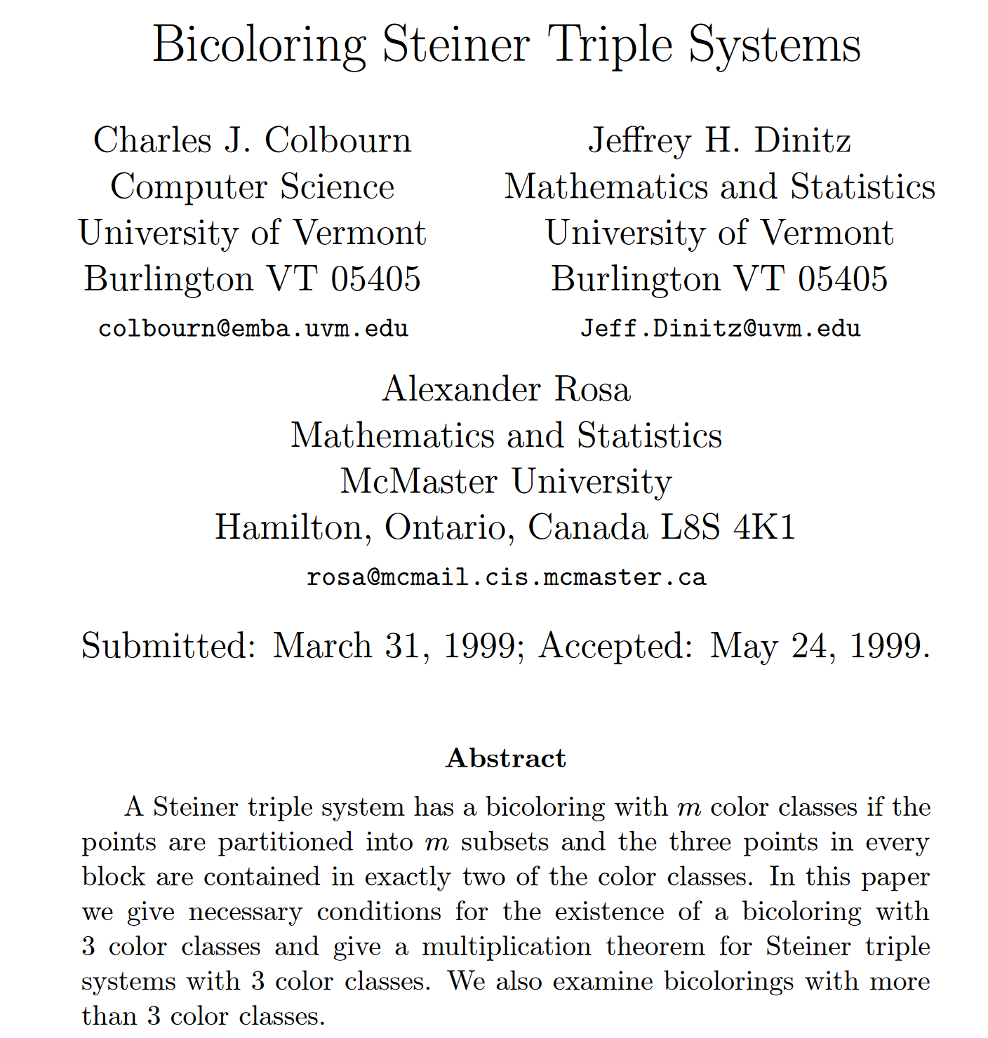
Section 18.6.
Strict colorings and
the upper chromatic number,
p. 340-341

Slide 56
Famous Auburn seminar…

Slide 57
WHERE ARE THOSE wonderful DAYS?

Slide 58
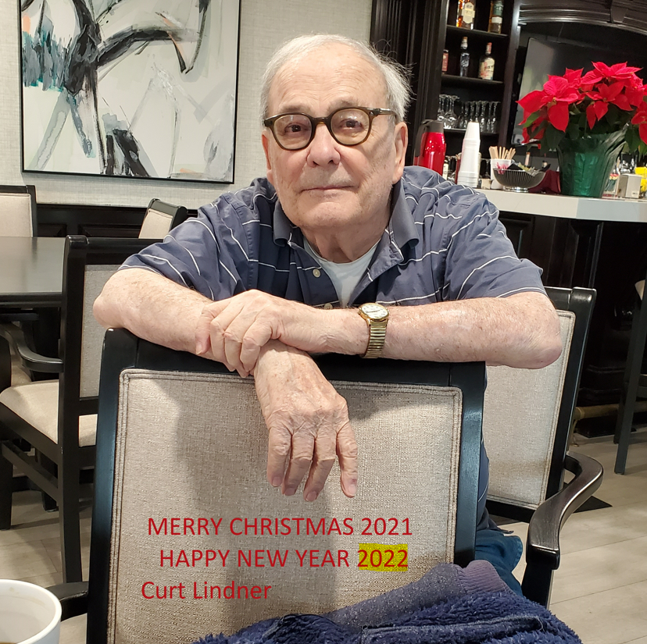
Curt Lindner…
Steiner Triple Systems FOREVER!

Slide 59
With Zsolt Tuza

Slide 60
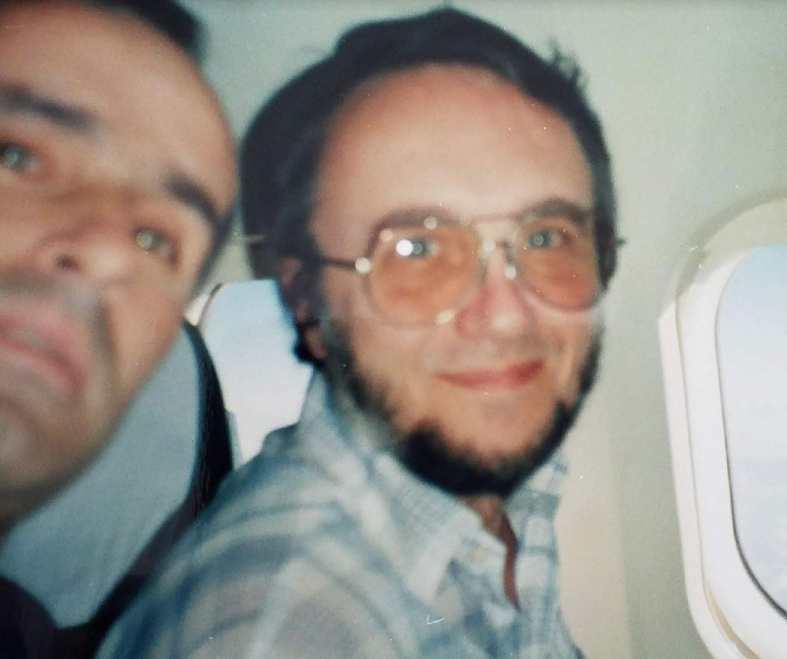
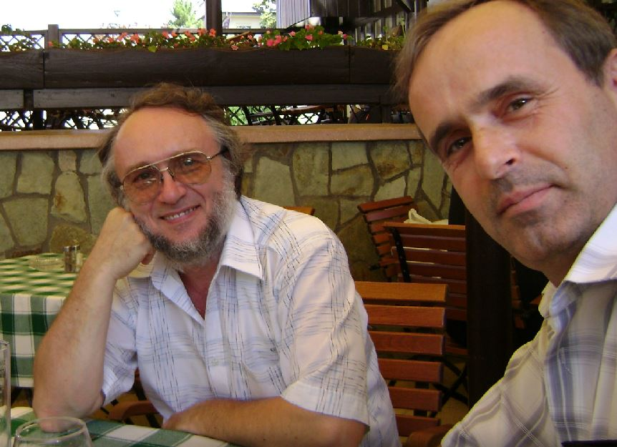
WITH ZSOLT TUZA 1995-2007; how young we were!

Slide 61
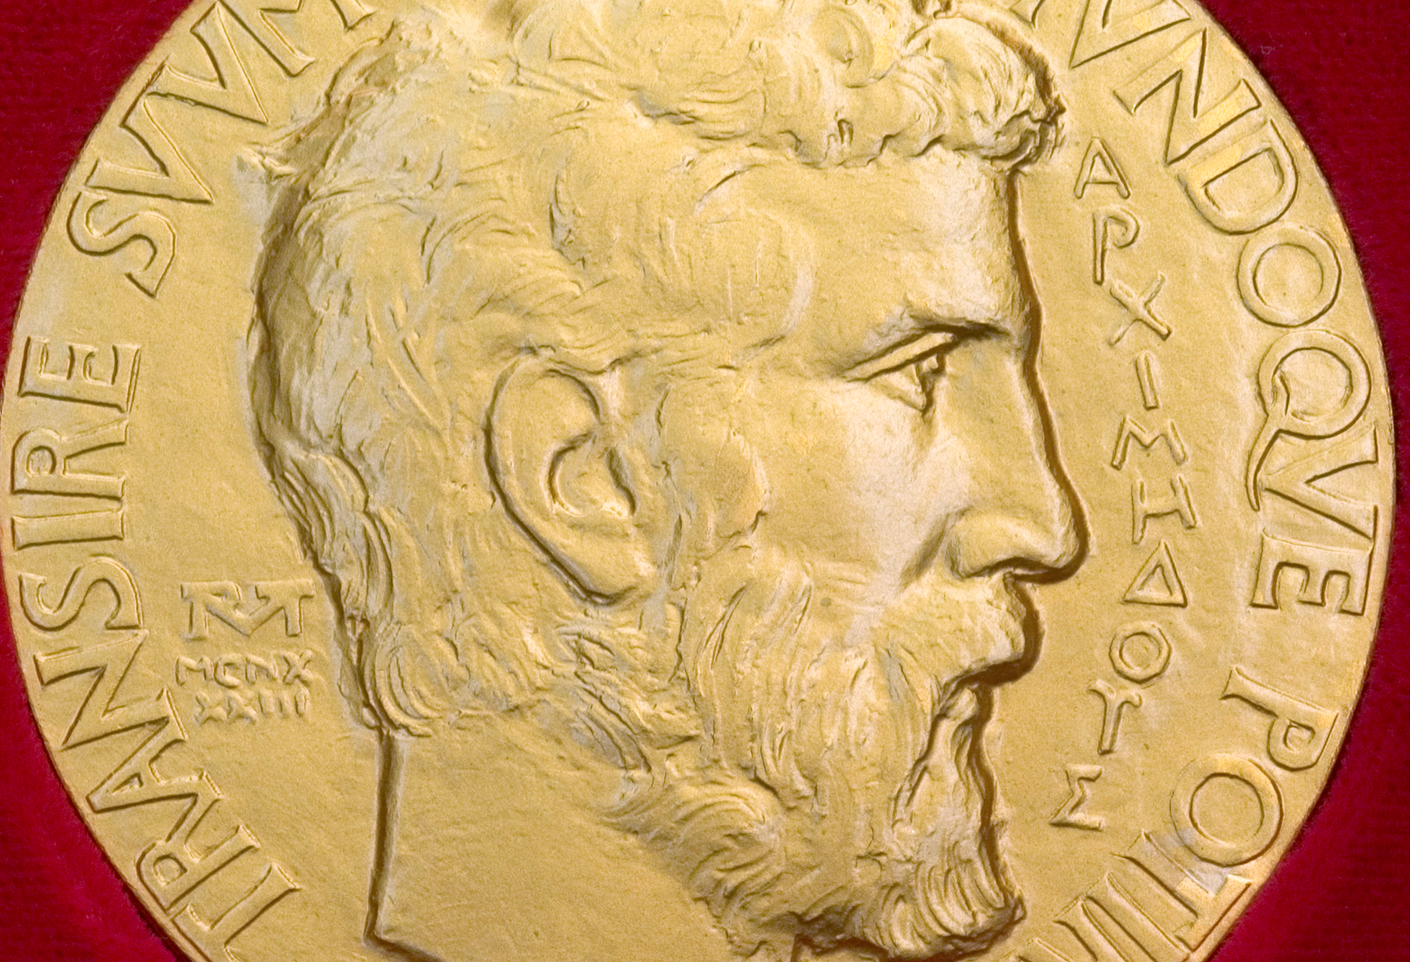
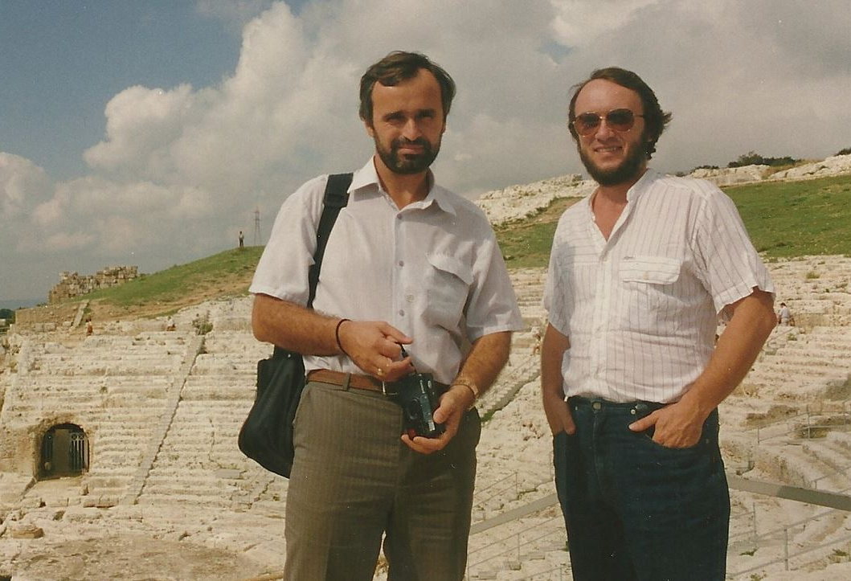
With Zsolt tuza At the Greek Theatre, Syracuse, 1995. In search for the “origin” of mixed hypergraph coloring applications... the most uncolorable mixed hypergraph models natural number concept so, Archimedes used it Even if he did not use a positional number system!

Slide 62
first joint papers

Slide 63
BREAKTHROUGH …

Slide 64
The smallest mixed hypergraph with a gap, H_{2,4} (Tuza, Catania 1998):
D
Bi-edges
R(H₂,₄)=(0,4,0,1,0,0)
D
C
S(H)={2,4}
C
C

Slide 65
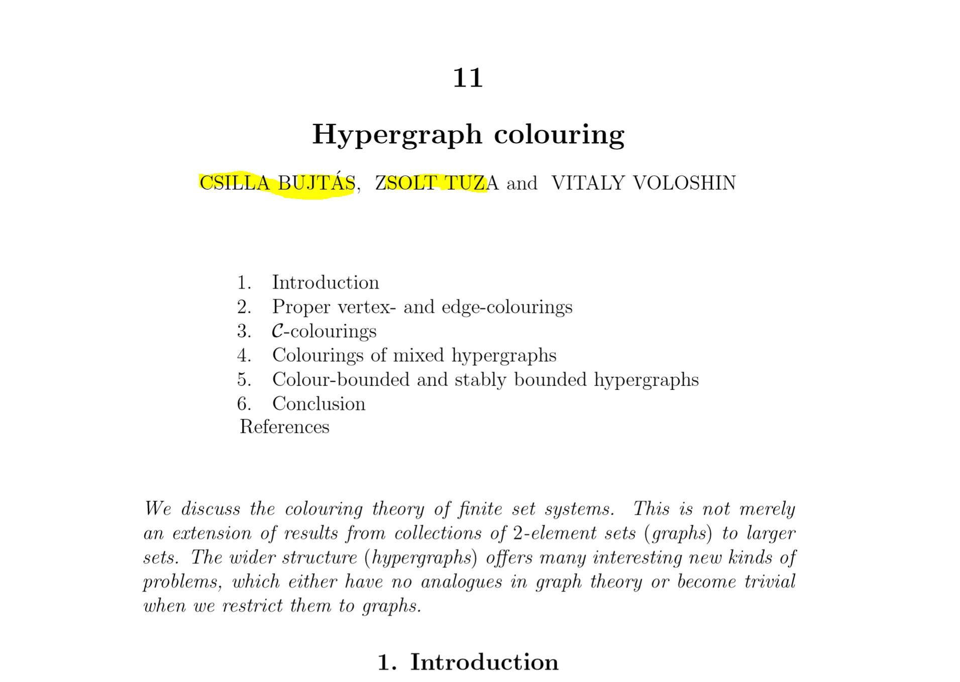
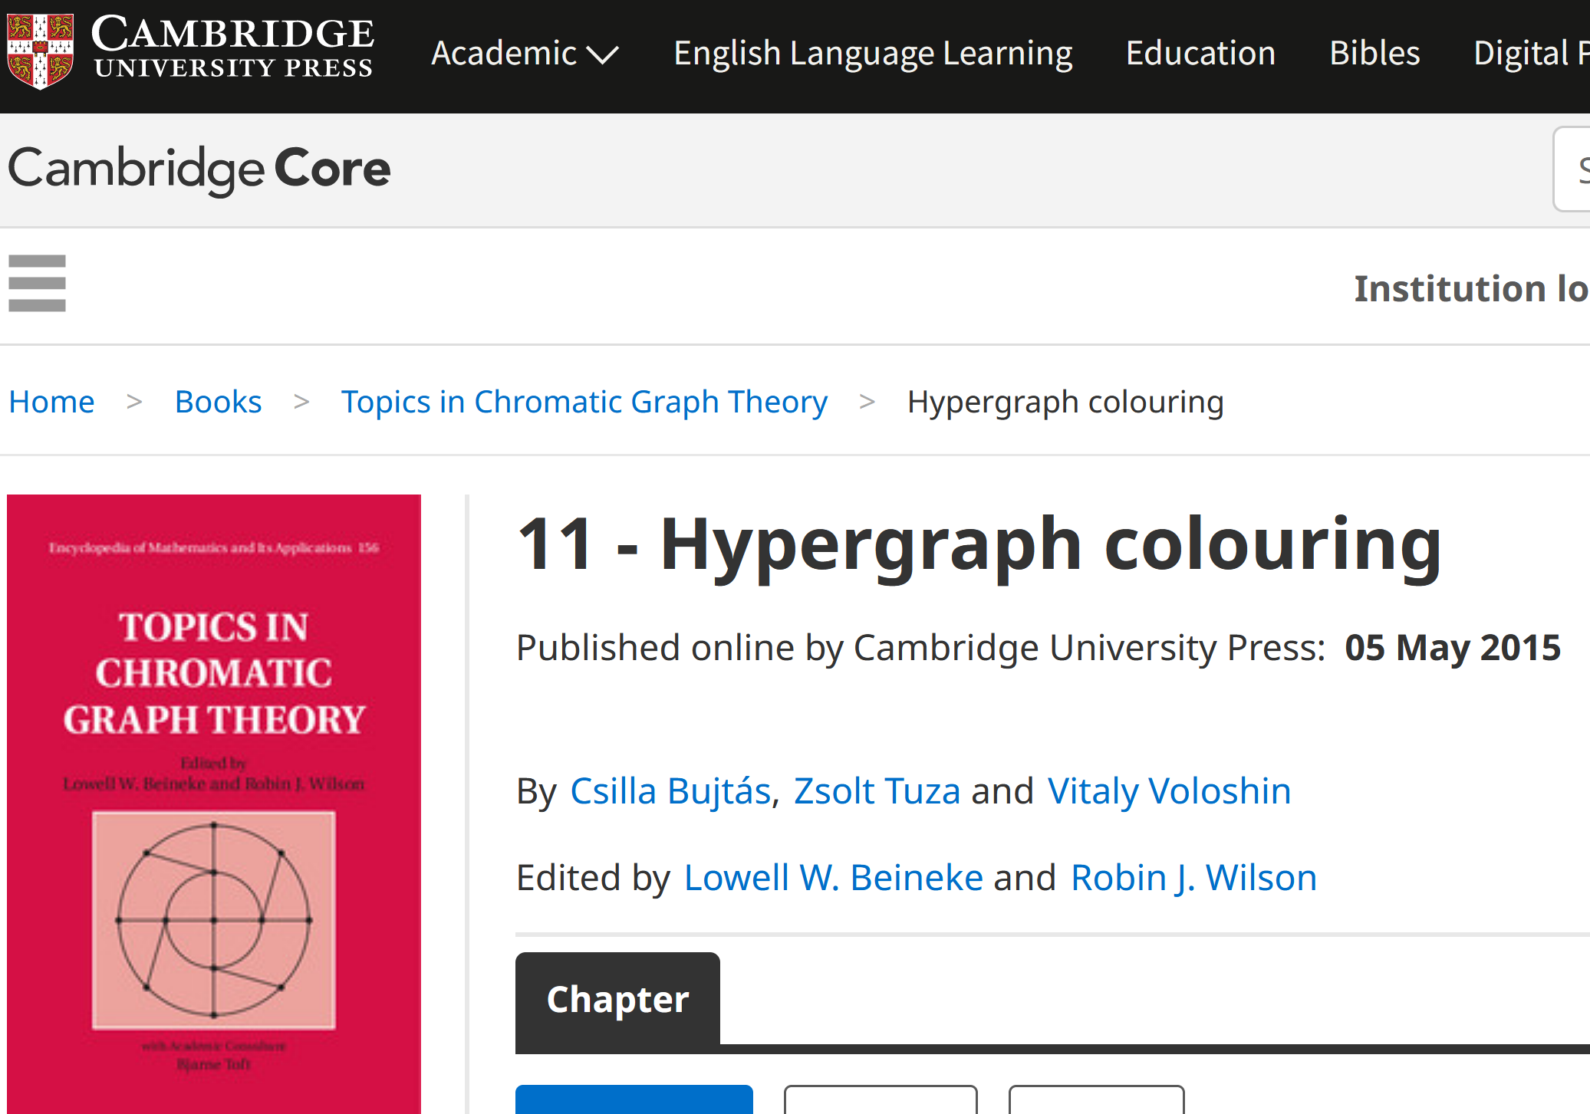
Survey paper

Slide 66
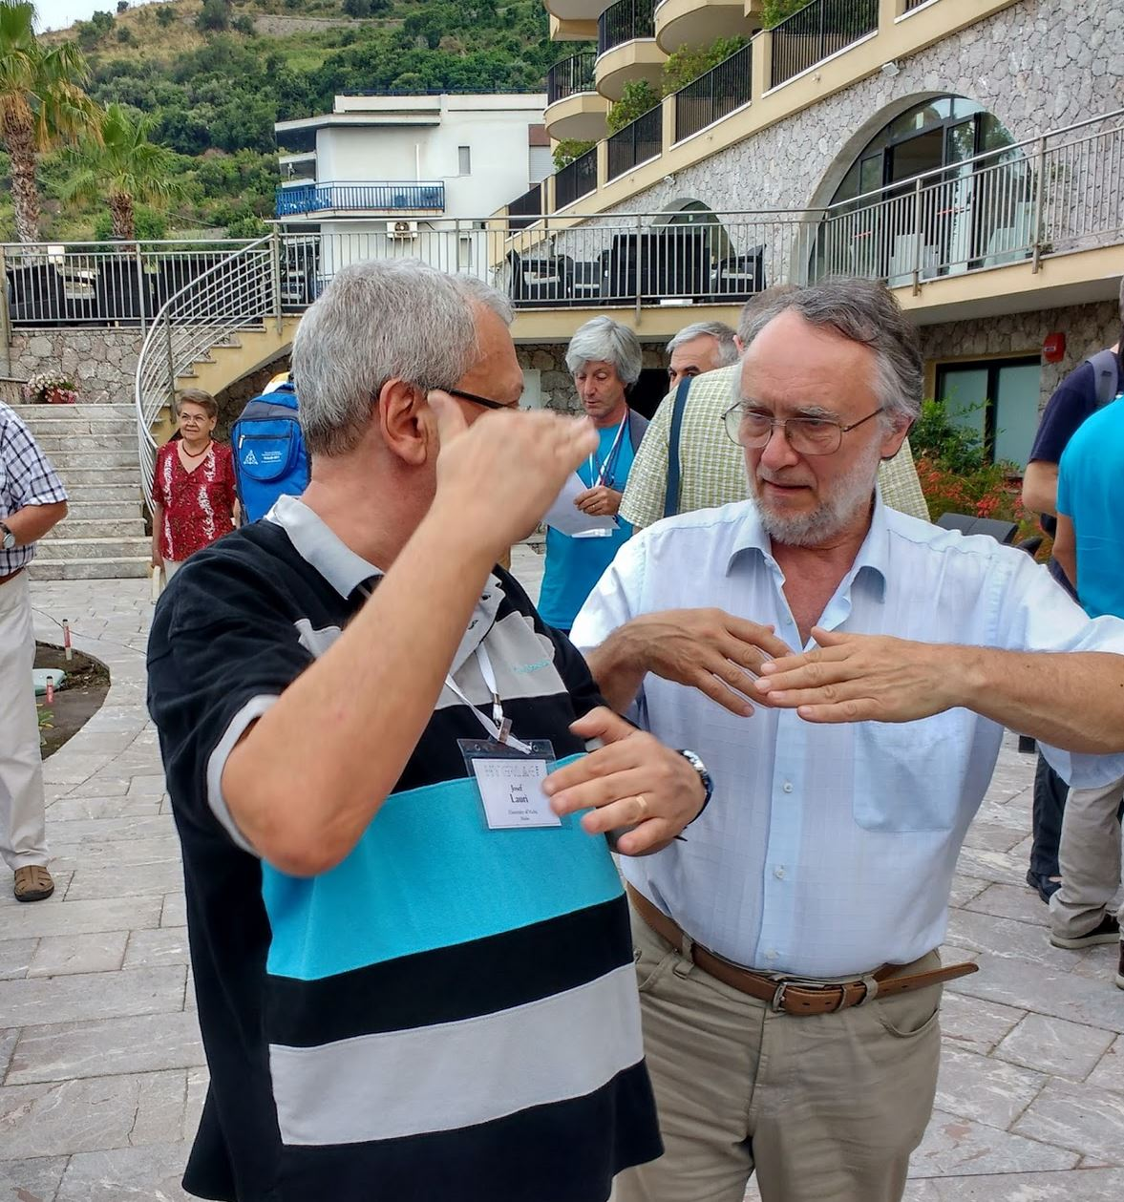
Usually pilots explain to each other how they fly the planes... Apparently, mathematicians do similar things...
IMAGINATION!

Slide 67
a “gap” in the plane…

Slide 68
Kobler and Kundgen, 2001

Slide 69
The smallest m.h. with two 1’s and a gap: unique 4-coloring
D
C
D
C
D
D
D
C
C
D
Starting vertices
R(H)=(0,1,0,1,0,0), S(H)={2,4}

Slide 70
Unique 2-coloring:
D
D
C
C
D
D
D
C
C
D
Starting vertices
R(H)=(0,1,0,1,0,0), S(H)={2,4}

Slide 71
Zs.Tuza, VV:“GAP” in the plane: no coloring with 3 colors, infinite m.h.
D
e
R=(0,1,0,1,0,…)
C
D
C
D
D
c
D
a
d
b
C
C
D
D
C
x
f
x = any point in the plane different from a, b, c, d, e, f: color of f.

Slide 72
Mixed Hypergraph Coloring in China

Slide 73
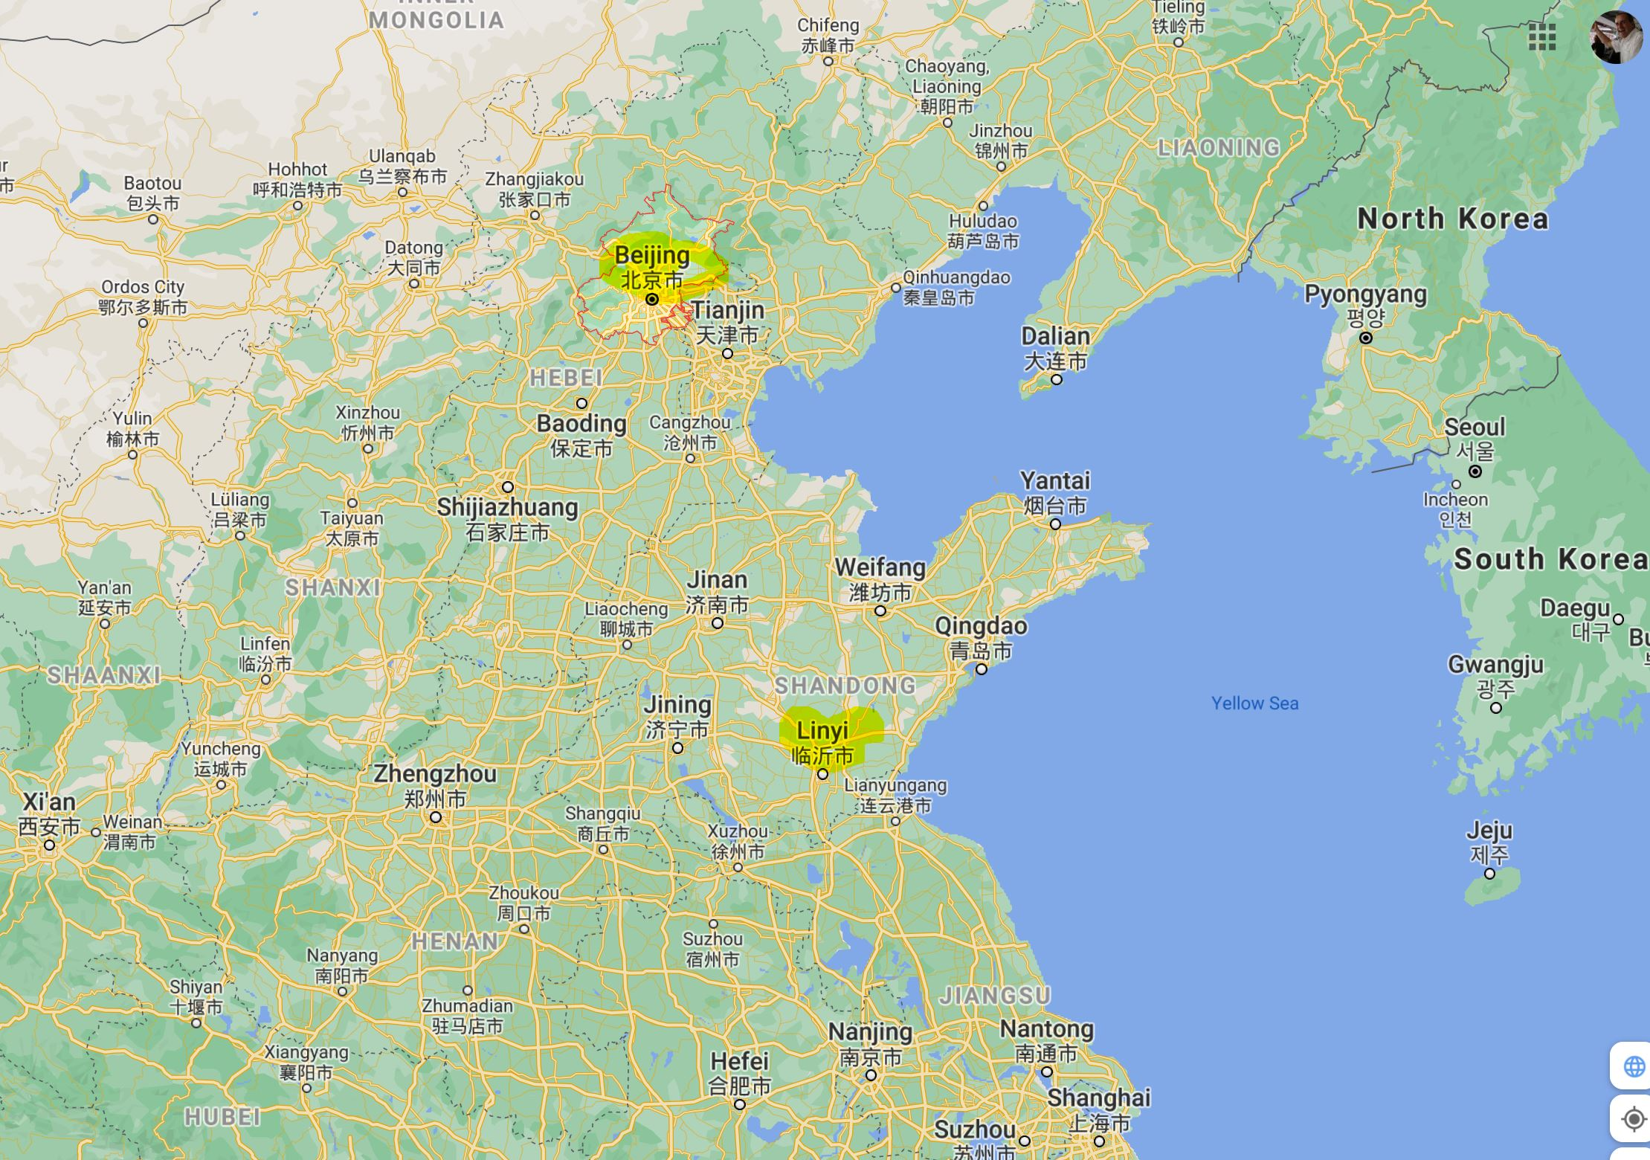
With kaishun wang and yanxun chang (Beijing, china, 2015)

Slide 74
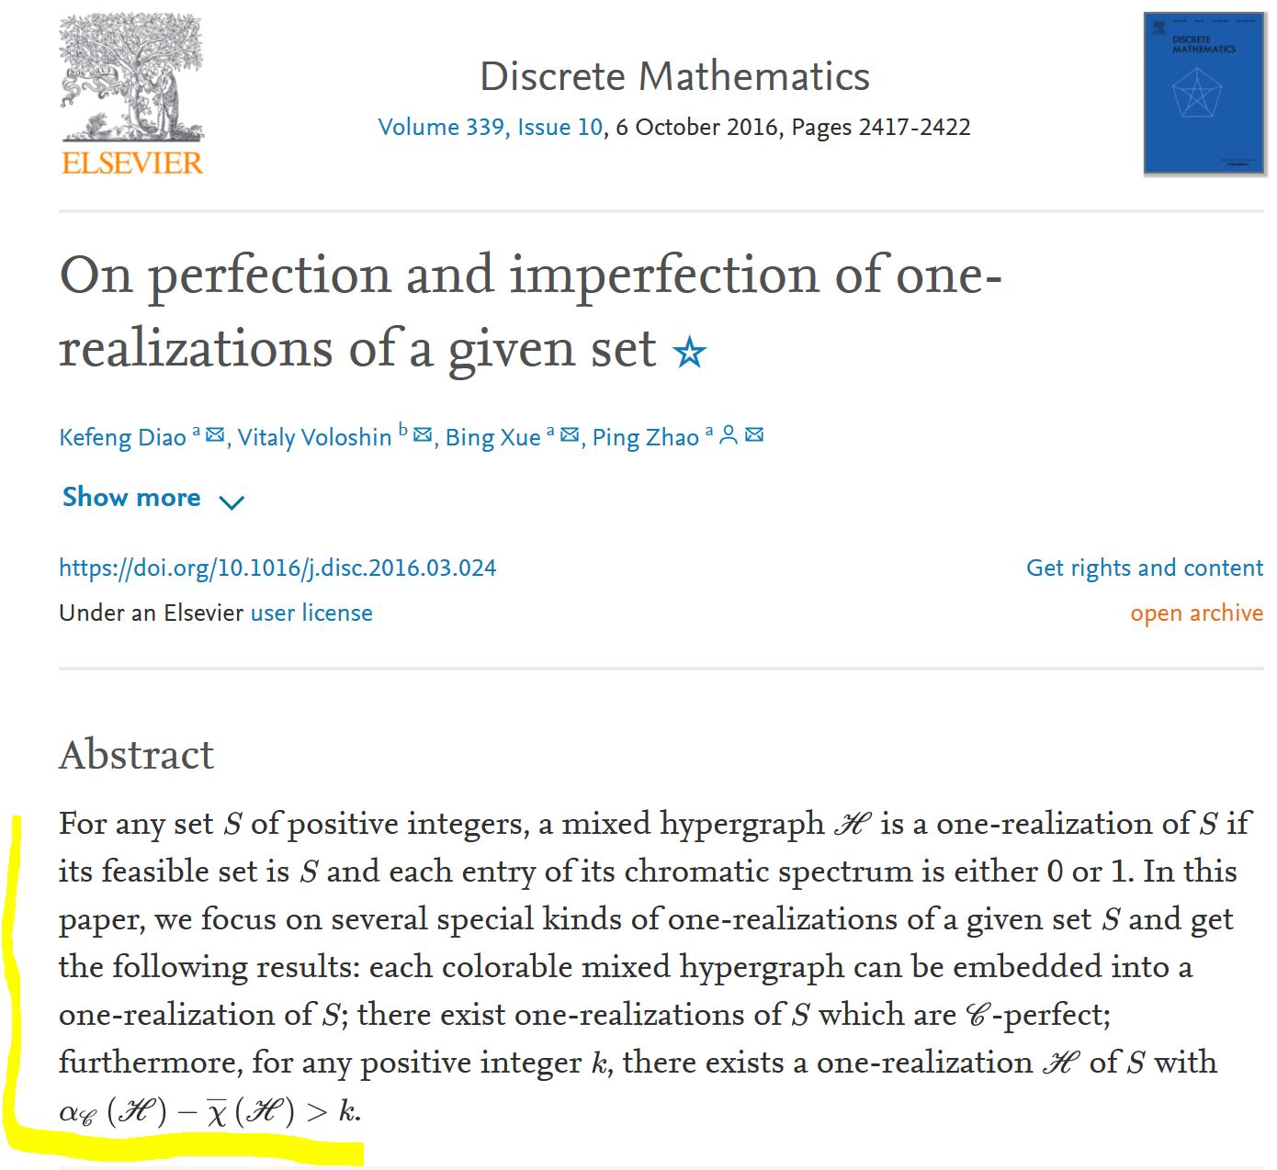
WITH KEFENG DIAO, PING ZHAO AND THEIR GROUP (LINYI, china, 2015)

Slide 75
Confucius: 551 - 479 BC, the most famous Chinese philosopher my 2015 trip to china was funded by Confucius institute of troy university this picture was taken at Confucius temple, Qufu, China

Slide 76
Leonhard Euler, 1707-1783

Slide 77
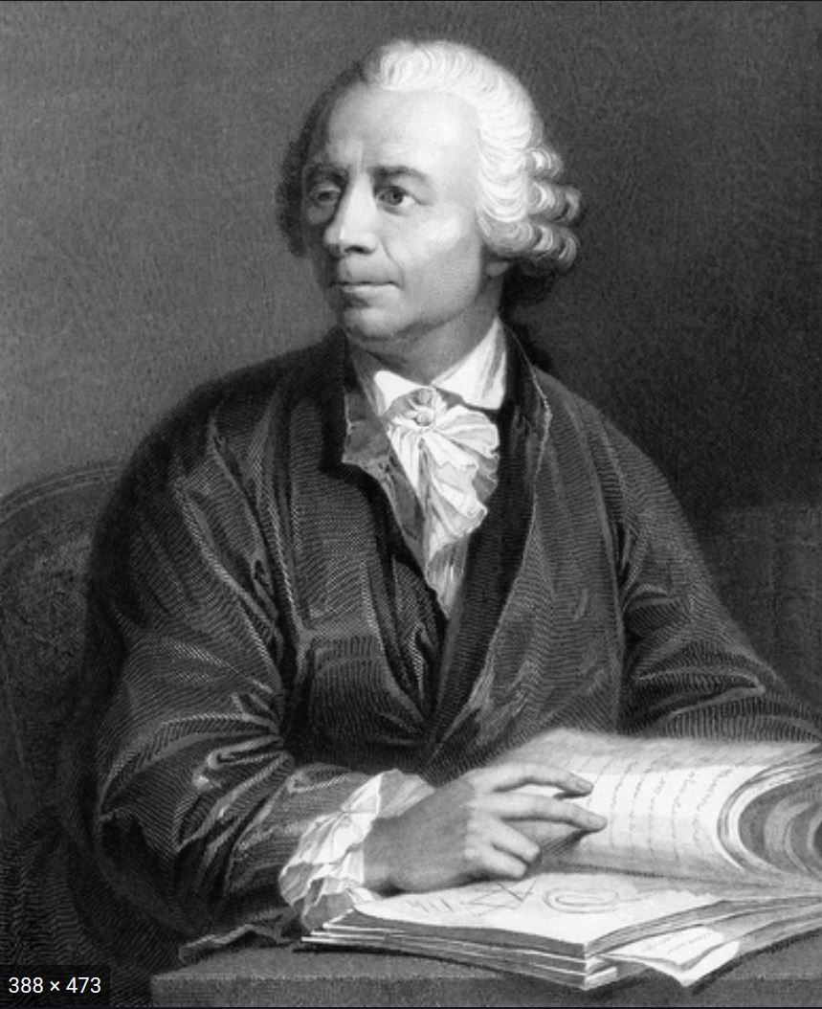
Where is euler now?

Slide 78
On the way to euler…

Slide 79
On the way to euler

Slide 80
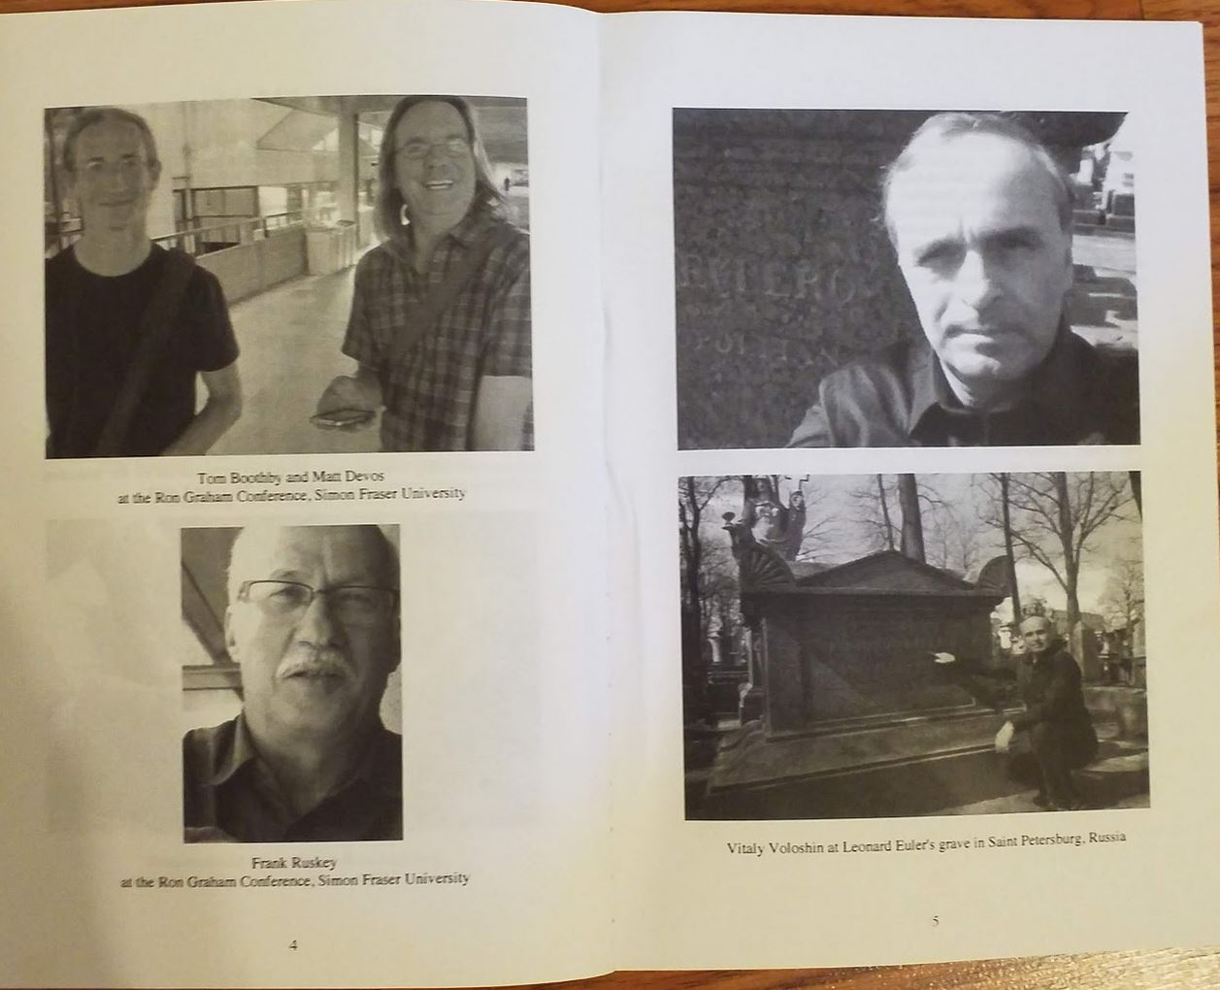
2015…

Slide 81
New! GRAND GRAND GRAND… FATHER OF MHC

Slide 82
Show must go on!!!

Slide 83
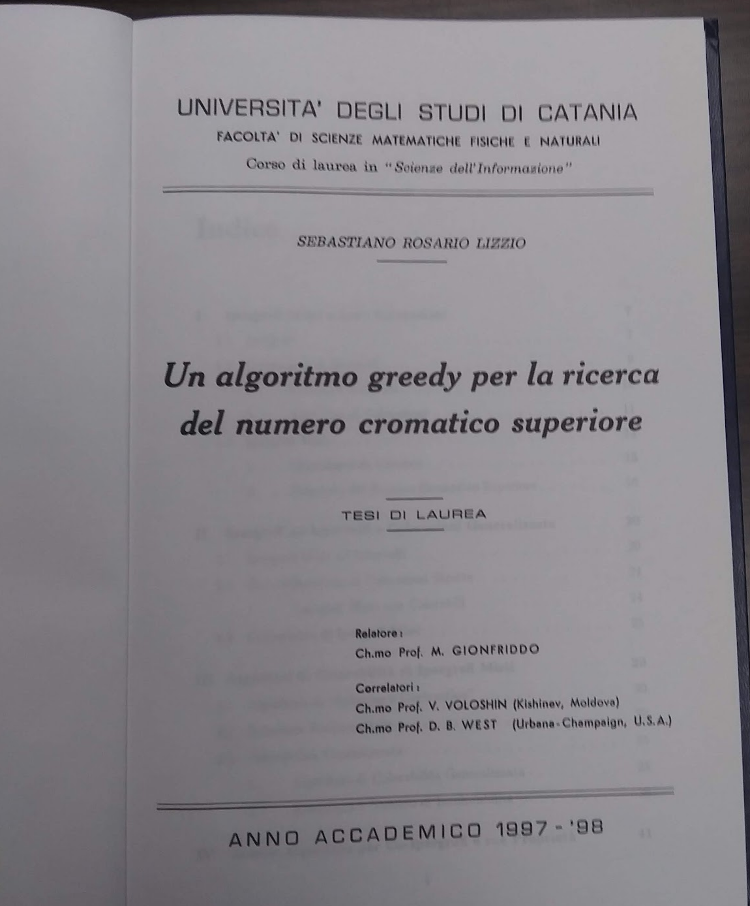
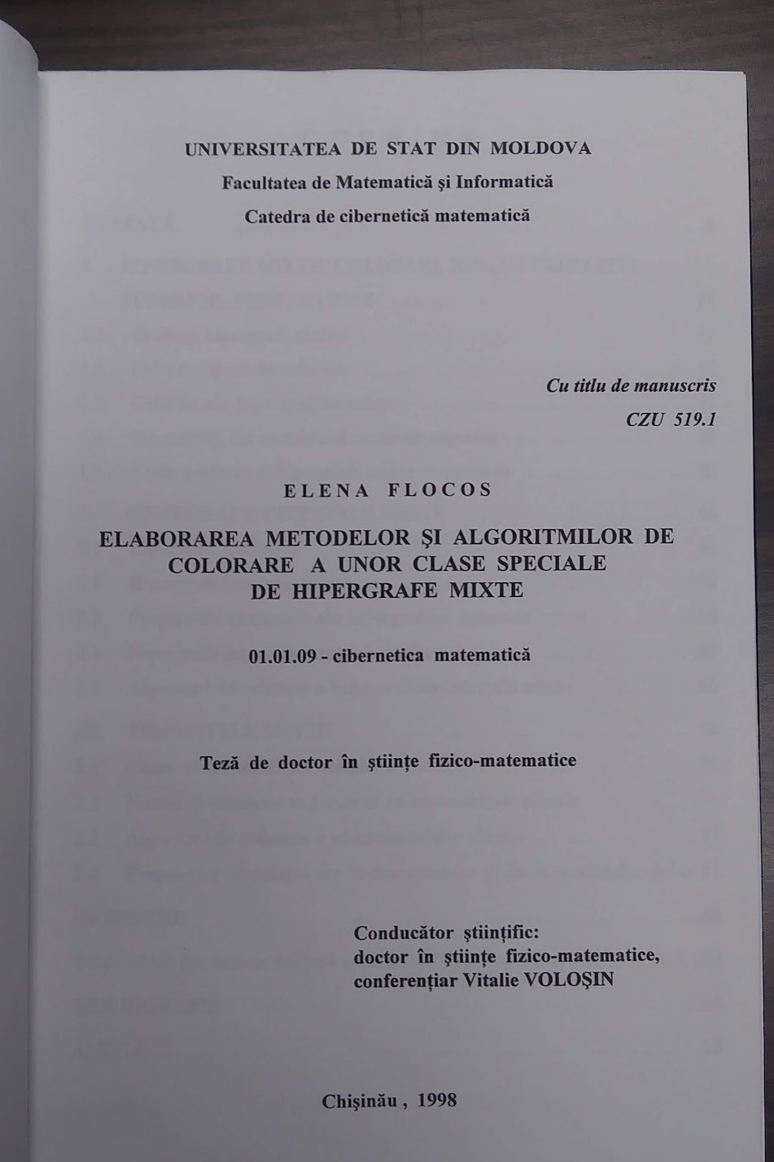
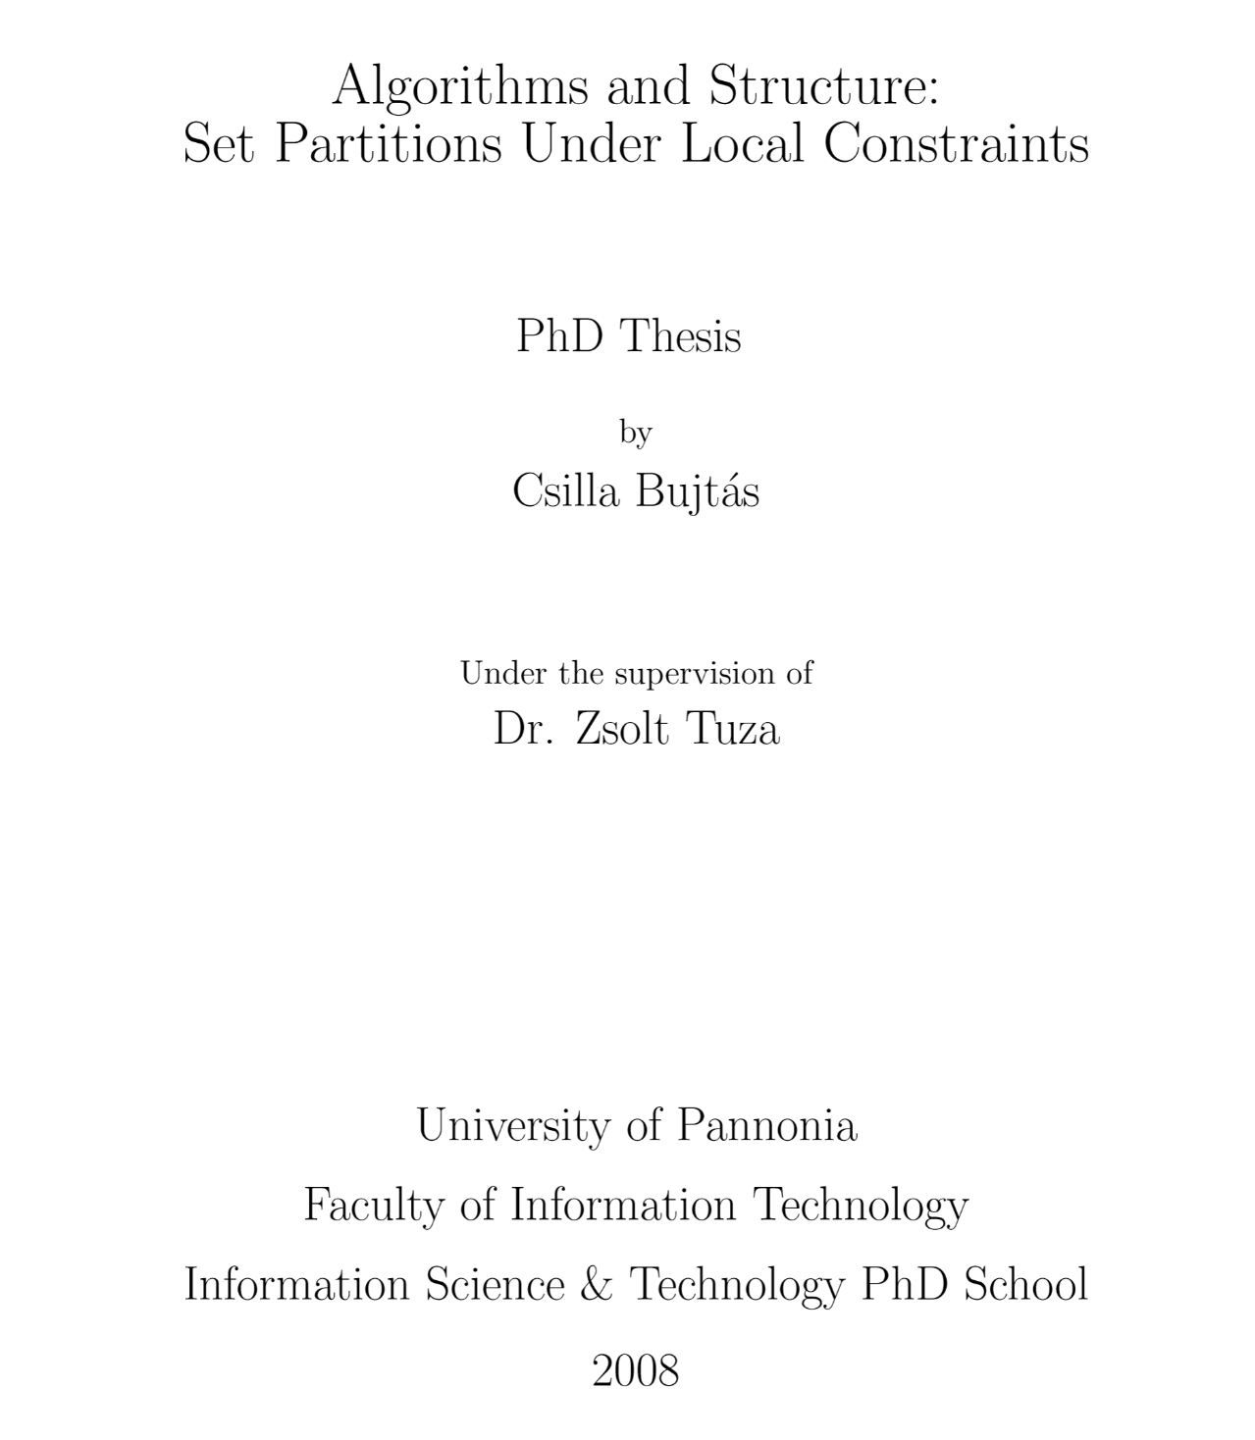
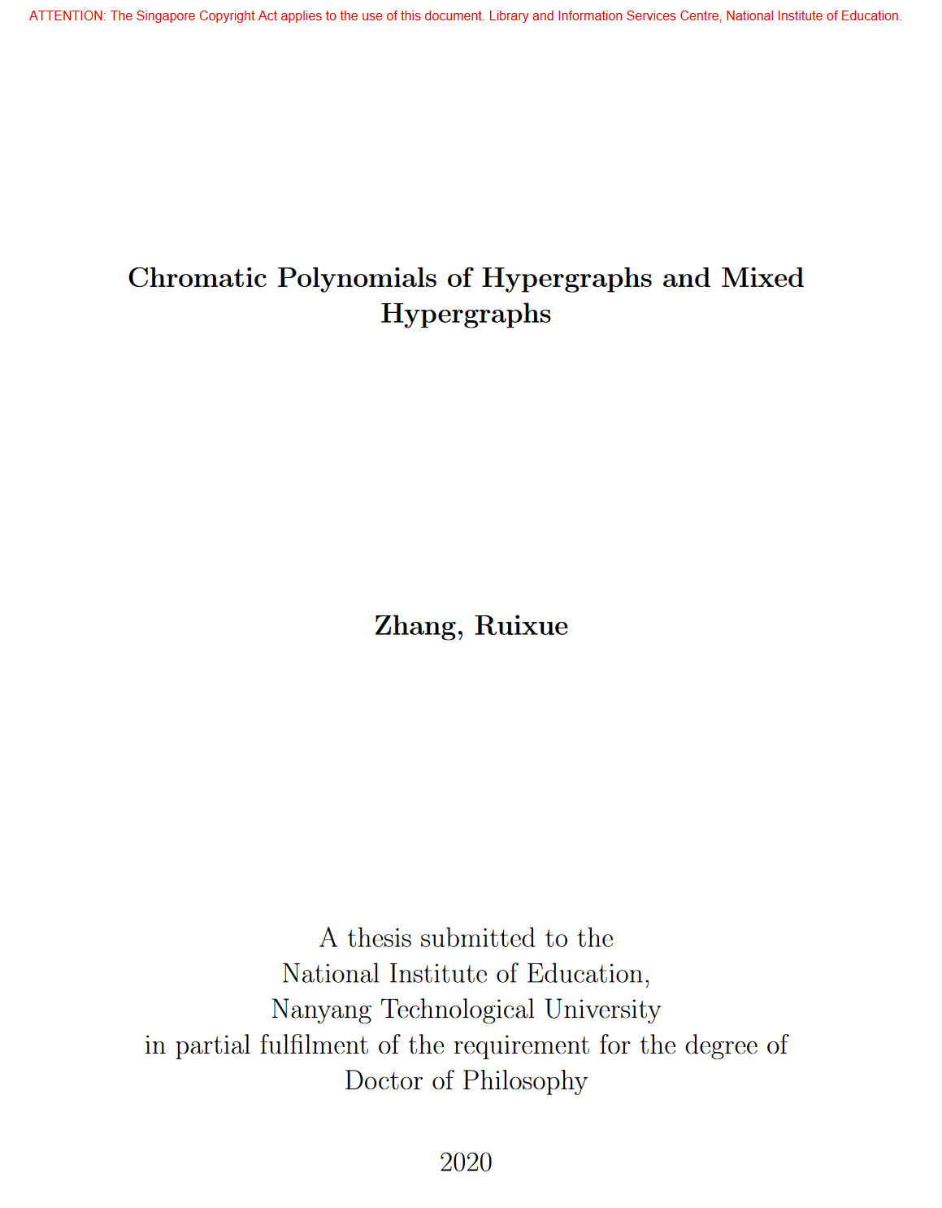
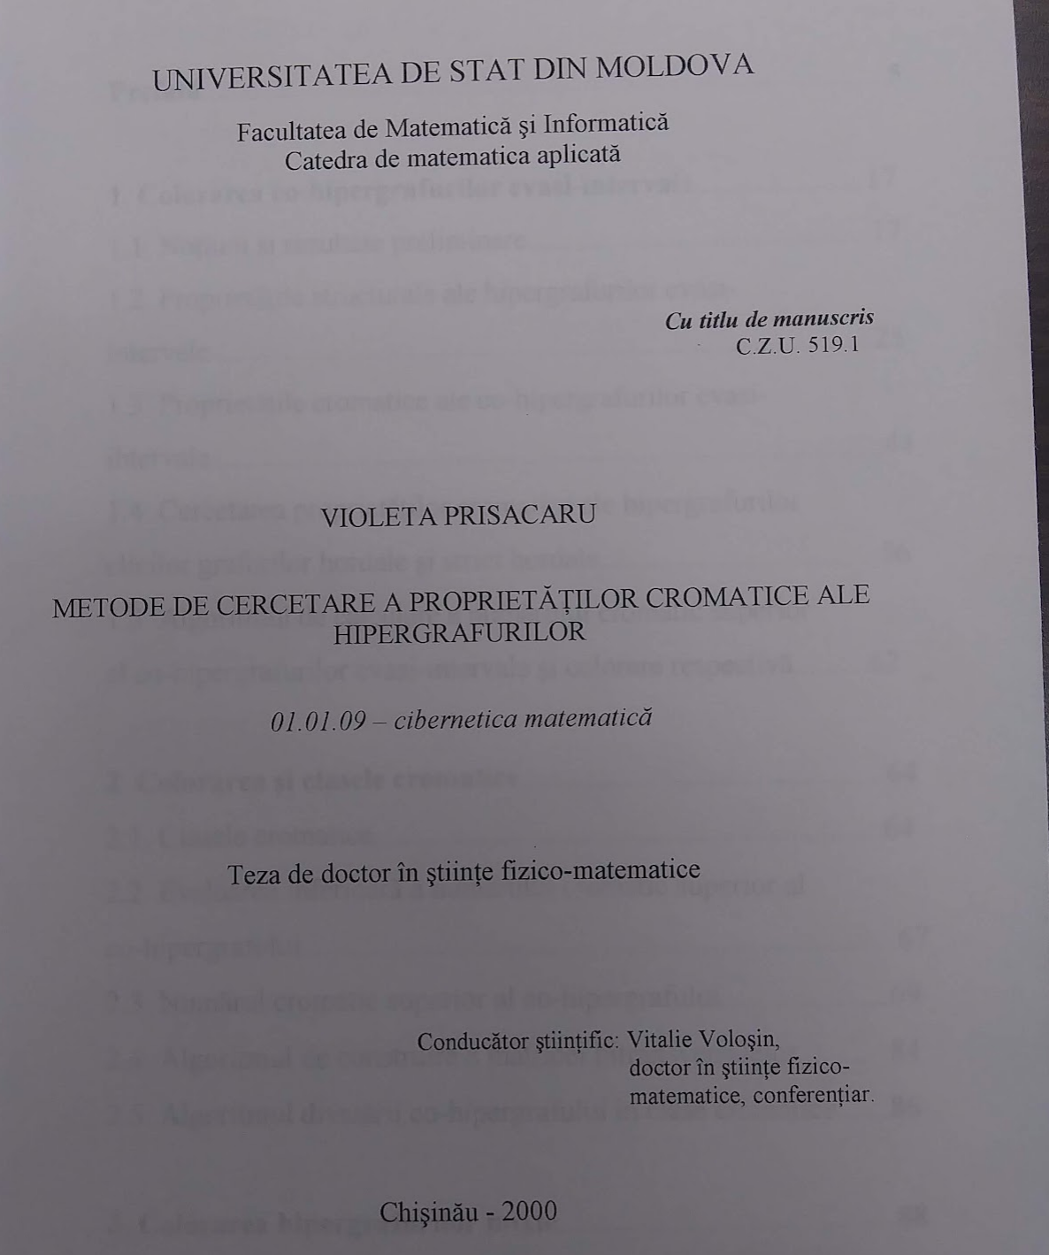
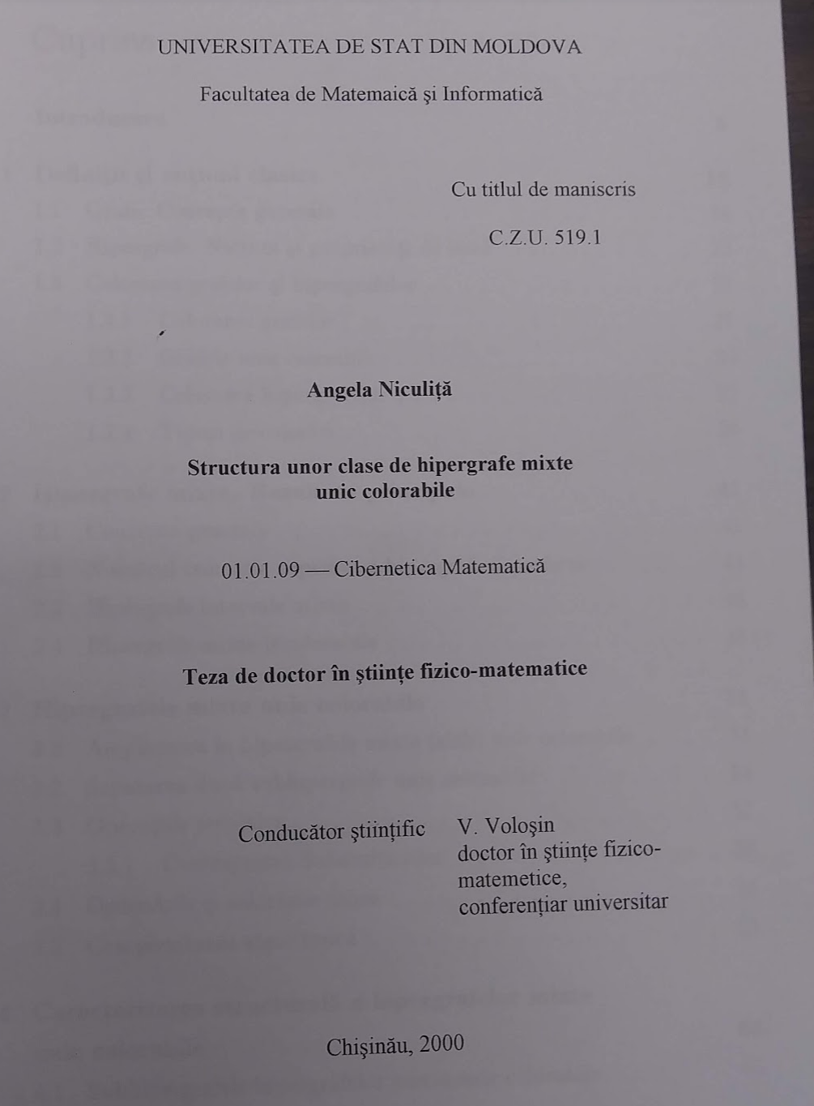
PhD theses on mixed hypergraph coloring

Slide 84
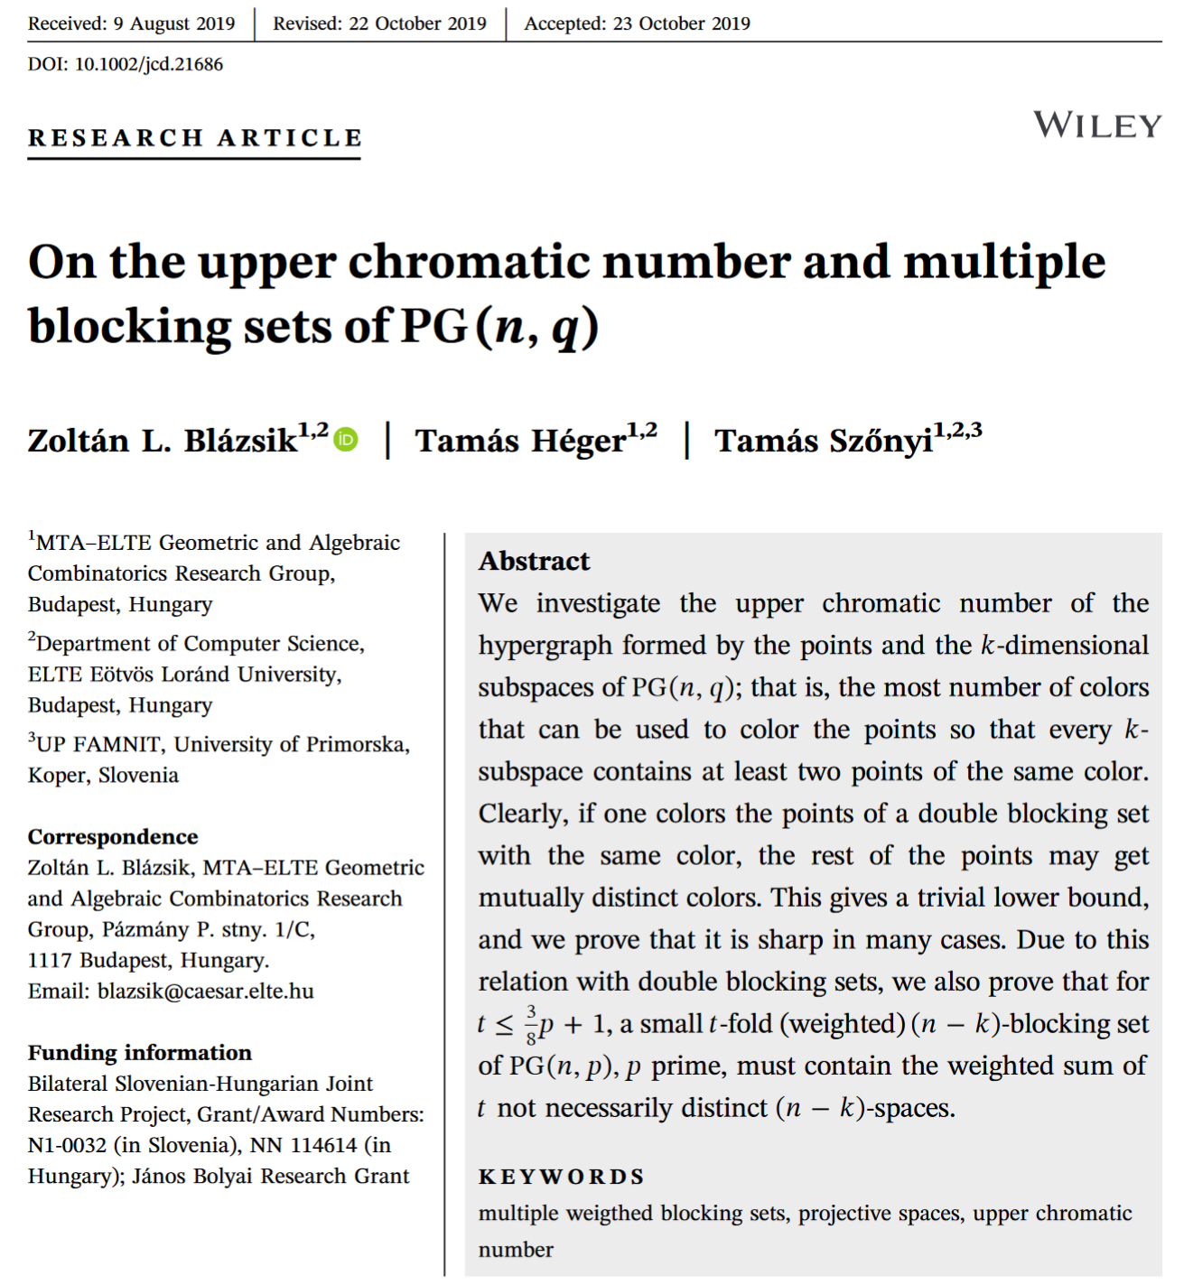
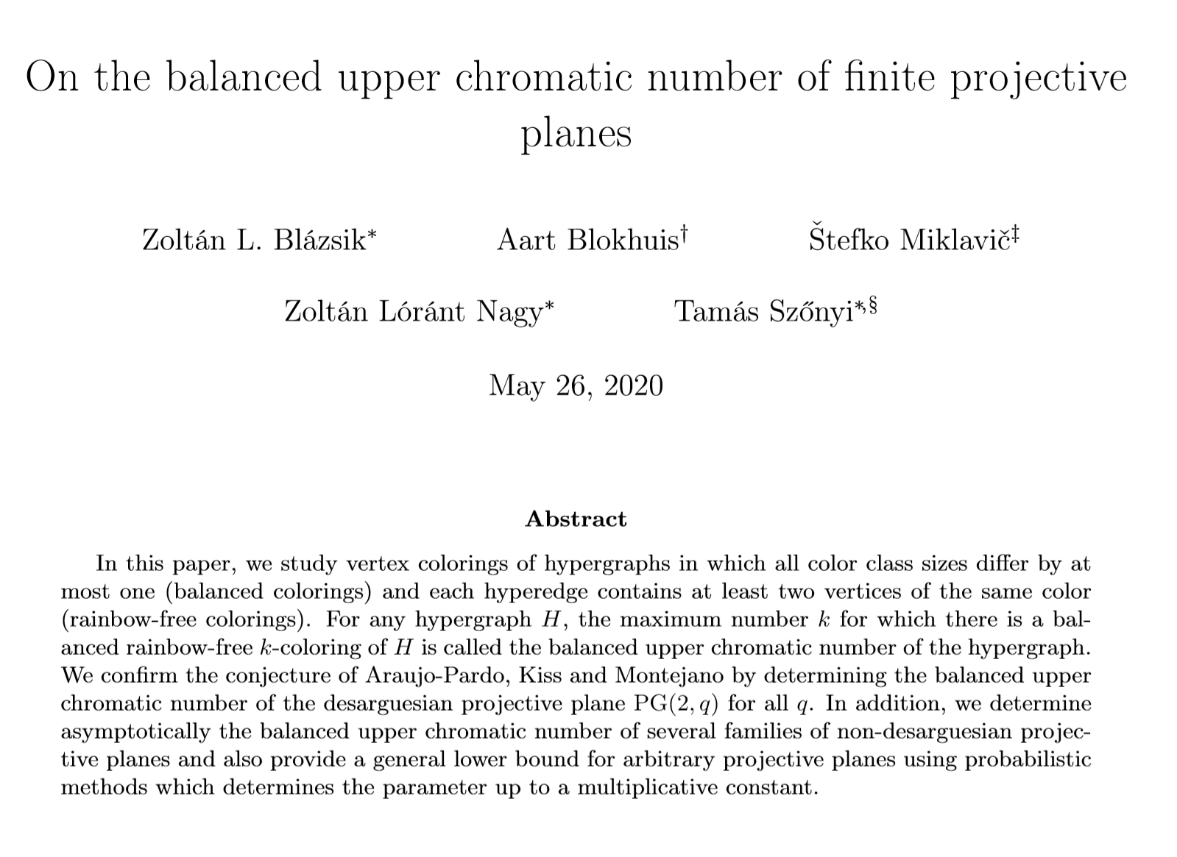
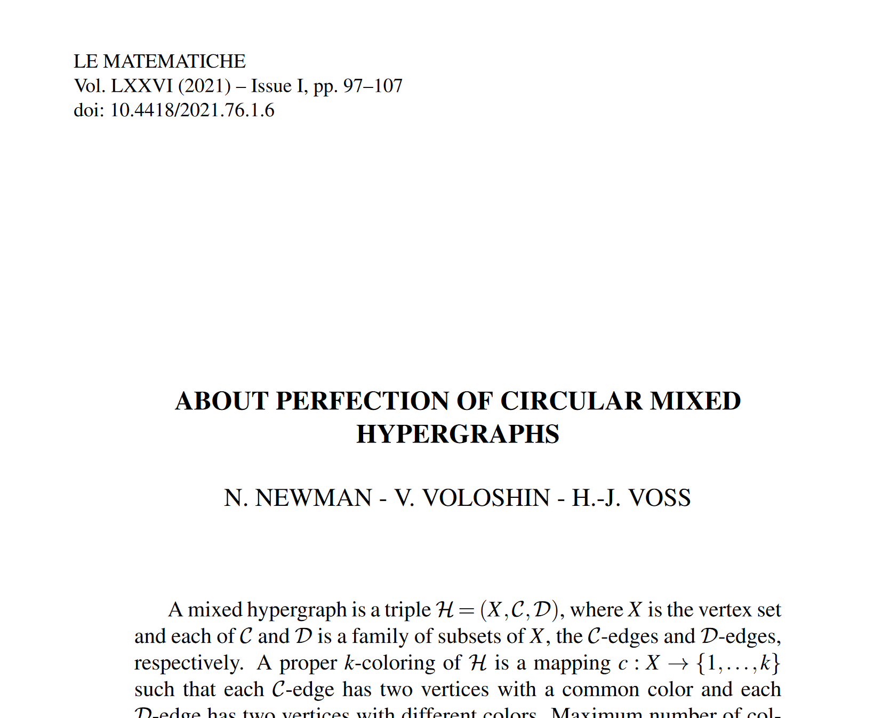
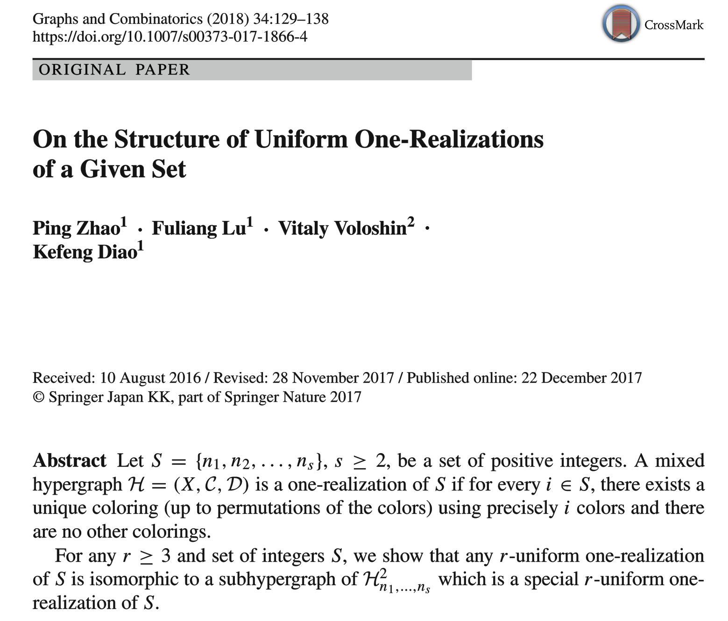
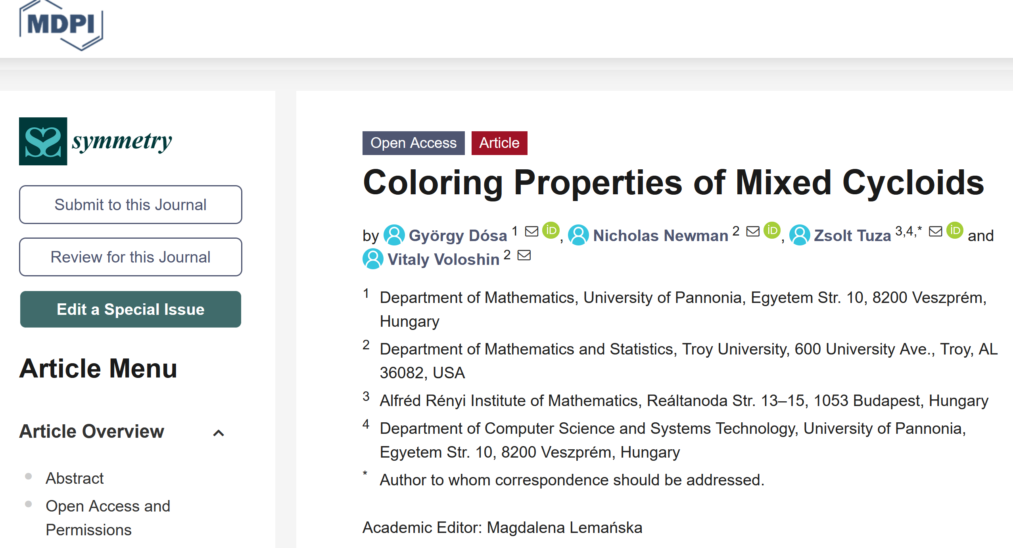
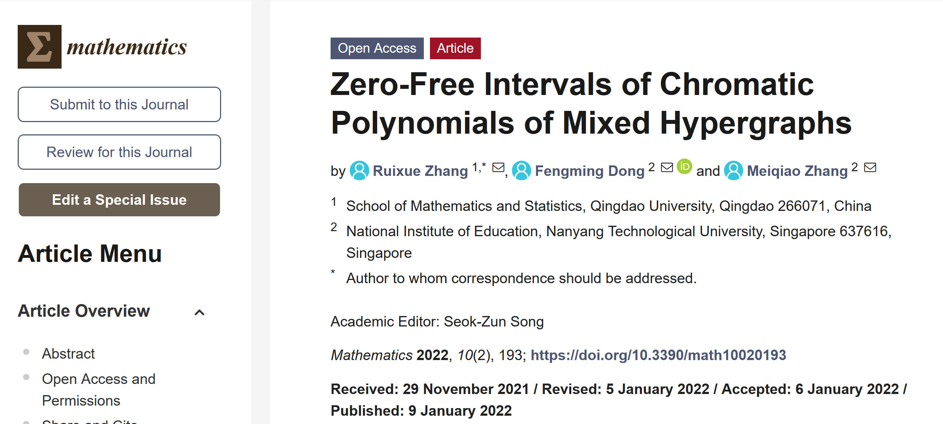
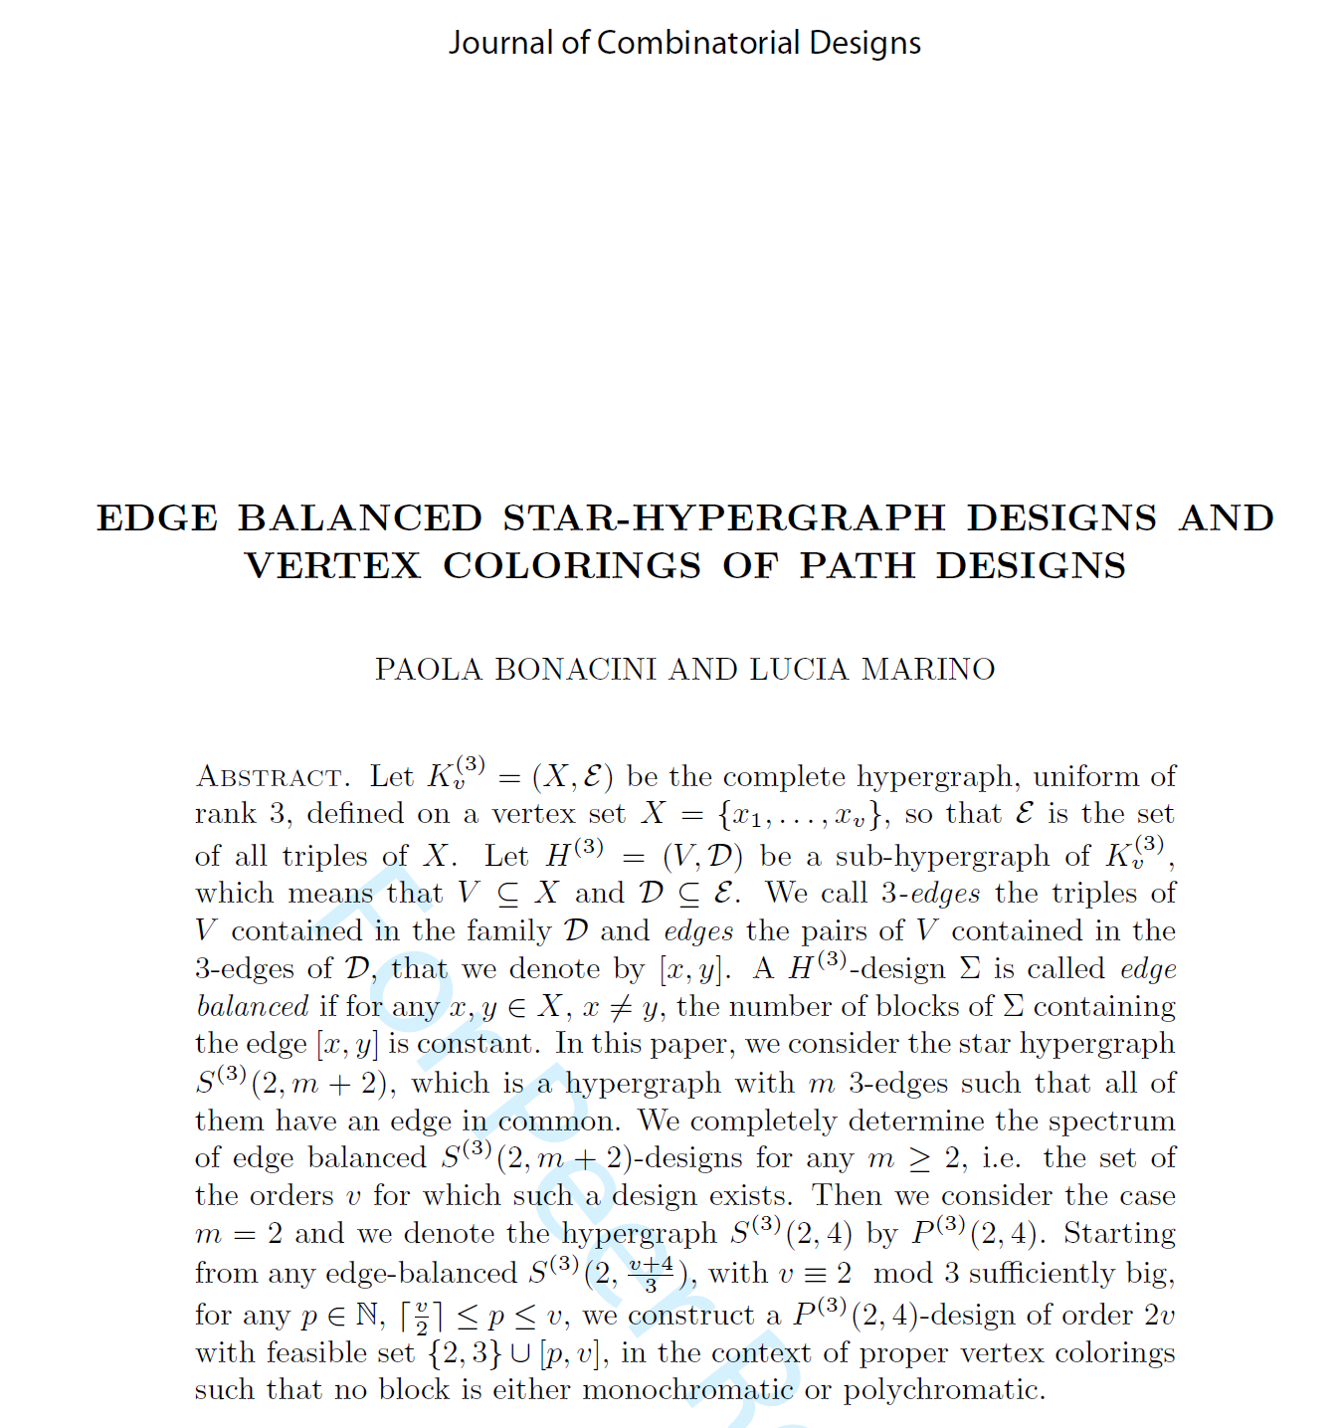
Show must go on!!!

Slide 85
OPEN PROBLEMS
“…more gas on the fire…”

Slide 86
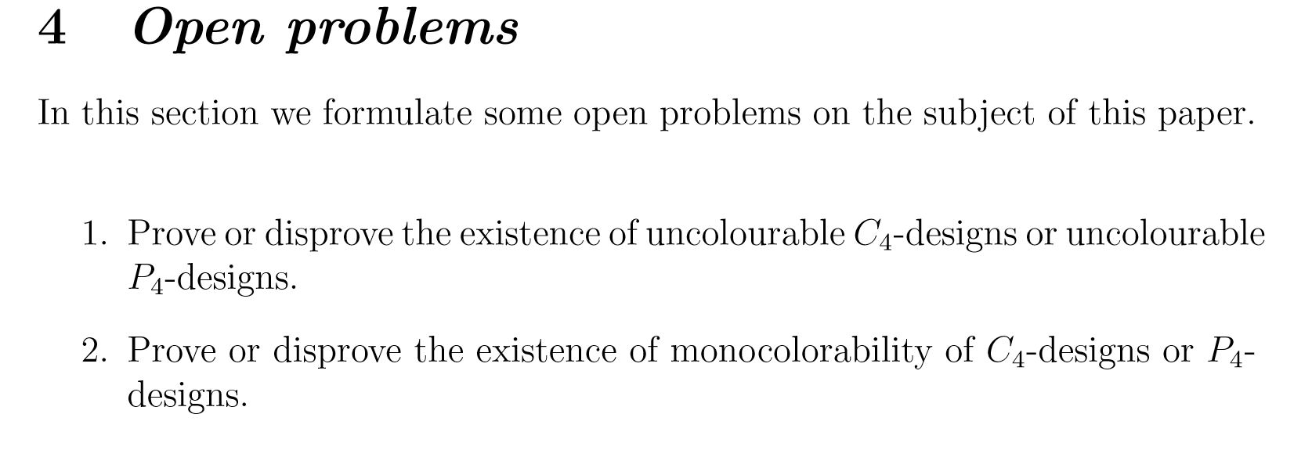
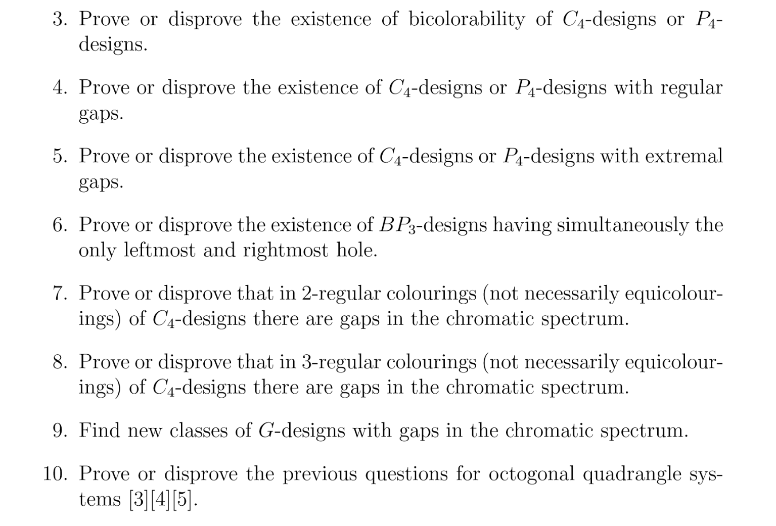
Mario gionfriddo’s open problems

Slide 87
Mario’s Conjecture

Slide 88
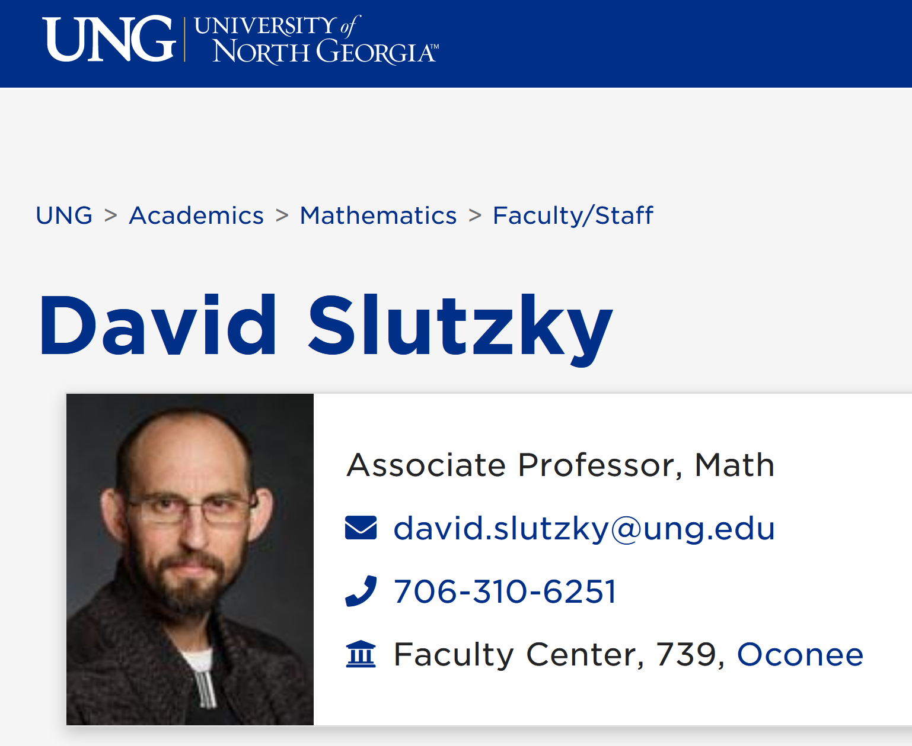
Slutzky’s numbers (chromatic spectra of complete r-uniform interval C-,D- and B-hypergraphs)

Slide 89
1976: The very first mentioning of interval hypergraphs

Slide 90
Origin of interval m.h.: 1997

Slide 91
MR3677170 Reviewed Slutzky, David(1-NGEOR3-DM) Recursive formulae for the chromatic polynomials of complete $r$-uniform mixed interval hypergraphs. (English summary) Ars Combin. 134 (2017), 303–324.

Slide 92
Complete interval mixed hypergraph K(7,3,2):
1
2
1
2
1
2
1
n=7 vertices
l=3, m=2
Sieve number s=5
Upper chi = n-s=7-5=2
R(H)=(0,1,0,0,0,0,0)
It is like complete graph K₂
(unfolding to color wave 1-2)
The same(!) chromatic polynomial
P=λ(λ-1)
??any relation to the replication of DNA molecules by triplets??
--only God knows!

Slide 93
Complete 3-uniform interval bihypergraph K(7,3,3):
n=7 vertices
l=m=3 (3-uniform)
Sieve number s=3
Upper chi = n-s=7-3=4
R(H)=(0,21,27,5,0,0,0)

Slide 94
Slutzky numbers: chromatic spectra for r=3:

Slide 95
Slutzky numbers: open problem: find next line in a simpler way!
# of colors (permutations do not count)
n\c | 1 | 2 | 3 | 4 | 5 | 6 | 7 | 8 | 9
3 | 0 | 3 | 0 | 0 | 0 | 0
4 | 0 | 5 | 1 | 0 | 0 | 0
5 | 0 | 8 | 4 | 0 | 0 | 0
6 | 0 | 13 | 11 | 1 | 0 | 0
7 | 0 | 21 | 27 | 5 | 0 | 0
8 | 0 | 34 | 62 | 19 | 1 | 0
9 | 0 | 65 | 137 | 61 | 6 | 0
10 | 0 | ? | ? | ? | ? | 1
# of vertices
Chromatic spectra

Slide 96
Can we calculate Slutzky numbers like Stirling numbers?

Slide 97
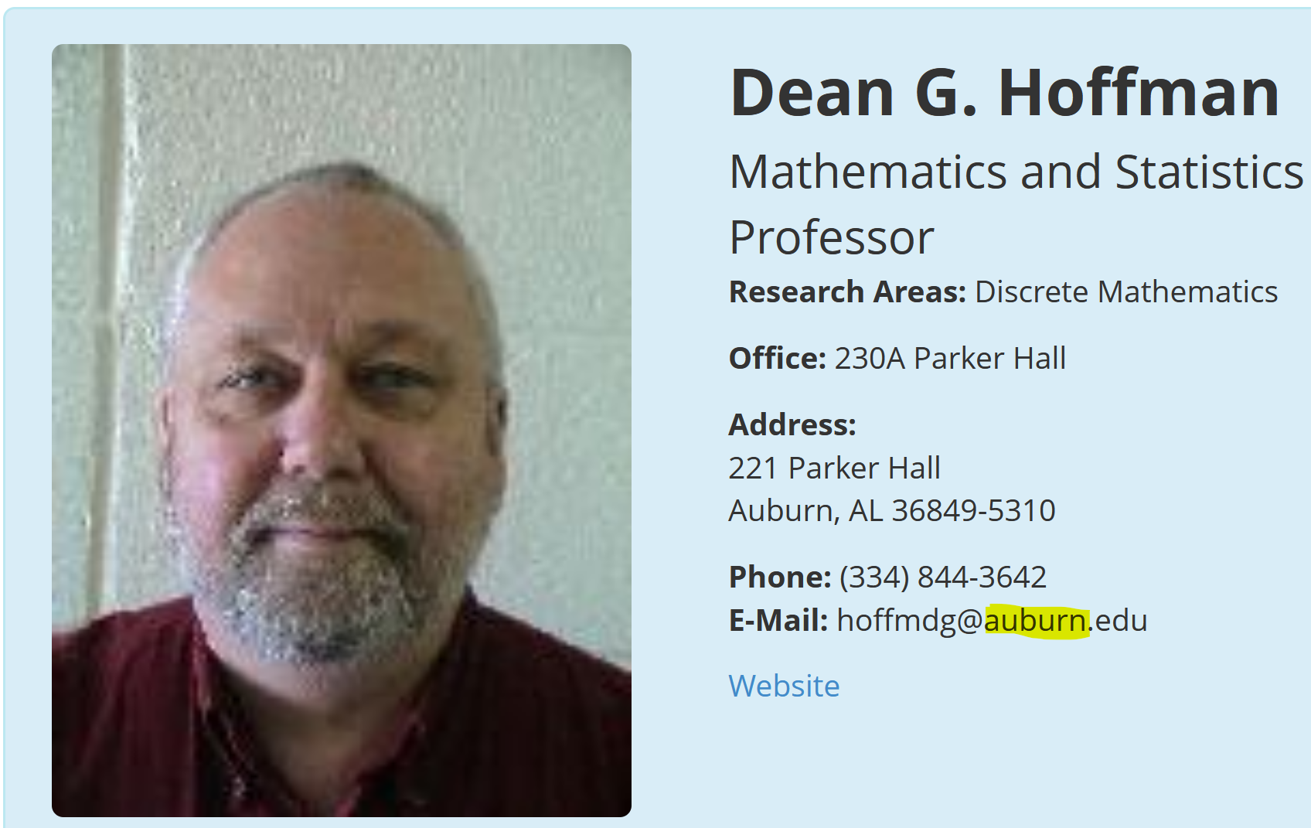
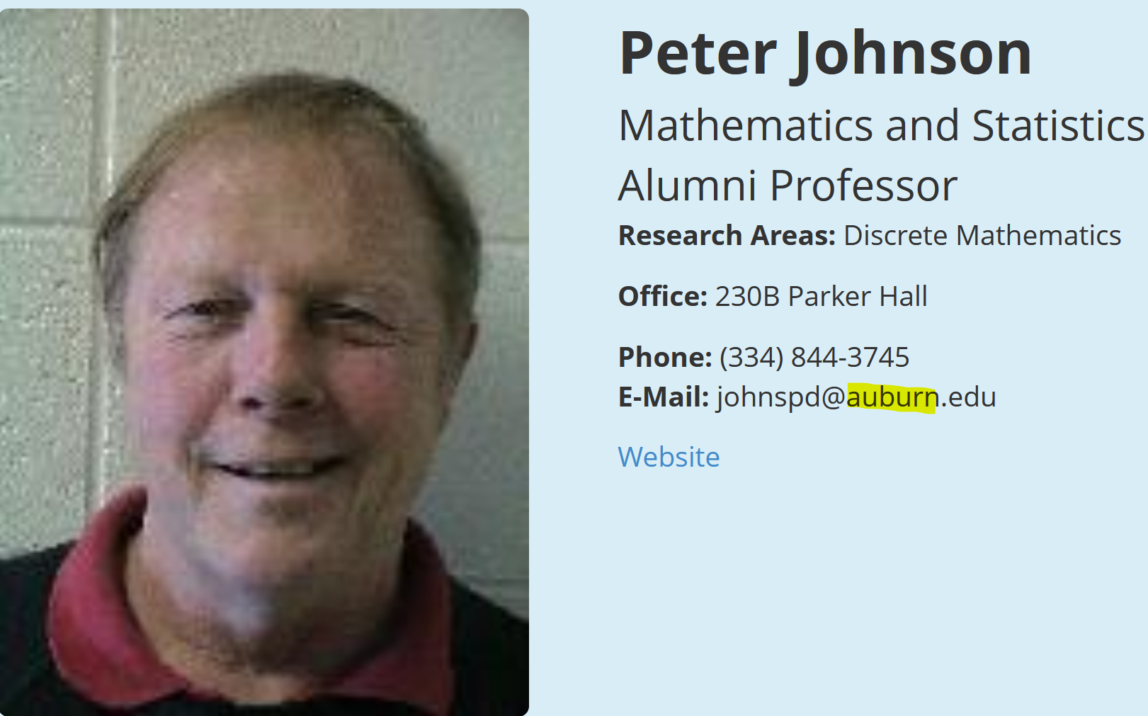
2019: New proper edge coloring of graphs: no rainbow cycles

Slide 98
New proper edge coloring of graphs: +no rainbow cycles
Find the general criterion of colorability.
Determine lower and upper chromatic index. It is particularly interesting if there exist graphs with lower chromatic index >Delta+1.
Revisit Vizing theorem’s proof to avoid rainbow cycles. Can we do those re-colorings and avoid rainbow cycles?
Characterize the chromatic spectrum/feasible set. At least, is it continuous? Broken?
Characterize C-perfect graphs as perfect mixed hypergraphs. Can the upper chromatic index be arbitrarily smaller than the C-stability number?
Determine if there are uniquely colorable graphs.
Solve the above problems for classes of graphs, like planar graphs, etc.
These are very fundamental and promising problems even if solved partially.

Slide 99
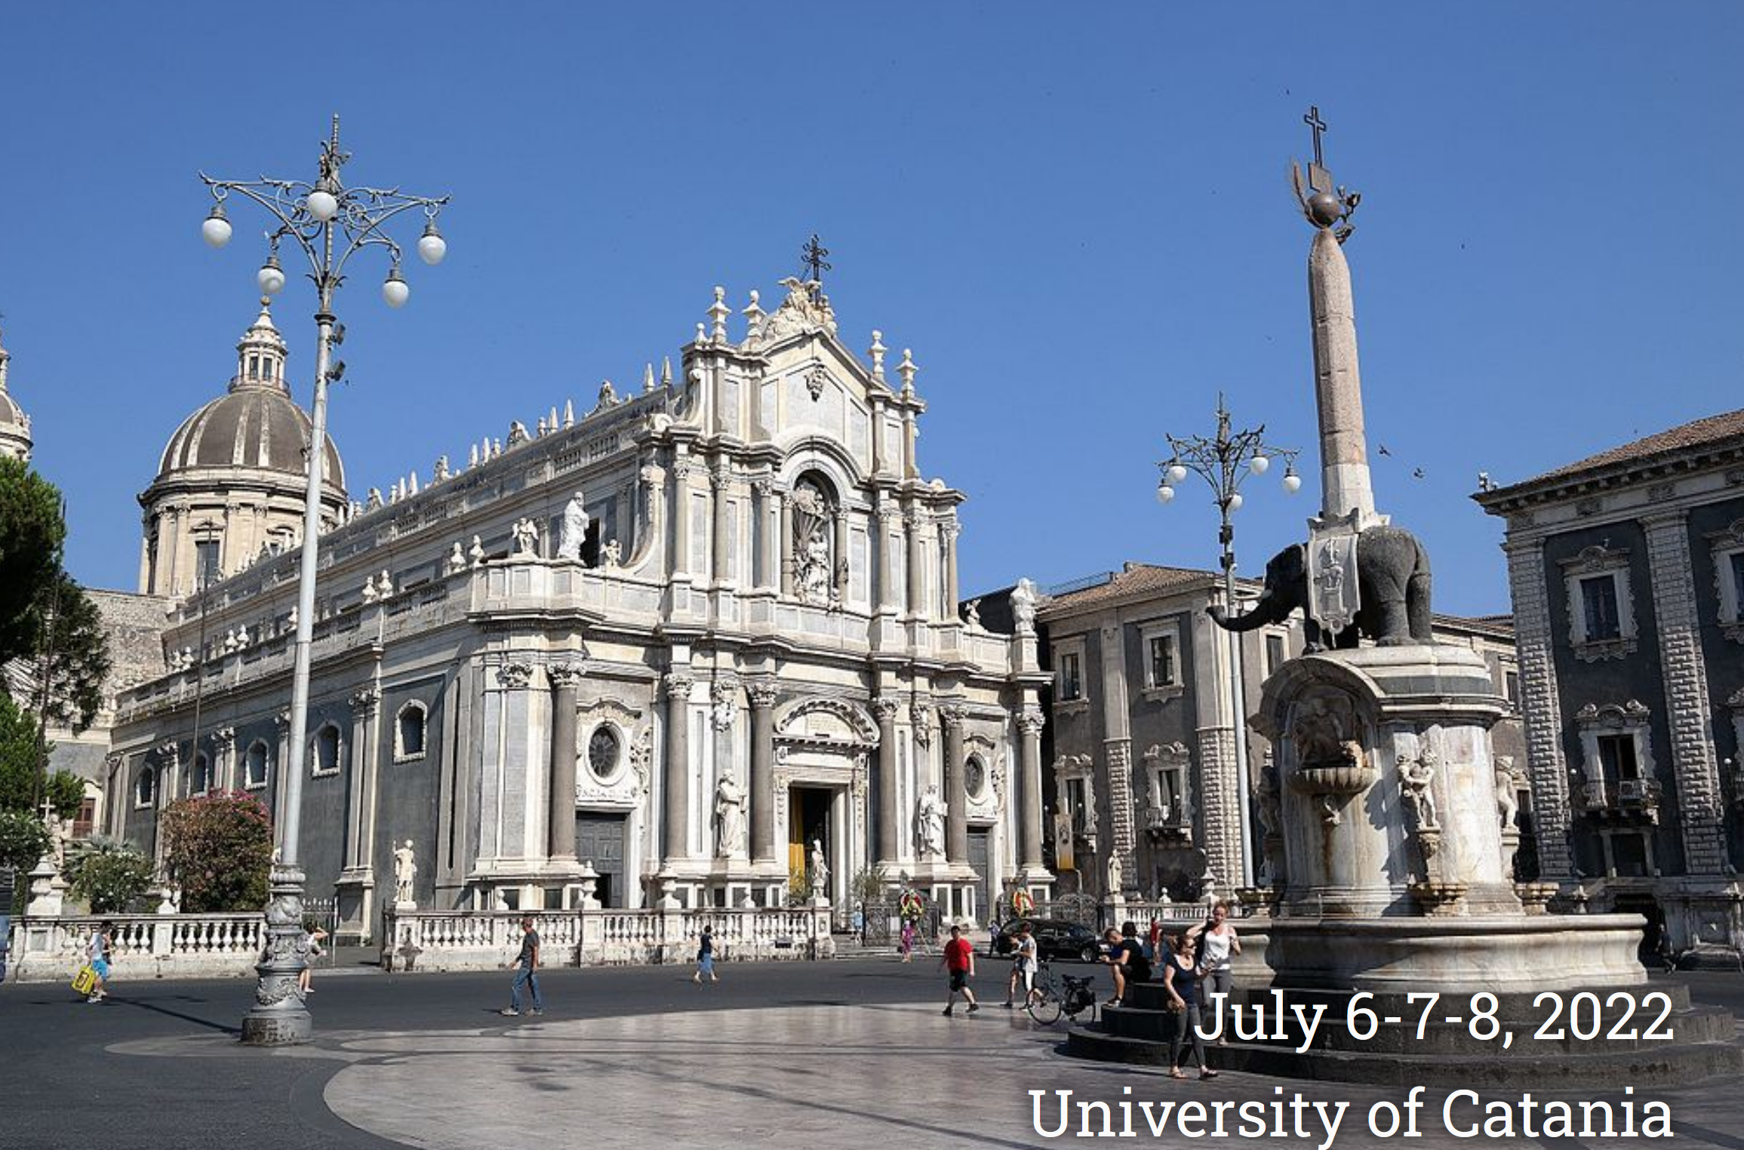
Thank you very much!
Mille Grazie!

