Slide 1
South Korea and Nigeria

Slide 2
Korea: Background
Colonialism (Japan in 1910)
World War II and liberation in 1945
North (DPRK)
South (ROK) Constitution of 1948
Cold War and the Korean War (1950)
Military coup (1960): General Park Chung Hee.

Slide 3
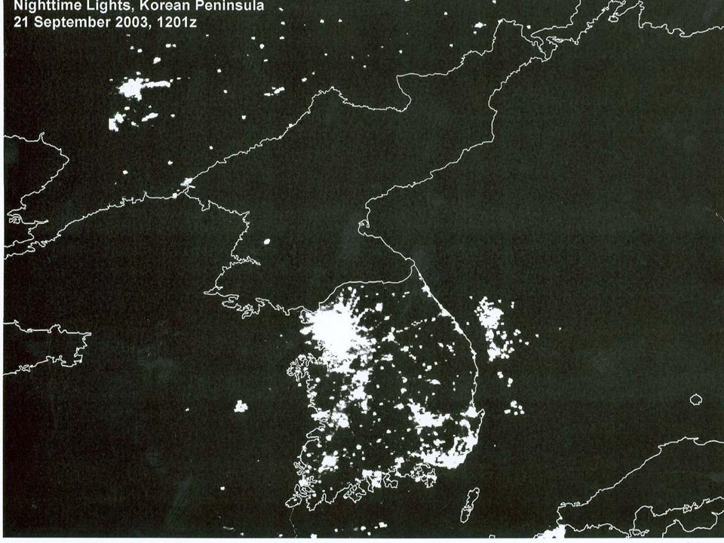

Slide 4
South Korea: Politics
Military in Politics
Military-Business alliance
Crushing independent unions
Creation of company unions
Nationalism
Rigged elections
Park assassinated in 1979
First civilian president: 1993.
Main cleavage during military era: supporters/opponents of military rule.
Now: Old/Young.

Slide 5
South Korea: Policies
Chaebol system:Daewoo, Hyundai, LG, Samsung
Industrial policy
Sunshine Policy (97-08)

Slide 6
South Korea: Institutions
Military
Korean Central Intelligence Agency
Economic Planning Boards
Political Parties
Now: unicameral, presidential, unitary

Slide 7
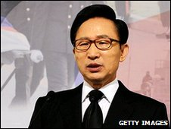
SK: Current Politics
Current President: Lee Myung-Bak
Former head of Hyundai
Former mayor of Seoul
Member of the Grand National Party.
2009 GDP: $1.364 trillion
2009 GDP per capita: $28,100

Slide 8
Nigeria
Former British colony
~250 ethnic groups
Resource wealthy: oil, natural gas, tin, arable land.

Slide 9
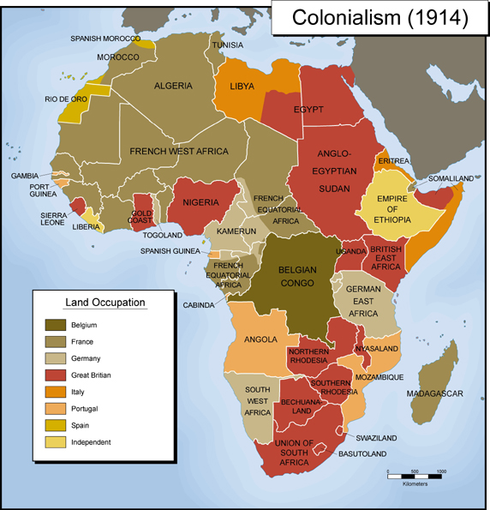
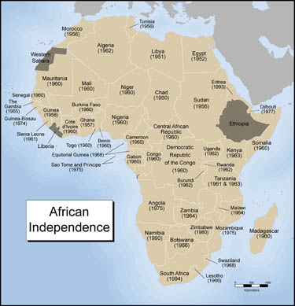

Slide 10
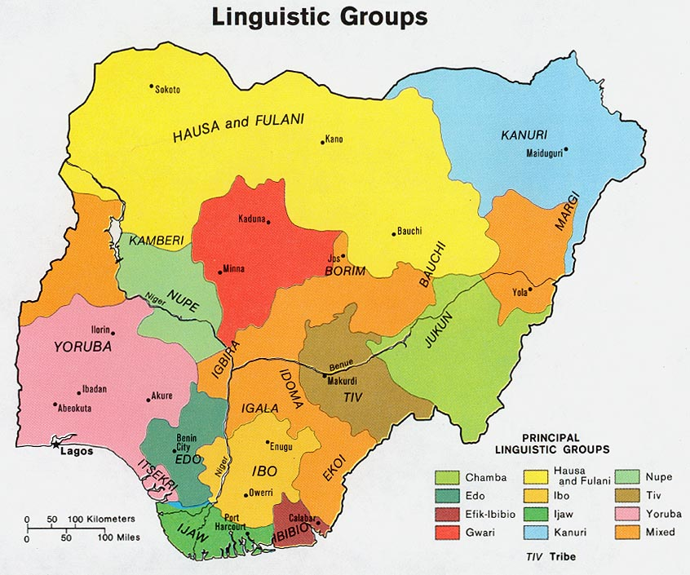

Slide 11
Nigeria: 3 Legacies of Colonialism
Weak sense of nationhood.
“Divide and rule” tactics used by British.
Personalism rather than institutions.

Slide 12
Nigeria: Politics
Independence in 1960
Failed democracy and military rule.
Military government: 28 of first 45 years of independence.
Patron-client networks
Big Men.
Spoils of office (e.g., loans)
Divide and rule.
Elimination of opposition.

Slide 13
Nigeria: Policies
Privatization for corrupt purposes
Plunder, not progress.

Slide 14
Nigeria: Institutions
No institutionalization
Cronyism
BYOI.

Slide 15
Contemporary Nigeria

