Slide 1
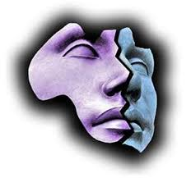
PSY 6669 Behavioral Pathology
Lecture 7
Mental Status Examination
Course Review

Slide 2
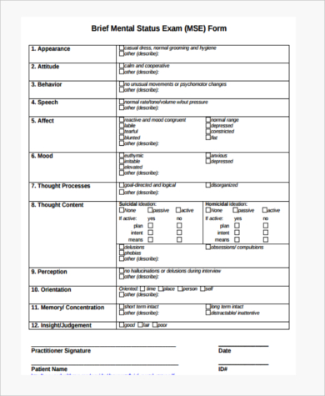
Mental Status Examination

Slide 3
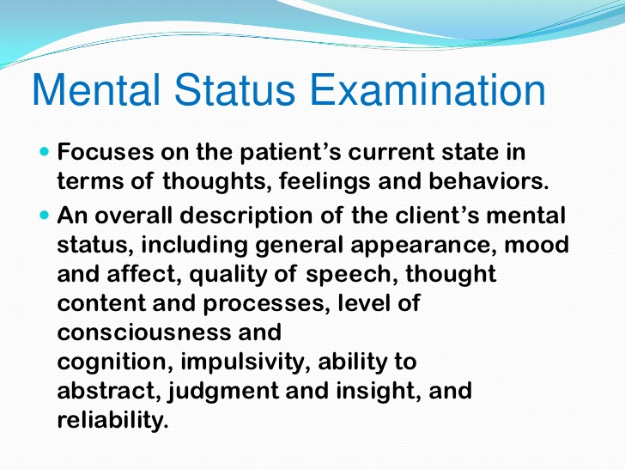

Slide 4
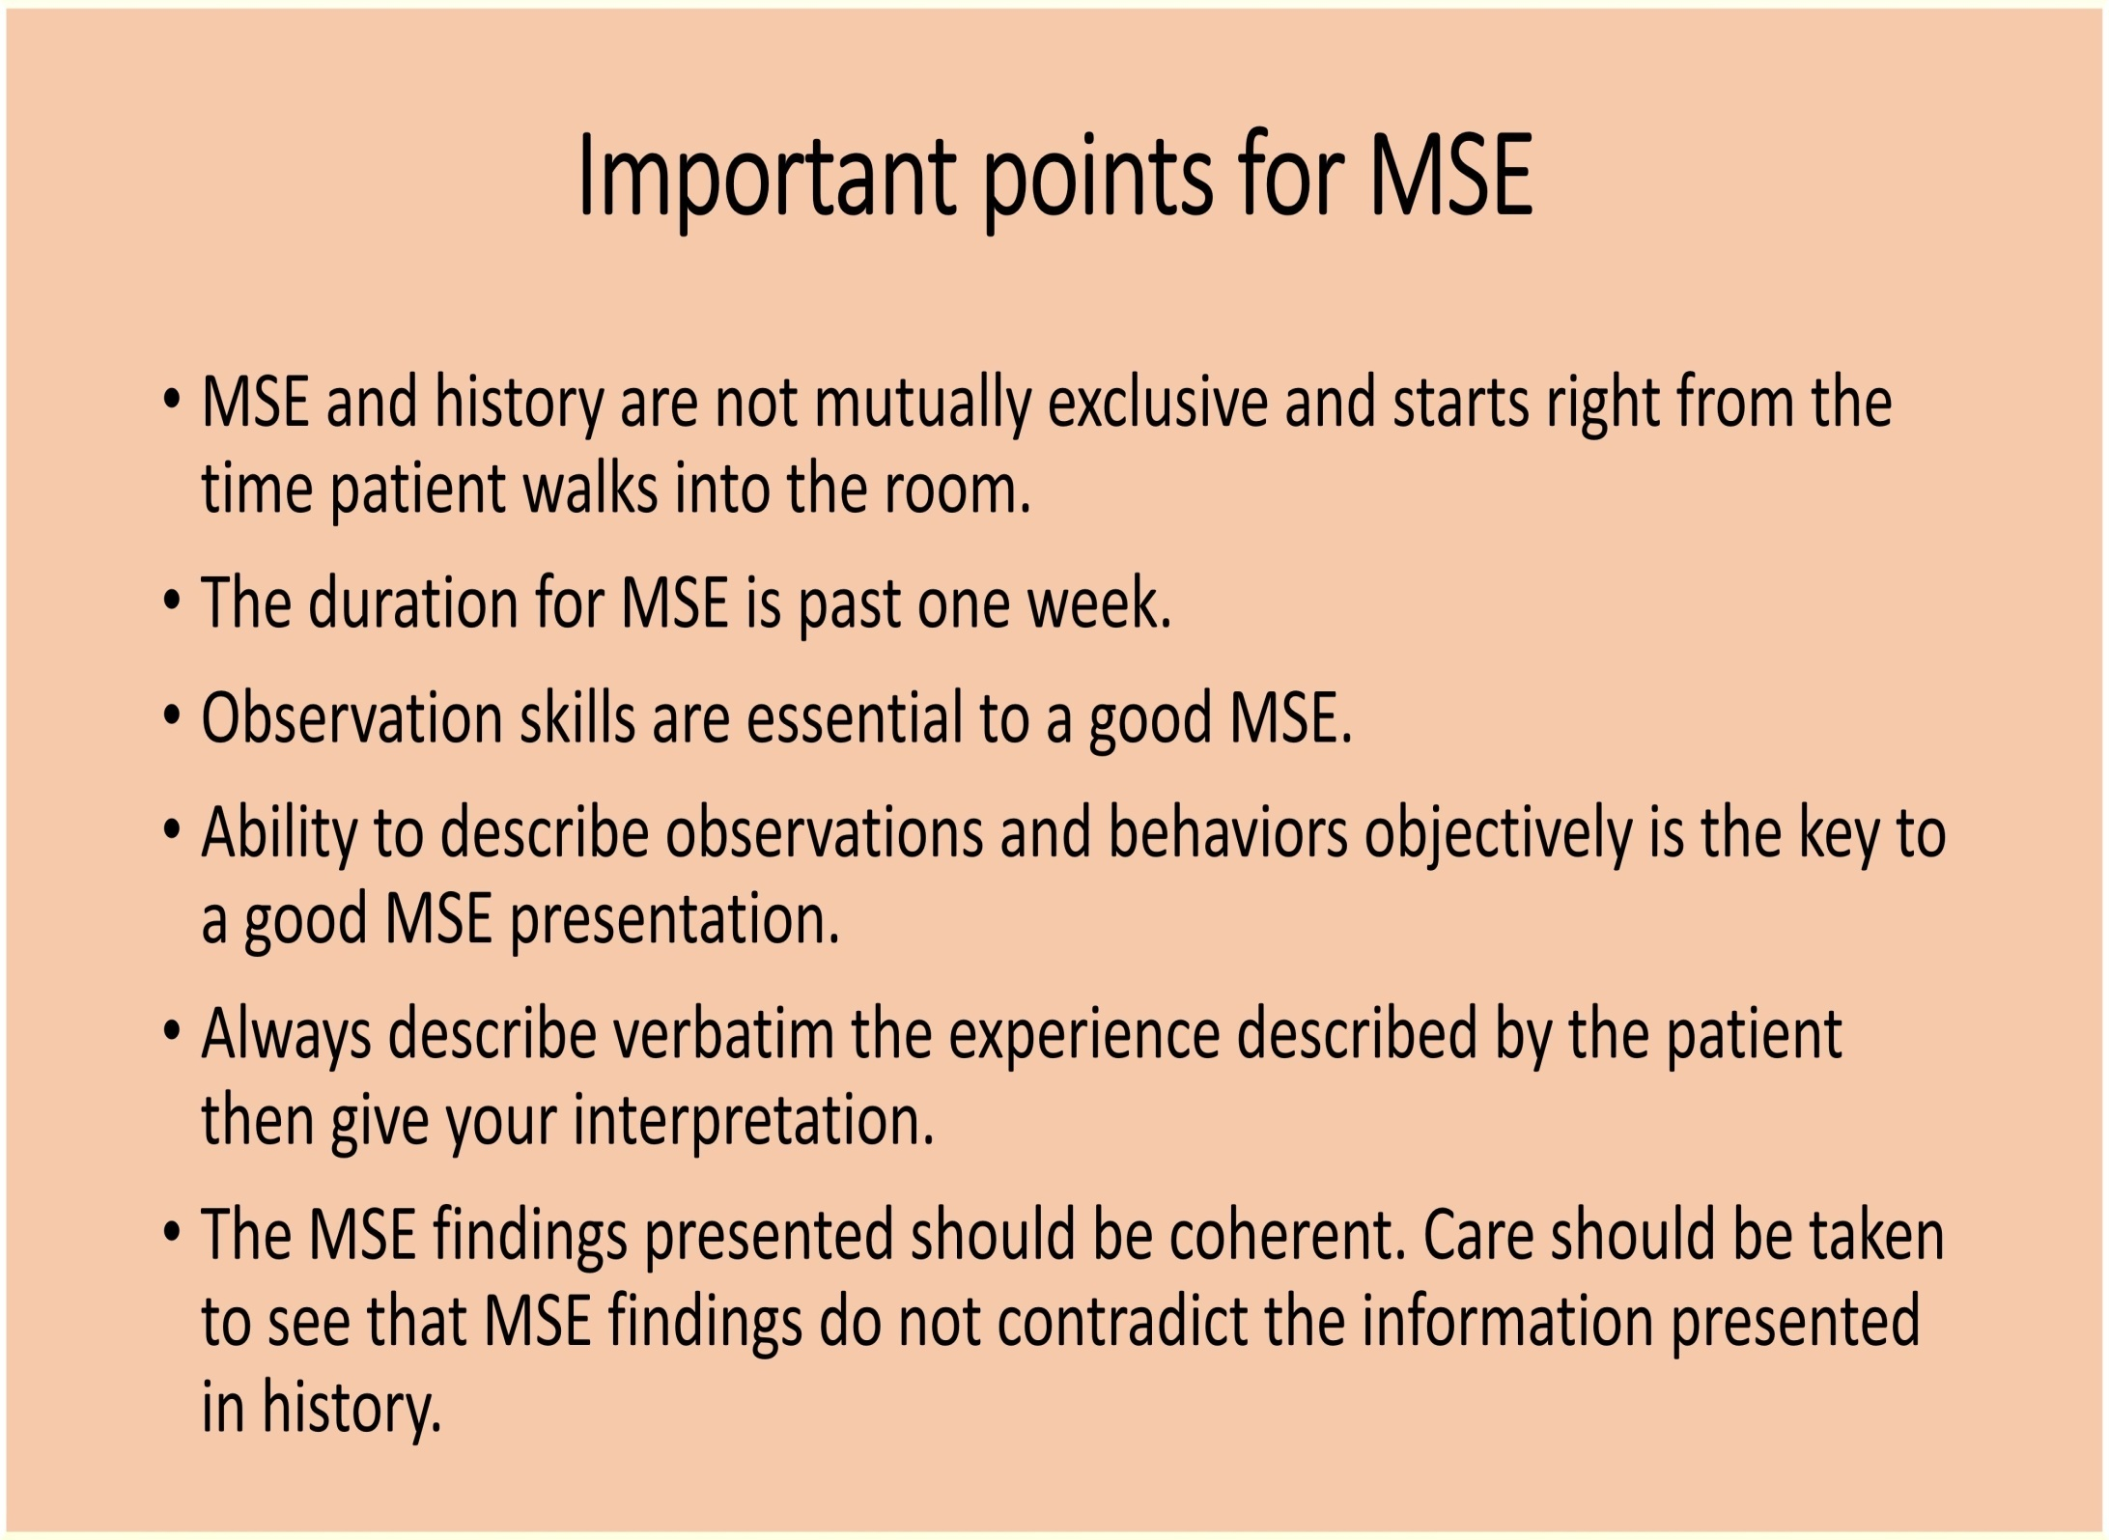

Slide 5
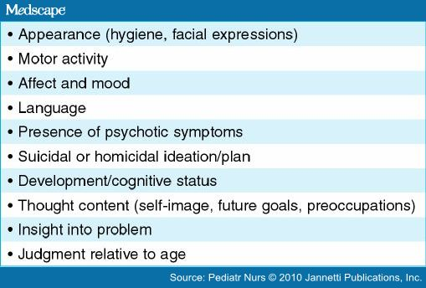
10 Assessments of the MSE

Slide 6
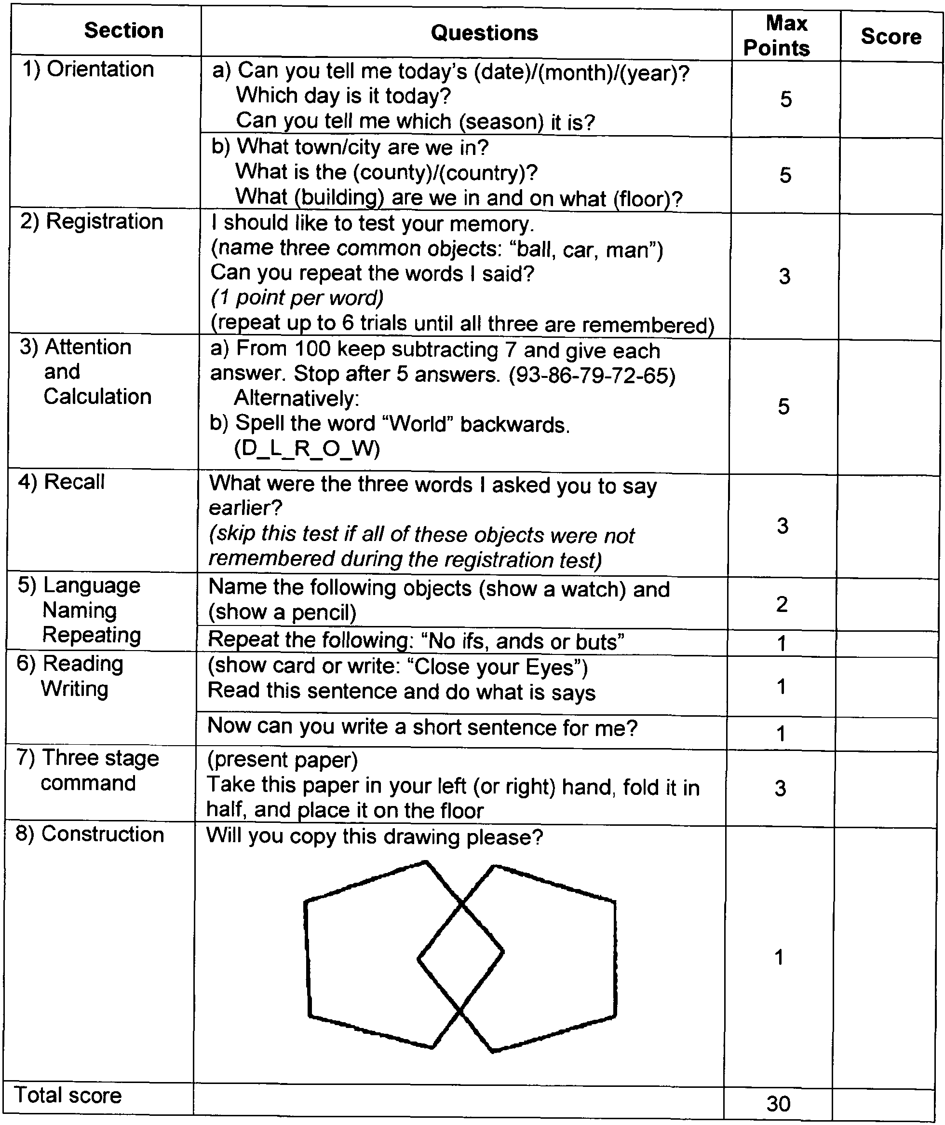

Slide 7
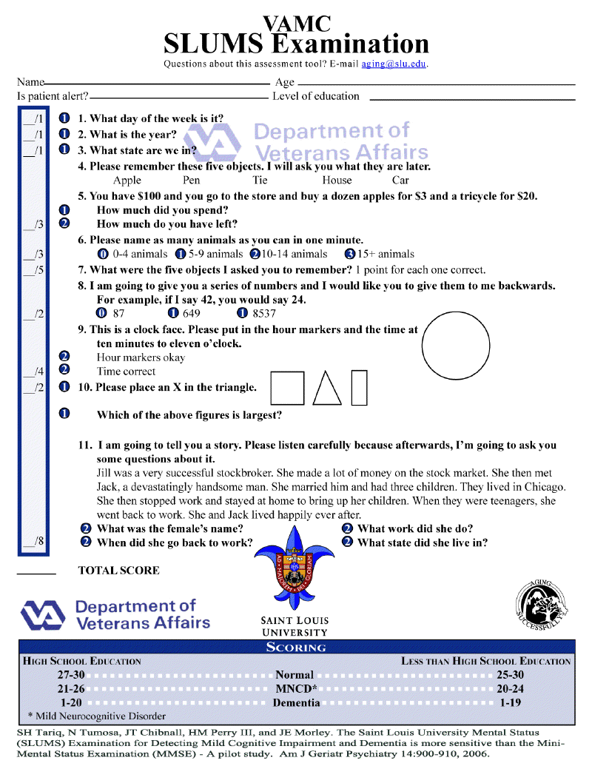

Slide 8
The patient is a 67-year-old African American female, who was evaluated during routine rounds at the Cedar Springs Nursing Home. She was about 5’ tall, wore a floral print summer dress, held tight to a matching purse, and appeared approximately her stated age. Her grooming was adequate and she was cooperative with the examination. She reported her mood as “desperate” because she had recently misplaced her glasses. Her affect was characterized by intermittent anxiety, generally associated with having misplaced items or with difficulty answering the examiner’s questions. Her speech was slow, halting, and soft. She repeatedly became concerned with her personal items, clothing, and general appearance, wondering where her scarf “ran off to” and occasionally inquiring as to whether her appearance was acceptable (e.g., “Do I look okay? You know, I have lots of visitors coming by later.”). The patient was oriented to person and place, but indicated the date as January 9, 1981 (today is July 8, 2019). She was unable to calculate serial sevens and after recalling zero of three items, became briefly anxious and concerned, stating “Oh my, I guess you pulled another one over me, didn’t you, sonny?” She quickly recovered her pleasant style, stating “And you’re such a gem for coming to visit me again.” Her proverb interpretations were concrete. Judgment, reliability, and insight were significantly impaired.

Slide 9
The patient is a 48-year-old white male, who appeared disheveled and unkempt on presentation to the hospital emergency room. He was wearing dirty khaki pants, an unbuttoned golf shirt, and white shoes and appeared slightly younger than his stated age. During the interview, he was agitated and restless, frequently changing seats. He was impatient and sometimes rude in his interactions with this examiner. The patient reported that today was the best day of his life, because he had decided to join the professional golf circuit. His affect was labile, but appropriate to the content of his speech (i.e., he became tearful when reporting he had “bogeyed number 15”). His speech was loud, pressured, and over-elaborative. He exhibited loosening of associations and flight of ideas; he intermittently and unpredictably shifted the topic of conversation from golf, to the mating habits of geese, to the likelihood of extraterrestrial life. The patient described grandiose delusions regarding his sexual and athletic performance. He reported auditory hallucinations (God had told him to quit his job and become a professional golfer) and was preoccupied with his athletic and sexual accomplishments. He was oriented to time and place, but claimed he was the illegitimate son of Jack Nicklaus. He denied suicidal and homicidal ideation. He refused to participate in intellectual- or memory-related portions of the examination. The patient was unreliable and exhibited poor judgment. Insight was absent.

Slide 10
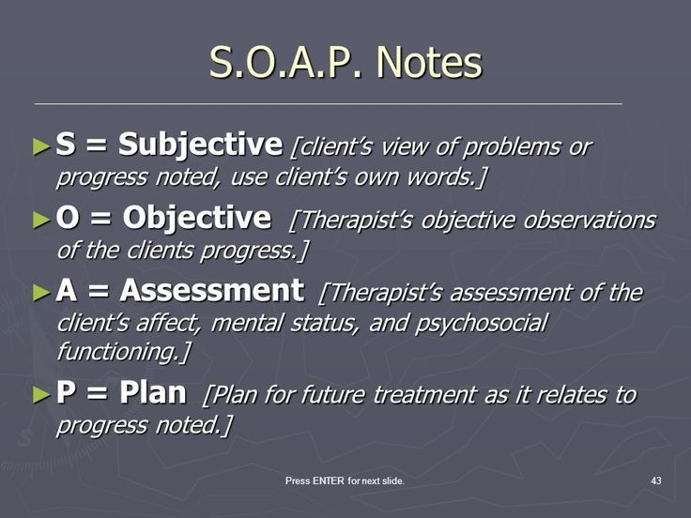
SOAP Progress Notes

Slide 11
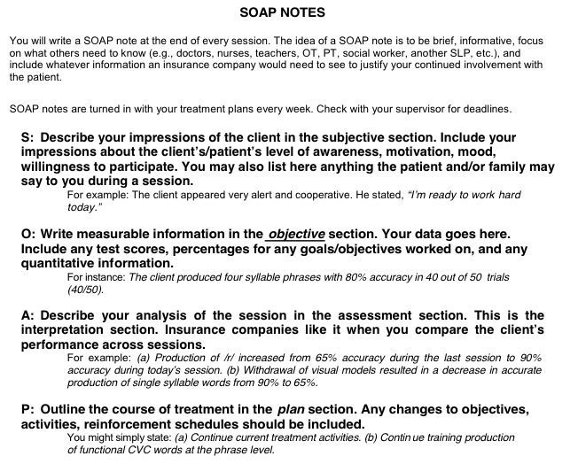

Slide 12
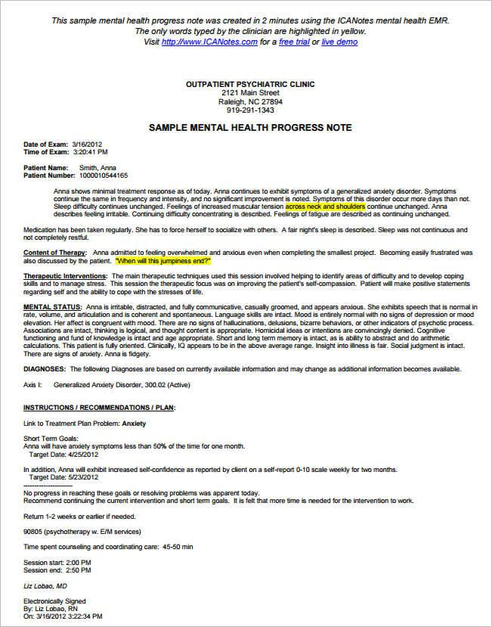

Slide 13
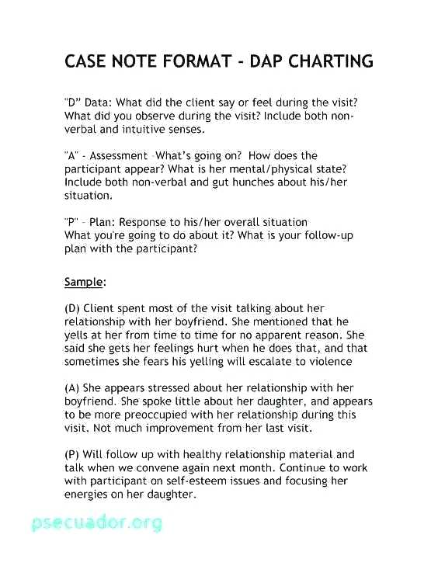

Slide 14
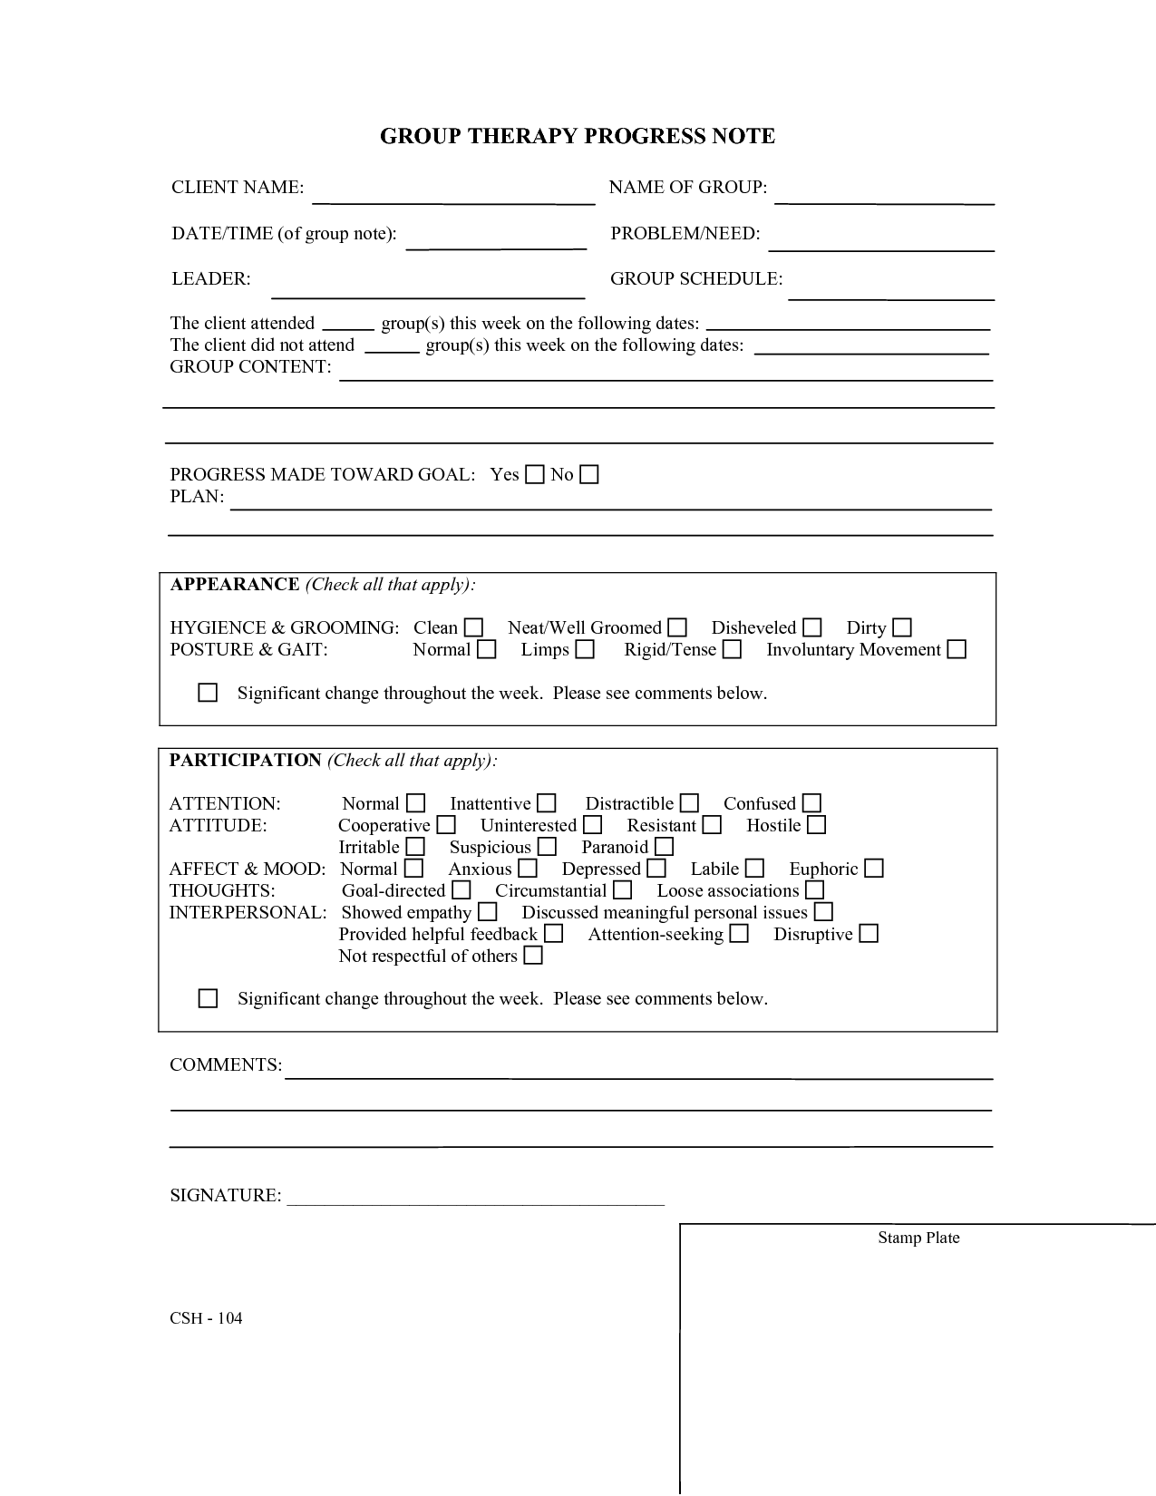

Slide 15

Review for Final Examinations

Slide 16
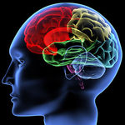
DSM-5 Organizational Structure
Neurodevelopmental Disorders: Intellectual Disorders, Autism Spectrum, Communication, Specific Learning, Motor/Tics, ADHD
Schizophrenia Spectrum and Other Psychotic Disorders: Brief Psychotic Disorder, Schizophreniform,
Schizophrenia,
Schizoaffective (Bipolar or Depressive type)
and Delusional Disorder (non-bizarre)

Slide 17
Bipolar I and II Disorders, Cyclothymia (specifiers)
Depressive Disorders: (specifiers)
Disruptive Mood Dysregulation Disorder,
Major Depressive Disorder (single or recurrent
episodes)
Persistent Depressive Disorder
Anxiety Disorders: Panic Disorder, Agoraphobia, Phobias, PTSD, Separation, Generalized, Mutism, OCD
Adjustment Disorders: with disturbance of mood, anxiety, conduct, or mixed

Slide 18
OCD Related Disorders: Body Dysphoric, Hoarding, Trichotillomania, Excoriation
Trauma- and Stressor-Related Disorders:
PTSD/Acute Stress, Reactive Attachment,
Disinhibited Social Engagement
Dissociative Disorders: Dissociative Identity, Dissociative Amnesia, Depersonalization/ Derealization Disorders
Somatic Symptom and Related Disorders
Feeding and Eating Disorders Anorexia, Bulimia, Binge Eating Disorders, Pica
Elimination Disorders: Enuresis & Encopresis

Slide 19
Sleep-Wake Disorders & Parasomnias
Sexual Dysfunctions & Paraphilic Disorders
Gender Dysphoria
Disruptive, Impulse Control, and Conduct Disorders: ODD, Conduct Disorder, Pyromania, Kleptomania
Substance-Related and Addictive Disorders:
Substance Use Disorders, Severity
Intoxication & Withdrawal Related Disorders
Major & Mild Neurocognitive Disorders

Slide 20
DSM-5 Organizational Structure
Personality Disorders
Cluster A: Odd/eccentric
Paranoid, Schizoid, Schizotypal
Cluster B: Dramatic
Antisocial, Borderline, Histrionic, Narcissistic
Cluster C: Fearful
Avoidant, Dependent, Obsessive-Compulsive
Medication-Induced Movement Disorders
Other Conditions That May Be a Focus of Clinical Attention – Z Codes

Slide 21
Tying it all Together
National Counselor’s
Mental Health Counselors’ Examination
Psychosocial
Testing & Referrals
Diagnosis
Treatment Plan

Slide 22
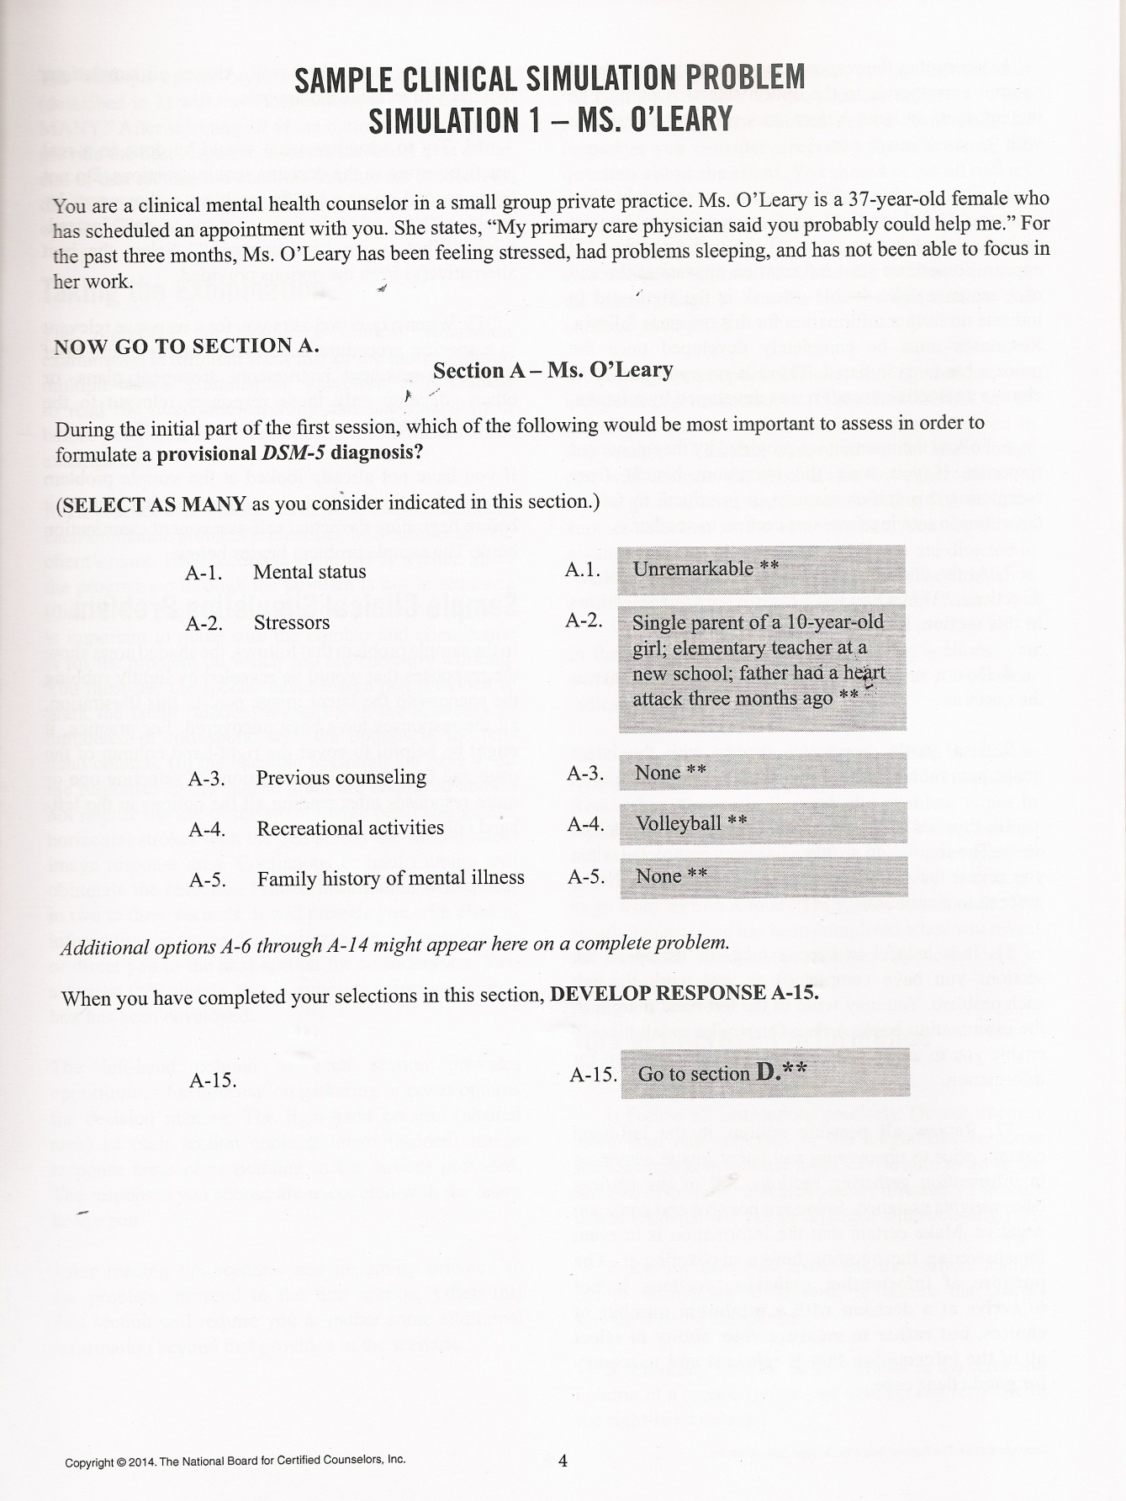

Slide 23
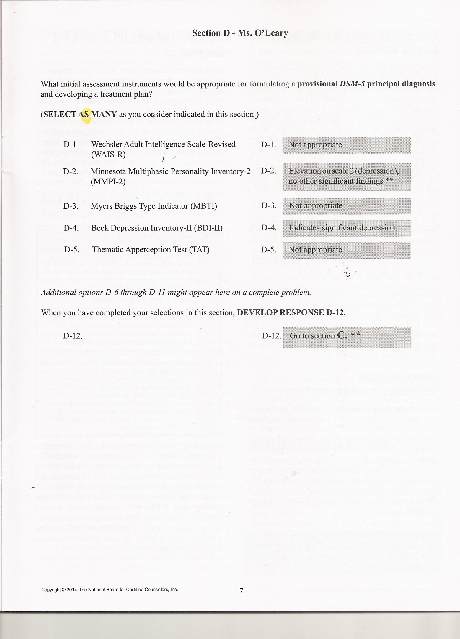

Slide 24
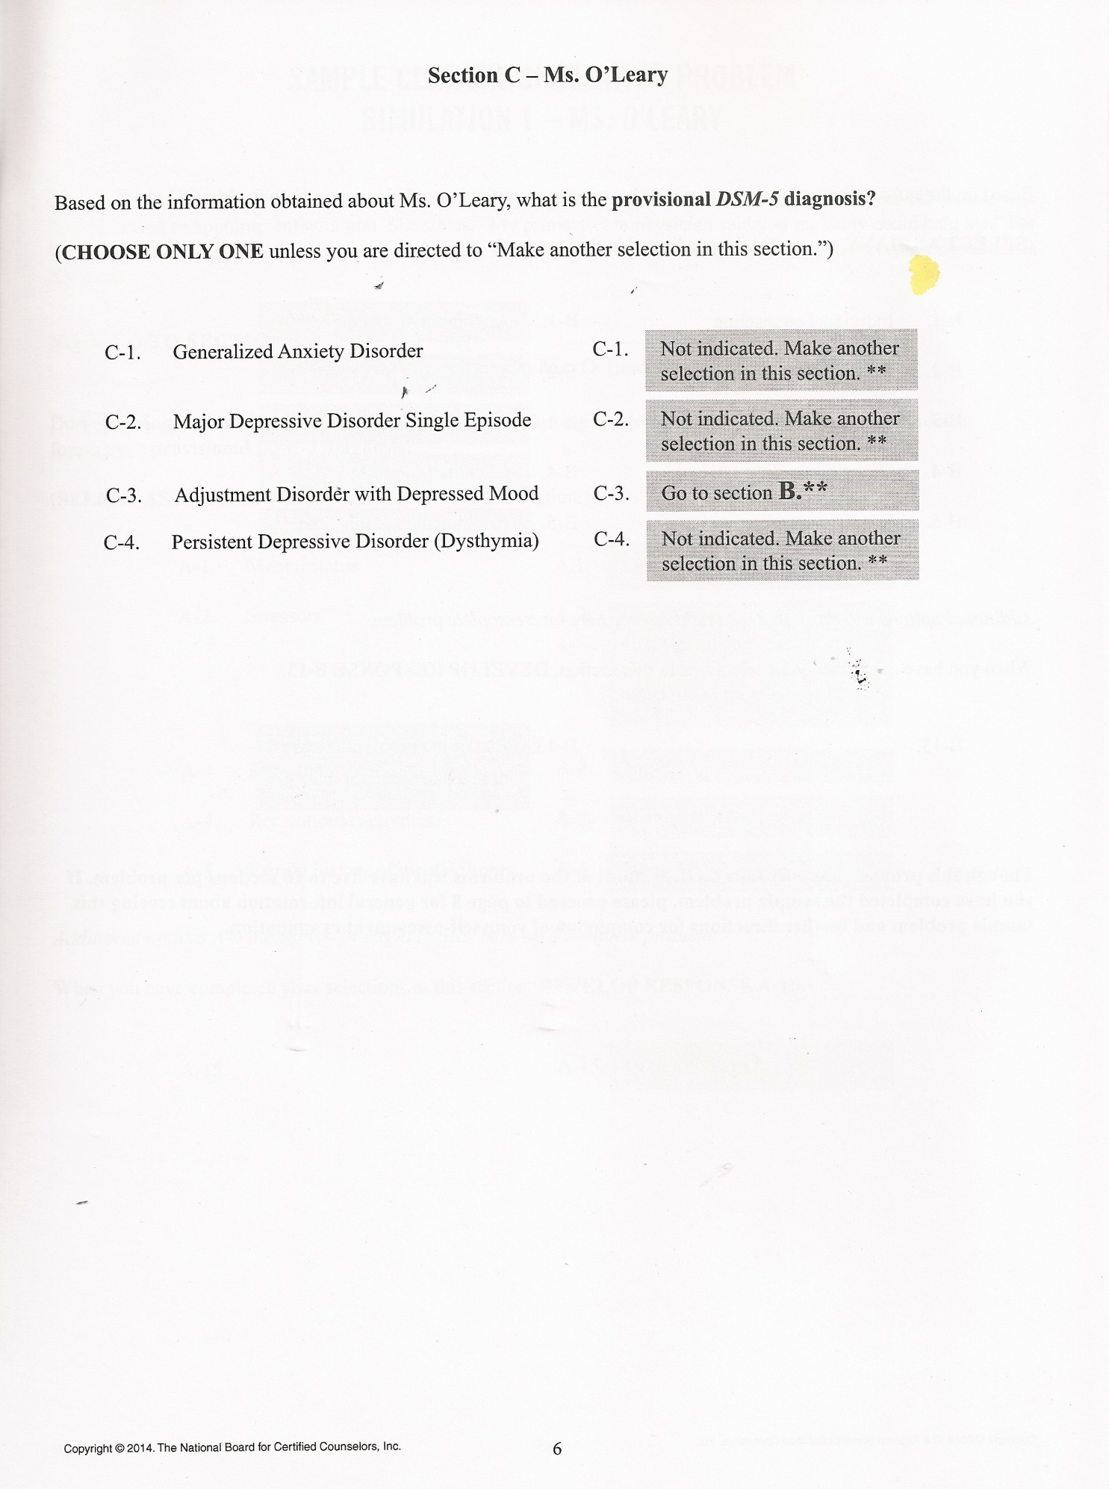

Slide 25
