Slide 1
PSY 6669 Behavioral Pathology
Lecture 6
Other Conditions That May Be a Focus of Clinical Attention
Z – Codes (or what we really get paid for)
Personality Disorders

Slide 2
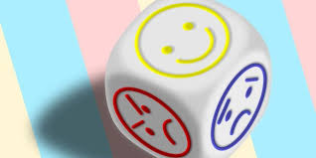
Reminder !!!
Term Papers Due Next Week.

Slide 3
Relational Problems (pg 715/355)
Parent-Child Relational Problem
Sibling Relational Problem
Upbringing Away from Parents
Child Affected by Parental Relationship Desires

Slide 4
Other Problems Related to Primary Support Group
Relationship Distress With Spouse or Intimate Partner
Disruption of Family by Separation or Divorce
High Expresses Emotional Level within Family
Uncomplicated Bereavement

Slide 5
Abuse and Neglect (pg 717/358)
Child Physical Abuse
Child Sexual Abuse
Child Neglect
Child Psychological Abuse
Adult Maltreatment and Neglect Problems
Specify : Suspected or Confirmed
Specify : Initial or Subsequent Encounter

Slide 6
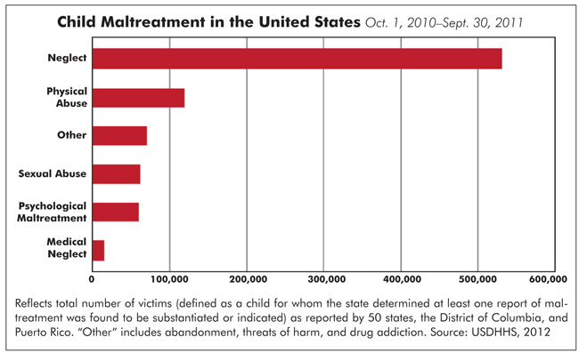

Slide 7
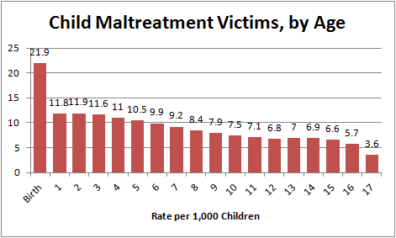

Slide 8
Adult Maltreatment & Neglect Disorders (720/363)
Spouse or Partner Violence, Physical
Spouse or Partner Violence, Sexual
Spouse or Partner Neglect
Spouse or Partner Abuse, Psychological
Specify : Suspected or Confirmed
Specify : Initial or Subsequent Encounter

Slide 9
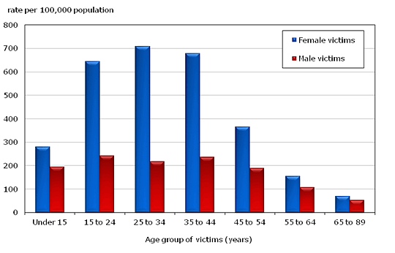
Violence by Age & Gender

Slide 10
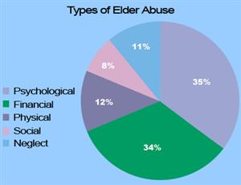
Elder Abuse

Slide 11
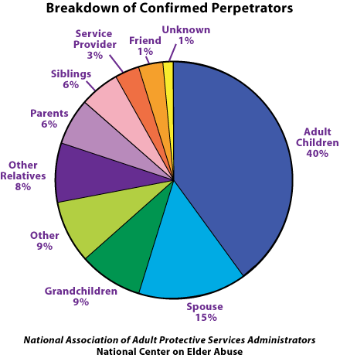

Slide 12
Nonspouse or Nonpartner (pg 720/363)
Nonspouse or Nonpartner Violence, Physical
Nonspouse or Nonpartner Violence, Sexual
Nonspouse or Nonpartner Neglect
Nonspouse or Nonpartner Abuse, Psychological
Specify : Suspected or Confirmed
Specify : Initial or Subsequent Encounter

Slide 13
Educational & Occupational (pg 723/367)
Educational Problems
Occupational Problems
Housing and Economic Problems
Economic Problems
Other Problems Related to the Social Environment
Problems Related to Crime or Interaction with the Legal System

Slide 14
Other Problems (pg 725/371)
Other Health Service Encounters for Counseling and medical Advice
Problems Related to Other Psychosocial, Personal, and Environmental Circumstances

Slide 15
Other Circumstances of Personal History (pg 726/372)
Other personal history of psychosocial trauma
Personal history of Self-Harm
Personal history of Military Deployment
Other personal risk factors
Problems related to lifestyle
Adult Antisocial behavior
Child or Adolescent Antisocial behavior

Slide 16
Problems related to Unavailable or Inaccessibility of Health Care
Problems related to Unavailable or Inaccessibility other Helping Agencies
Nonadherence to Medical Treatment
Overweight or Obesity
Malingering
Wandering Associated with a Medical Disorder
Borderline Intellectual Functioning

Slide 17
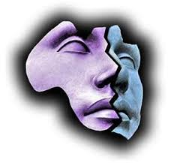
PSY 6669 Behavioral Pathology
Personality Disorders

Slide 18
APA Definition of Personality
Personality refers to individual differences in characteristic patterns of thinking, feeling, and behaving. The study of personality focuses on two broad areas: One it the understanding of individual differences in particular personality characteristics, such as sociability or irritability. The other is understanding how the various parts of a person come together as a whole.

Slide 19
Psychiatric Association
Personality is the way of thinking, feeling, and behaving that makes a person different from other people. An individual’s personality is influenced by experiences, environment (surroundings, life situation), and inherited characteristics.
A Personality Disorder is a way of thinking, feeling, and behaving that deviates from the expectations of the culture, causes distress or problems functioning, and lasts over time.

Slide 20
Definition of a Personality Disorder (pg 645/321)
The ingrained, enduring patterns of behaving, feeling, perceiving, and thinking. Personality traits become personality disorders when they:
Become inflexible and maladaptive.
Significantly impair social and occupational functioning or cause substantial subjective distress.
Personality disorders should ONLY be diagnosed when they cause life long problems and not just discrete periods of dysfunction.

Slide 21
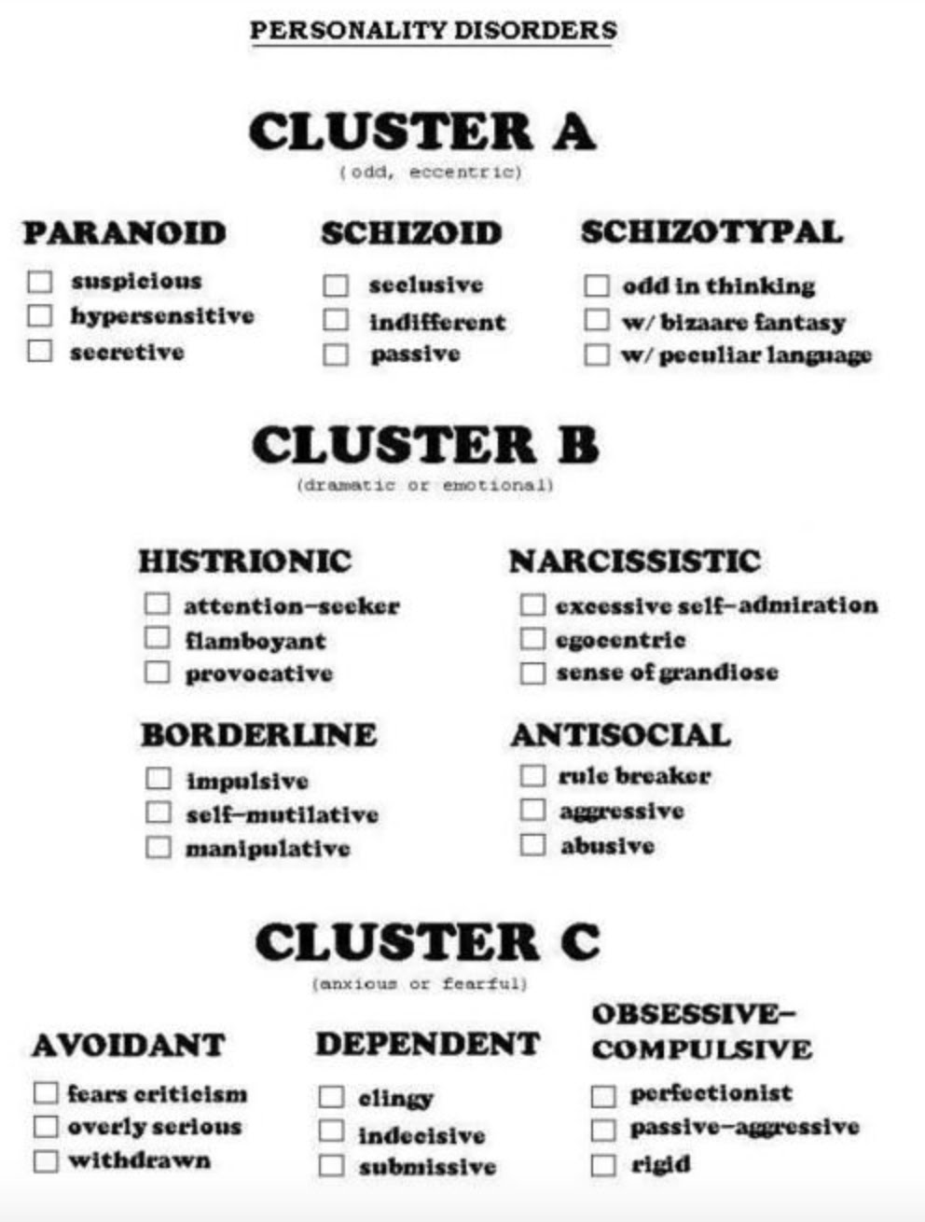

Slide 22
Prevalence
OCPD 2%
Paranoid 2%
Antisocial 1-4%
Schizoid 1%?
Schizotypical 1%
Avoidant 1-2%
Histrionic 2%
Borderline 2-3%
Dependent 0.5%
Narcissistic .5-1%

Slide 23
Etiology
Likely multi-factorial like almost all other psychiatric diagnoses.
Genetic and environmental factors such as chaotic home environment and abuse have been implicated in development of maladaptive behavioral patterns.

Slide 24
Cultural Considerations
Judgments about persistent and pervasive personality traits cannot be made without consideration of a person’s cultural background.
Always use caution!!!!!!!!!!
Particular care should be exercised in diagnosing members of a minority group with Paranoid Personality Disorder.

Slide 25
? Cultural influences ?
Studies have found that in Norway compared to US, Germany and UK avoidant personality 3-4X more prevalent, dependent personality 2-3X more prevalent and schizoid is 2X more prevalent. Borderline is <½ as frequent and antisocial is ½ has prevalent.
Pattern exhibits increased internalization personality disorders are prevalent and externalization disorders are rarer.

Slide 26
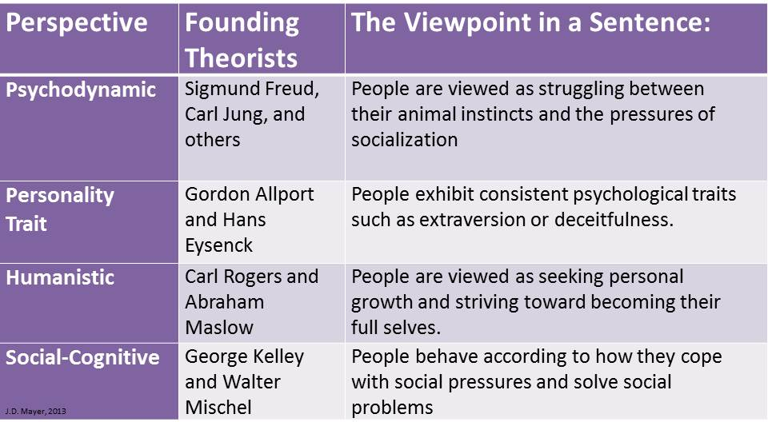

Slide 27
Personality Disorder Clusters
Cluster A: Characterized by odd or eccentric behavior
Paranoid Personality Disorder
Schizoid Personality Disorder
Schizotypal Personality Disorder

Slide 28
paranoid personality disorder
A personality disorder whose outstanding feature is that the individual is unduly suspicious of others and is always on guard against potential danger or harm.
Impossible to trust people
Project blame onto others
Refuse to seek professional help

Slide 29
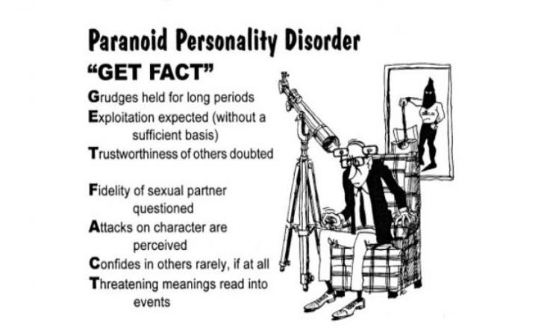

Slide 30
Schizoid Personality Disorder
Indifference to social and sexual relationships
Prefer to be alone
No desire to love or be loved
Cold, reserved, withdrawn
Insensitive to feelings of others

Slide 31
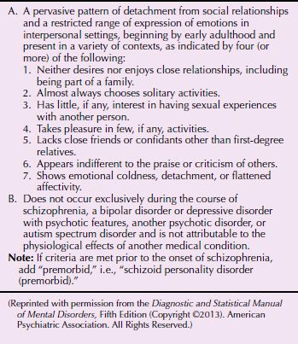

Slide 32
Schizotypal Personality Disorder
A personality disorder that primarily involves odd beliefs, behavior, appearance, and interpersonal style.
Such individuals lack a clear sense of direction or motivation, and do not have a clear set of standards against which to measure their behavior
Notes:
People with this disorder may have peculiar ideas, such as magical thinking and beliefs in psychic phenomena.
They lack a clear sense of direction or motivation, and do not have a clear set of standards against which to measure their behavior.

Slide 33
Schizotypal Personality Disorder
Social isolation
Eccentricity
Peculiar communication
Poor social adaptation
Treatment
Parallels interventions commonly used in treating schizophrenia

Slide 34
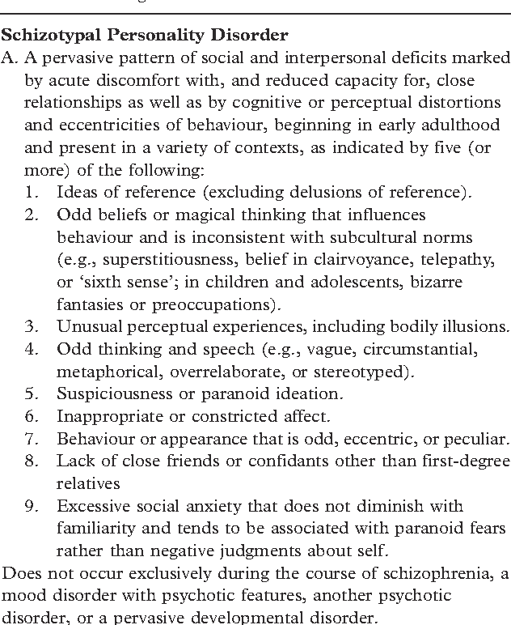
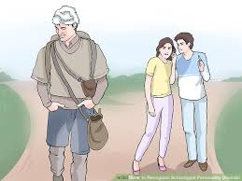

Slide 35
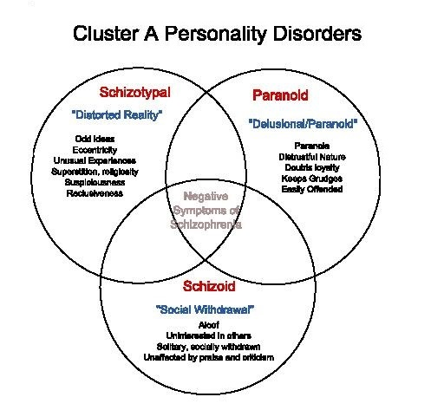

Slide 36
Personality Disorder
Cluster B: Characterized by dramatic, over-emotional, and erratic behavior.
Antisocial Personality Disorder
Borderline Personality Disorder
Histrionic Personality Disorder
Narcissistic Personality Disorder

Slide 37
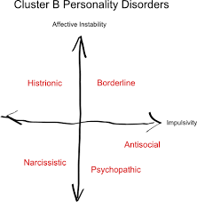

Slide 38
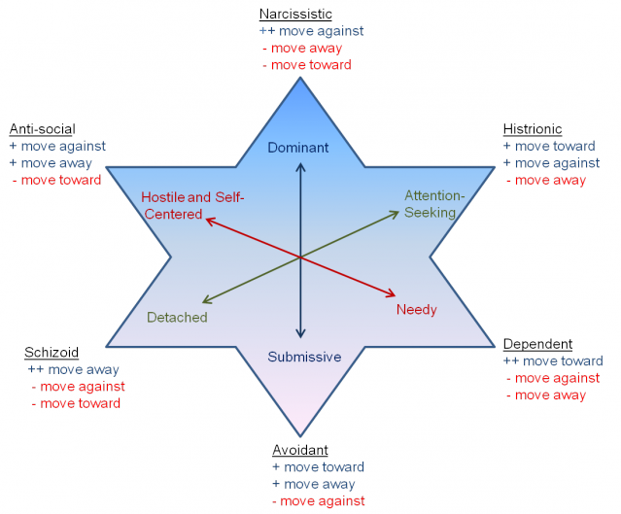

Slide 39
Antisocial
This diagnosis is not given to clients under the age of 18.
Usually engage in illegal activities;
Routinely practice deceit;
Often aggressive and violent;
Typically irresponsible
Generally ignore the rights and feelings of others.
Rarely show remorse

Slide 40
Antisocial Personality Disorder
The diagnostic criteria in the DSM-5 require that an individual show a pervasive pattern of three out of seven possible behaviors:
Failure to conform to social norms
Deceitfulness
Impulsivity
Aggressiveness
Disregard for safety of self or others
Irresponsibility
Lack of remorse
Notes:
The changes in DSM-5’s diagnostic system for personality disorders will result in organizing the seven DSM-IV-TR criteria into the categories of:
Personality functioning
Interpersonal functioning
Personality traits

Slide 41
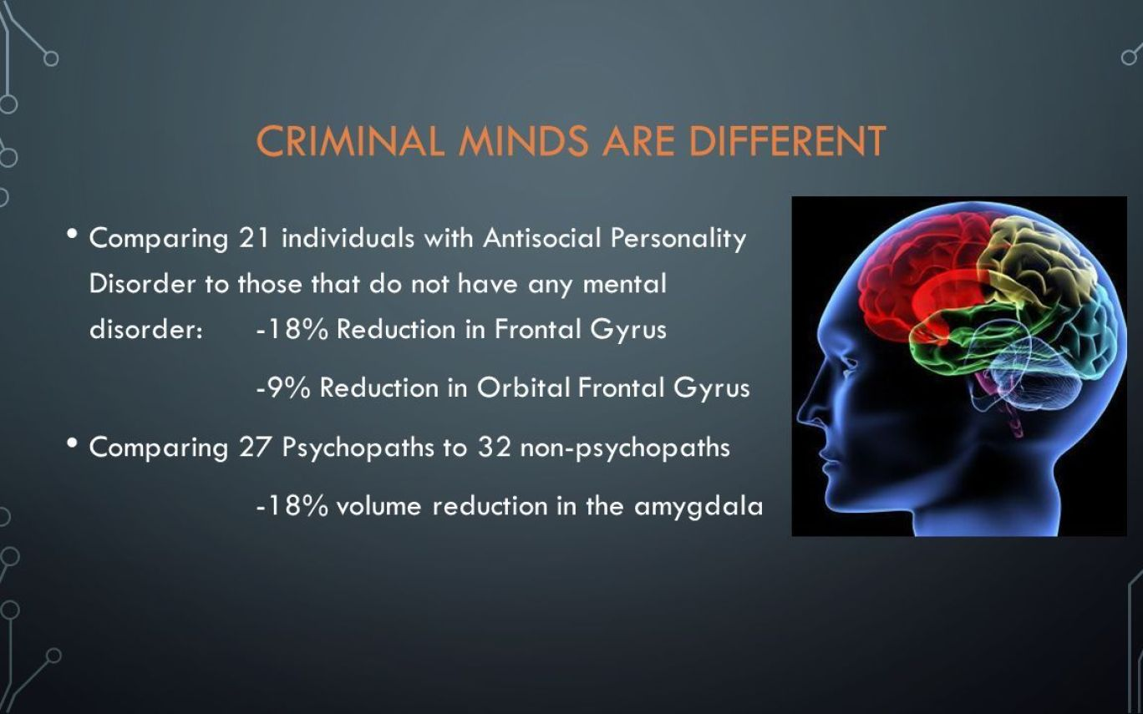

Slide 42
Borderline Personality Disorder
Pervasive pattern of poor impulse control and instability in mood, interpersonal relationships, and self-image
BPD’s central feature is that of instability
The way that people with BPD relate to others is termed “splitting”
Notes:
BPD rests on the individual’s demonstration of at least five out of a possible nine behaviors:
Frantic efforts to avoid abandonment
Unstable and intense relationships
Identity disturbance
Impulsivity in areas such as sexuality, spending, or reckless driving
Recurrent suicidal behavior
Affective instability
Chronic feelings of emptiness
Difficulty controlling anger
Occasional feelings of paranoia or dissociative symptoms.
Splitting: A defense, as being all good or all bad, usually resulting in disturbed interpersonal relationships.

Slide 43
Perspectives on Borderline Personality
Biological
High heritability
Abnormalities in:
Amygdala and prefrontal cortex
Neurotransmitters and hormones
Notes:
Childhood sexual abuse may alter sympathetic nervous system that leads to hypersensitivity and impulsivity in adulthood.
BPD symptoms are tied to a number of biological factors:
High heritability.
Abnormalities in the amygdala and prefrontal cortex, areas of the brain involved in emotional processing and regulation.
People with BPD may also have abnormalities in neurotransmitters and hormones involved in regulating emotional responses and sensitivity to pain.

Slide 44
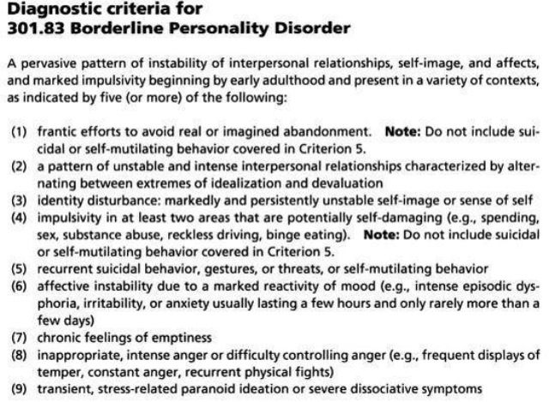

Slide 45
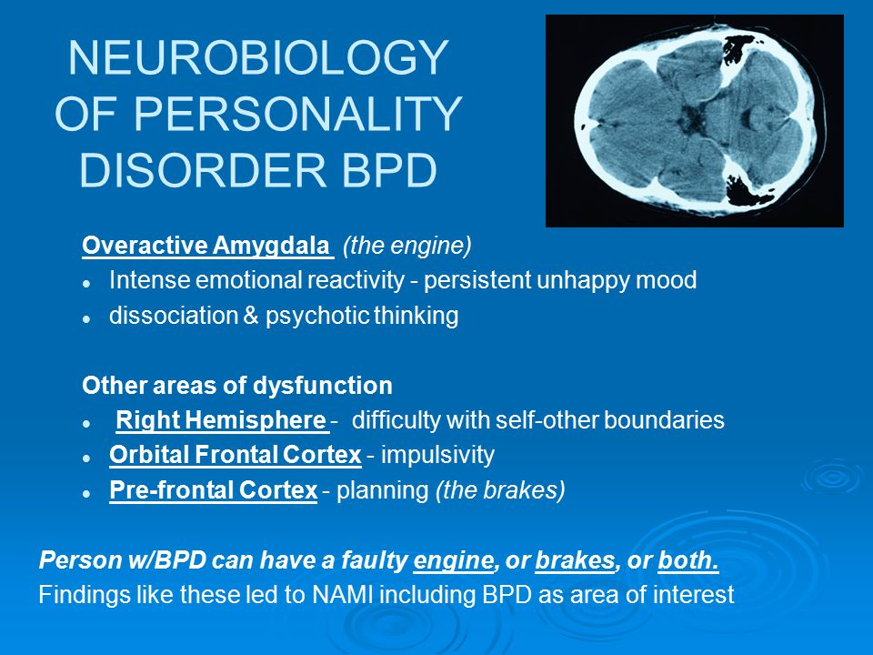

Slide 46
Borderline Pathology
Poor Boundaries (S-O)
Limited Ego Integration (Split good/bad)
Regressive Behavior
Lacks object constancy
Enmeshment vs. Destruction
Urge to merge (love) vs. Fear of engulfment (hate)
Dependency vs. Independence

Slide 47
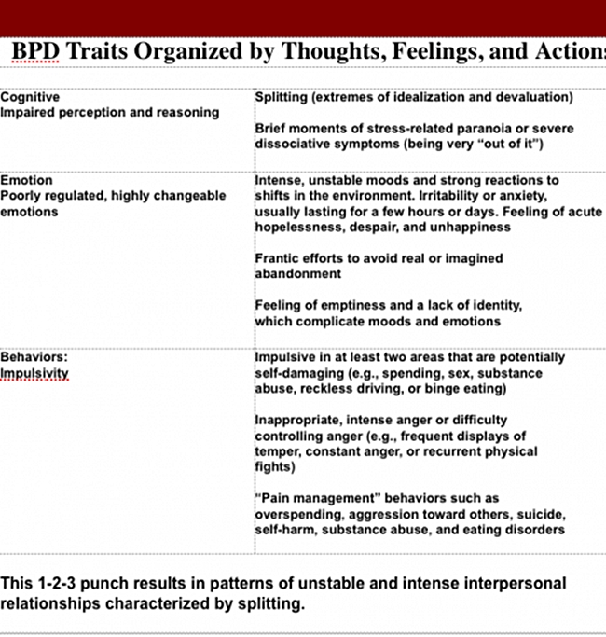

Slide 48
Borderline
They rarely see themselves or others in a balanced way.
These clients are the most likely of people with personality disorders to seek treatment.

Slide 49
Differential Diagnoses
Cyclothymic Disorder
Posttraumatic Stress Disorder
Narcissistic Personality Disorder
Substance Abuse/Use Disorder

Slide 50
High Functioning: Borderline Personality Traits
Does not Meet the DSM-5 criteria
Over idealized/undervalued interpersonal relationships
Mood Shifts (depression-anxiety)
“Empty” feeling
Possible Abandonment Issues
Both have Identity Disturbance

Slide 51
Borderline Personality Disorder
Low Functioning BPD:
Intense and unstable interpersonal relationships
Impulsive (self-destructive behaviors)
Mood Shifts (unstable emotions)
Anger (inappropriate)
Suicidal/Self-mutilating
“Emptiness” especially when not in a relationship
Abandonment Issues (emotionally left to “die”)

Slide 52
Treatment Issues
Consistent and predictive environment
Tolerate affect without abandonment
Avoid the split
Don’t rescue ! Maintain intolerance to independence
Supportive Interpretations
Build Ego functions

Slide 53
Histrionic Personality Disorder
Exaggerated emotional reactions, approaching theatricality, in everyday behavior.
Show extreme pleasure as the center of attention and who behave in whatever way necessary to ensure that this happens.
They are excessively concerned with their physical appearance, often trying to draw attention to themselves in such extreme ways that their behavior seems ludicrous.
Notes:
Attention-seeking is one of the pathological personality traits.

Slide 54
Histrionic Personality Disorder
Flirtatious and seductive
Demand reassurance, praise, approval of others
Need for immediate gratification
Easily influenced by others
Lack analytical ability
Notes:
They want immediate gratification of their wishes and overreact to even minor provocations, usually in an exaggerated way, such as by weeping or fainting.
Although their relationships are superficial, they assume them to be intimate and refer to acquaintances as “dear” friends.

Slide 55
Narcissistic Personality
A grandiose sense of self-importance;
A need for attention
A reduced capacity for empathy
Often seem to have an exaggerated sense of entitlement;
Expect to be admired and obeyed by others.
Usually seeks treatment when frustrated by others.

Slide 56
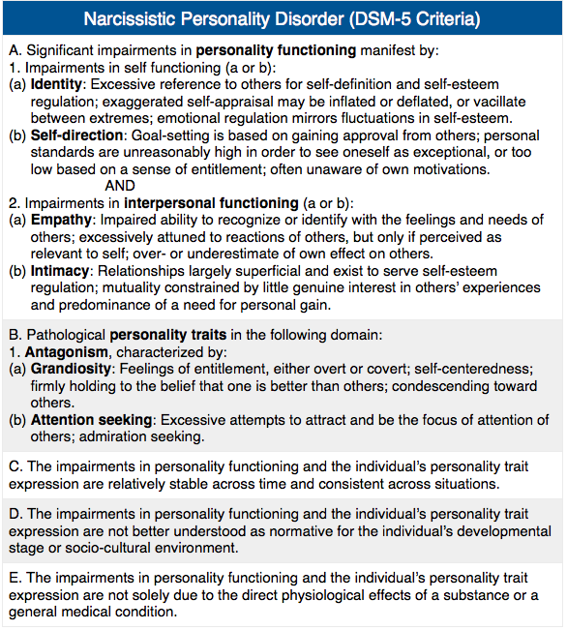
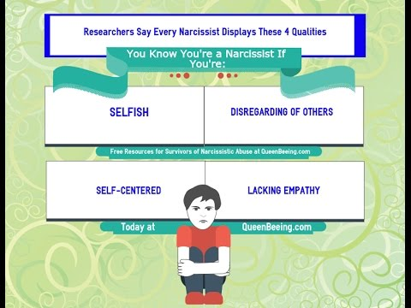

Slide 57
Personality Disorders
Cluster C: Characterized by highly anxious and fearful affect.
Avoidant Personality Disorder
Dependent Personality Disorder
Obsessive Compulsive Personality Disorder

Slide 58
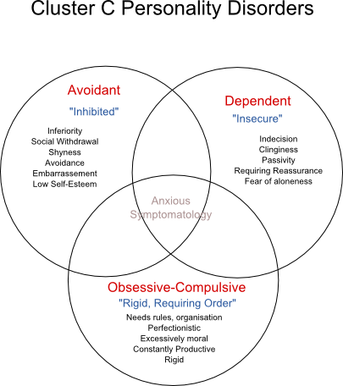

Slide 59
Avoidant Personality Disorder
The individual desires, but is fearful of, any involvement with other people and is terrified at the prospect of being publicly embarrassed
Notes:
People with avoidant personality disorder become extremely sensitive to rejection and ridicule, interpreting the most innocent remark as criticism.
Withdrawn, unlikely to experience intimacy, and unable to feel pleasure.

Slide 60
Avoidant - Theories
Cognitive-behavioral
Hypersensitive due to parental criticism
Feel unworthy of other people’s regard
Expect not to be liked
Avoid getting close to avoid expected rejection
Distorted perceptions of experiences with others
Notes:
The psychodynamic perspective focuses on fear of attachment.

Slide 61
Avoidant Personality Disorder
Demonstrate marked feelings of inadequacy that are associated with hypersensitivity to negative feedback and/or social inhibition.
Seldom put themselves in “risky” or even new situations in which they may perform poorly.
Seldom develop intimate interpersonal relationships.
May constrain occupational choices based on fear of negative judgments.

Slide 62
Dependent Personality Disorder
The individual is extremely passive
Tends to cling to other people to the point of being unable to make any decisions
Notes:
Without others near them, people with dependent personality feel despondent and abandoned.

Slide 63
Dependent Personality
Seek someone to take care of them, even to the extent of being submissive, clinging, and fearful of separation.
Avoid decisive action and encourage others to make decisions for them.
Subservience makes it quite difficult to express disagreement, even when asked to undertake unpleasant activities.

Slide 64
Dependent Personality
Fear being alone and quickly substitute a new relationship if an old one is lost.
They systematically underestimate themselves and their ability to function independently.

Slide 65
Obsessive-Compulsive Personality Disorder
A personality disorder involving intense perfectionism and inflexibility manifested in worrying, indecisiveness, and behavioral rigidity.
OCPD is a disturbance of personality, not a disturbance involving anxiety or even out-of-control behaviors
OCPD do not experience obsessions and compulsions. OCPD refers to this rigidly compulsive personality tendency and also obsessive concern with perfectionism.

Slide 66
Obsessive-Compulsive PD
Have well-controlled perfectionistic patterns of behavior at the expense of spontaneity, flexibility, and even efficiency.
There is often such preoccupation with planning and details that tasks are not completed.
Difficulty delegating responsibilities and tend to work long hours in order to meet their own standards regarding productivity.

Slide 67
OCPD: Anal-retentive
Tend to collect and hoard things even when those things have little value.
Unlike obsessive-compulsive disorder, individuals with OCPD do not necessarily have obsessions or compulsions.
Tendency is to be rigid in their actions and thinking, adhering to strict and controlled patterns of thought and behaviors.

Slide 68
Theories of Obsessive-Compulsive
Freudian
Fixation at anal psychosexual stage
Cognitive-behavioral
Unrealistic standard of perfection
Ruminative tendency
Metacognitive interpersonal therapy
Think about their thinking
Notes:
Failure to achieve their unrealistic standard of perfection makes them feel worthless.
Person with OCPD tends to intellectualize, to ruminate over past actions, and to worry about making mistakes.

Slide 69
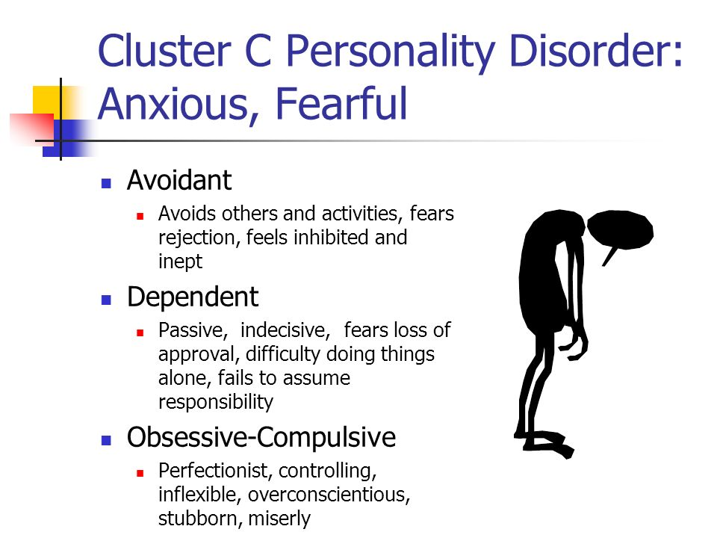

Slide 70
Other Personality Disorder
Personality change due to another medical condition (pg 682/330)
Specify whether: Labile, Disinhibited, Aggressive, Apathetic, Paranoid, Other, Unspecified, or Combined Type
Other Specified/Unspecified Personality Disorder

Slide 71
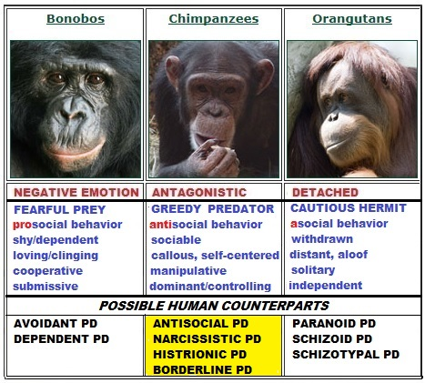

Slide 72
Video Case Study: Gary

Slide 73
Gary
F60.1 Schizoid Personality Disorder

Slide 74
SNL Case Study

Slide 75
Video Case Study
F60.1 Obsessive-Compulsive Personality Disorder
Verse
F42 Obsessive-Compulsive Disorder

