Slide 1

PSY 6669 Behavioral Pathology
Lecture 5
Somatic Symptoms and Related Medical Disorders

Slide 2
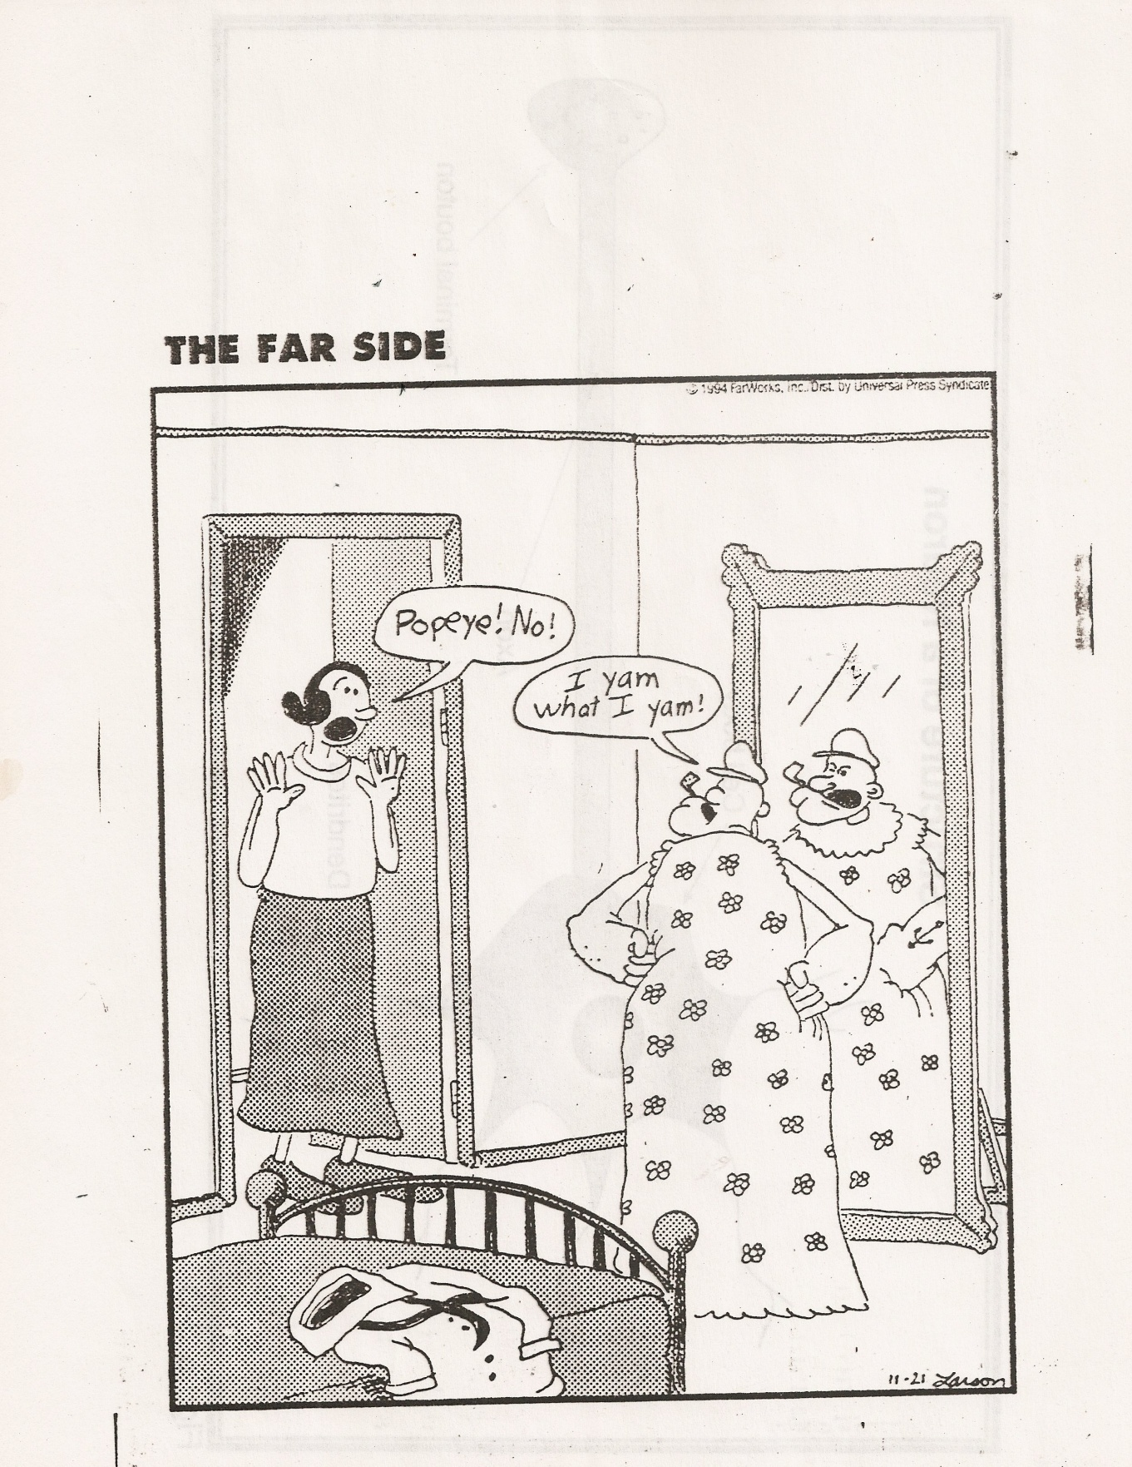

Slide 3
Related Disorders
F45.22 Body Dysmorphic Disorder
F42 Hoarding Disorder
F63.2 Trichotillomania
L98.1 Excoriation (Skin-picking) Disorder
Substance/Medication-Induced OCD
  Specify: With onset during intoxication, withdrawal, or after medication use.
  OCD Related to Another Medical Condition
  Other specified/unspecified OCD (specify)

Slide 4
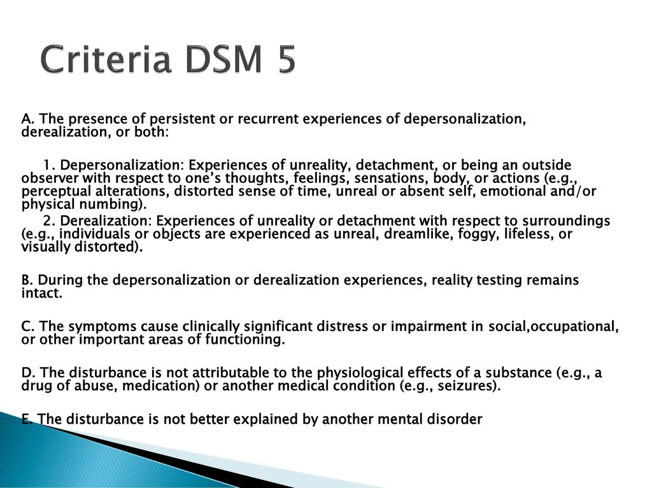

Slide 5
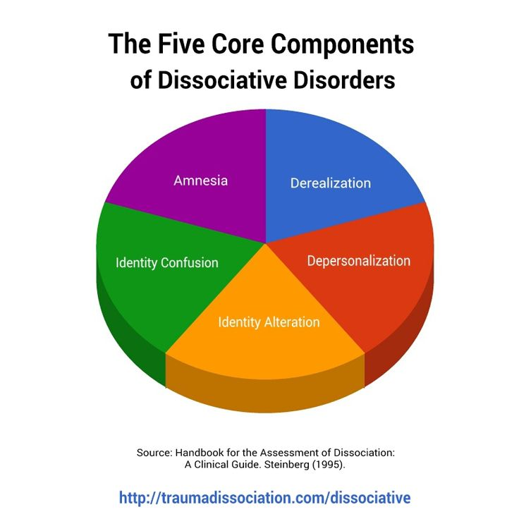

Slide 6
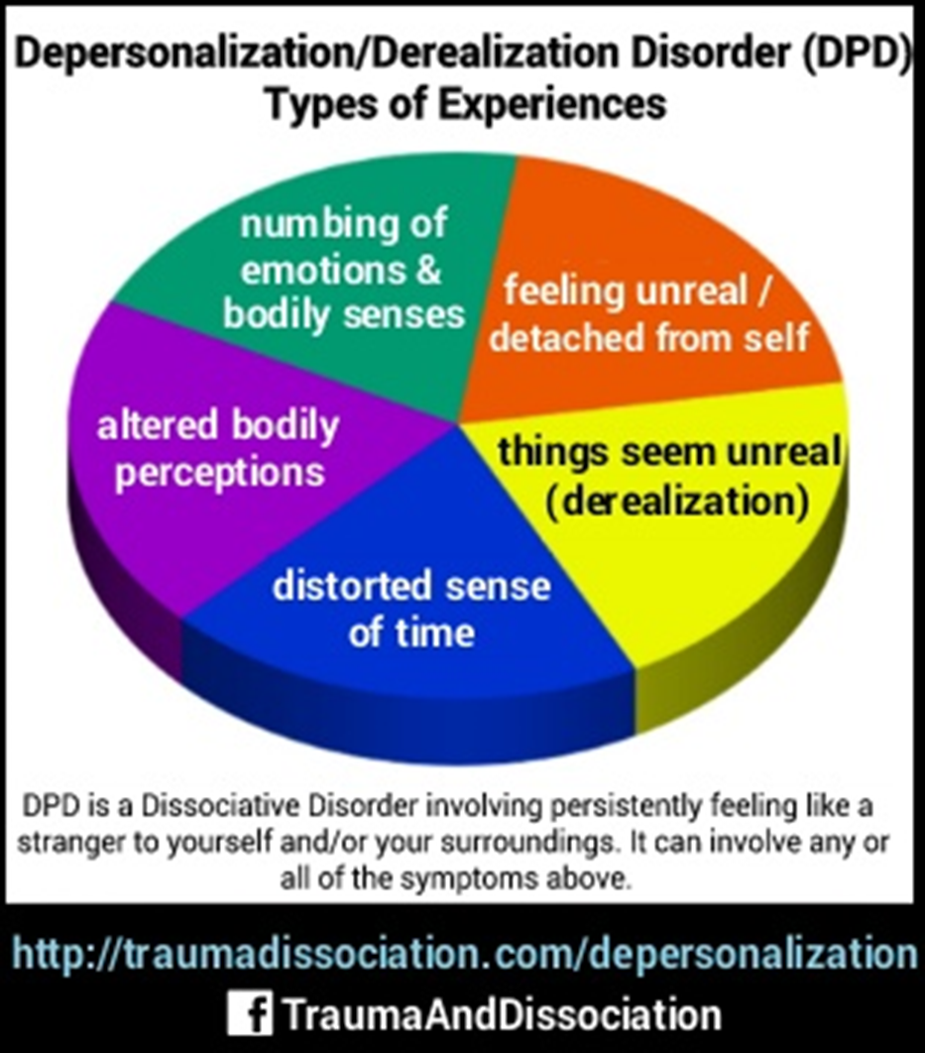

Slide 7
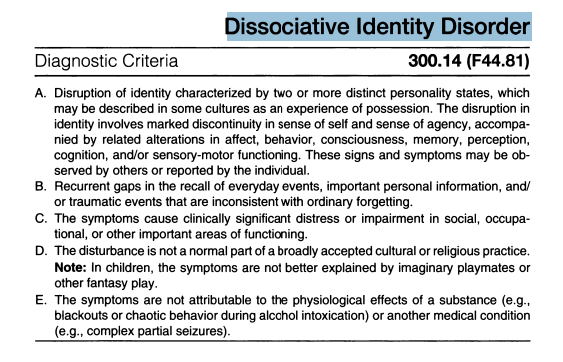
Pg 292/155

Slide 8
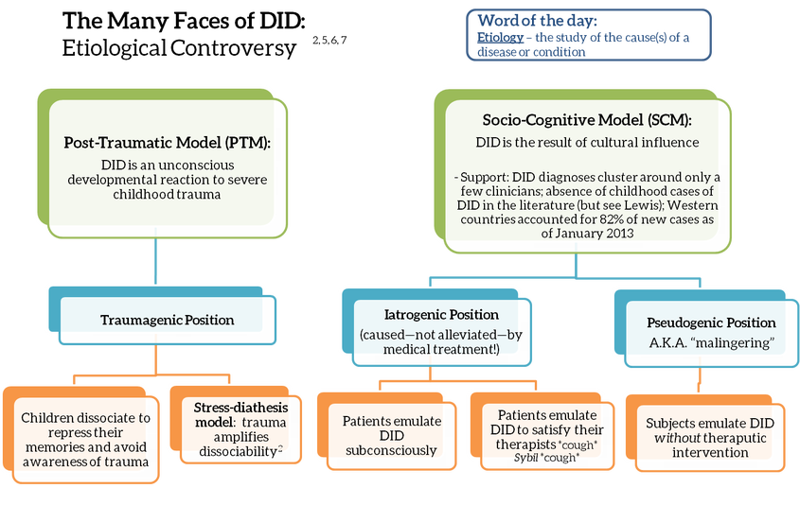

Slide 9
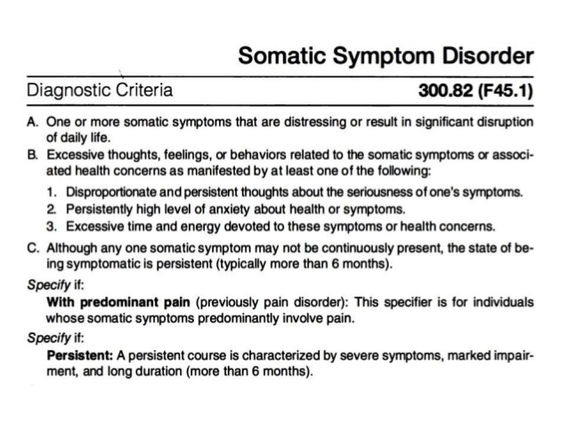
Somatic Symptom and Related Disorders (pg 309/161)

Slide 10
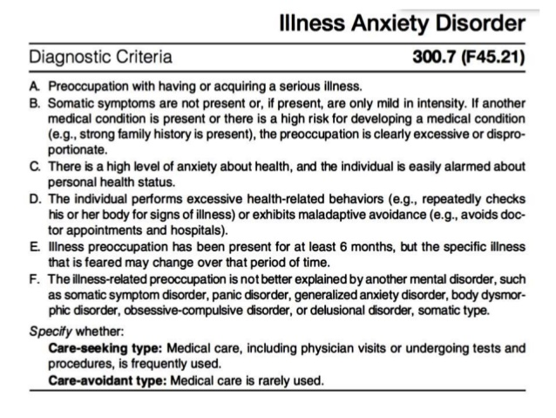
F45.21 Illness Anxiety Disorder
(pg 315/162)

Slide 11
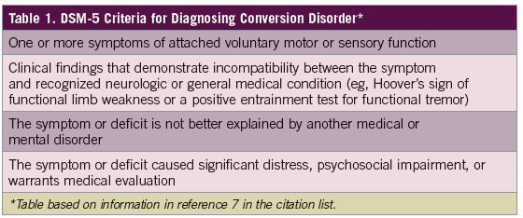
Conversion Disorder

Slide 12
F44.x Conversion Disorder
(pg 318/163)
Specify symptom type: weakness, paralysis, abnormal movement, swallowing, speech, attacks or seizures, anesthesia or sensory loss, with mixed symptoms.
Specify if Acute episode or Persistent
Specify with Psychological Stressor or Without Psychological Stressor

Slide 13
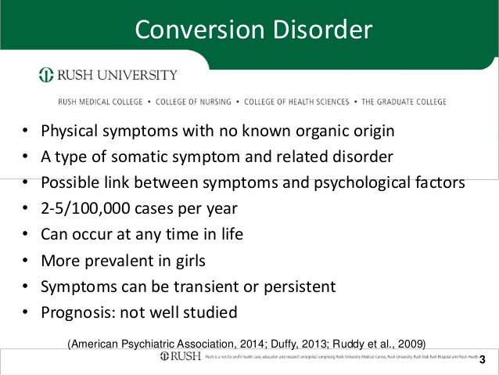

Slide 14
Psychological Factors Affecting Other Medical Conditions
(pg.322/164)
An actual medical symptom or condition is present, But….
Specify current severity: Mild, Moderate, Severe, Extreme (ignoring life threatening risks)

Slide 15
F68.10 Factitious Disorder Imposed on Self (pg 324/165)
Specify : Single episode or Recurrent episodes.
Factitious Disorder Imposed on Another (Previously Factitious Disorder by Proxy)
Specify: Single Episode or Recurrent episodes
Z76.5 Malingering (pg. 726/373)

Slide 16
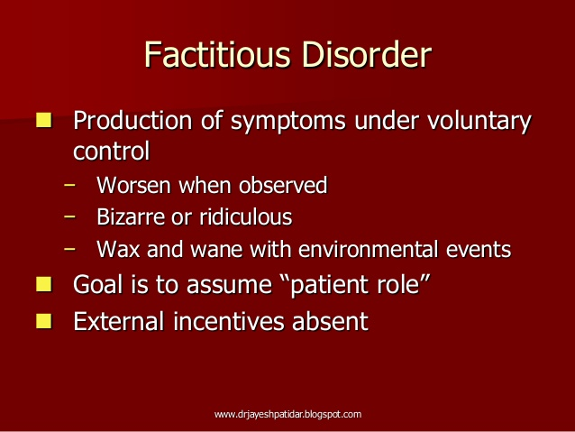

Slide 17
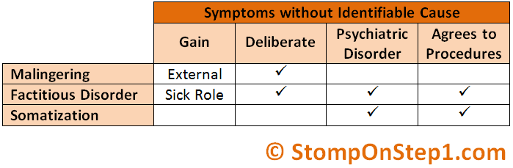
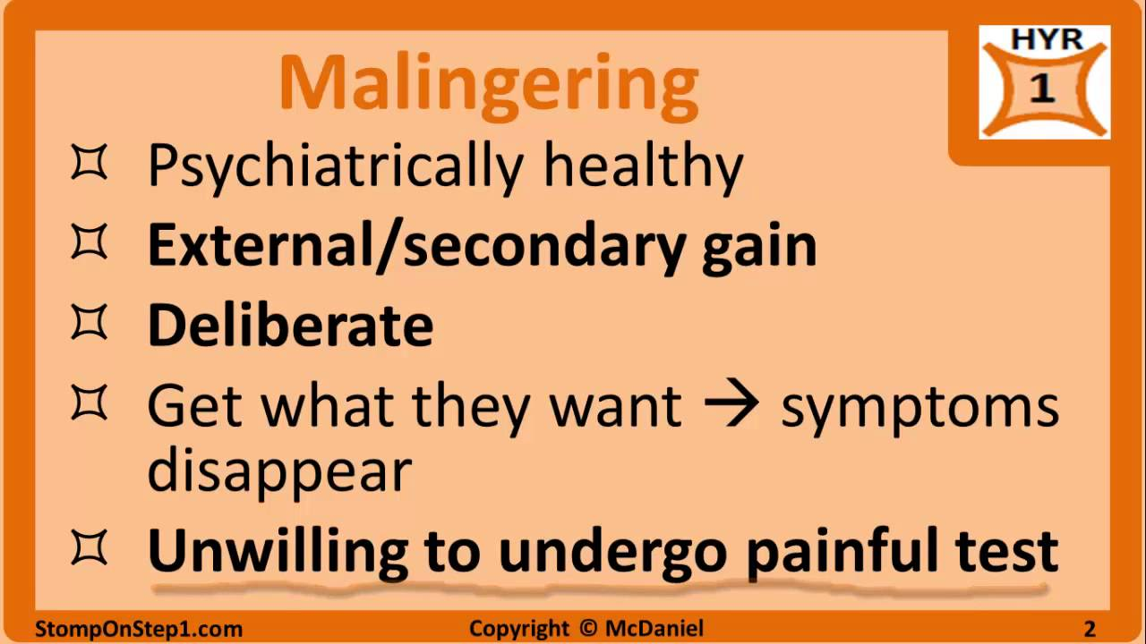

Slide 18
Video Case Study: Joyce

Slide 19
Joyce
F44.6 Conversion Disorder, With special
sensory symptoms, Acute episode,
With psychological stressors (witness
of child sexual abuse)

Slide 20
Feeding and Eating Disorders
(pg 329/169)
Pica (In children and In adults)
Rumination Disorder
Avoidant/restrictive Food Intake Disorder
Anorexia Nervosa
  Specify: Restricting type, Binge-eating/purging type & In partial remission or In full remission
Bulimia Nervosa
  Specify: In partial remission or In full remission
  Specify: Mild, Moderate, Severe, or Extreme

Slide 21

Anorexia Nervosa

Slide 22
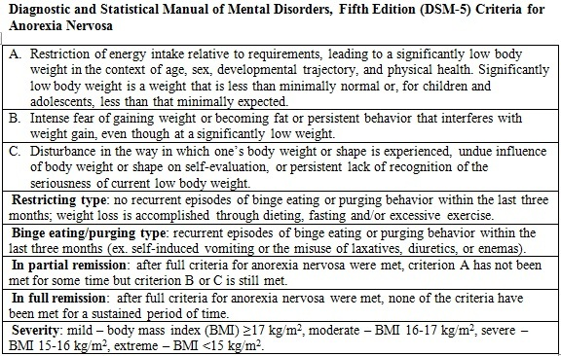
Anorexia Nervosa Pg 338/171

Slide 23
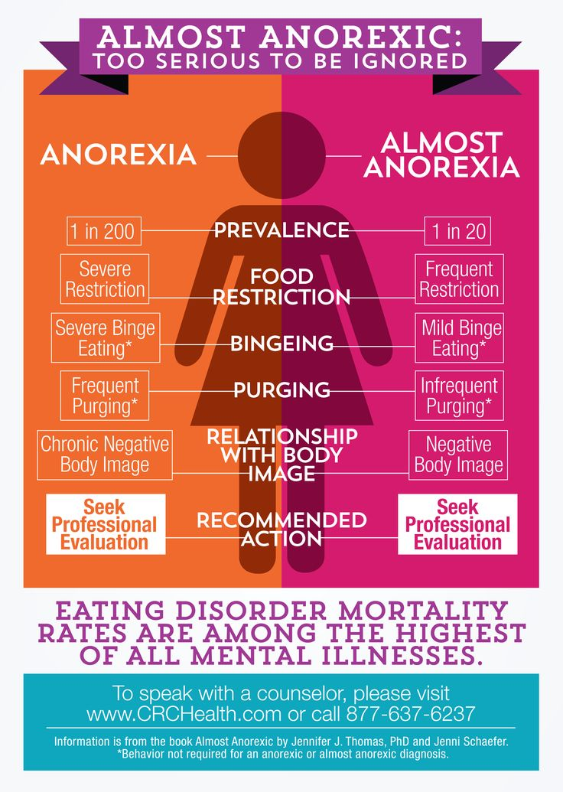

Slide 24
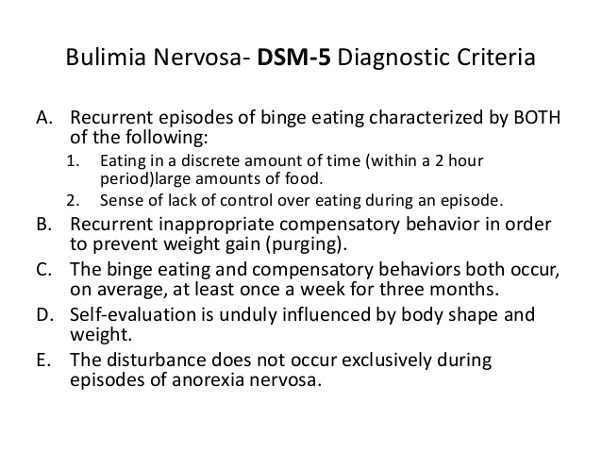
Bulimia Nervosa pg 345/172

Slide 25
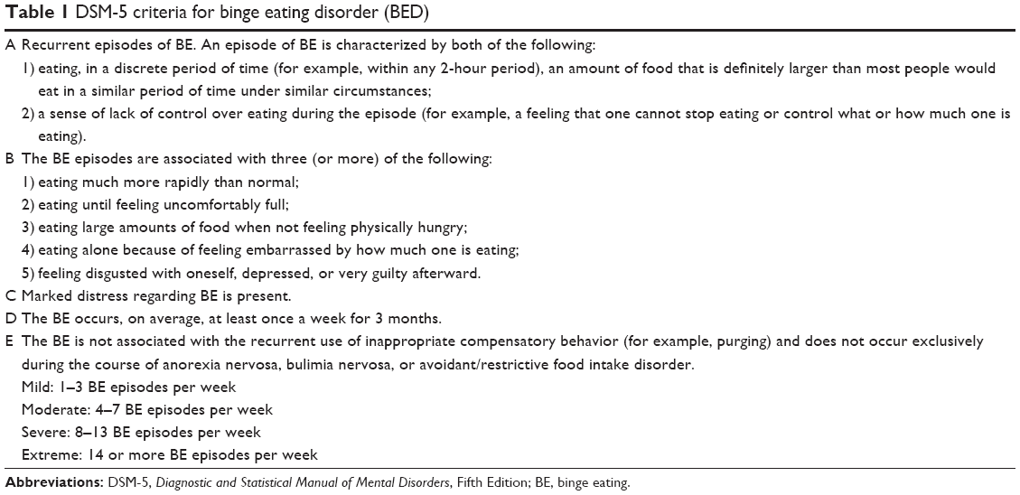
Binge Eating Disorder
(pg. 350/174)

Slide 26
Binge-Eating Disorder (pg. 350/174)
  Specify: In partial remission or In full remission
  Specify: Mild, Moderate, Severe, or Extreme
  Specify: In partial remission or In full remission
  Specify: Mild, Moderate, Severe, or Extreme
Other Specified Feeding or Eating Disorder
  Specify Atypical anorexia nervosa, Low frequency or limited duration Bulimia nervosa or Binge-eating, Purge Disorder, Night eating syndrome
Unspecified Feeding or Eating Disorder

Slide 27
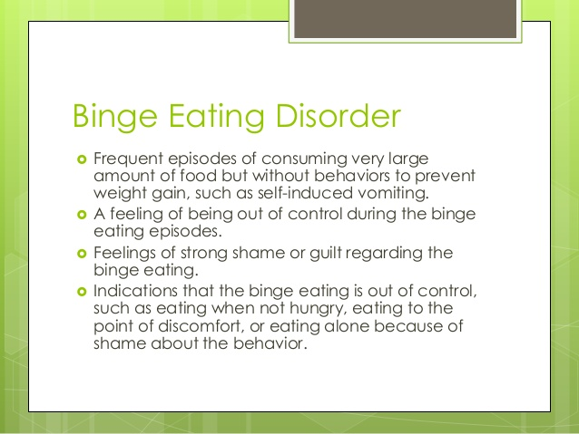

Slide 28
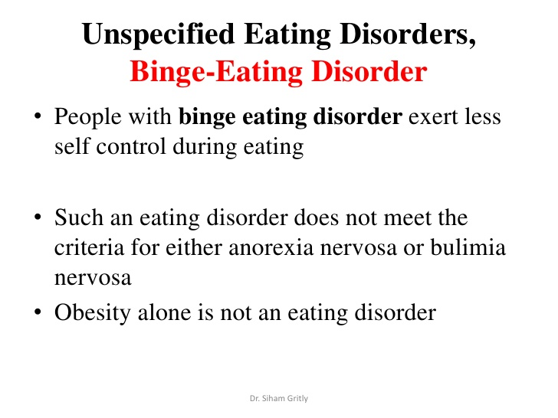

Slide 29
Elimination Disorders
(pg 355/177)
Enuresis, Nocturnal only, Diurnal only, or nocturnal and diurnal
Encopresis, with or without constipation and overflow incontinence
Other Specified Elimination Disorder
Unspecified Elimination Disorder

Slide 30
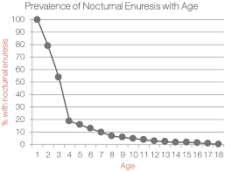

Slide 31
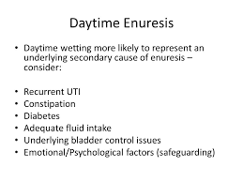

Slide 32
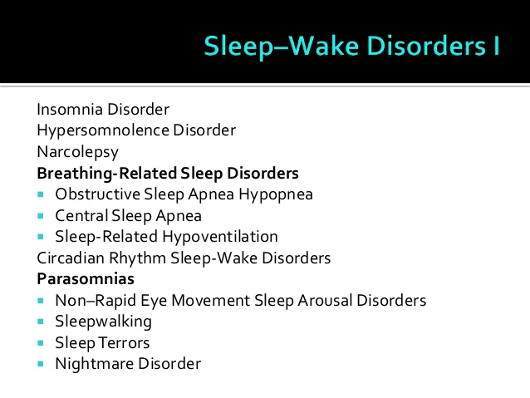

Sleep-Wake Disorders
(pg 361/181)

Slide 33


Slide 34
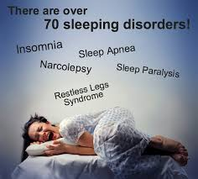

Slide 35
Sleep-Wake Disorders
(pg 361/181)
Insomnia Disorder
Hypersomnolence Disorder
Narcolepsy
  Specify: comorbid medical disorders
  Specify duration
  Specify severity

Slide 36
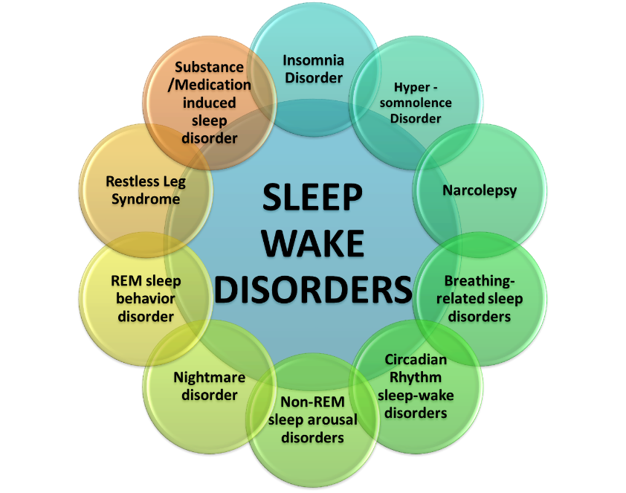

Slide 37
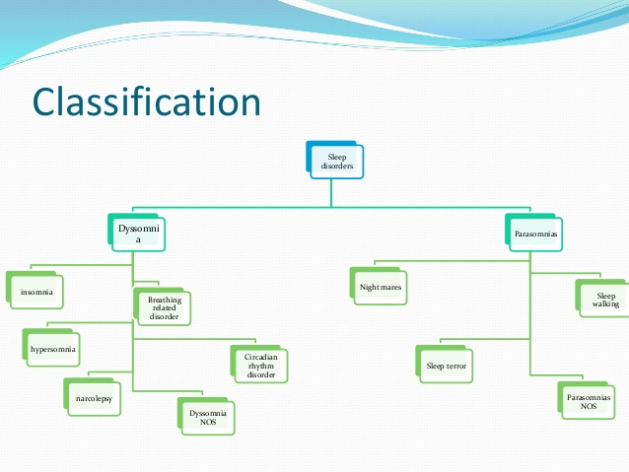

Slide 38
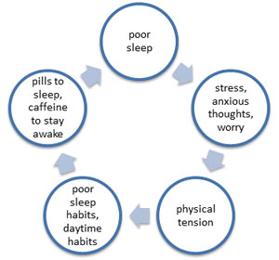
Sleep Disorder Cycle

Slide 39
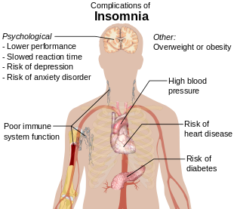

Slide 40
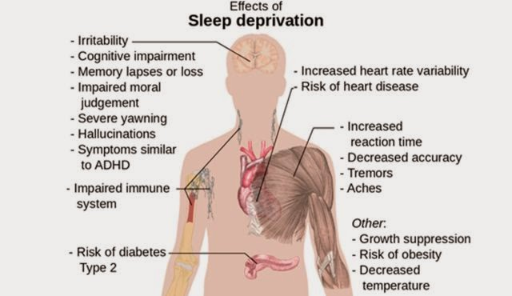

Slide 41
Breathing-related Sleep Disorders (pg 378/186)
Obstructive Sleep Apnea Hypopnea
Central Sleep Apnea
Sleep-related Hypoventilation
Circadian Rhythm Sleep-Wake Disorder

Slide 42
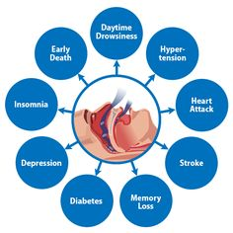
Sleep Apnea

Slide 43
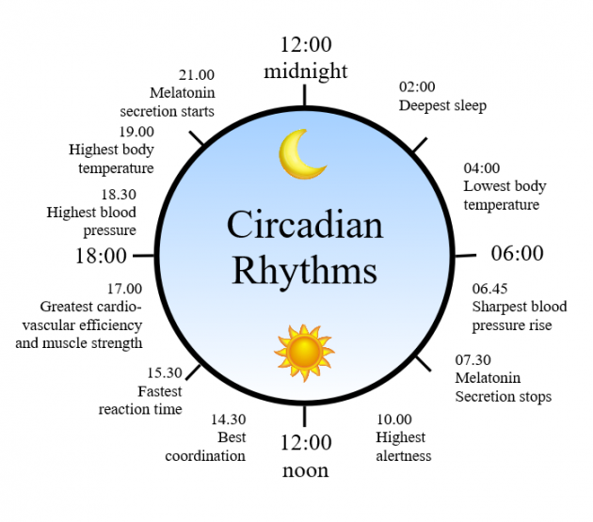

Slide 44
Parasomnias (pg 399/190)
Non-Rapid Eye Movement Sleep Arousal Disorder
Nightmare Disorder
Rapid Eye Movement Sleep Behavior Disorder
Restless Leg Syndrome
Substance/Medication-Induced Sleep Disorder

Slide 45
Other Specified and Unspecified Sleep Disorders (pg 420/197)
Unspecified Insomnia Disorder
Other Specified Hypersomnolence Disorder
Unspecified Hypersomnolence Disorder
Other Specified Sleep-Wake Disorder
Unspecified Sleep-Wake Disorder

Slide 46
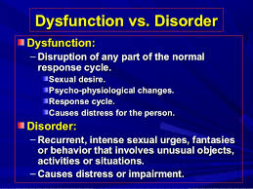
Sexual Diagnosis:

Slide 47
Sexual Dysfunction
(pg 423/201)
Delayed Ejaculation
Erectile Disorder
Female Orgasmic Disorder
Female Sexual Interest/Arousal Disorder
Genito-Pelvic Pain/Penetration Disorder
Male Hypoactive Sexual Desire Disorder
Premature (Early) Ejaculation
Substance/Medication-Induced Sexual Dysfunction
Other Specified or Unspecified Sexual Dysfunction

Slide 48
Sexual Dysfunctions:
Experienced almost all of the time (75-100%)
Duration of at least 6 months.
Specifiers
  Lifelong
  Acquired
  Generalized
  Situational
  Severity: Mild, Moderate, Severe

Slide 49
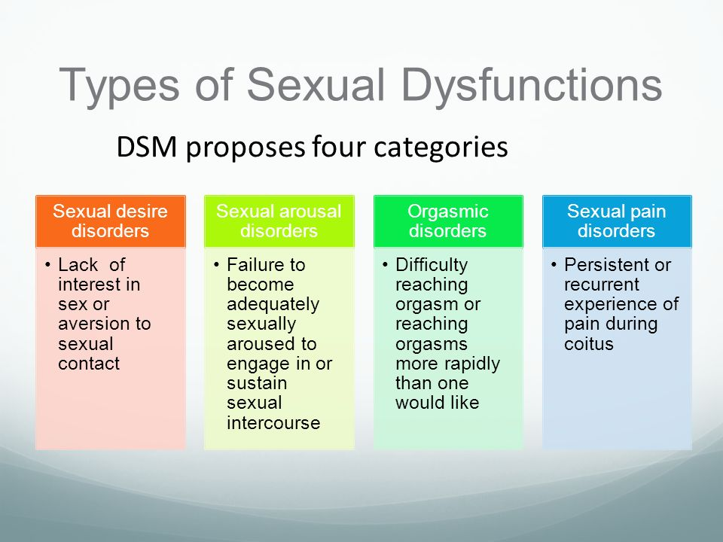

Slide 50
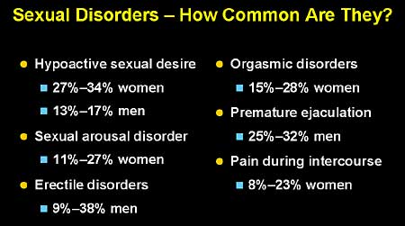

Slide 51
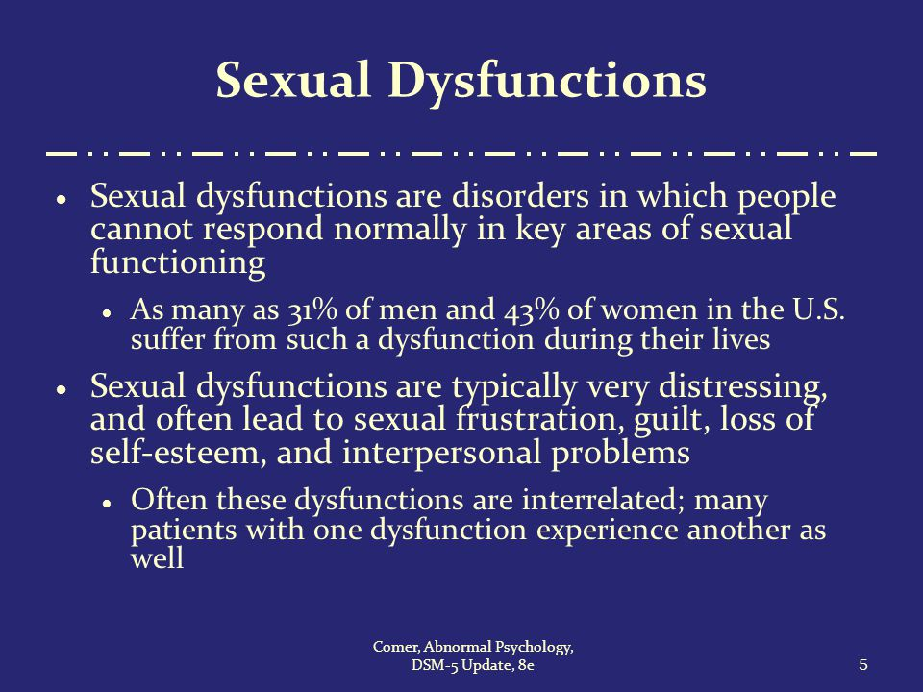

Slide 52
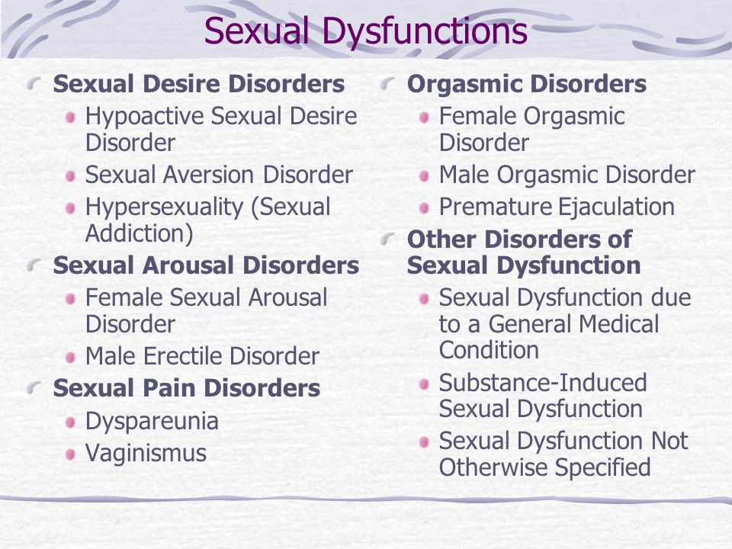

Slide 53
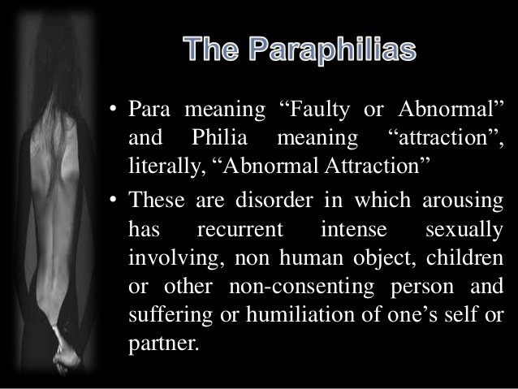

Slide 54
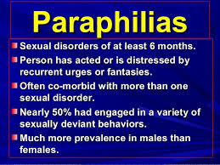

Slide 55
Paraphilic Disorders(pg 685/333)
Voyeuristic Disorder
Exhibitionistic Disorder
Frotteuristic Disorder
Sexual Sadism Disorder
Fetishistic Disorder
Transvestic Disorder
Other Specified Paraphilic Disorder
Unspecified Paraphilic Disorder

Slide 56
Paraphilic Disorders
Duration of at least 6 months
Specifier: In controlled environment.
Specifier: In full remission: At least 5 years while in an uncontrolled environment.
Pedophilic Disorder has NO In remission specifier.

Slide 57
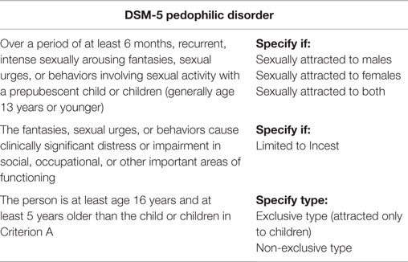

Slide 58
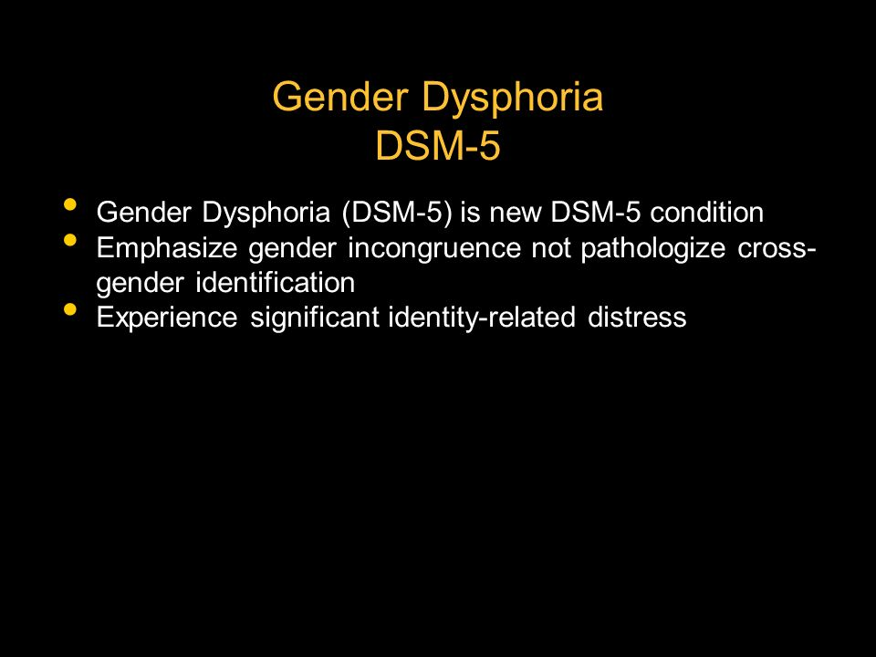

Slide 59
Gender Dysphoria (pg. 451/215)
Gender Dysphoria in Children
Specify: with a disorder of sex development
Gender Dysphoria in Adolescents and Adults
Specify: with a disorder of sex development
Specify: Post transitional
Other Specified Gender Dyshoria
Other Unspecified Gender Dysphoria

Slide 60
Homework
Case Study # 4

