Slide 1

PSY 6669 Behavioral Pathology
Lesson 4
Mood & Anxiety Disorders

Slide 2
Bipolar and Related Disorders (pg xiii and123/65)
F31.xx Bipolar I Disorder
F31.81 Bipolar II Disorder
F34.0 Cyclothymic Disorder
Bipolar and Related Disorder Due to Another Medical Condition

Slide 3
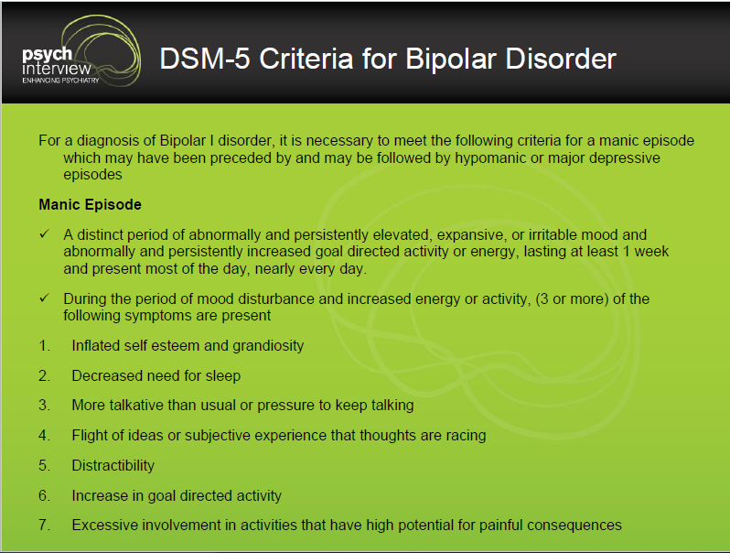

Slide 4
Manic Episode (pg 124/65)
Lasts at least one week (7 days) *
Increased energy or activity
Decreased need for sleep (3 or less hours)
Excessive involvement in potentially damaging activities

Slide 5
Hypomanic episode
(pg 124/66)
Distinct period of abnormally and persistently elevated, expansive, or irritable mood and persistently increased activity or energy, lasting at least 4 days and present most of the day, nearly everyday, BUT the episodes are not severe enough to cause marked impairment in functioning (criteria E.)

Slide 6
Cyclothymic Disorder (139/76)
For 24 months (12 months for Children and Adolescents) hypomanic and depressive symptoms.
Never Diagnosed with Bipolar I, Bipolar II, or Major Depressive Disorder.

Slide 7
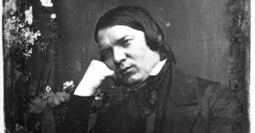
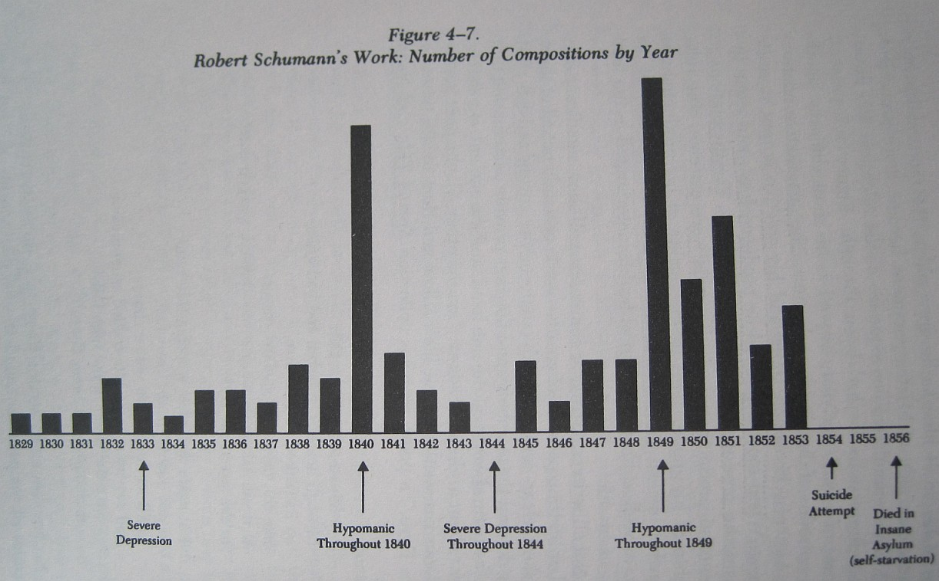
Manic “Productivity”

Slide 8
Specifiers (pg 149/83)
With anxious distress
With mixed features
With Rapid cycling (4-6 episodes per year)
With melancholic features
With atypical features
With mood-congruent psychotic features
With mood-incongruent psychotic features
With catatonia
With peripartum onset
With seasonal pattern

Slide 9
Example:
F31.2 Bipolar I Disorder, Most recent
episode manic, Severe, With
      mood-congruent psychotic features,
      With rapid cycling

Slide 10
Treatment of Bipolar
Mood Stabilizers
Antipsychotic Medication to address severe manic symptoms
Antidepressants as required
Substance abuse counseling/treatment

Slide 11
Depressive Disorders
(pg xv and 155/93)
F34.8 Disruptive Mood Dysregulation Disorder
F32.x Major Depressive Disorder, Single episode, (Severity) (pg 160/94)
F33.x Major Depressive Disorder, Recurrent episodes, (Severity)
F34.1 Persistent Depressive Disorder
  (previously: Dysthymia)

Slide 12
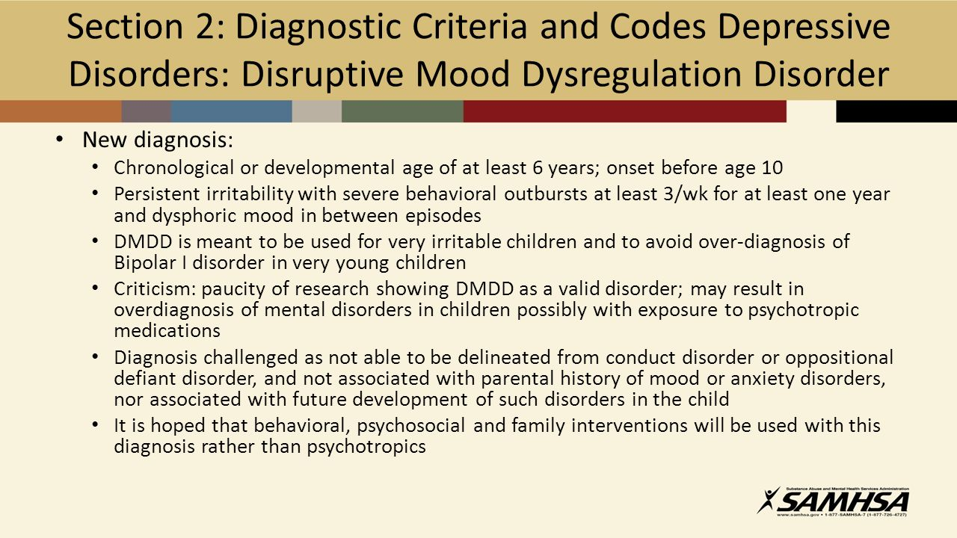

Slide 13
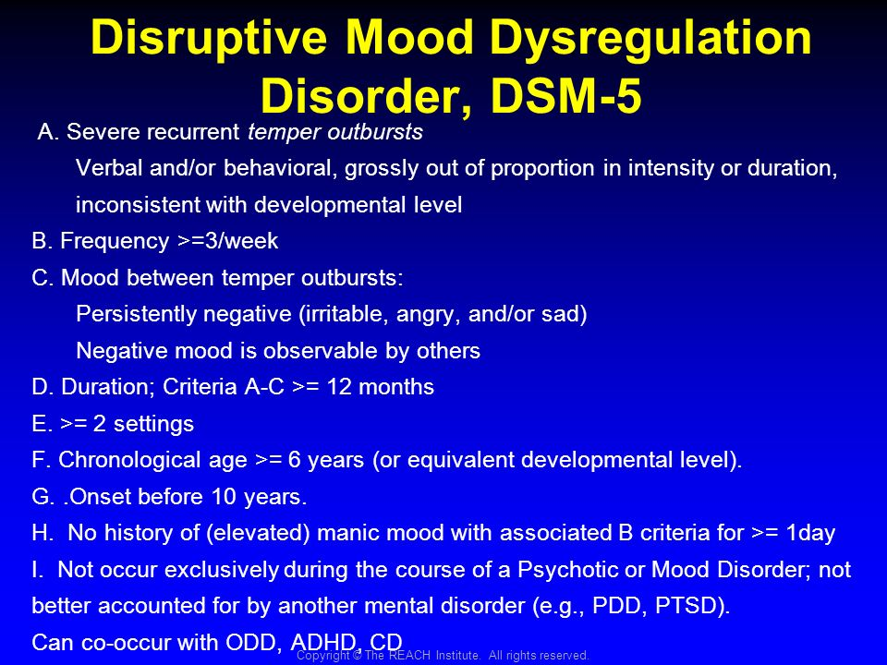

Slide 14
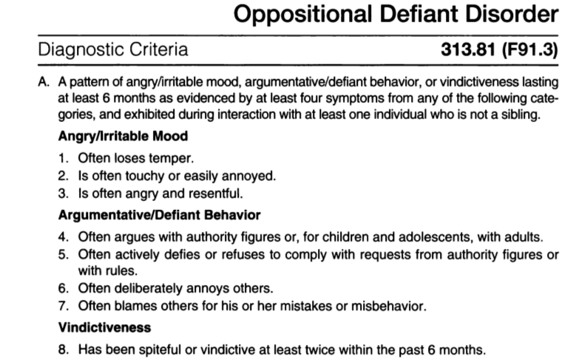

Slide 15
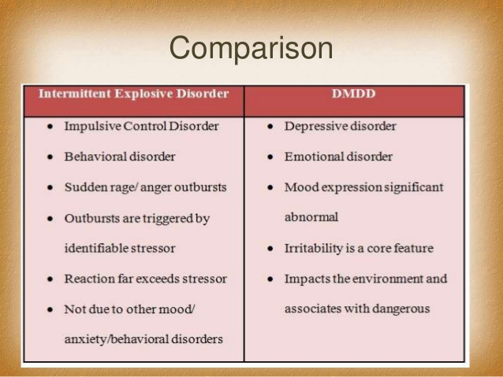

Slide 16
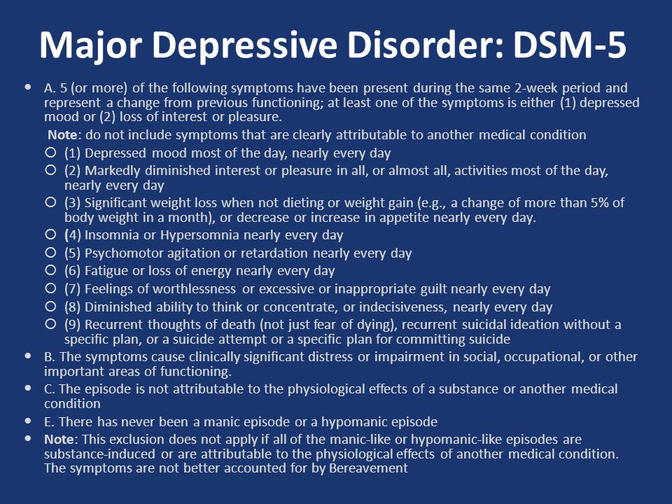

Slide 17

Major Depressive Episode
(pg. 133/67) (pg. 160/95)
Five or more symptoms for Two Weeks
Including: Depressed Mood OR Loss of interest or pleasure plus 4 other symptoms.

Slide 18
Specifiers (pg xvi and 149/83)
With anxious distress
With mixed features
With Rapid cycling (4-6 episodes per year)
With melancholic features
With atypical features
With mood-congruent psychotic features
With mood-incongruent psychotic features
With catatonia
With peripartum onset
With seasonal pattern

Slide 19
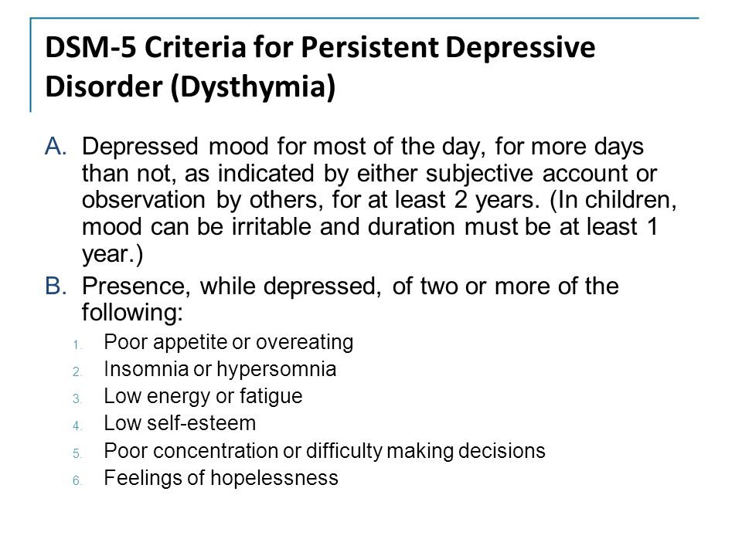

Slide 20
Persistent Depressive Disorder
(pg 168/97)
Depressed mood for more days than not for 24 months (12 months for child/adolescent).
Specify:
With pure dysthymic syndrome.
With persistent major depression episode.
With intermittent major depressive episodes with/without current episode.

Slide 21
Depressive Disorder (pg171/100)
N94.3 Premenstrual Dysphoric Disorder
Substance/medication-Induced Depressive Disorder (pg 103)
Depressive Disorder Due to Another Medical Condition
Other Specified/Unspecified Depressive Disorder

Slide 22
Depression, most common diagnosis in out patient Tx.
Usually a syndrome (500+ combinations)
Endogenous vs. Exogenous
Primary or Secondary Depression
Unipolar vs. Bipolar

Slide 23
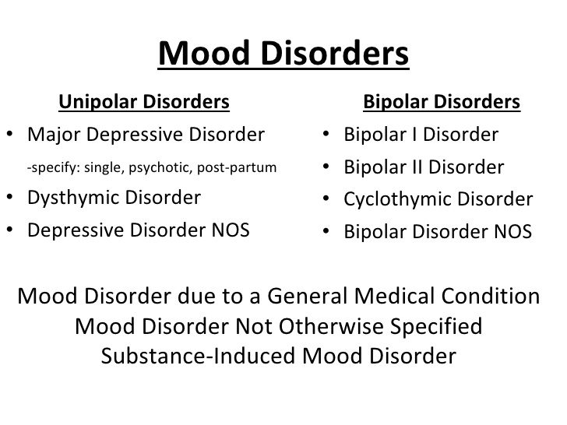
Depression Related Terms
Melancholic & Psychotic Features
Masked Depression
Pseudo-dementia

Slide 24

Minister for Loneliness
Jan. 2018 UK appoints a Minster for Loneliness to the PM Cabinet.
Loneliness affects 9 Million citizens in UK.
2nd leading cause of death, between smoking and obesity.
Loneliness is “equivalent” to smoking 15 cigarettes per day.
Loneliness costs UK an estimated 1.5 Billion Pounds per year.

Slide 25
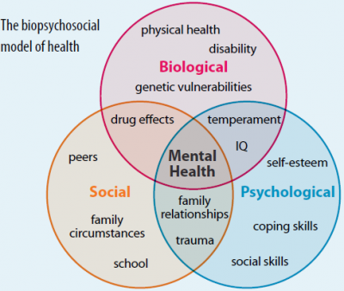
Depression - etiology
Biochemical Theories/Genetics
Psychosocial Theories
Biopsychosocial Theory

Slide 26
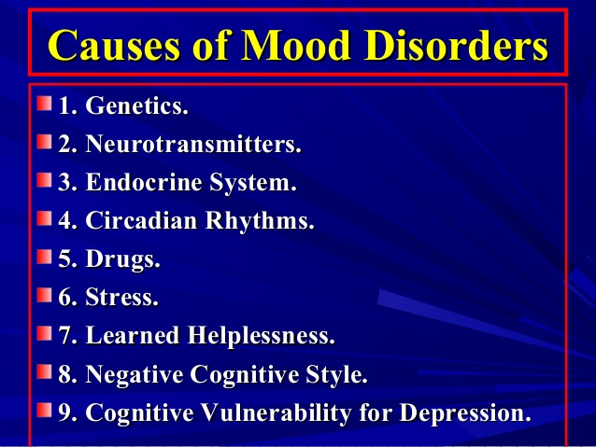

Slide 27
Video Case Study: Jerry

Slide 28
Jerry
F31.4 Bipolar I Disorder, Most recent episode
depressed, Severe, With melancholic
features

Slide 29
Treatment of Depression
Monoamine-Oxidase Inhibitors (MAOI’s)
Tricyclic Antidepressants (TCA’s)
Selective Serotonin Reuptake Inhibitors (SSRI,s)
Electroconvulsive Therapy (ECT)
Cognitive-Behavioral Therapy
Family involvement & support
Education
Suicide assessment & prevention

Slide 30
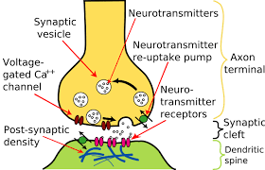
Biochemical Theory

Slide 31
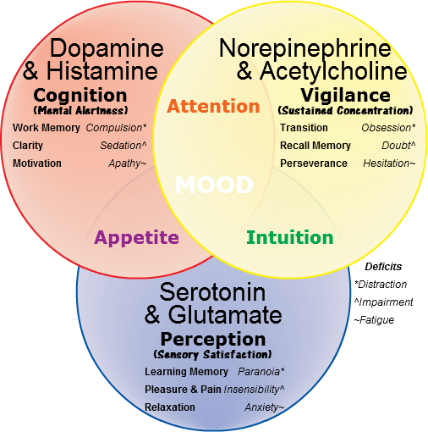
Neurotransmitters:

Slide 32
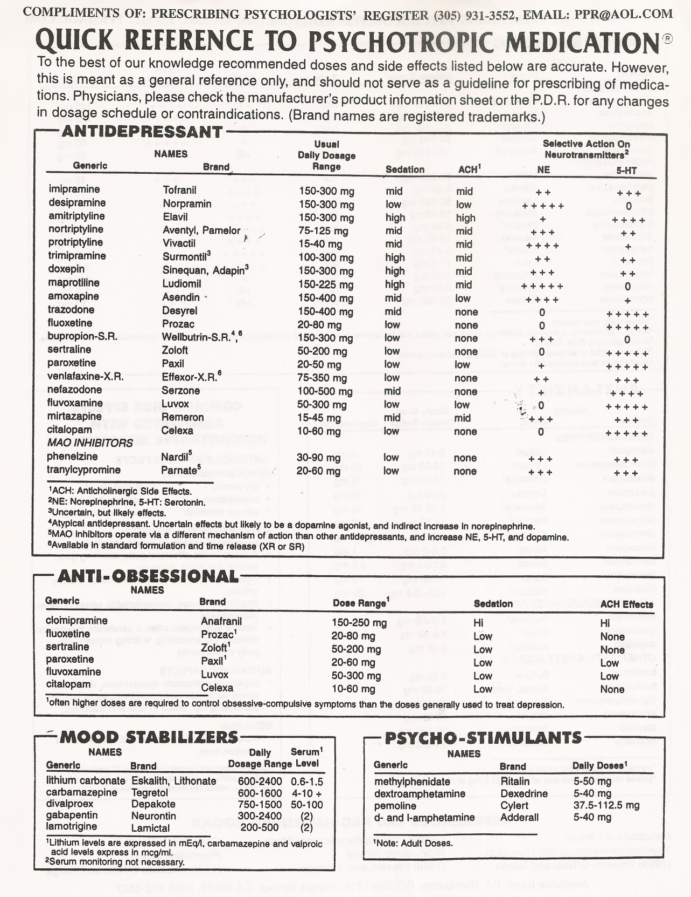

Slide 33
Ketamine
Ketamine (anesthesia and “club” drug) in the treatment of severe major depression. Usually administered IV as an ER treatment for suicidal ideations.
NOT FDA approved at this point, although initial results demonstrated an 85% success rate.

Slide 34
Nasal Spray for Depression
Janssen Pharmaceuticals has developed a nasal spray Esketamine. Especially beneficial for older patients with persistent depression. FDA in now reviewing the medication in the fast-tracking approval process.

Slide 35
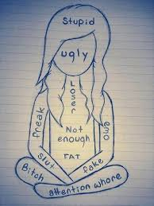
Suicide

Slide 36
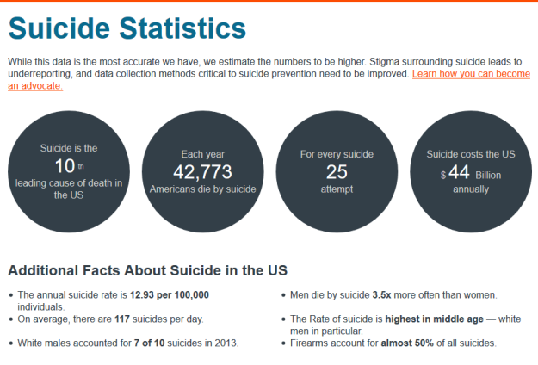

Slide 37
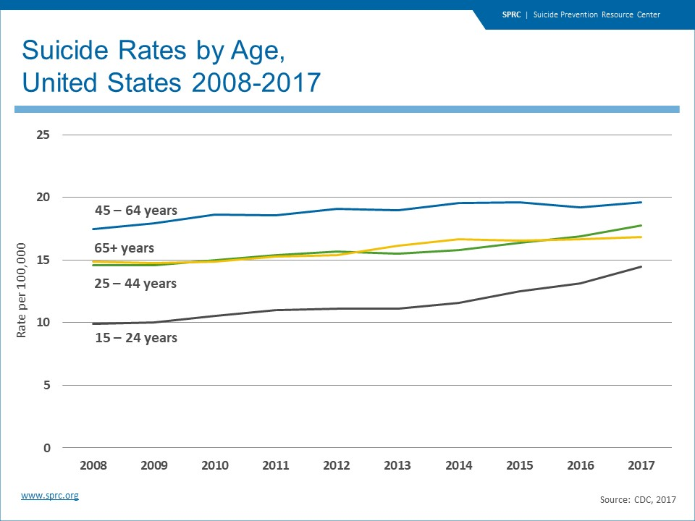

Slide 38
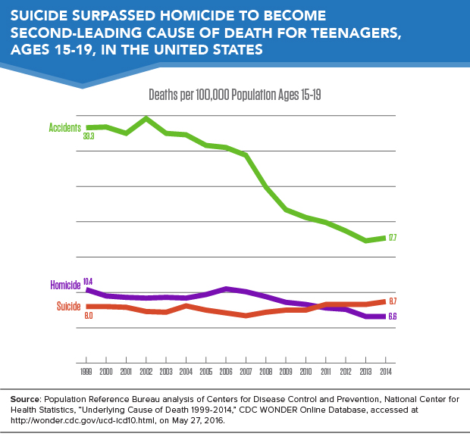

Slide 39
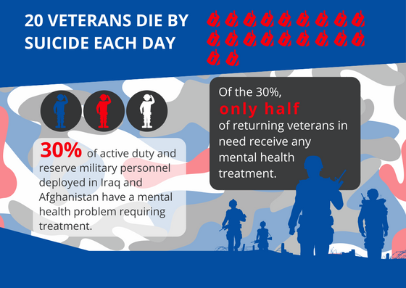
Suicide and the Military

Slide 40
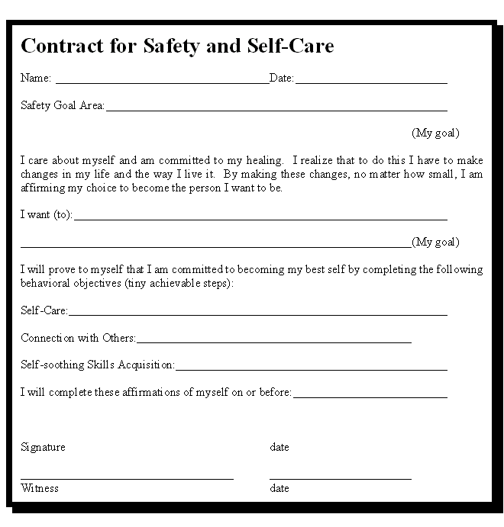
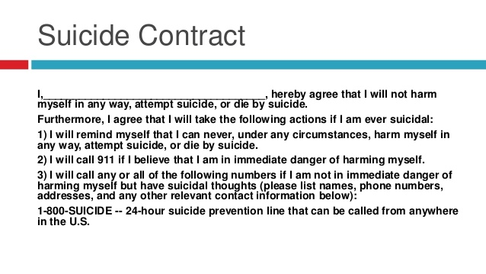

Slide 41
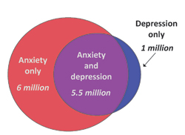
Depression & Anxiety

Slide 42
Anxiety Disorders (pg 189/115)
Separation Anxiety Disorder
Selective Mutism
Specific Phobia
Social Anxiety Disorder
Panic Disorder
Agoraphobia
Generalized Anxiety Disorder
Substance-Induced Anxiety Disorder
Anxiety Related to Another Medical condition
Others specified/unspecified Anxiety Dx

Slide 43
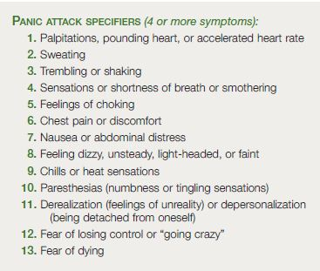
Panic Attacks (pg. 214/120)

Slide 44
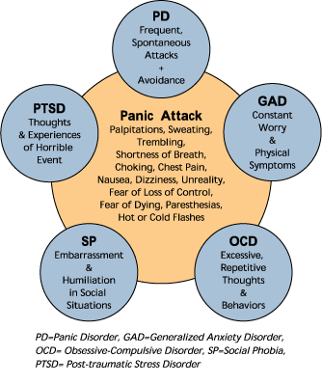
Anxiety Disorders

Slide 45
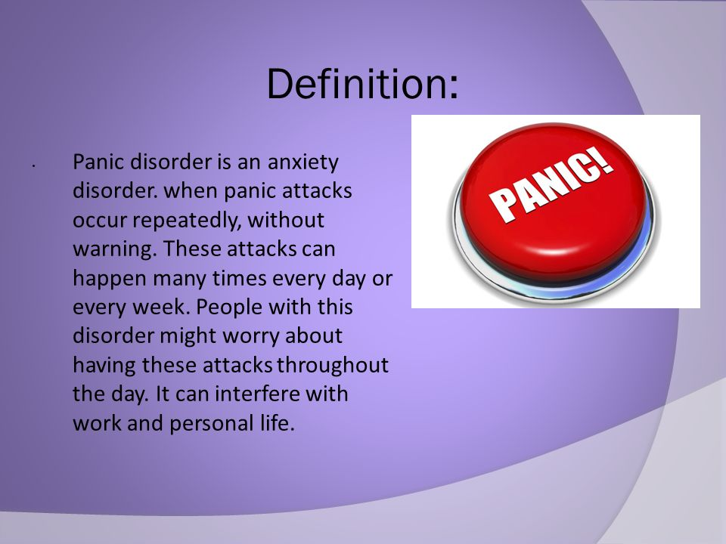

Slide 46
Separation Anxiety Disorder
(pg 190/115)
Developmentally inappropriate and excessive fear or anxiety concerning separation from those whom the individual is attached.
Fear or anxiety persists for 4 weeks for children and adolescents; 6 months for adults.

Slide 47
Selective Mutism (195/116)
Consistent failure to speak in Specific social situations despite speaking in other situations.

Slide 48
Specific Phobia (197/116)
F40.218 Specific Phobia, Animals
F40.228 Specific Phobia, Natural environment
F40.23x Specific Phobia, Blood-injection-injury
F40.248 Specific Phobia, Situational
F40.298 Specific Phobia, Other
NOTE: When more than one phobic stimulus is present, code ALL types.

Slide 49
Social Anxiety Disorder
(pg. 202/118)
Marked fear or anxiety about one or more social situations in which the individual is exposed to possible scrutiny by others.
Specify if : Performance only

Slide 50
Panic Disorder (208/119)
Recurrent and Unexpected Panic Attacks.
At least one of the attacks has been followed by one month of persistent concern about additional attacks OR significant maladaptive changes in behavior related to the attacks.

Slide 51
Agoraphobia (217/121)
Marked fear or anxiety about two or more specific situations.
Individual fears or avoids these situations.
Typically lasting 6 months or more.

Slide 52
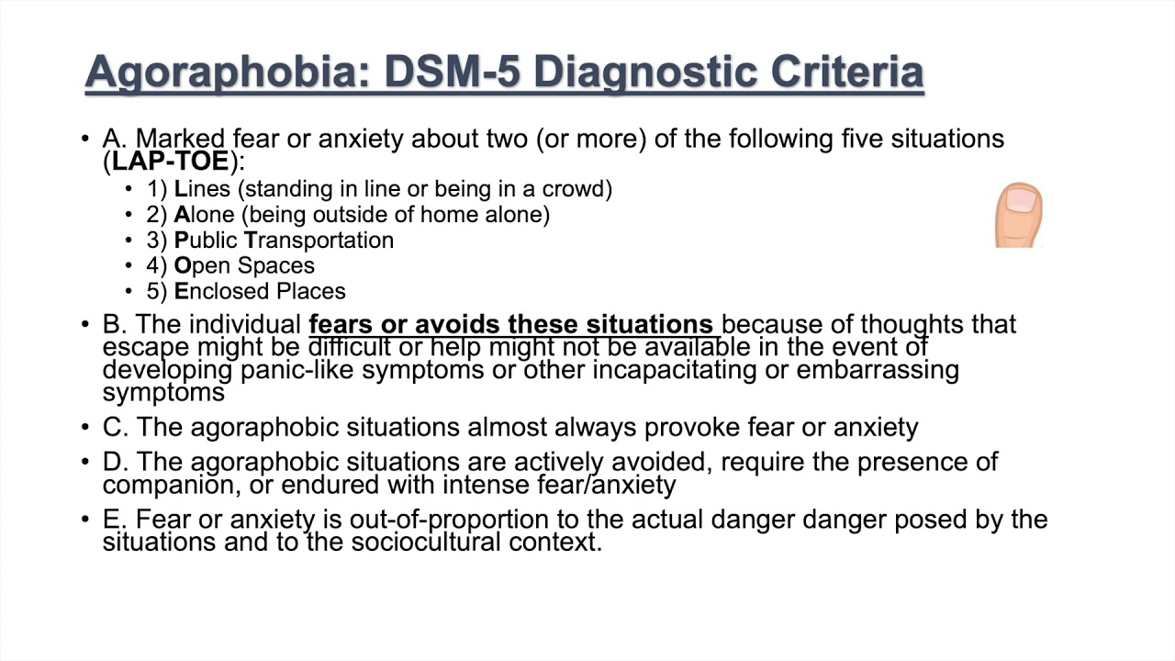

Slide 53
Generalized Anxiety Disorder
(pg. 222/122)
Excessive anxiety and worry more days than not for at least 6 months.
The individual finds it difficult to control the worrying.
Three or more: Restlessness, Easily fatigued, Difficulty concentrating, Irritability, Tension, or Sleep disturbance.

Slide 54
Substance Induced Anxiety
Disorder (226/123-125)
Symptoms develop during or soon after substance intoxication or withdrawal.
Examples:
F10.280 Alcohol Induced Anxiety Disorder, Moderate, with onset during withdrawal
F15.280 Amphetamine Induced Anxiety Disorder, Severe, with onset during intoxication

Slide 55
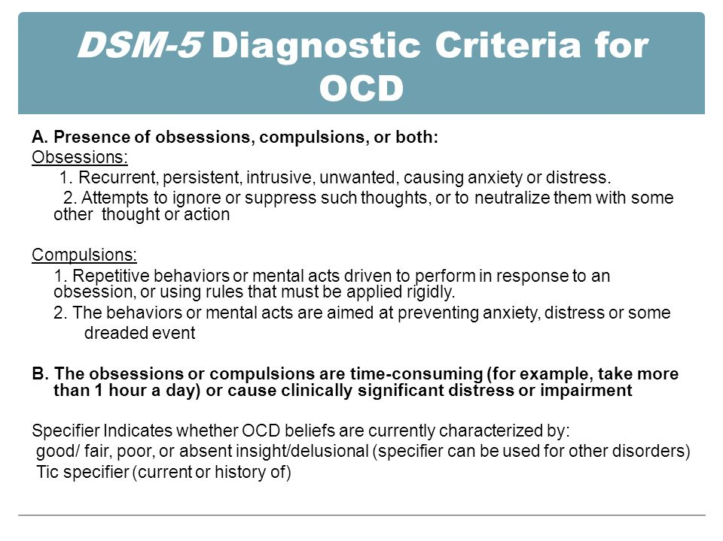
Obsessive-Compulsive and Related Disorder (pg 235/129)

Slide 56
Obsessive-Compulsive and Related Disorder (pg 235/129)
F42 Obsessive-Compulsive Disorder
  Specify: With good or fair insight
  : With poor insight
  : With absent insight/delusional beliefs
  Specify: Tic-related

Slide 57
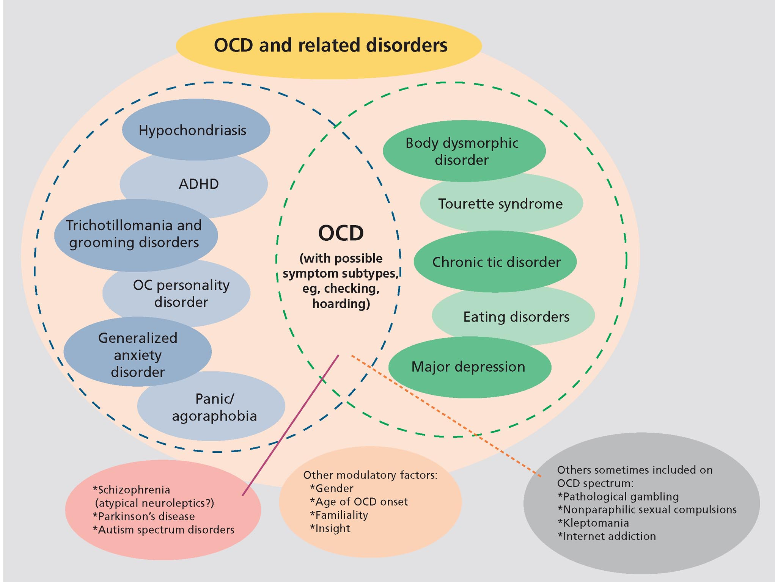

Slide 58
Related Disorders
F45.22 Body Dysmorphic Disorder
F42 Hoarding Disorder
F63.2 Trichotillomania
L98.1 Excoriation (Skin-picking) Disorder
Substance/Medication-Induced OCD
  Specify: With onset during intoxication, withdrawal, or after medication use.
  OCD Related to Another Medical Condition
  Other specified/unspecified OCD (specify)

Slide 59
Body Dysmorphic Disorder
(pg. 242/131)
F45.22, Body Dysmorphic Disorder,
Specify : With muscle dysmorphia
Specify:
with good or fair insight.
with poor insight
with absent insight/delusional beliefs

Slide 60
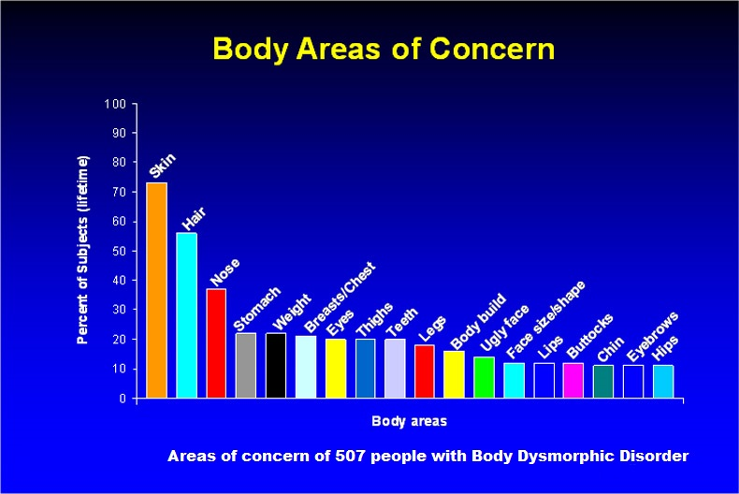

Slide 61
F42 Hoarding Disorder (pg247/132)
  Specify: with excessive acquisitions
  Specify: degree of insight
F63.3 Trichotillomania (251/133)
L98.1 Excoriation Disorder (254/133)
Substance Induced Obsessive-Compulsive Disorder (257/134)

Slide 62
Trauma and Stressor Related Disorders (pg 265/141)
Reactive Attachment Disorder
Disinhibited Social Engagement Disorder
Posttraumatic Stress Disorder
Acute Stress Disorder
Adjustment Disorders
  Specify: With Depressed Mood, With Anxiety, With Mixed anxiety and depressive Mood, With Mixed disturbance of emotions and conduct, or Unspecified

Slide 63
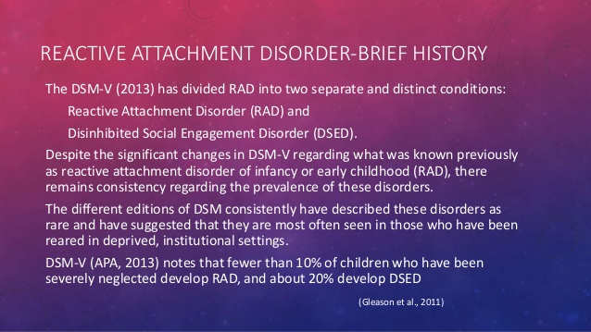

Slide 64
F94.1 Reactive Attachment Disorder,
F94.2 Disinhibited Social Engagement Disorder
For Both:
  Specify : Persistent
  Specify: Severity

Slide 65
Posttraumatic Stress Disorder
(pg. 271/143)
Adults, adolescents, and children older that 6 years of age.
1. Exposure to a Trauma
2. Intrusion Symptoms (re-experiencing)
3. Avoidance of traumatic stimuli
4. Negative alterations of cognition or
mood.
5. Marked alterations in arousal (anxiety
symptoms)

Slide 66
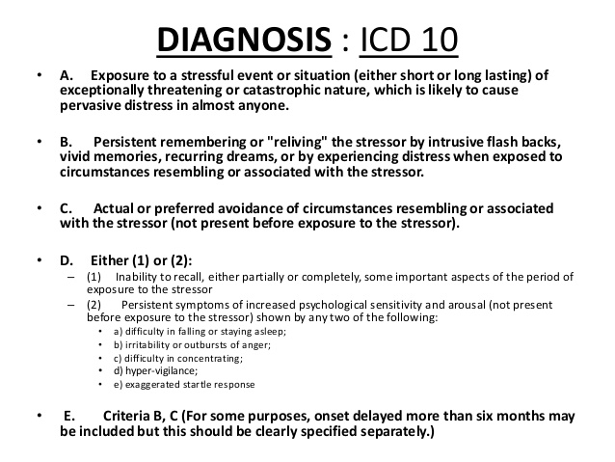

Slide 67
PTSD of children 6 years and younger
1. Experience a traumatic event
2. One or more intrusion symptoms
3. One or more avoidance behaviors or
negative alterations in cognition.
Specify: with dissociative symptoms
Specify: with delayed expression

Slide 68
Acute Stress Disorder (280/149)
1. Exposure to a traumatic event
2. Nine or more related symptoms or
behaviors.
3. Duration of 3 days but less than 30.

Slide 69
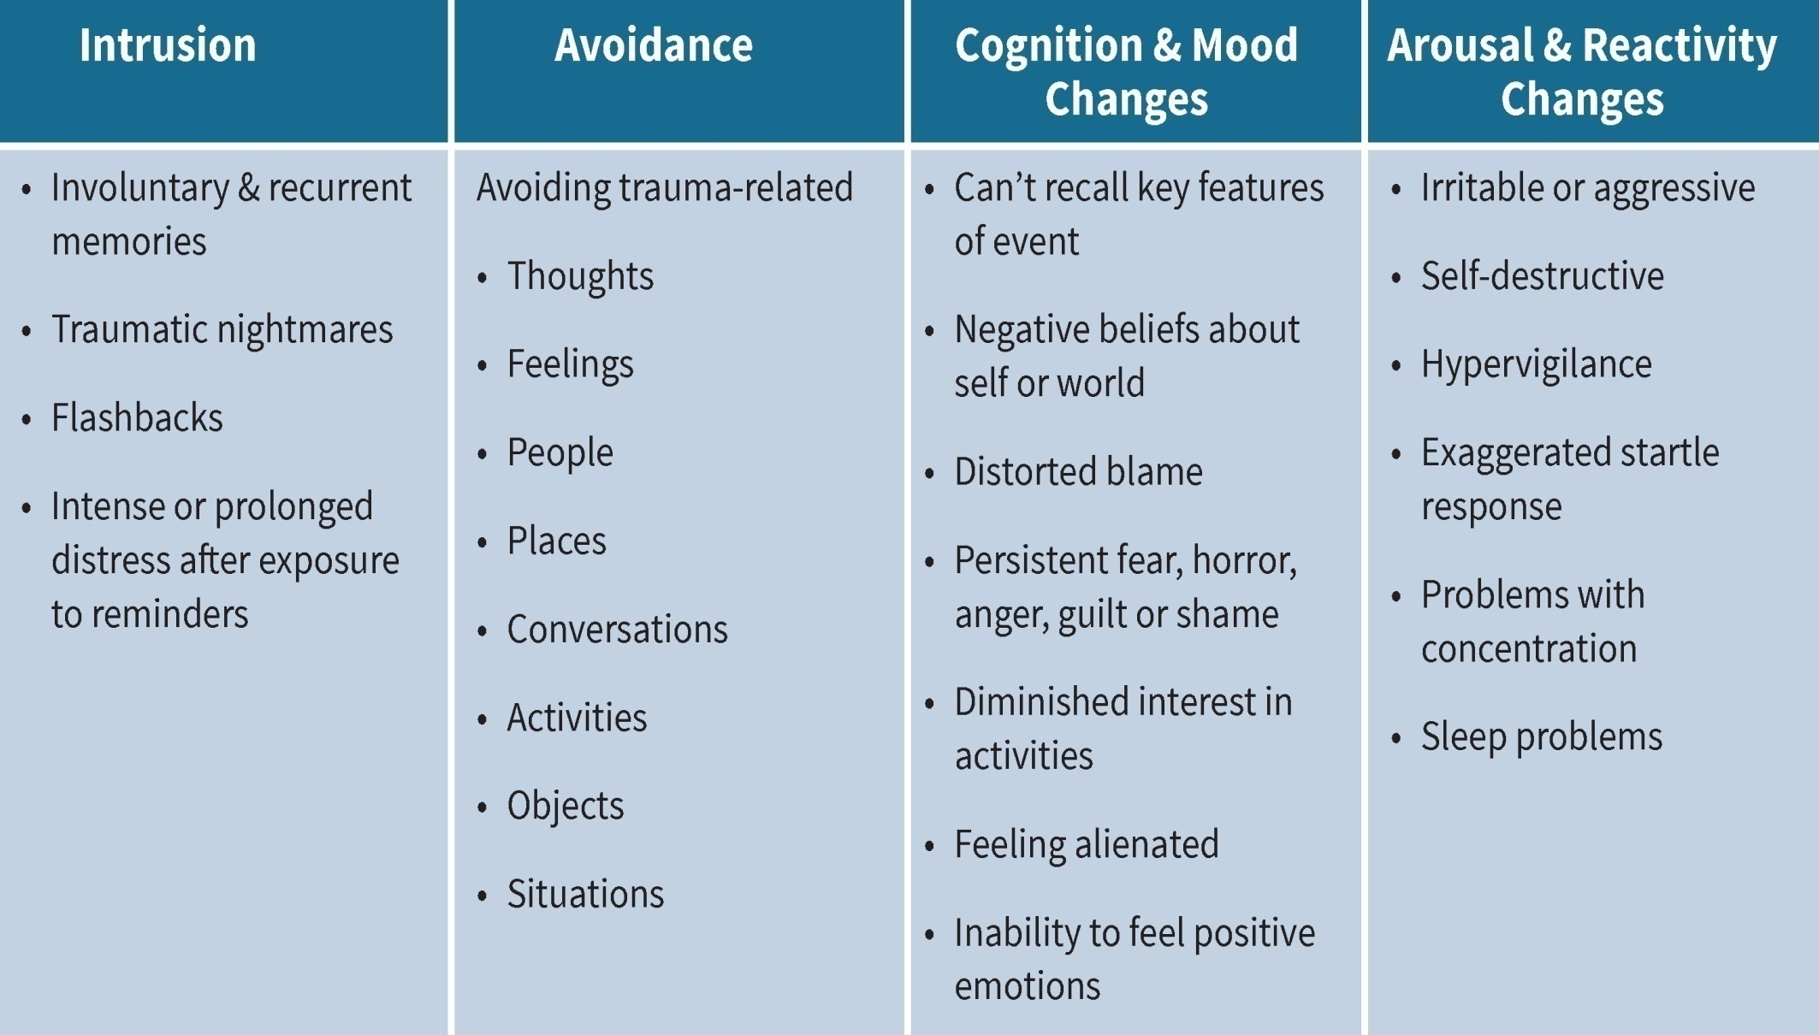
Post-Traumatic Stress Disorder

Slide 70
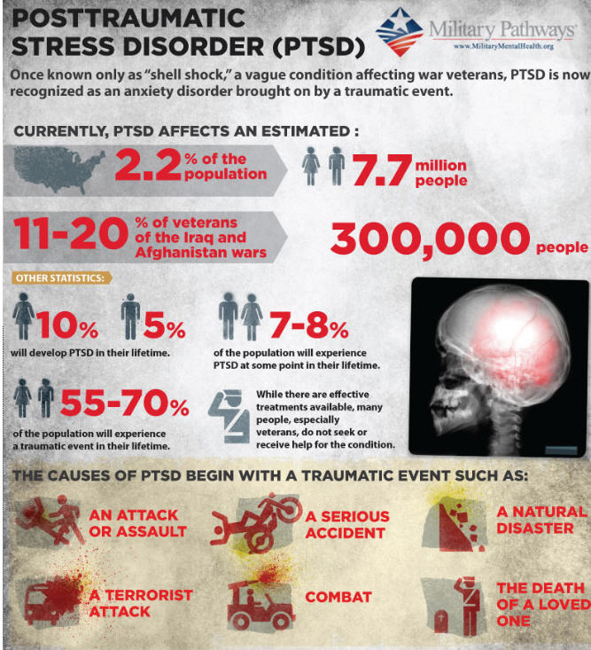

Slide 71
Adjustment Disorders (286/151)
Development of emotional or behavioral symptoms within 3 months of an identified stressor.
Once the stressor or its consequences have terminated, the symptoms do not persist for more than an additional 6 months.

Slide 72
Examples
F43.21 Adjustment Disorder, With
depressed mood.
F43.25 Adjustment Disorder, With mixed
disturbance of emotions and conduct

Slide 73
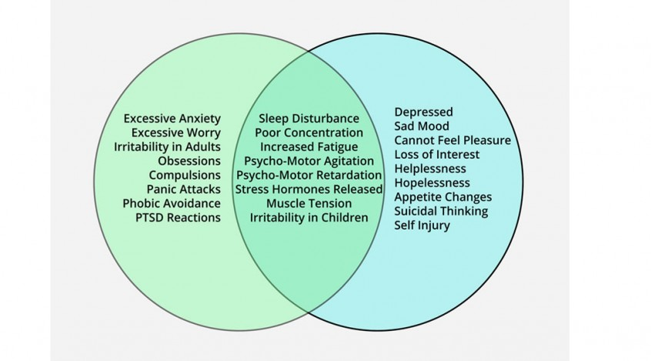
REVIEW Mood vs. Anxiety

Slide 74
Mood Disorders
Bipolar (Hx of Manic episode)
Cyclothymic
Major Depression
Persistent Depressive Disorder
Disruptive Mood Disorder
Adjustment Disorder
Substance-Induced Mood Disorder
Mood Disorder due to Medical Condition

Slide 75
Anxiety Disorders (pg. 189/115)
1: Panic Disorder & Agoraphobia
2: Trauma or Stress-related
3: Obsessive-Compulsive Disorder
4: Specific Phobia
5: Separation Anxiety & Selective Mutism
6: Generalized Anxiety Disorder
Adjustment Disorder
Substance-Induced or due to Medical Condition

Slide 76
Homework
Case Study # 3

