Slide 1
PSY 6669 Behavioral Pathology
Lecture 3
Substance-Related and Addictive Disorders

Slide 2
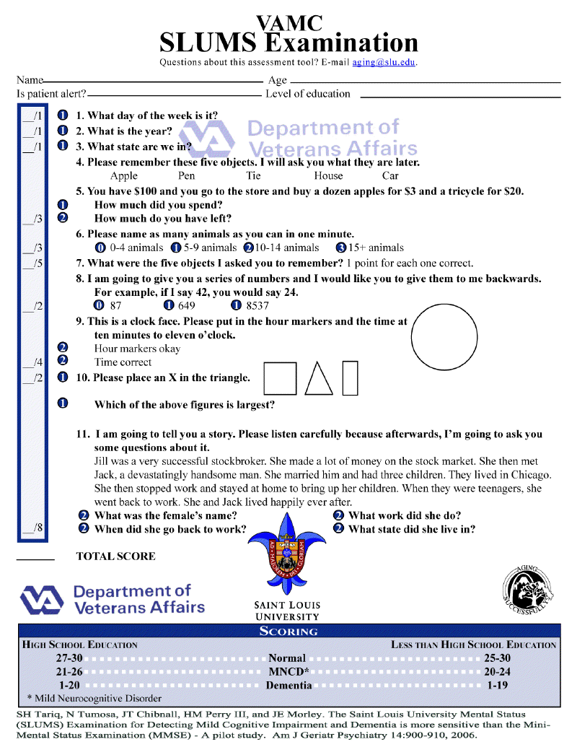

Slide 3
Disruptive, Impulse-Control, and Conduct Disorders (pg 461/219)
F91.3 Oppositional Defiant Disorder
F63.81 Intermittent Explosive Disorder
F91.1 Conduct Disorder, Childhood Onset
F91.2 Conduct Disorder, Adolescent Onset
With limited prosocial emotions
Mild, Moderate, or Severe
Differentiate: Antisocial Personality Disorder

Slide 4
Disruptive and Conduct Disorders
9% of Boys and 2% of Girls.
High risk for substance abuse.
Usually 2 or more grade behind in one or more academic subjects.
Low self-esteem and poor frustration tolerance.
Secondary Diagnosis of ADHD.
R/O “Masked Depression”
Family history of antisocial behavior and substance abuse.

Slide 5
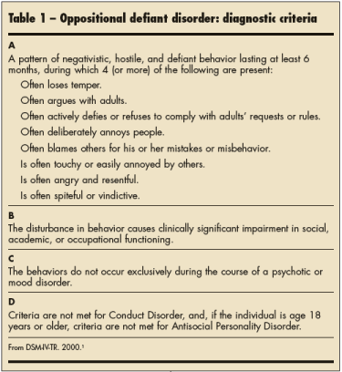

Slide 6
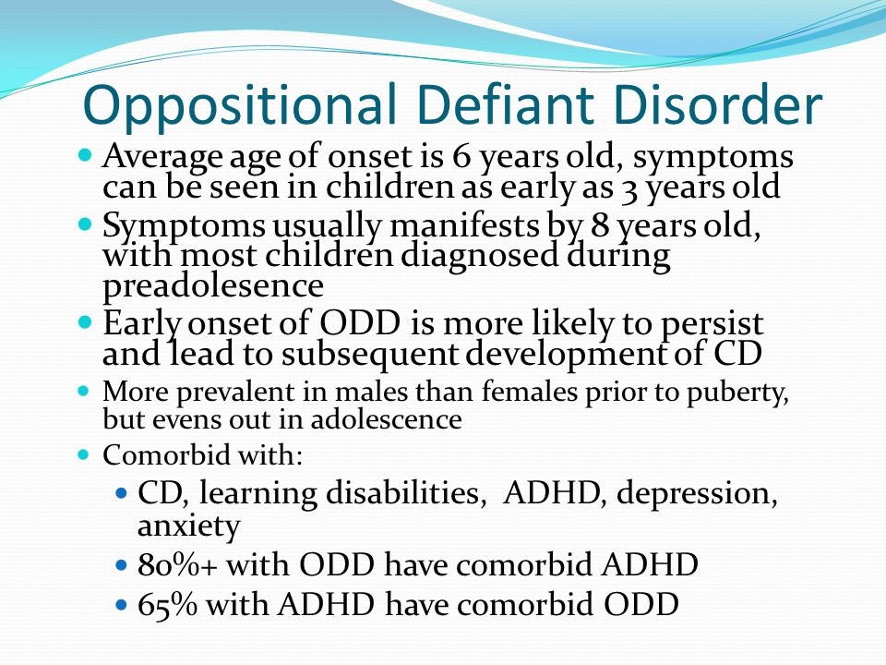

Slide 7
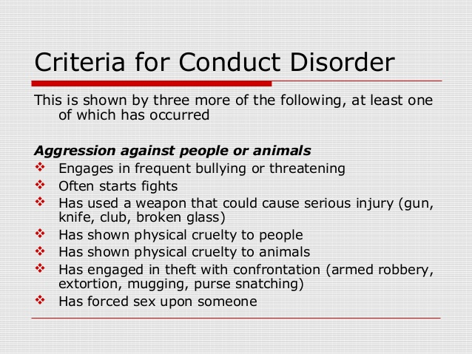

Slide 8
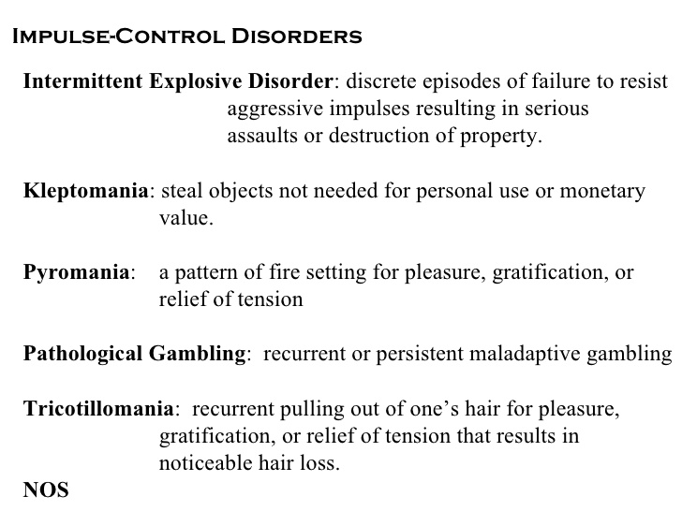

Slide 9
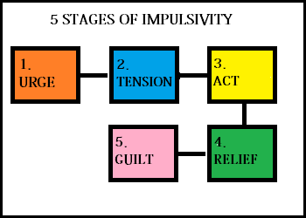
Impulsive Disorders

Slide 10
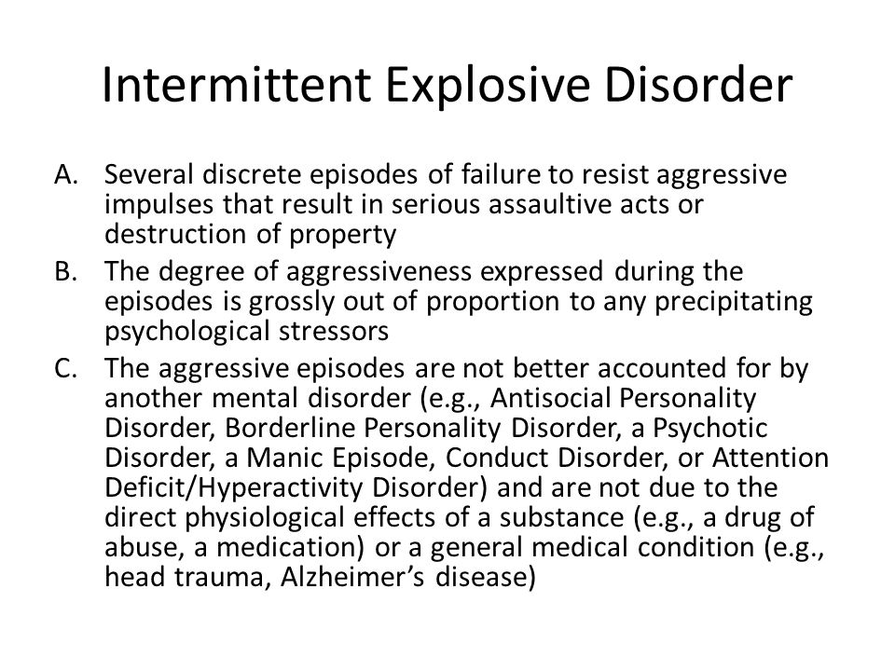

Slide 11
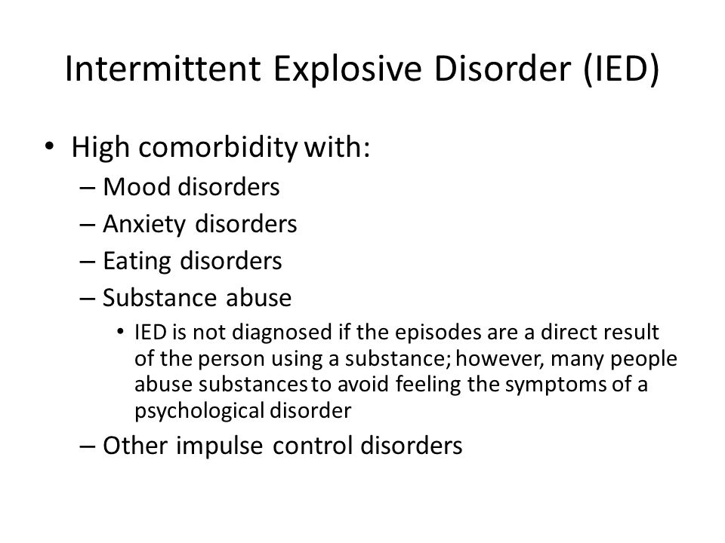

Slide 12

Attention-deficit Hyperactivity Disorder

Slide 13
F90.X Attention-Deficit/ Hyperactivity Disorder (ADHD)
(Review : pg 59/31)
F90.0 Predominately inattentive presentation
F90.1 Predominately hyperactive/ impulsive presentation
  Specify if: In partial remission
  Specify current severity: Mild, Moderate, or Severe
F90.2 Combined Presentation
F90.8 Other Specified ADHD
F90.9 Unspecified ADHD

Slide 14
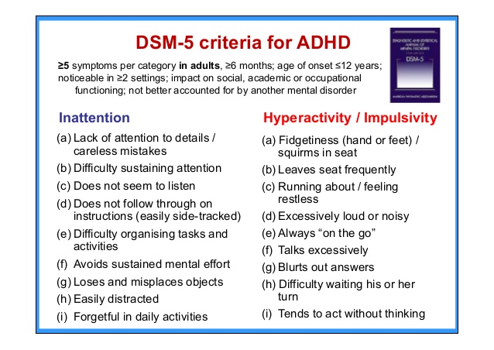

Slide 15
Attention-Deficit Hyperactivity Disorder
12 % of school population (NYT:11/11/18).
3 to 1 Ratio of boys to girls.
40% of Hyperactive kids also have ODD.
Depression and Anxiety (OCD) are also comorbid with ADHD.
Conduct Disorders misdiagnosed as ADHD.
¼ of Children/teens take prescription medication (NYT:11/11/18)
Risk for Substance Abuse as teens.

Slide 16
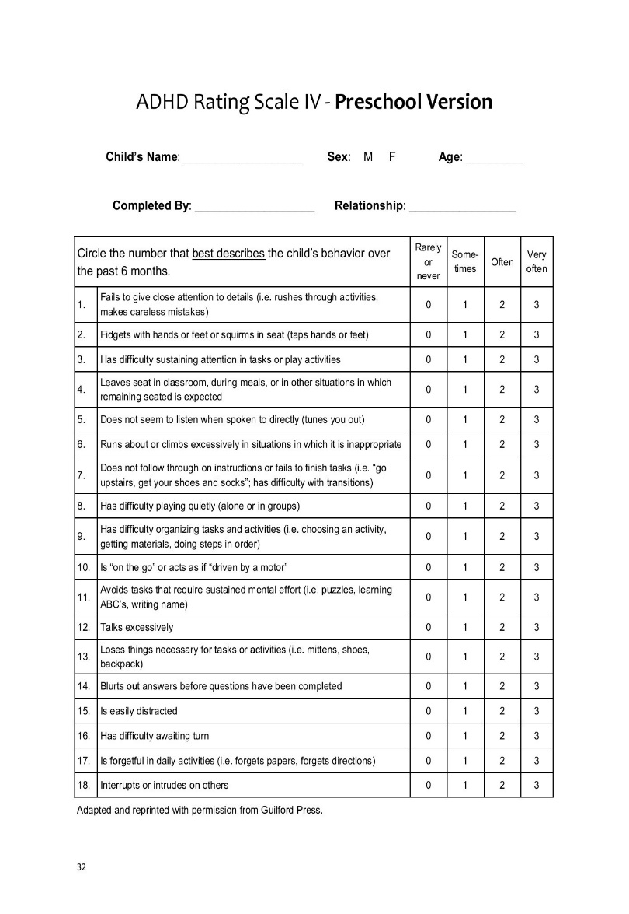
ADHD-Rating Scale
Mean = 12, Standard Deviation = 6
Standard Error of Measure +/- 3
Average Range 6 – 18
Borderline 18 - 24
Mild ADHD 24 – 30
Moderate ADHD 30 – 42
Severe ADHD 42 – 54 eTNS Group 34.1 to 23.4 (20.4 – 26.4)
Placebo 33.7 to 27.5 (24.5 - 30.5)

Slide 17

SUBSTANCE USE
DISORDERS

Slide 18
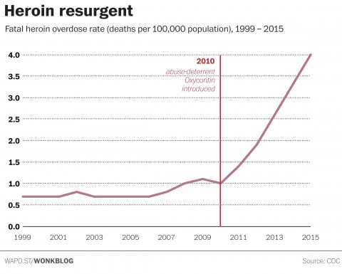
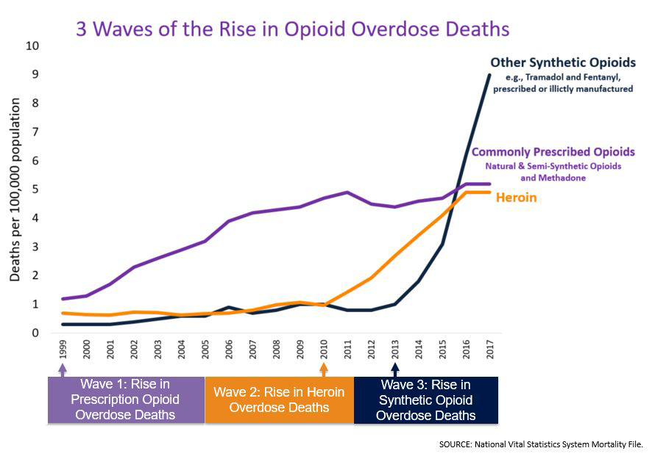

Slide 19
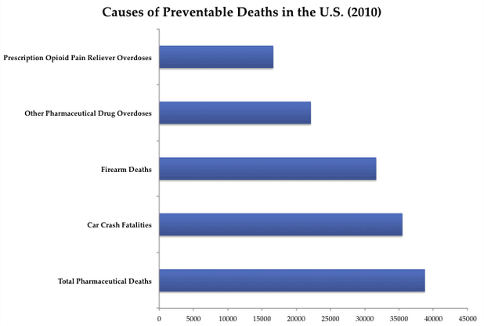

Slide 20
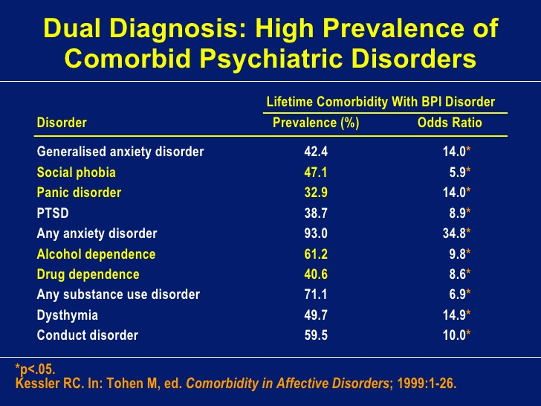

Slide 21
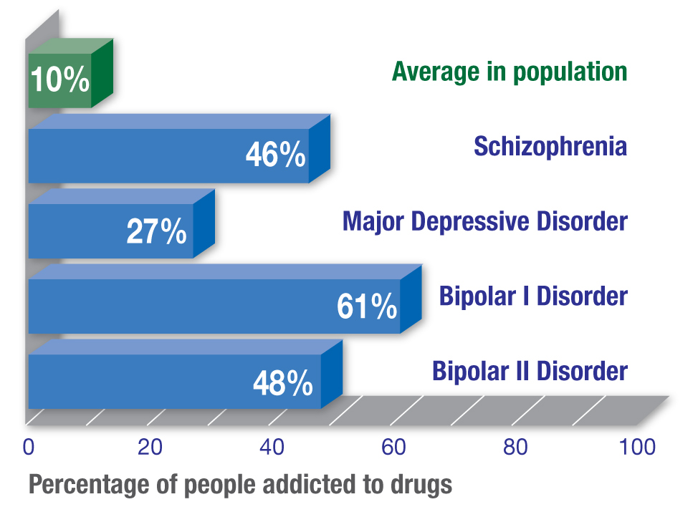

Slide 22
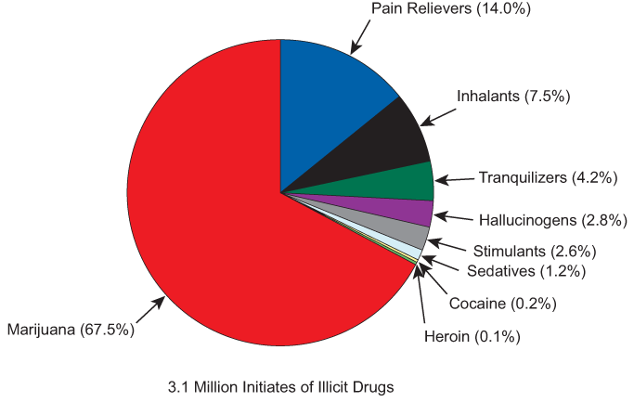
DRUG USE IN AMERICA

Slide 23
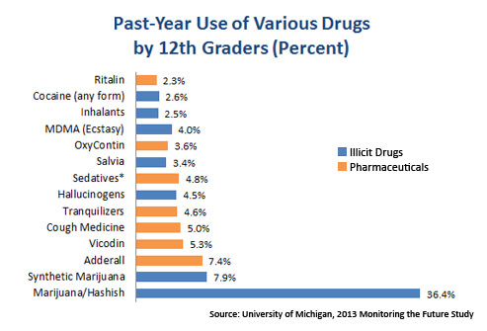

Slide 24
Substance Use Disorder
(pg 490/233)
Depends on whether there is a comorbid substance-induced disorder (including intoxication and withdrawal).
No longer specifies Abuse verse Dependence but rather Specify Mild, Moderate, or Severe based upon the number of symptoms present.

Slide 25
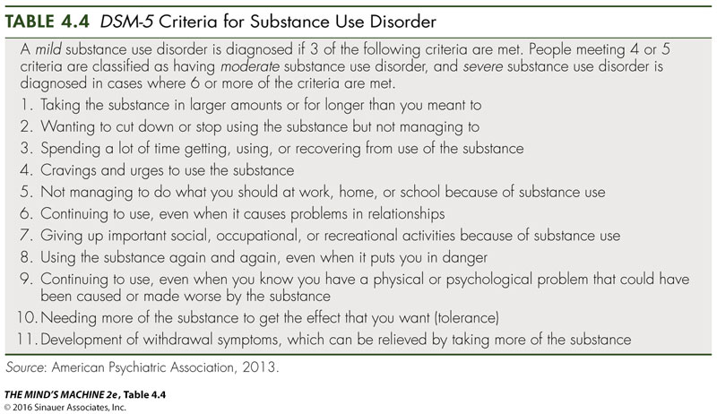

Slide 26

Substance Use Disorder
Specify if in Early Remission (90 days) or In Sustained Remission (12 months).
Specify If In a Controlled Environment.

Slide 27
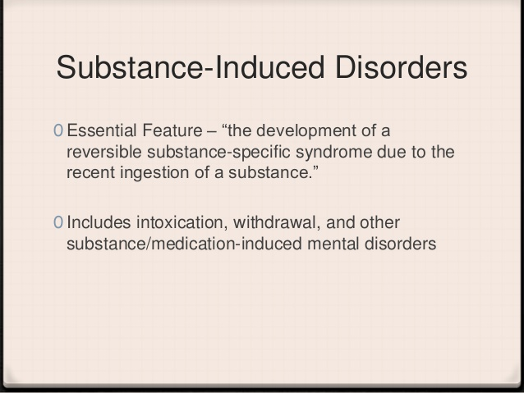


Slide 28
Substance-Induced Disorders
(pg 497/235)
Specify Intoxication or Withdrawal.
Specify if With Perceptual Disturbance.
Other Specified Substance-Induced Disorder (e.g. F39.10 Anabolic Steroid Use Disorder, Mild)
Other Unspecified Substance-Induced Disorder.

Slide 29
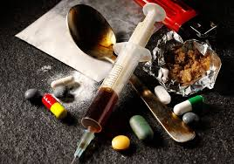
Alcohol
Caffeine
Cannabis
Hallucinogen
Inhalant
Opioid
Sedative, Hypnotic, or Anxiolytic
Stimulant
Tobacco
Other or Unknown Substance

Slide 30
Example:
F10.229 Alcohol Intoxication
F10.20 Alcohol Use Disorder, In a controlled environment, Moderate

Slide 31
Additional Substance or Medication Induced Disorders
Substance Induced Psychotic Disorder
Substance Induced Bipolar Disorder
Substance Induced Depressive Disorder
Substance Induced Anxiety Disorder
Substance Induced Sleep Disorder
Substance Induced Sexual Dysfunction
Substance Induced Delirium
Substance Induced Mild or Major
Neurocognitive Disorder

Slide 32
Examples:
F12.259 Cannabis-Induced Psychotic Disorder, With onset during intoxication, Moderate
F19.24 Prozac-Induced Bipolar Disorder, Moderate
F19.13 Sinemet-Induced Depressive Disorder, Mild
F18.280 Cocaine-Induced Anxiety Disorder, With onset during withdrawal, Moderate
F11.182 Opioid-Induced Sleep Disorder, Insomnia type, With onset during withdrawal, Mild

Slide 33
Antidepressant Discontinuation Syndrome
(pg 712/351)
Specify: Initial encounter, Subsequent encounter, or Sequelae
Other Adverse Effect of Medication
Specify: Initial encounter, Subsequent encounter, or Sequelae

Slide 34
Neurocognitive Domains
(pg 596/292)
Substance Intoxication Delirium
Substance Withdrawal Delirium
  Specify Acute (lasting hour or days) or Persistent (lasting weeks or months)
  Specify Hyperactive, Hypoactive, or Mixed level of activity.

Slide 35
Medication-Induced Movement Disorders and other Adverse Effects of Medication
Neuroleptic-Induced Parkinsonism
Other Medication-Induced Parkinsonism
Neuroleptic Malignant Syndrome
Medication-Induced Acute Dystonia
Medication-Induced Acute Akthisia
Tardive Dyskinesia, Dystonia, Akthisia
Medication-induced Postural Tremor
Other Medication-induced Movement
Disorder

Slide 36
Non-Substance-Related Disorders (pg 585/282)
Gambling Disorder
  Specify if Episodic or Persistent
  Specify if In early remission or In sustained remission
  Specify severity: Mild, Moderate, Severe

Slide 37
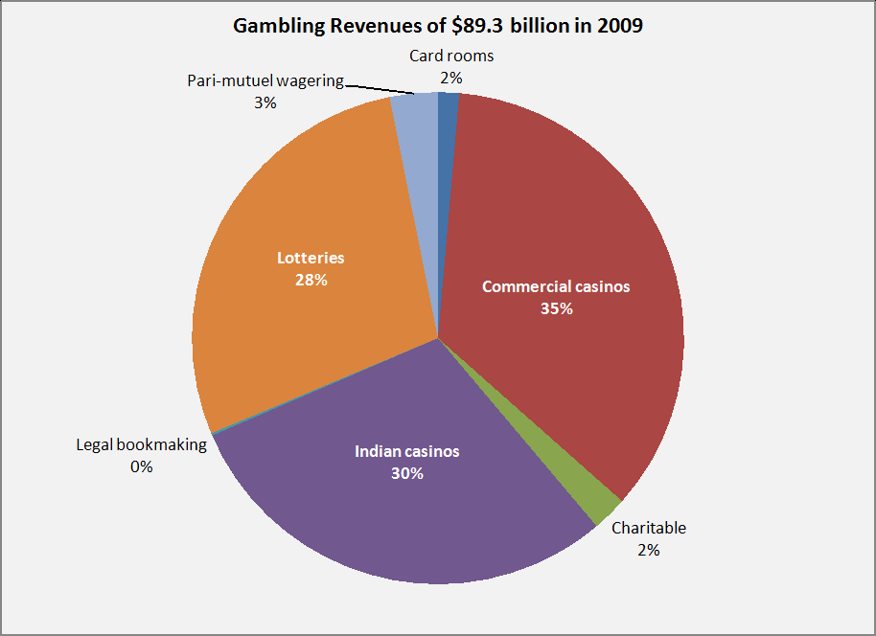

Slide 38
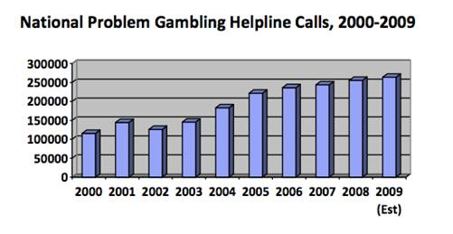
Growth of Gambling Addiction

Slide 39
F63.1 Pyromania (pg476/224)
F63.3 Kleptomania (pg 478/225)
F91.8 Other Specified Disruptive, Impulse-Control, and Conduct Disorder
F91.9 Unspecified Disruptive, Impulse-Control, and Conduct Disorder

Slide 40
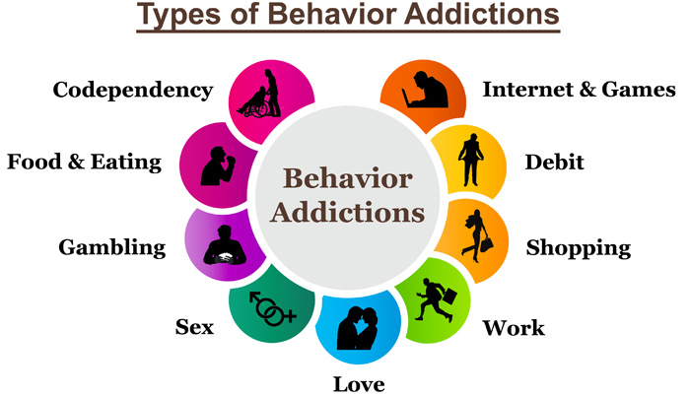

Slide 41
Homework
Case Study # 2

