Slide 1
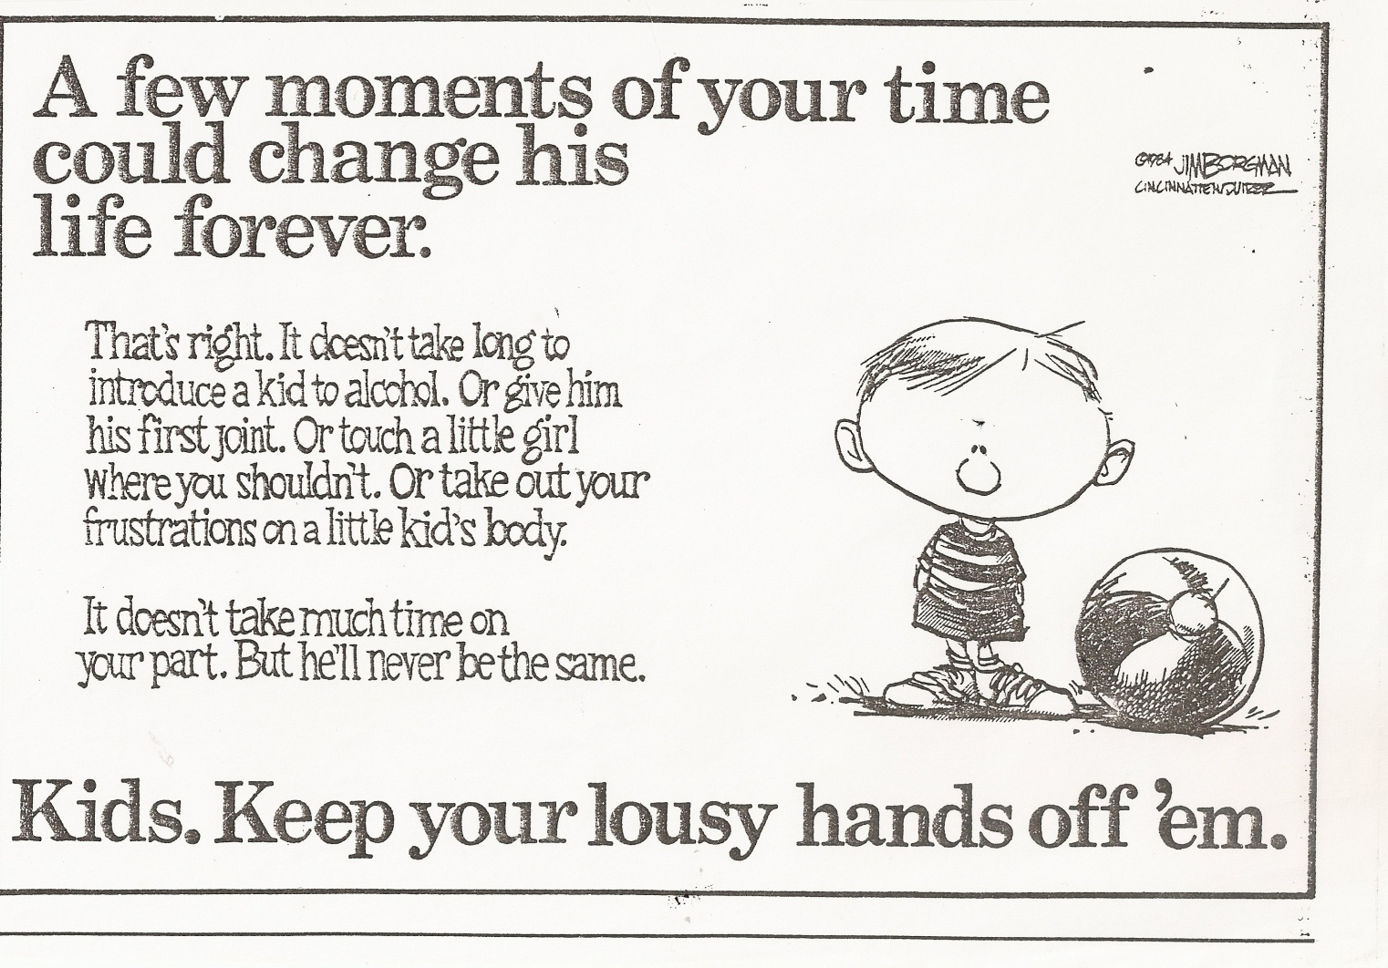
PSY 6669 Behavioral Pathology
Lecture 2

Slide 2
Neurodevelopmental Disorder (pg 33/17)
Intellectual Disabilities
Global Developmental Delay
Communication Disorders
Autism Spectrum Disorders
Attention-deficit Hyperactivity Disorder
Specific Learning Disorders
Motor Disorders
Other Neurodevelopmental Disorders

Slide 3
Intellectual Disabilities
(Intellectual Developmental Disorder : ICD-11)
A. Deficits in intellectual functions.
  Requires standardized tests
B. Deficits in adaptive functioning that results in failure to meet developmental and sociocultural standards for personal independence and social responsibilities.
  Requires standardized tests or assessment
C. Onset and deficits during the developmental period.

Slide 4
Intellectual Disability
ICD-10 Codes (pg 33/18)
R41.83 Borderline Intellectual Functioning
  IQ = 70 - 84
F70 Intellectual Disability, Mild
  IQ = 55 – 69
F71 Intellectual Disability, Moderate
  IQ = 40 – 54
F72 Intellectual Disability, Severe
  IQ = 25 – 39
F73 Intellectual Disability, Profound
  IQ = less than 25

Slide 5
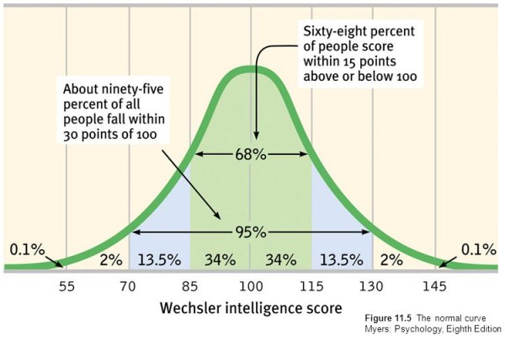
Standard Bell Curve & IQ

Slide 6
Standardized Tests
Intellectual Functioning:
Wechsler IQ Scales
  WIPPSI – IV (2.6 – 7.7 ages)
  WISC – V (6 – 16 years)
  WAIS – V (16 – adult)
  Stanford-Binet 5th edition(SB5) (2 – 85+)
Developmental Functioning:
  Vineland Adaptive Behavior Scale 3 (2 – 21)
  AAMD Adoptive Behavior Scale (3 – adult)

Slide 7
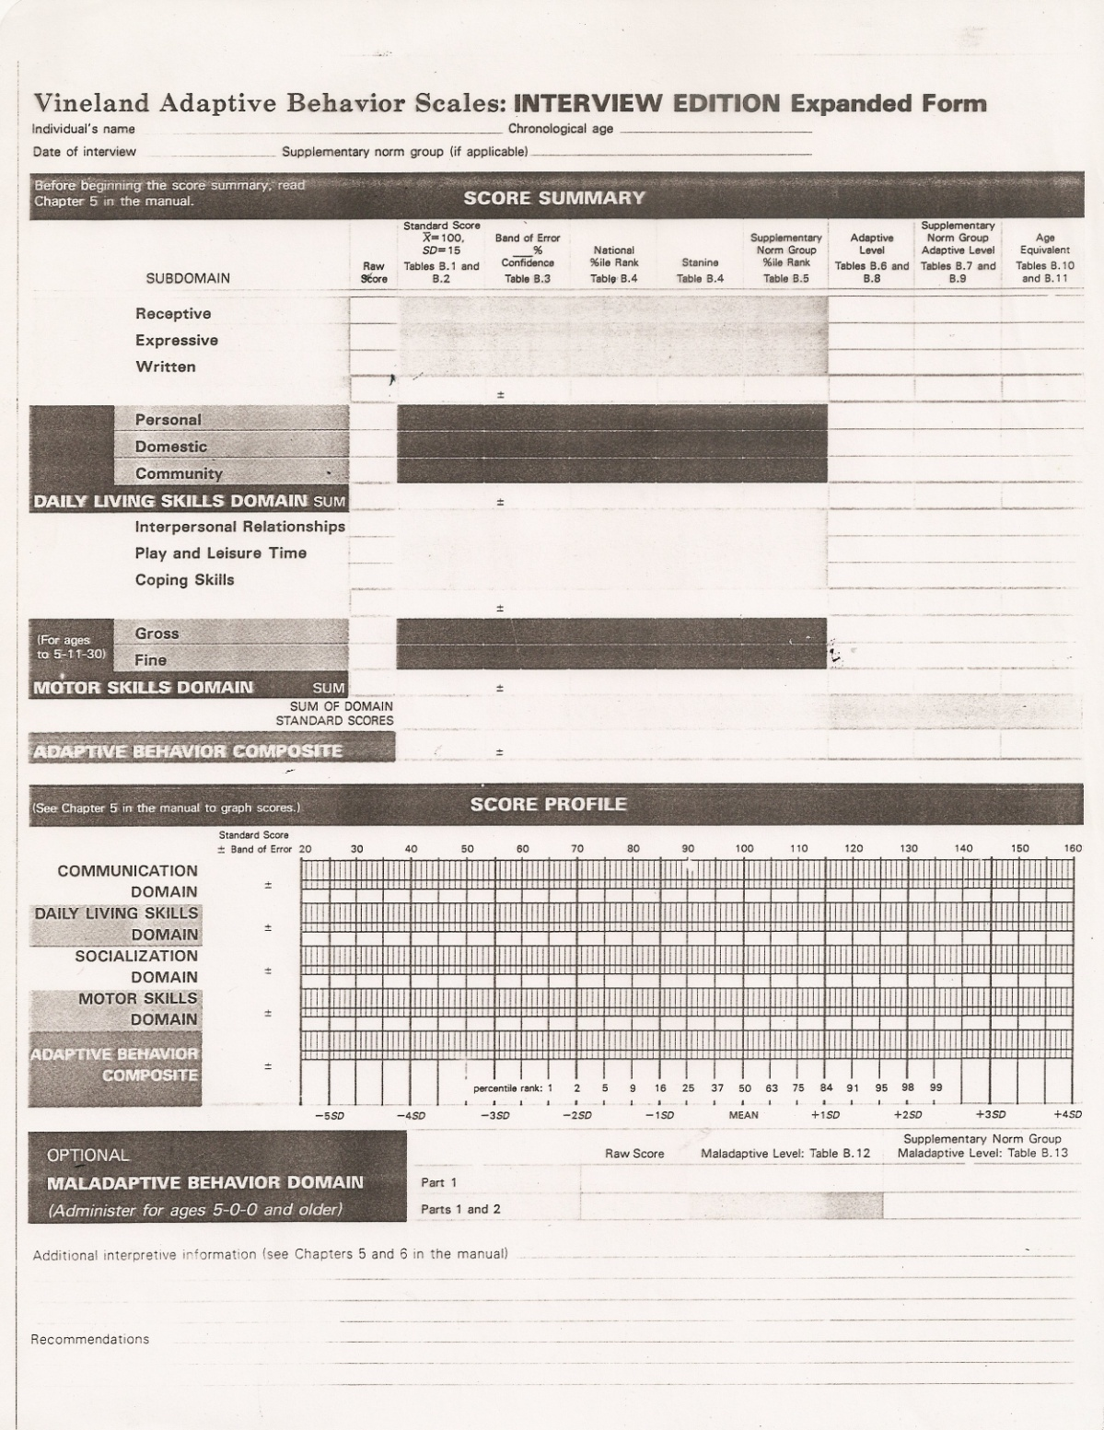

Slide 8
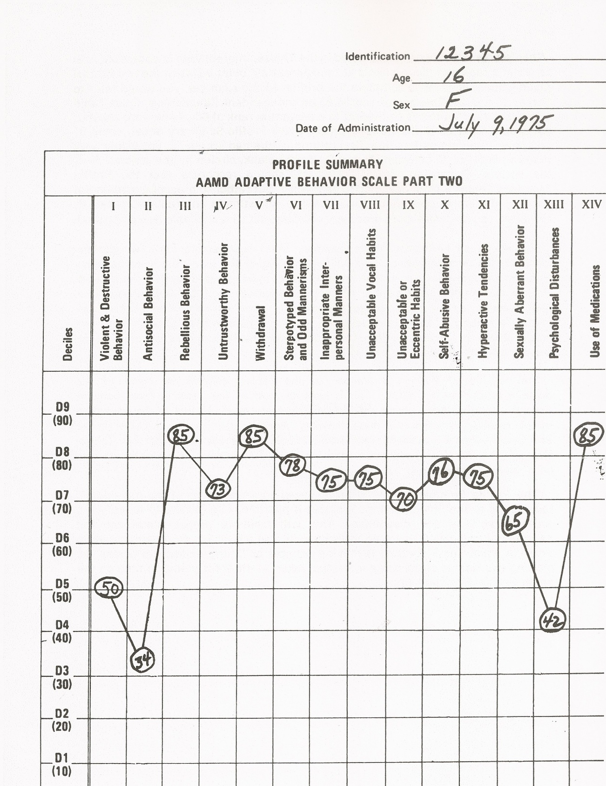

Slide 9
315.8 Global Developmental Delay (pg 41/23)
For individuals under the age of 5 years when assessment of the degree of intellectual disability cannot be assessed.
May be the result of blindness, deafness, locomotor disability or presence of severe problems behaviors making formalized testing difficult and invalid.

Slide 10
Communication Disorders
(pg 42/24)
F80.2 Language Disorder
F80.0 Speech Sound Disorder
F80.81 Childhood-Onset Fluency Disorder (stuttering)
F80.89 Social Communication Disorder

Slide 11
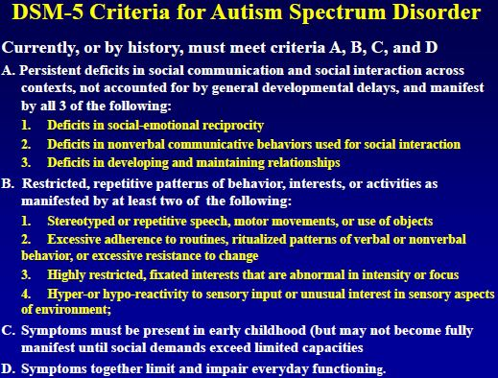
(pg 50/27)

Slide 12
Autism Spectrum Disorder
(pg 50/27)
F84.0 Autism Spectrum Disorder
specify if : Associated with a known medication
specify degree of required support
specify if with or without accompanying impairment
Example Diagnosis:
F84.0 Autism Spectrum Disorder, Requiring support, Without
accompanying intellectual impairment, With accompanying language impairment.

Slide 13
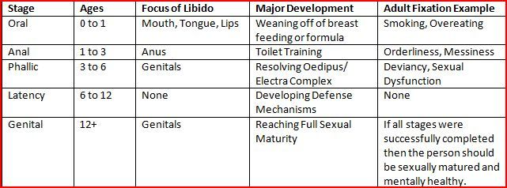
Freud’s Developmental Stages

Slide 14
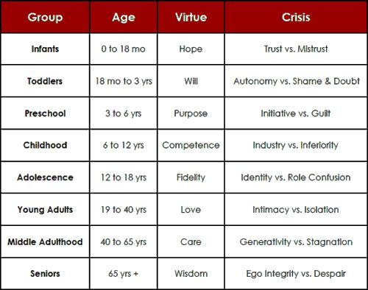
Erikson’s Psychosocial Stages

Slide 15
Specific Learning Disorder
(pg 66/36)
F81.0 Specific Learning Disorder, With impairment in reading
F81.81 Specified Learning Disorder, With impairment in written expression
F81.2 Specific Learning Disorder, With impairment in mathematics
Specifiers…..

Slide 16
Example
F81.2 Specific Learning Disability, With impairment in mathematics: Memorization of arithmetic facts, Moderate

Slide 17
Motor Disorder (pg74/39)
F82 Developmental Coordination Disorder
F98.4 Stereotypic Movement Disorder
  Specify if: With or Without self-injurious behavior
  Specify Severity : Mild, Moderate, or Severe

Slide 18
Tic Disorders (pg 81/41)
F95.2 Tourette’s Disorder
F95.1 Persistent Motor or Vocal Tic Disorder
  Specify if: With motor tics only or With vocal tics only
F95.0 Provisional Tic Disorder
F95.8 Other Specified Tic Disorder
F95.9 Unspecified Tic Disorder
F89 Unspecified Neurodevelopmental Disorder

Slide 19
Early Brain Trauma
Trauma suffered during childhood (including physical or sexual abuse and/or neglect) may cause physical damage to the brain making the individual more susceptible to depression later in life.

Slide 20
Neurocognitive Disorders
“Dementia” (pg 591/285)
Major Neurocognitive Disorders:
with or without behavioral disturbance
specify: Mild, Moderate, or Severe
Mild Neurocognitive Disorders:
with or without behavioral disturbance
Substance/Medication-Induced

Slide 21
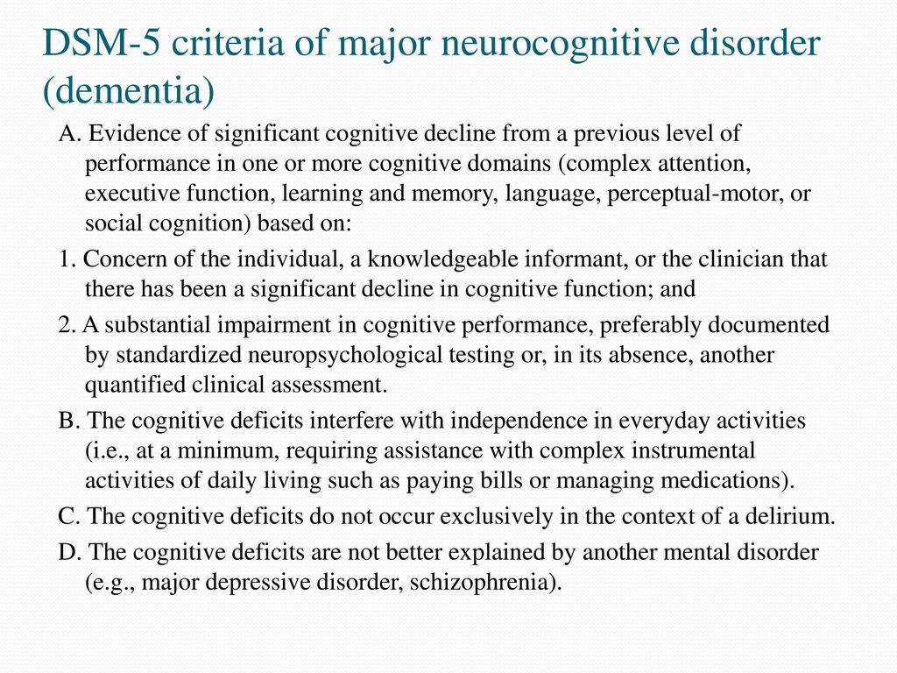

Slide 22
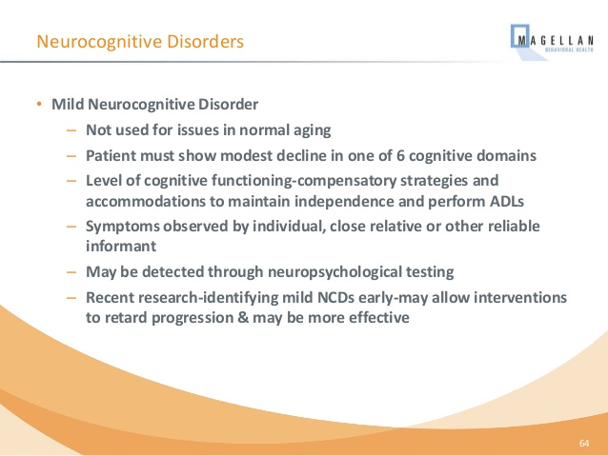

Slide 23
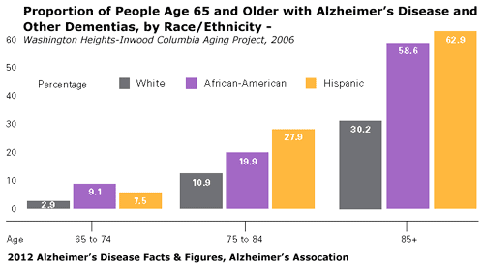

Slide 24
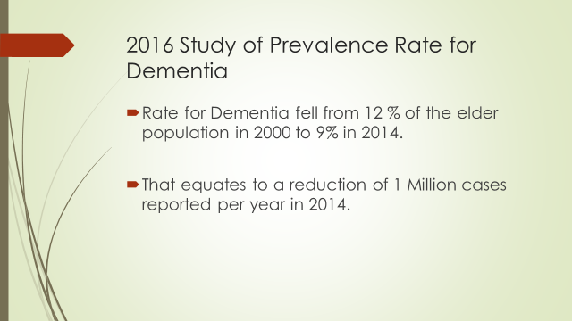

Slide 25
2015 Study at the University of Washingtion
People age 65 and older who took anticholinergic medications (Paxil, Benadryl, Anafranil, Cogentin, Artane, Thorazine, other antipsychotics, muscle relaxants, bladder control, and Parkinson’s medications)for three years had a 54% greater risk for developing dementia than those who took the medications for three months or less.
2014 study at Indiana State reviewed 30 studies that suggested cognitive decline increased with the amount of anticholinergic medication taken.

Slide 26
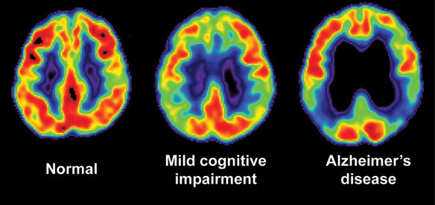
MRI Scans of Adult

Slide 27
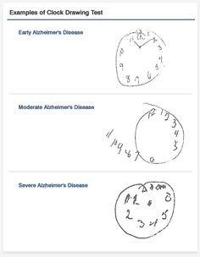

Slide 28
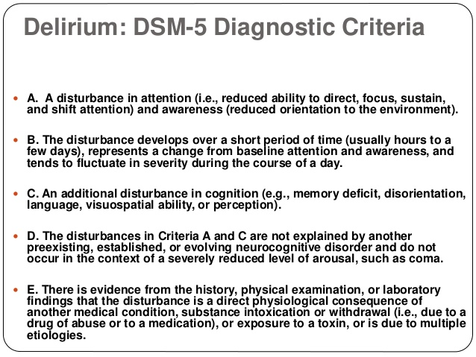

Slide 29
Delirium (pg 591/292)
Neurocognitive Disorder
Substance Intoxication Delirium
Substance Withdrawal Delirium
Medication Induced Delirium
Delirium due to Another Medical Condition
Delirium due to Multiple Etiologies
Specify: Acute or Persistent
Specify: Hyperactive, Hypoactive, or Mixed level of activity

Slide 30
Video Case Study: Vivian

Slide 31
Vivian
F02.80 Mild Neurocognitive Disorder due
to Alzheimer’s Disease, Without
behavioral disturbance, Severe

Slide 32
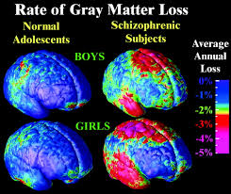
Schizophrenia Spectrum and other Psychotic Disorders
Pg 87/45

Slide 33
Schizophrenia Spectrum & Other Psychotic Disorders
(pg 87/45)
Delusional Disorder
Brief Psychotic Disorder
Schizophreniform Disorder
Schizophrenia
Schizoaffective Disorder
Substance-Inducted Psychotic Disorder
Psychotic Disorder due to Another Medical Condition
Catatonia

Slide 34
Bleuler’s 4 “A”s of Schizophrenia
Associative Disturbance
Affective Disturbance
Autism (withdrawal & fantasy)
Ambivalence (conflicting emotions)

Slide 35
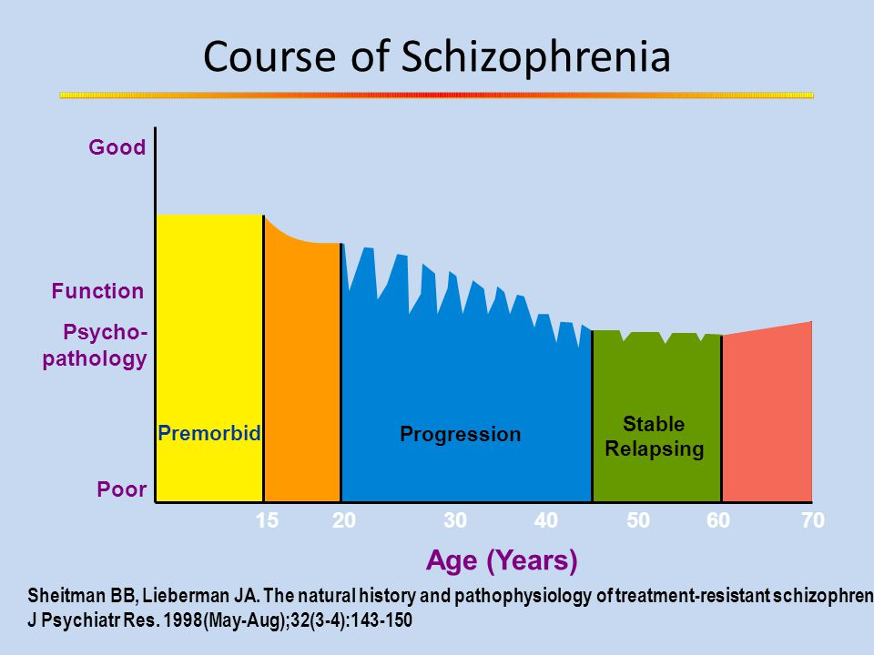

Slide 36
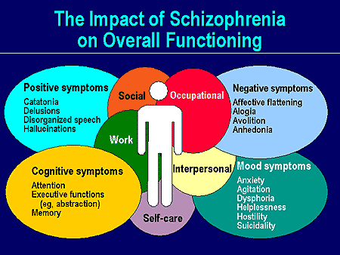

Slide 37
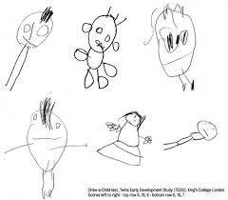
Schizophrenic Drawings

Slide 38
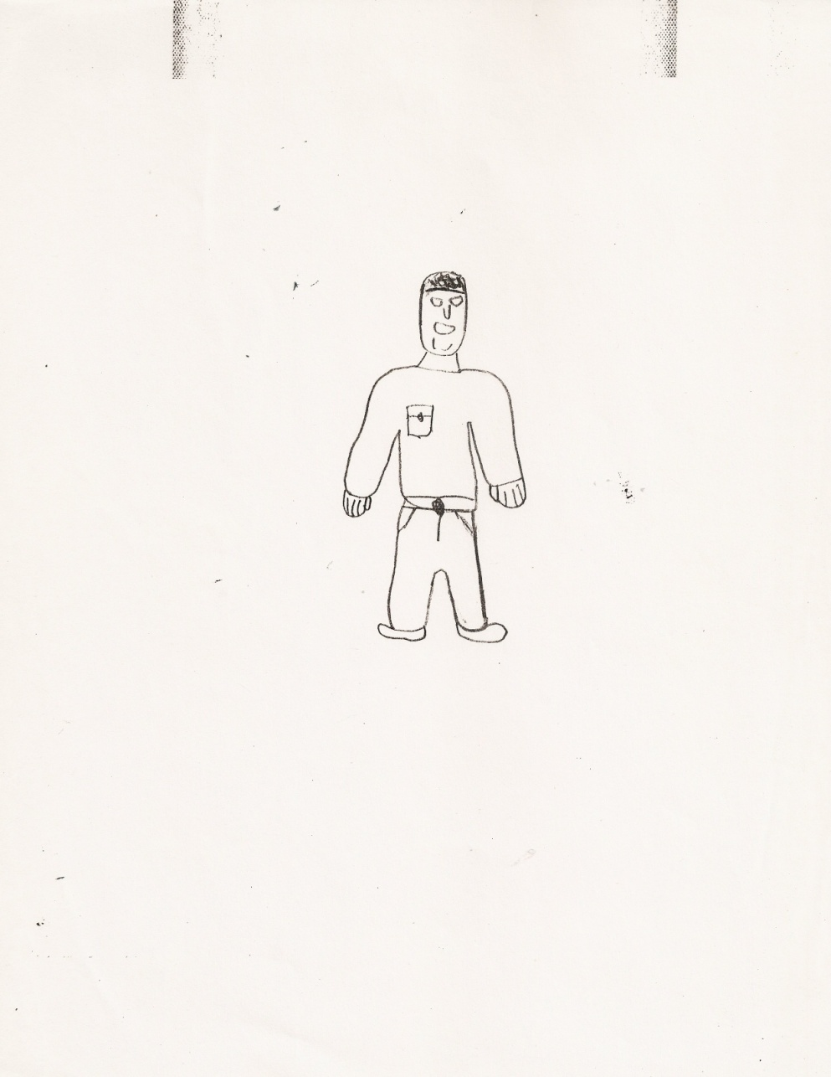
Draw a Person - Adult

Slide 39
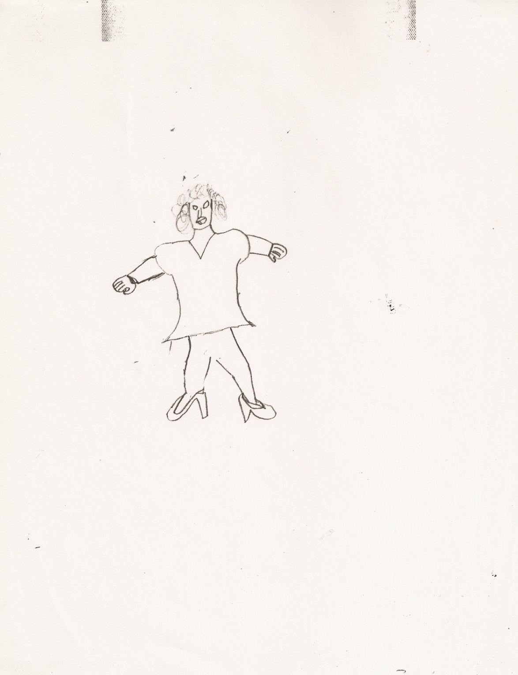

Slide 40
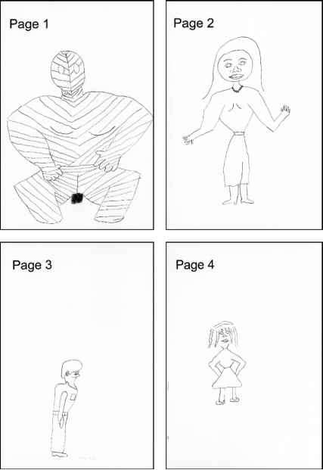

Slide 41
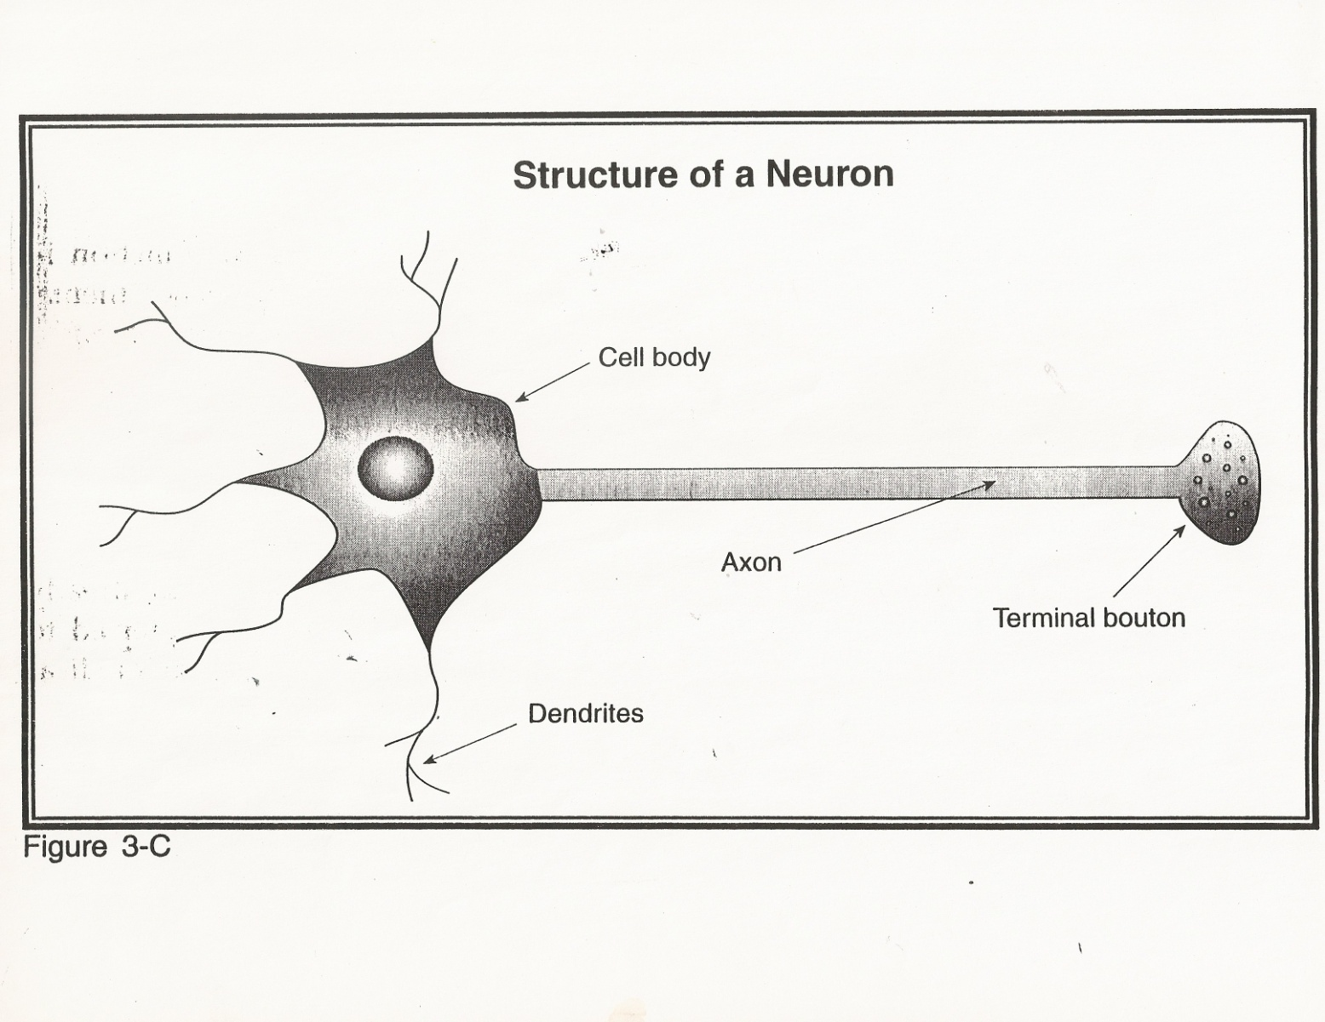
Biochemical Theory

Slide 42
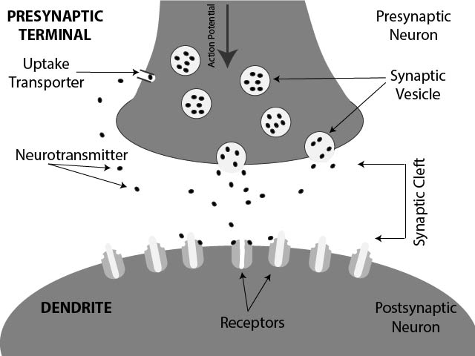

Slide 43
Schizophrenia Spectrum & Other Psychotic Disorders (pg 87/45)
Delusional Disorder
Brief Psychotic Disorder
Schizophreniform Disorder
Schizophrenia
Schizoaffective Disorder
Substance-Inducted Psychotic Disorder
Psychotic Disorder due to Another Medical Condition
Catatonia

Slide 44
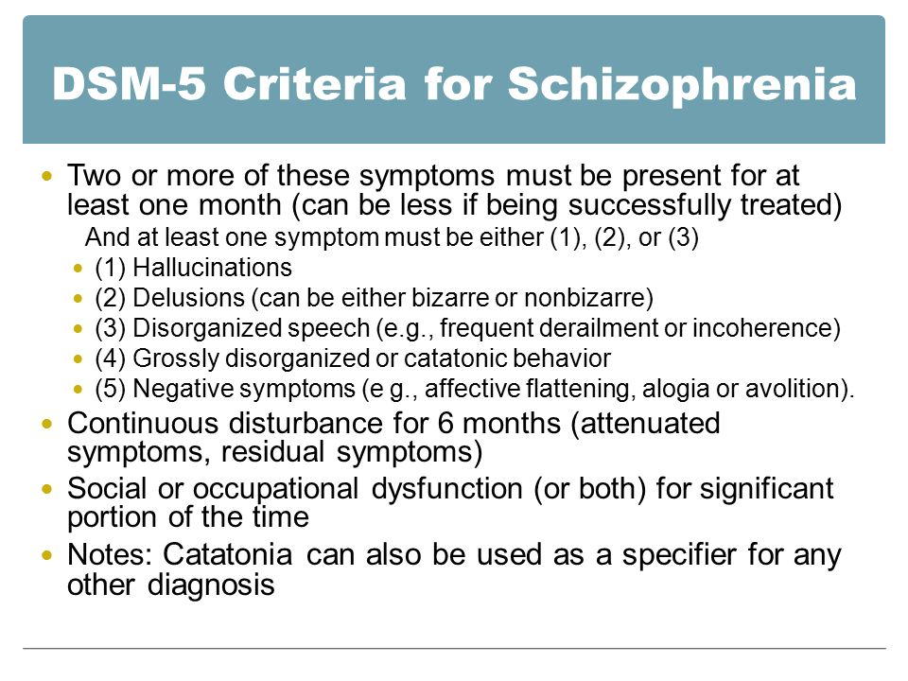

Slide 45
Schizophrenia
1 Content of Thought (formal thought disorder)
  Delusions
  Thought broadcasting
  Thought insertion
  Thought withdrawal

Slide 46
Schizophrenia
2 Formal Thought Disorder
  Loosening of Associations
  Poverty of content of speech
  Word salad

Slide 47
Schizophrenia
3 Perceptions
  Hallucinations/Command hallucinations
  Visual, Auditory (interior or exterior)
  Tactile, Olfactory, or Somatic

Slide 48
Schizophrenia
4 Affect
  Flat or Inappropriate
  Sudden or unexpected changes in Affect
  Inexplicable outbursts of anger

Slide 49
Schizophrenia
5 Sense of Self
  Loss of ego boundaries
  Perplex about one’s identity or meaning of existence.

Slide 50
Schizophrenia
6 Volition
Disturbance in self-initiated, goal-directed activity which may impair work or other role functioning.

Slide 51
Schizophrenia
7 Impaired Interpersonal Functioning & relationships with the external world.
Social withdrawal & Emotional detachment (“Autism”).

Slide 52
Schizophrenia
8 Psychomotor Behavior
  Catatonic rigidity
  Catatonic stupor
  Purposeless & stereotyped
  Bizarre postures
  Grimacing

Slide 53
Age of Onset
Teens to early 20’s = Schizophrenia
Mid-life = Delusional Disorder
Elderly (60 + age) = Dementia

Slide 54
F20.81 Schizophreniform Disorder (pg 96/49)
Two or more: Delusions, hallucinations, disorganized speech, grossly disorganized or catatonic behavior, or negative symptoms.
Duration at least One Month but less than 6 Months.
Specify: With/Without good prognostic features

Slide 55
F23 Brief Psychotic Disorder
(pg 94/47)
A. Delusions, hallucinations, disorganized speech, or grossly disorganized or catatonic behavior. (Active Phase)
Duration of at least One day but less than One Month (30 days)
Not better explained by another disorder

Slide 56
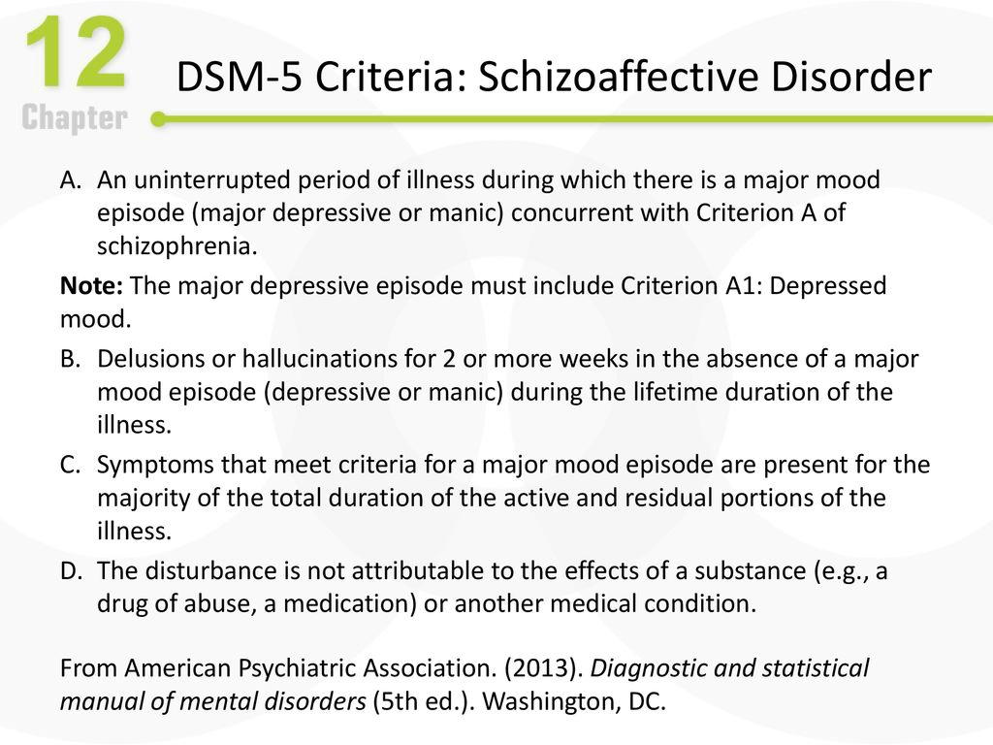

Slide 57
Schizoaffective Disorder
(pg 105/53)
Uninterrupted period of illness during which there is a major mood disorder.
Delusions or Hallucinations for 2 or more weeks in the absence of a major mood disorder.
Symptoms meet criteria for a major mood disorder are present for the majority of the total duration of the active or residual symptoms.

Slide 58
Schizoaffective Dx.
F25.0 Schizoaffective Disorder, Bipolar type
F25.1 Schizoaffective Disorder, Depressive type

Slide 59
F22 Delusional Disorder
(pg 90/45)
Erotomanic Type
Grandiose Type
Jealous Type
Persecutory Type
Somatic Type
Mixed Type
Unspecified Type
  Specify if: With bizarre content

Slide 60
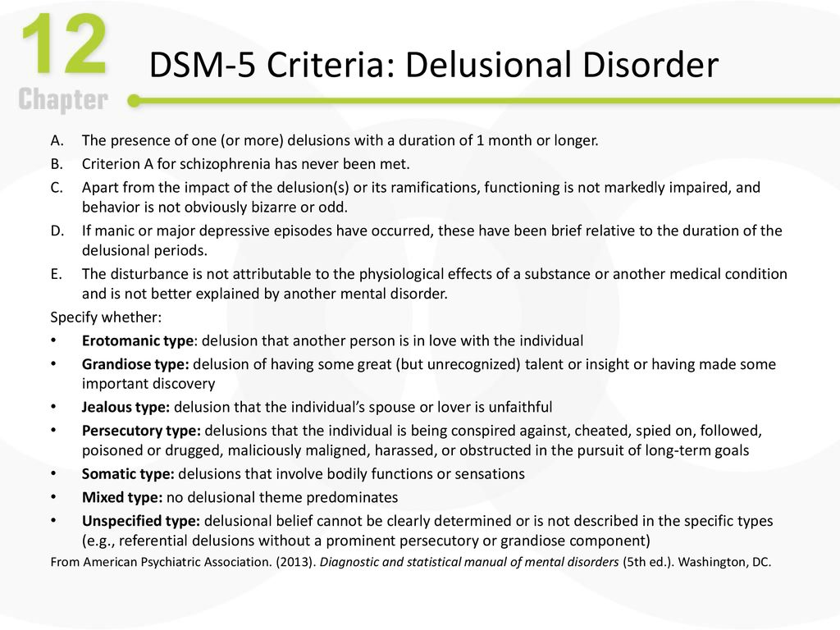

Slide 61
Pg 110/55
F10.259 Alcohol-Induced Psychotic Disorder, With onset during withdrawal, moderate
F06.0 Psychotic Disorder Due to Another Medical Condition, With hallucinations

Slide 62
Video Case Study: Greg

Slide 63
Greg
F20.9 Schizophrenia, Multiple episodes,
current in acute episode

Slide 64
Video Case Study: Rita

Slide 65
Rita
F22 Delusional Disorder, Erotomanic type,
First episode, currently in acute episode

Slide 66
Homework
Case Study # 1

