Slide 1
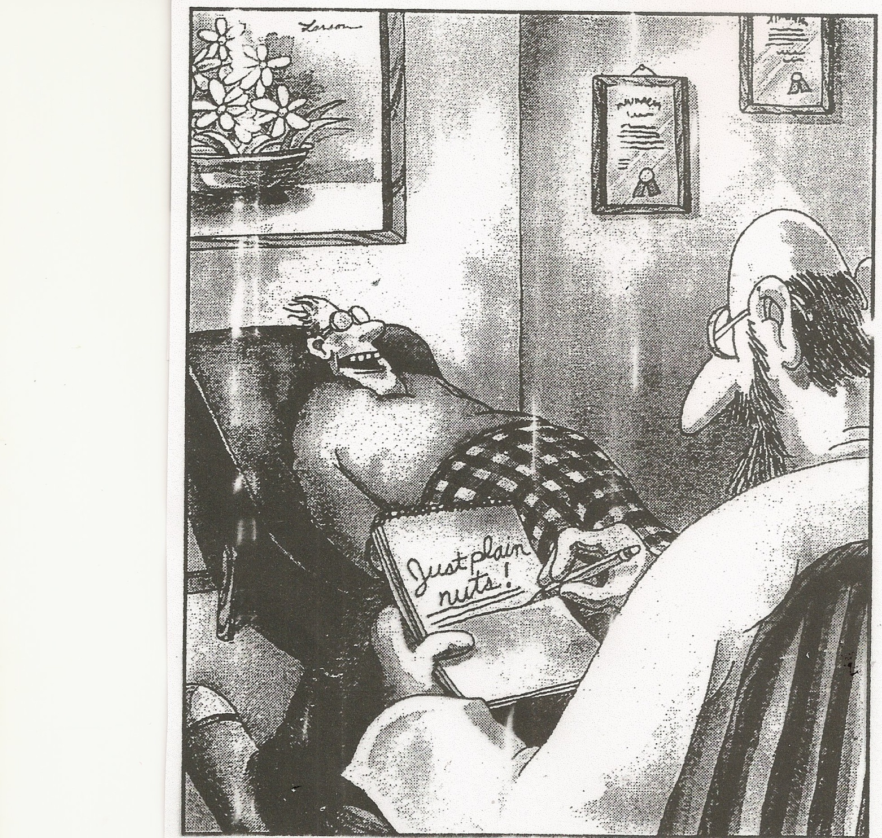
PSY 6669 Behavior Pathology
Joel K. Fairbanks, Ph.D.

Slide 2
Recommended Texts
Desk Reference to the Diagnostic Criteria from the DSM-5 spiral bound edition
Essential Psychopathology & Its Treatment, 4th Ed
Casebook for DSM-5: Diagnosis and Treatment Planning
Elizabeth Ventura (Editor)
NBCC’s Official Preparation Guide for the NCMHCE $44.95 @ NBCC.org
NBCC Code of Ethics
Free download @ NBCC.org

Slide 3
Syllabus
Grading:
Weekly Vignettes 10 %
Mid-term Examination 30 %
Case Study Paper 30 %
Due Week 8
Final Examination 30 %

Slide 4
Final Course Grade
A = 100 – 90 percentage points
B = 80 – 89 percentage points
C = 70 – 79 percentage points
D = 60 – 69 percentage points

Slide 5
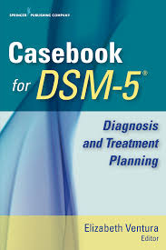
Why diagnostic labels ?
“Such is man that if he has a name for something it ceases to be a riddle.”
I. B. Singer
Define clinical entities.
Determine Treatment.
Insurance Reimbursement.

Slide 6
Psychopathology or behavior pathology ?
Psychopathology: the Why of dysfunction.
Behavior Pathology What is “abnormal”.
Manifestations of Mental Disorders.

Slide 7
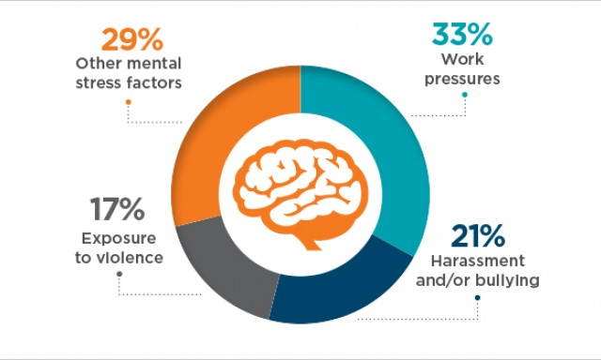
Etiology
Biological Trauma from the Environment.
Psychological Trauma Inducing Biological Changes.
GenoTypes and PhenoTypes.
Psychosocial Theories: Genetic predisposition and inability to cope with the stress or stressors.

Slide 8
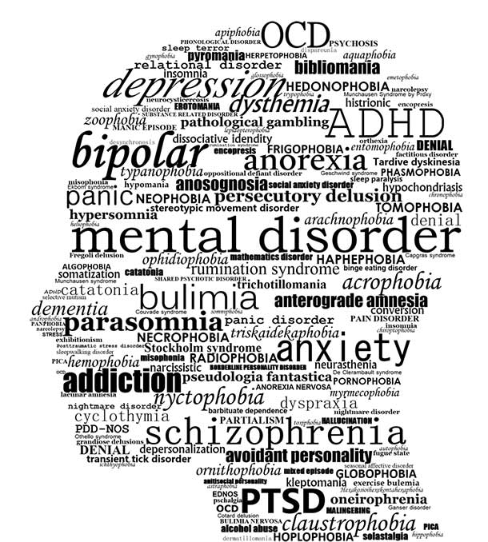
Mental Disorders
A mental disorder is a syndrome characterized by the clinically significant disturbance in an individual’s cognition, emotion regulation, or behavior that reflects a dysfunction in the psychosocial, biological, or developmental processes underlying mental functioning (i.e. Symptoms and Impaired Functioning).

Slide 9
Mental Disorders:
Mental Disorders are usually associated with significant Distress or Disability in social, occupational or other important activities.
Biological changes may or may not be involved.
Everyone has some degree of pathology.

Slide 10
Mental Disorders
An expected or Culturally approved response to a common stressor or loss, such as the death of a loved one, is not a mental disorder.
Socially deviant behavior (e.g., political, religious, or sexual) and conflicts that are primarily between the individual and society are not mental disorders.

Slide 11
History of psycho-diagnostics
1840 the U.S. included only one category for mental disorders.
1880 census expanded to include 7 different categories.
1917 APA developed a classification system that incorporated 59 disorder.
1951 DSM-I published with 106 categories.

Slide 12
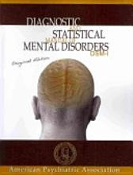
History of Diagnosing: DSM I
1952 -- DSM I
106 diagnoses

Slide 13
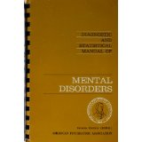
History of Diagnosing: DSM II
1968 -- DSM II
182 diagnoses

Slide 14
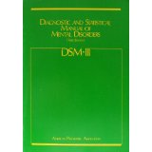
History of Diagnosing: DSM III
1980 -- DSM III
265 diagnoses

Slide 15

History of Diagnosing: DSM III R
1987 -- DSM III R
292 diagnoses

Slide 16
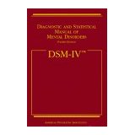
History of Diagnosing: DSM IV
1994 -- DSM IV
374 diagnoses

Slide 17
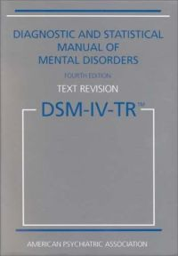
History of Diagnosing: DSM IV TR
2000 -- DSM IV TR
Same diagnoses as in
DSM IV

Slide 18
1968 DSM-II expanded to include 182 diagnostic categories with ICD-8.
1974 DSM-III included 265 Diagnostic categories and developed the Multi-Axial Diagnostic System with ICD-9.
1987 DSM-III R increased to 292 categories with ICD-9-CM.
1997 DSM-IV increased to 374 diagnostic categories with ICD-10.
2000 DSM-IV-TR Minor changes in the numbering and naming of categories to reflect ICD-10 system.

Slide 19
DSM-IV Multi-axial diagnosis
Axis I: 296.23 Major Depressive Disorder, Single Episode, Moderate
305.00 Alcohol Abuse, Mild
Polysubstance Abuse (Provisional)
Axis II: 301.50 Histrionic Personality Disorder
Axis III: 297.0 Barbiturates Overdose
Axis IV: Problems with Primary Support Group, Recent separation.
Axis V: Current GAF = 25
Highest GAF past Year = 60

Slide 20
DSM – V published 2013
485 Diagnoses.
15 new categories added.
Many diagnoses renamed to be more generic or politically correct.
Eliminated the Multi-axial format.
New numbering system with letters to match ICD-10 codes and ICD-11 terms.
NOS (not otherwise specified) replaced with Unspecified (e.g. Unspecified Depressive Disorder).

Slide 21


Why do DSM-5’s Revisions Matter?
Revisions are designed to produce more accurate diagnostic criteria and nosology
Earlier diagnosis
Earlier treatment
More accurate treatment

Slide 22

The Context of Development in DSM-5
Within the diagnostic criteria
Examples of how criteria may present
in children and adolescents
Within the organization of chapters
Diagnoses arranged in lifespan
fashion, with disorders usually
diagnosed earlier in life placed first

Slide 23
Diagnostic Categories in DSM-5
Revised organization of DSM’s diagnostic categories
Use of dimensions can inform a “meta-structure” that clarifies etiologic and pathophysiological relationships between disorders
The “spectra” approach
Autism Spectrum Disorder
Schizophrenia Spectrum Disorders

Slide 24
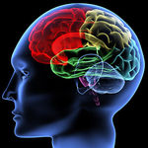
DSM-5 Organizational Structure
Neurodevelopmental Disorders
Schizophrenia Spectrum and Other Psychotic Disorders
Bipolar and Related Disorders
Depressive Disorders
Anxiety Disorders

Slide 25
DSM-5 Organizational Structure
Obsessive-Compulsive and Related Disorders
Trauma- and Stressor-Related Disorders
Dissociative Disorders
Somatic Symptom and Related Disorders
Feeding and Eating Disorders
Elimination Disorders

Slide 26
DSM-5 Organizational Structure
Sleep-Wake Disorders
Sexual Dysfunctions
Gender Dysphoria
Disruptive, Impulse Control, and Conduct Disorders
Substance-Related and Addictive Disorders
Neurocognitive Disorders

Slide 27
DSM-5 Organizational Structure
Personality Disorders
Paraphilic Disorders
Other Mental Disorders
Medication-Induced Movement Disorders and Other adverse Effects of Medication
Other Conditions That May Be a Focus of Clinical Attention

Slide 28
definitions
Etiology: the study of the cause, origin, or reasons.
Epidemiological: the study of the frequency and distribution within various populations.
Incident: refers to the number of new cases in a given timeframe.
Prevalence: refers to the number of existing cases.

Slide 29
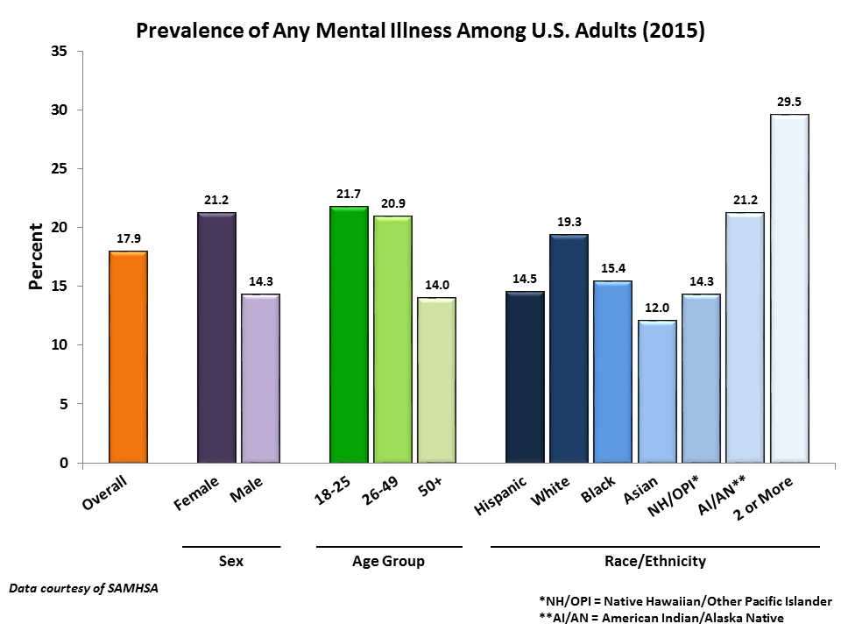

Slide 30
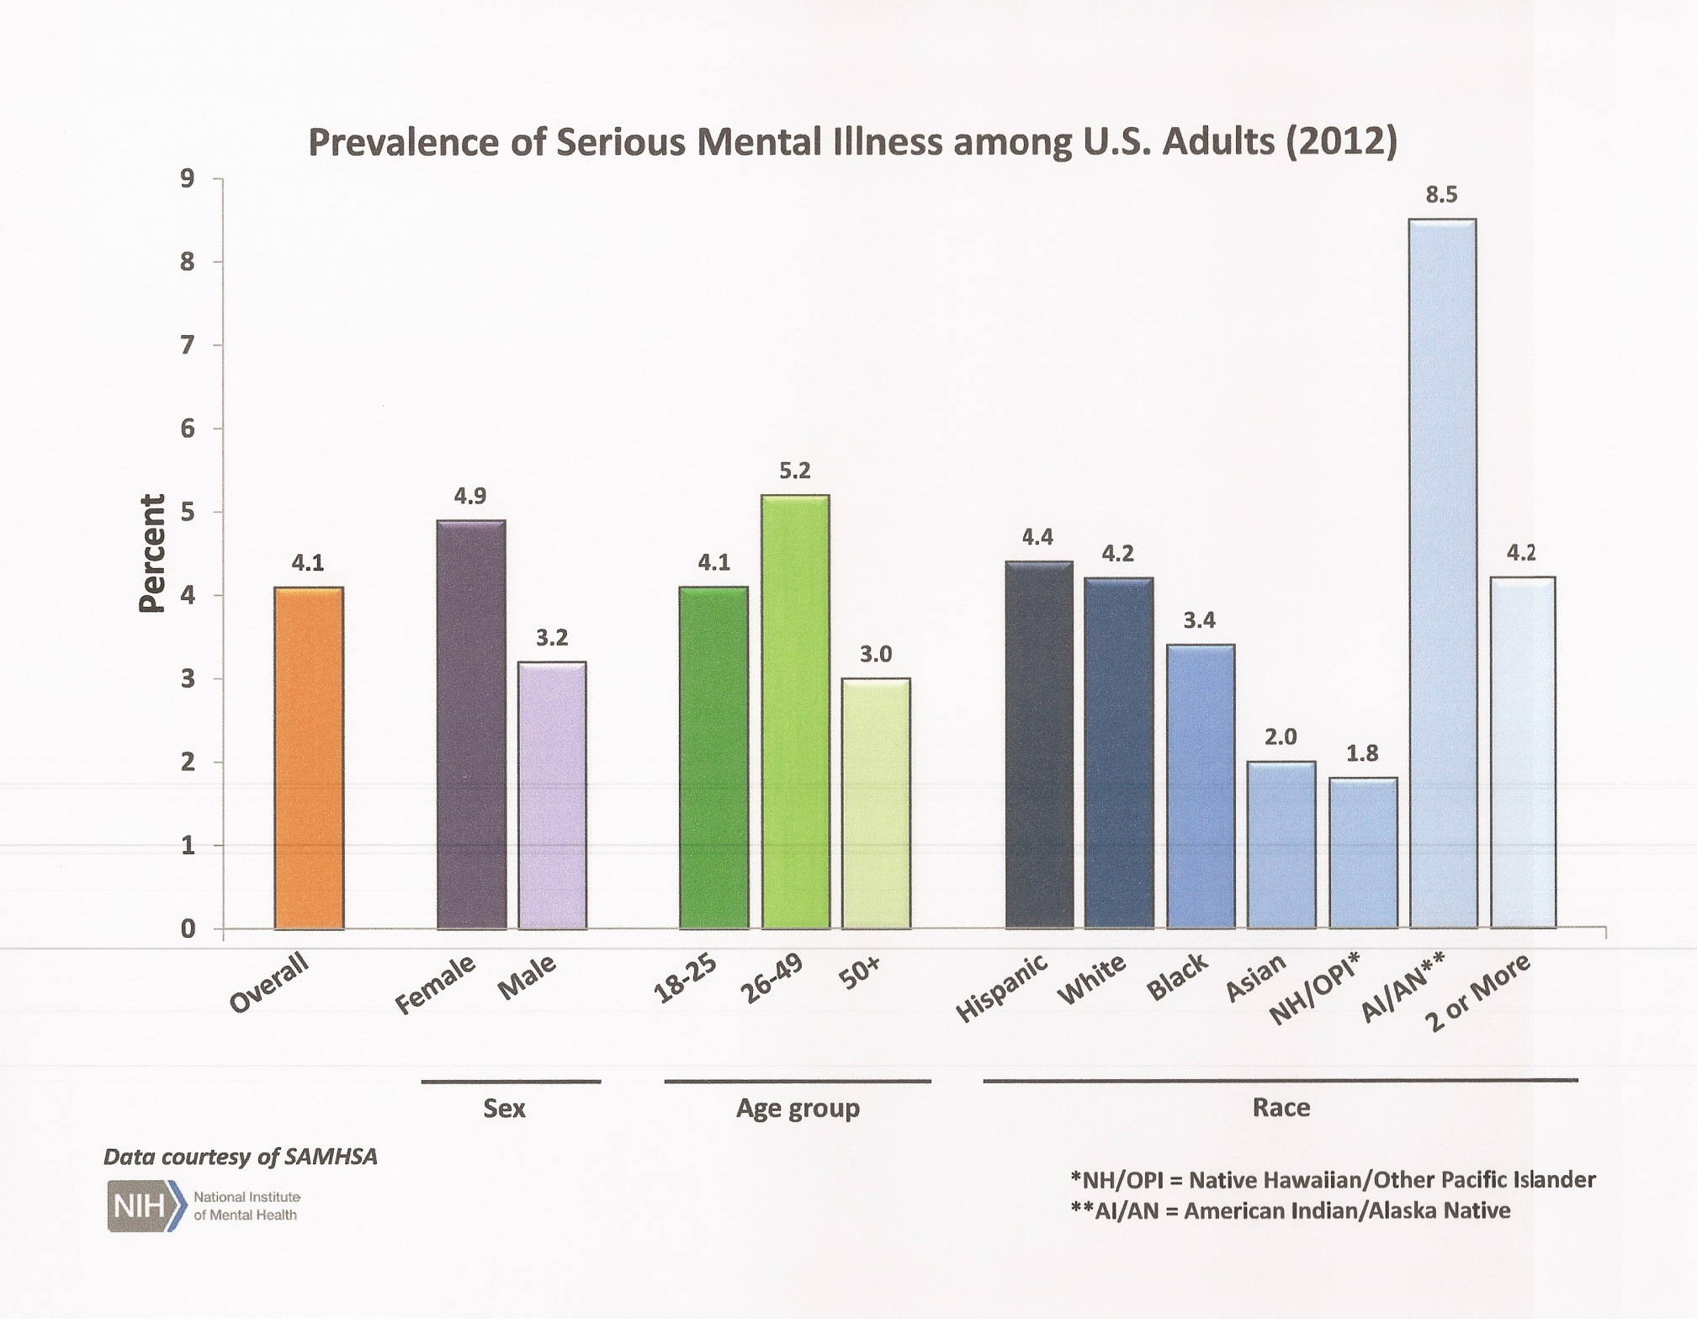

Slide 31
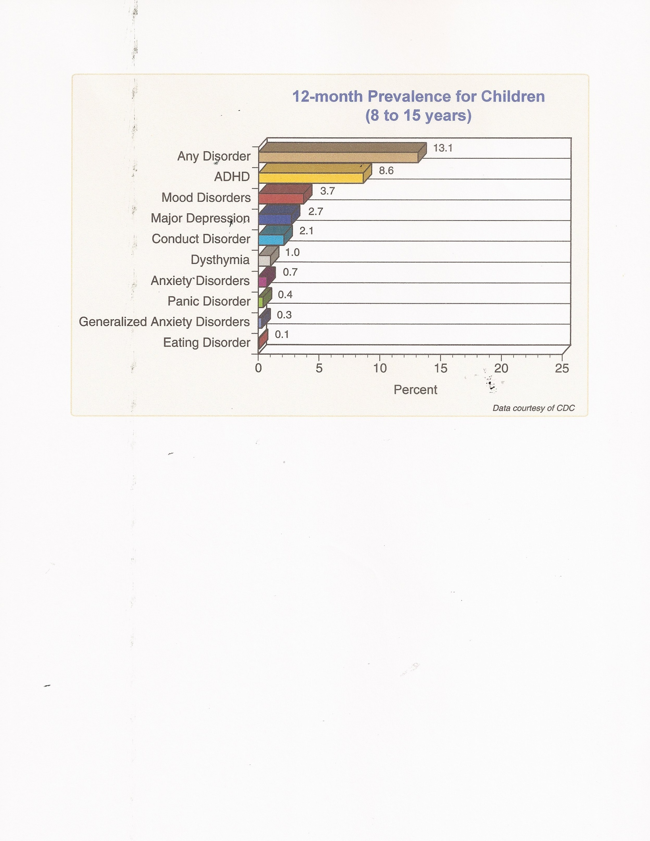

Slide 32
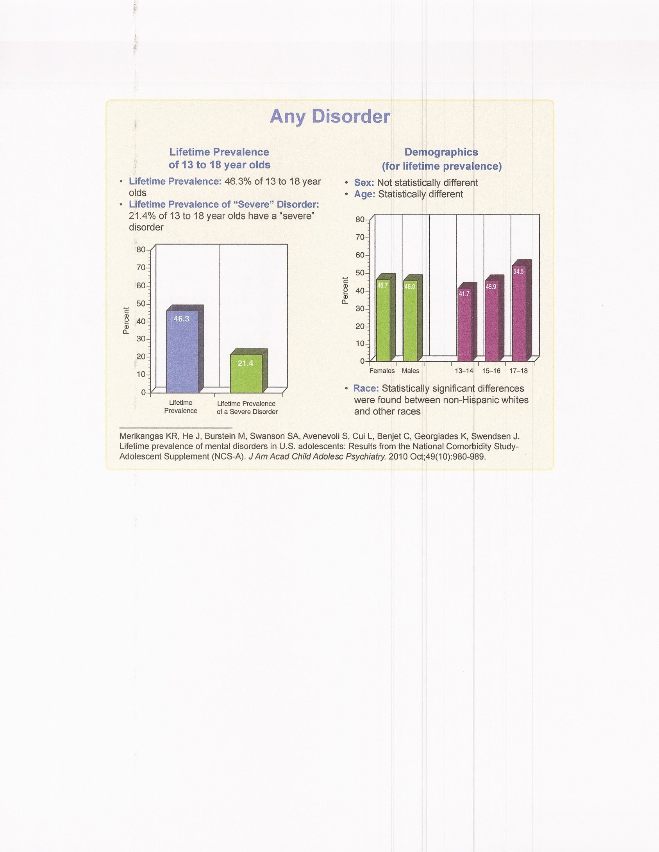

Slide 33
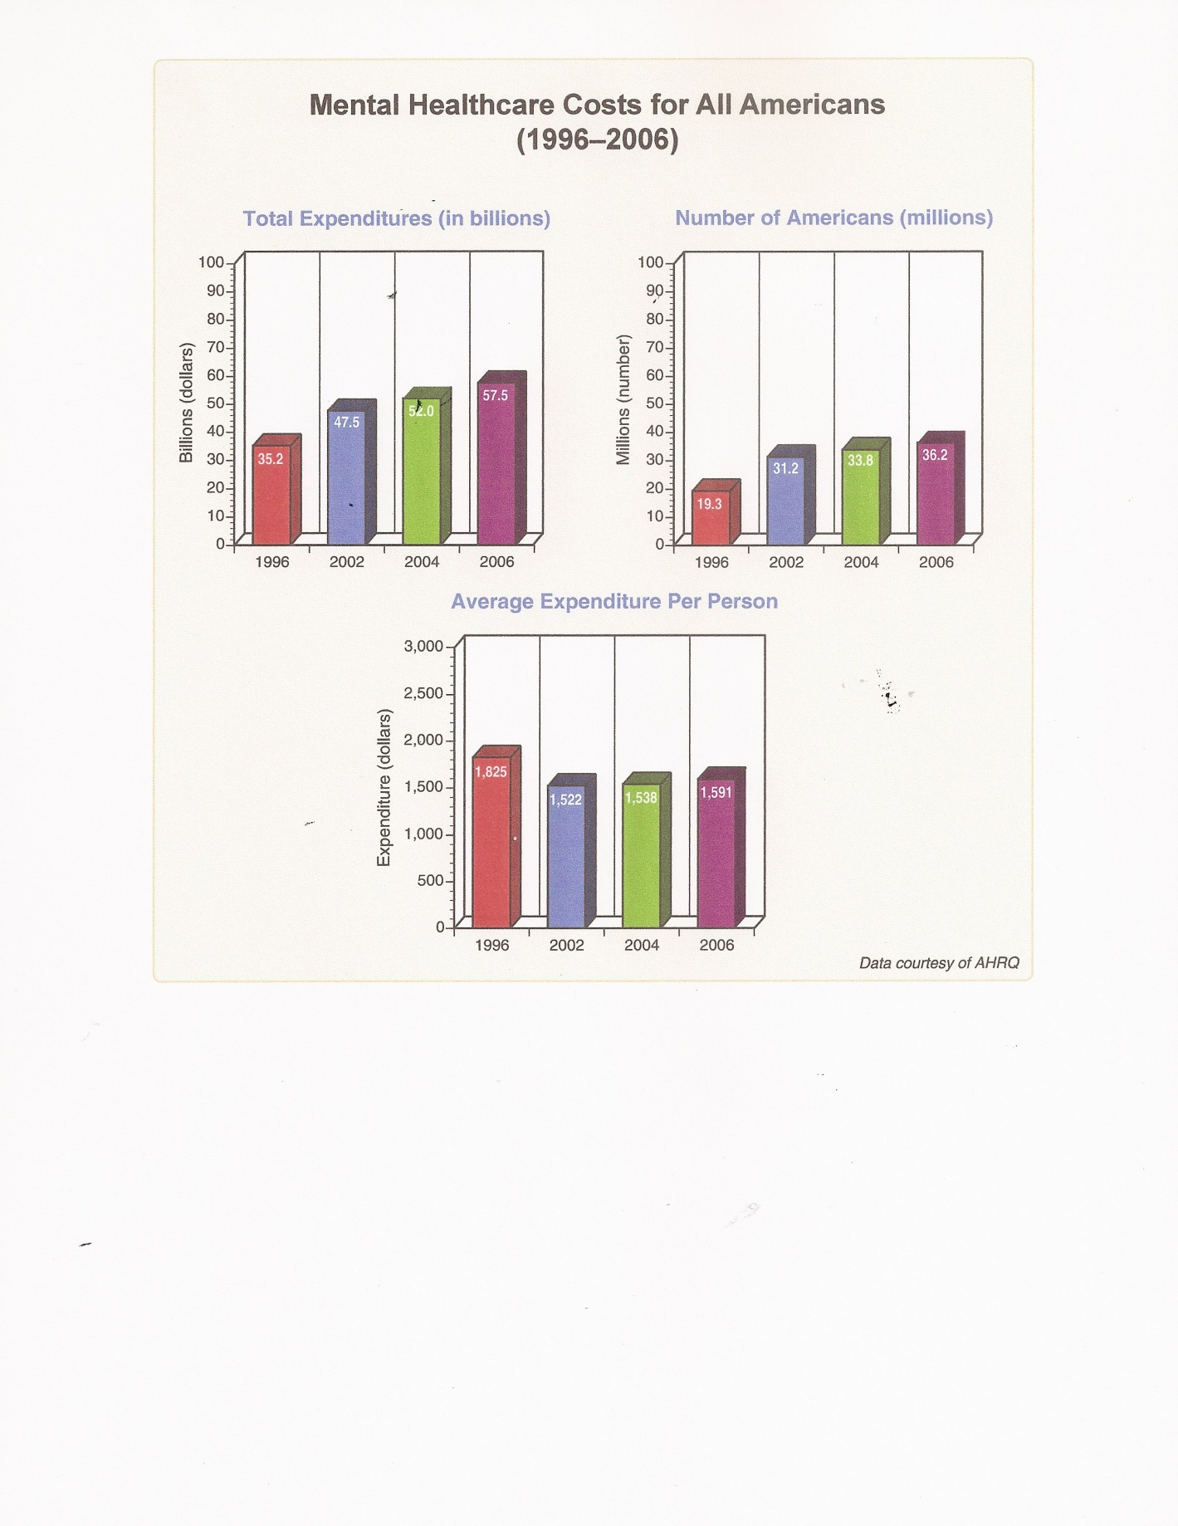

Slide 34
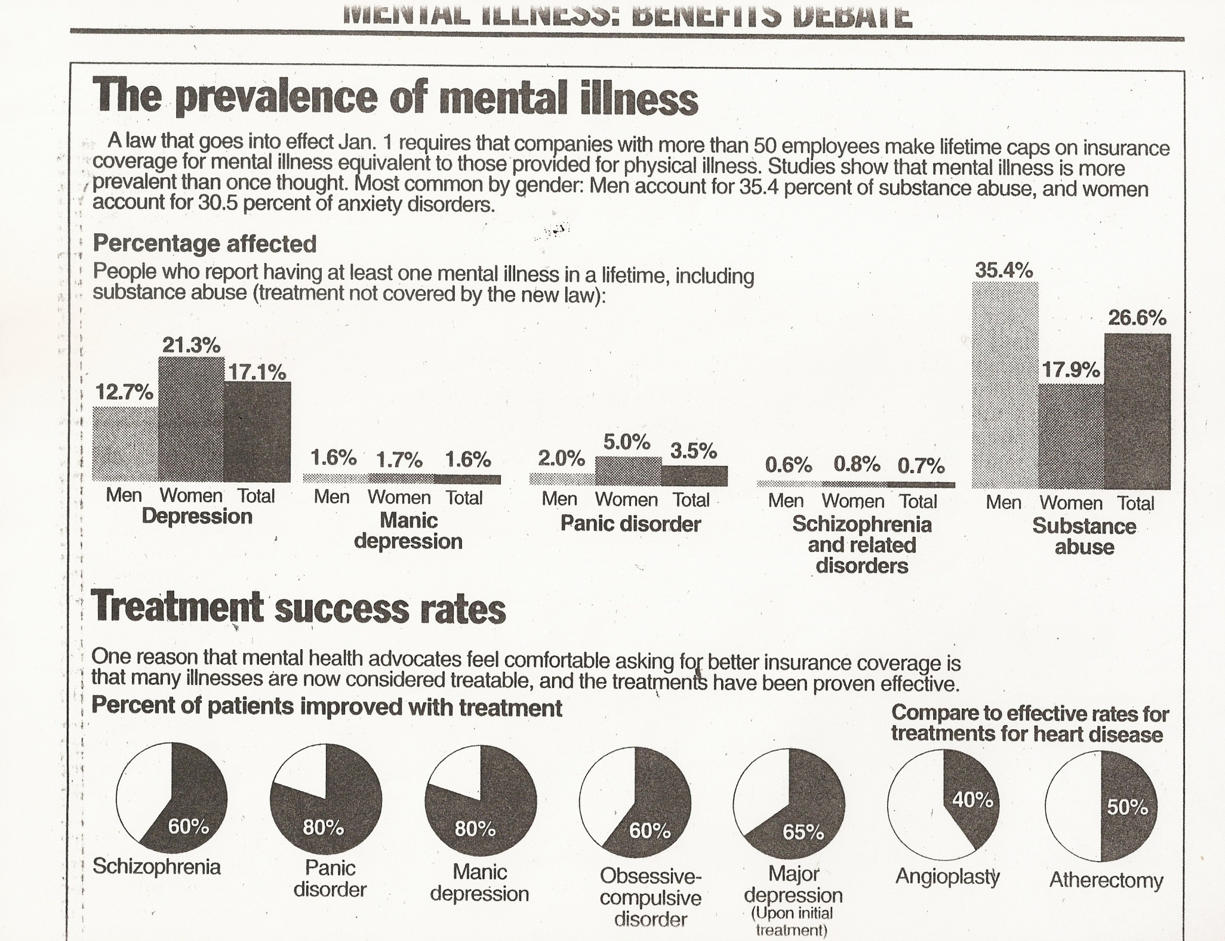

Slide 35
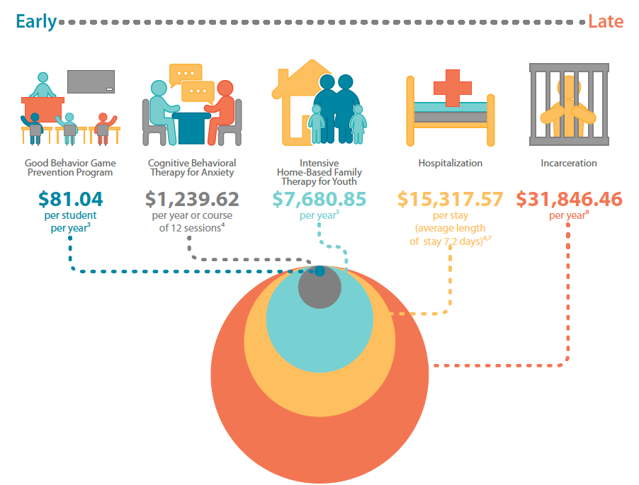

Slide 36
Diagnostic theory
Principle of Hierarchy. Address the most severe possible diagnosis then work down the list of possible diagnoses.
Principle of Parsimony: What is the simplest and “cleanest” diagnosis or diagnoses to account for all of the symptoms and behaviors. KISS.

Slide 37
Assessment Process
History: Case study & Review of Records
Interview: Psychosocial & Mental Status
Examination
Behavioral Observations
Norm Referenced Testing & Referrals
Resolve diagnostic uncertainties

Slide 38
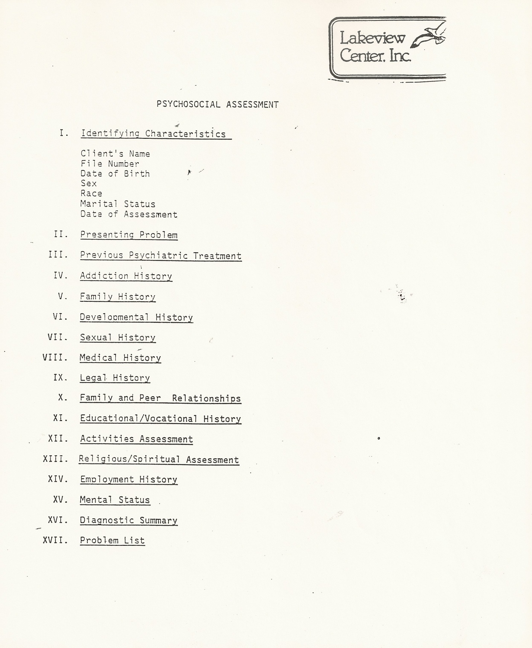

Slide 39
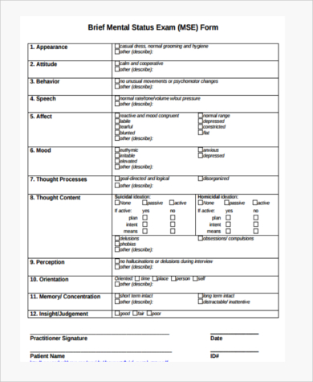

Slide 40
7 Steps for making a diagnosis
Collect data.
Identifying pathologies.
Evaluate reliability of the data.
Determine overall distinctive features.
Arriving at the Diagnosis.
Check diagnostic criteria.
Resolve diagnostic uncertainty.

Slide 41
Common abbreviations
Sx Symptoms R/O Rule Out
Hx History NOS not otherwise
Dx Diagnosis specified
Tx Treatment __
Rx Prescriptions C With
H&P History & Physical __
AEB As Evidenced By S Without
Pt. Patient

Slide 42
Prognosis
1. Natural course of the pts. disorder.
2. Highest prior level of functioning.
3. Duration of present illness.
4. Abruptness of onset.
5. Age of onset.
6. Availability of effective treatment.
7. Treatment compliance.
8. Having a supportive social network.

Slide 43
Subtypes & Specifiers
Subtypes define mutually and jointly exhaustive phenomenological sub-groupings within a diagnosis (e.g., Delusional Disorder, paranoid type).
Specifiers provide an opportunity to define a more homogeneous subgrouping of individuals with the disorder who share certain features (e.g., Major Depressive Disorder, with mixed features).

Slide 44
Principal Diagnosis
When more than one diagnosis for an individual is given, the Principal Diagnosis is the reason for admission or the presenting problems at the time of intake and the focus of attention or treatment.

Slide 45
Provisional Diagnosis
The Specifier “Provisional” can be used when there is a strong assumption that the full criteria will ultimately be met for a disorder but not enough information is available to make a firm diagnosis.
F32.9 Unspecified Depressive Disorder Major Depressive Disorder, Provisional

Slide 46
Sample DSM-5 Diagnosis
F33.0 Major Depressive Disorder, Recurrent,
Mild, With seasonal pattern
F91.3 Oppositional Defiant Disorder, Moderate
F10.20 Alcohol Use, Moderate
Inhalant Use Disorder (Provisional)

Slide 47
NBCC National Mental Health Counselors Exam
Initial interview and assessment
Recommended Testing or Referrals
Diagnosis
Treatment Plan & Ethical Concerns

Slide 48
NBCC Terms & Definitions
Plausible Diagnoses; All possible diagnoses.
Differential Diagnoses: DSM5 defined similar diagnoses to be considered.
Rule Out: Opposite of the diagnosis and the first to be quickly eliminated.

Slide 49
Information Gathering
SPLAT
Symptom Identification
Problem Recognition
Level of Functioning
Assessment Tools
Treatment Progress

Slide 50
Decision Making : TOASTED
Treatment Techniques
Objectives & Goals
Adjunct Services
Services during Treatment
Termination & Referrals
Ethics
Diagnosis

Slide 51
Assessments on the NBCC
Aptitude Tests measure “Success oriented”.
Interest Inventories assess Occupational satisfaction.

Slide 53
Case Study
What is the presenting Problem ?
List all Symptoms and Behaviors.
Note Duration, Time-frame, Intensity.
Where is the dysfunction or setting ?

Slide 54
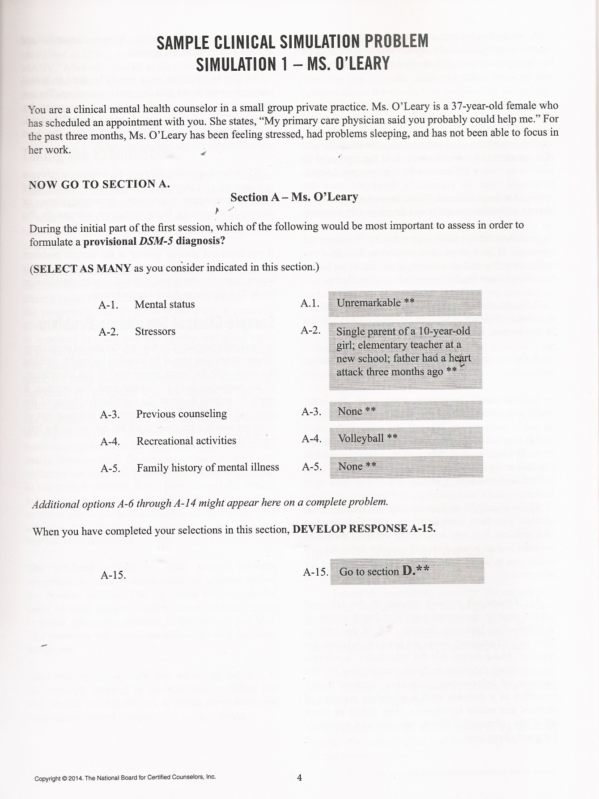

Slide 55
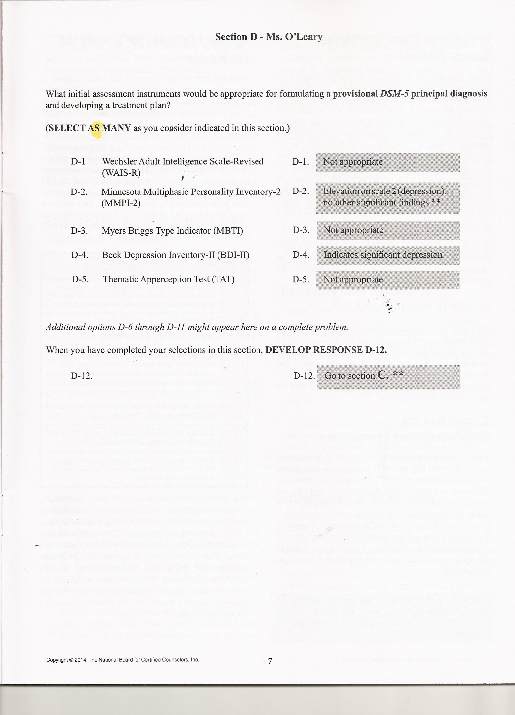

Slide 56
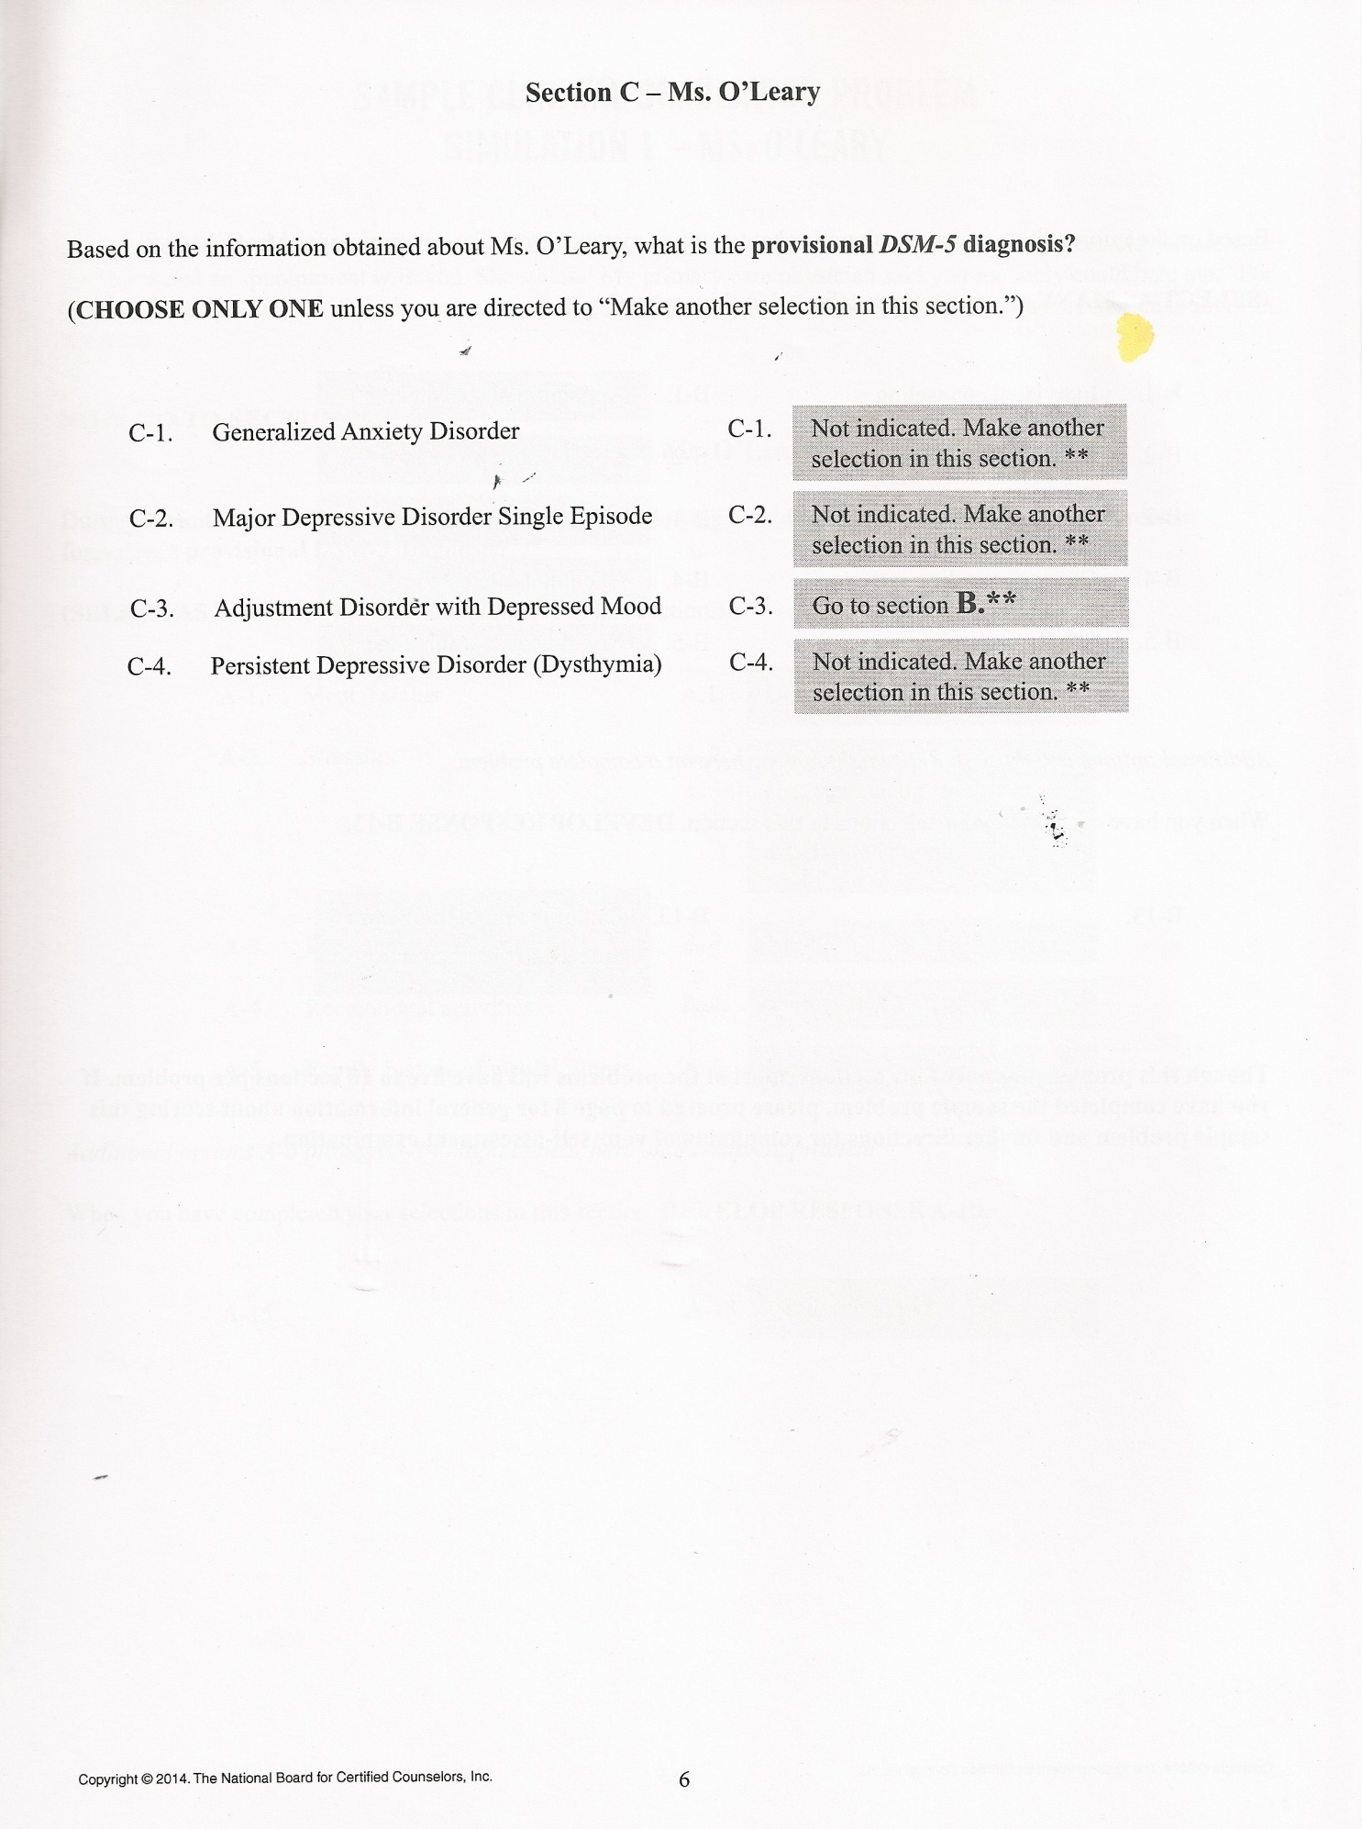

Slide 57
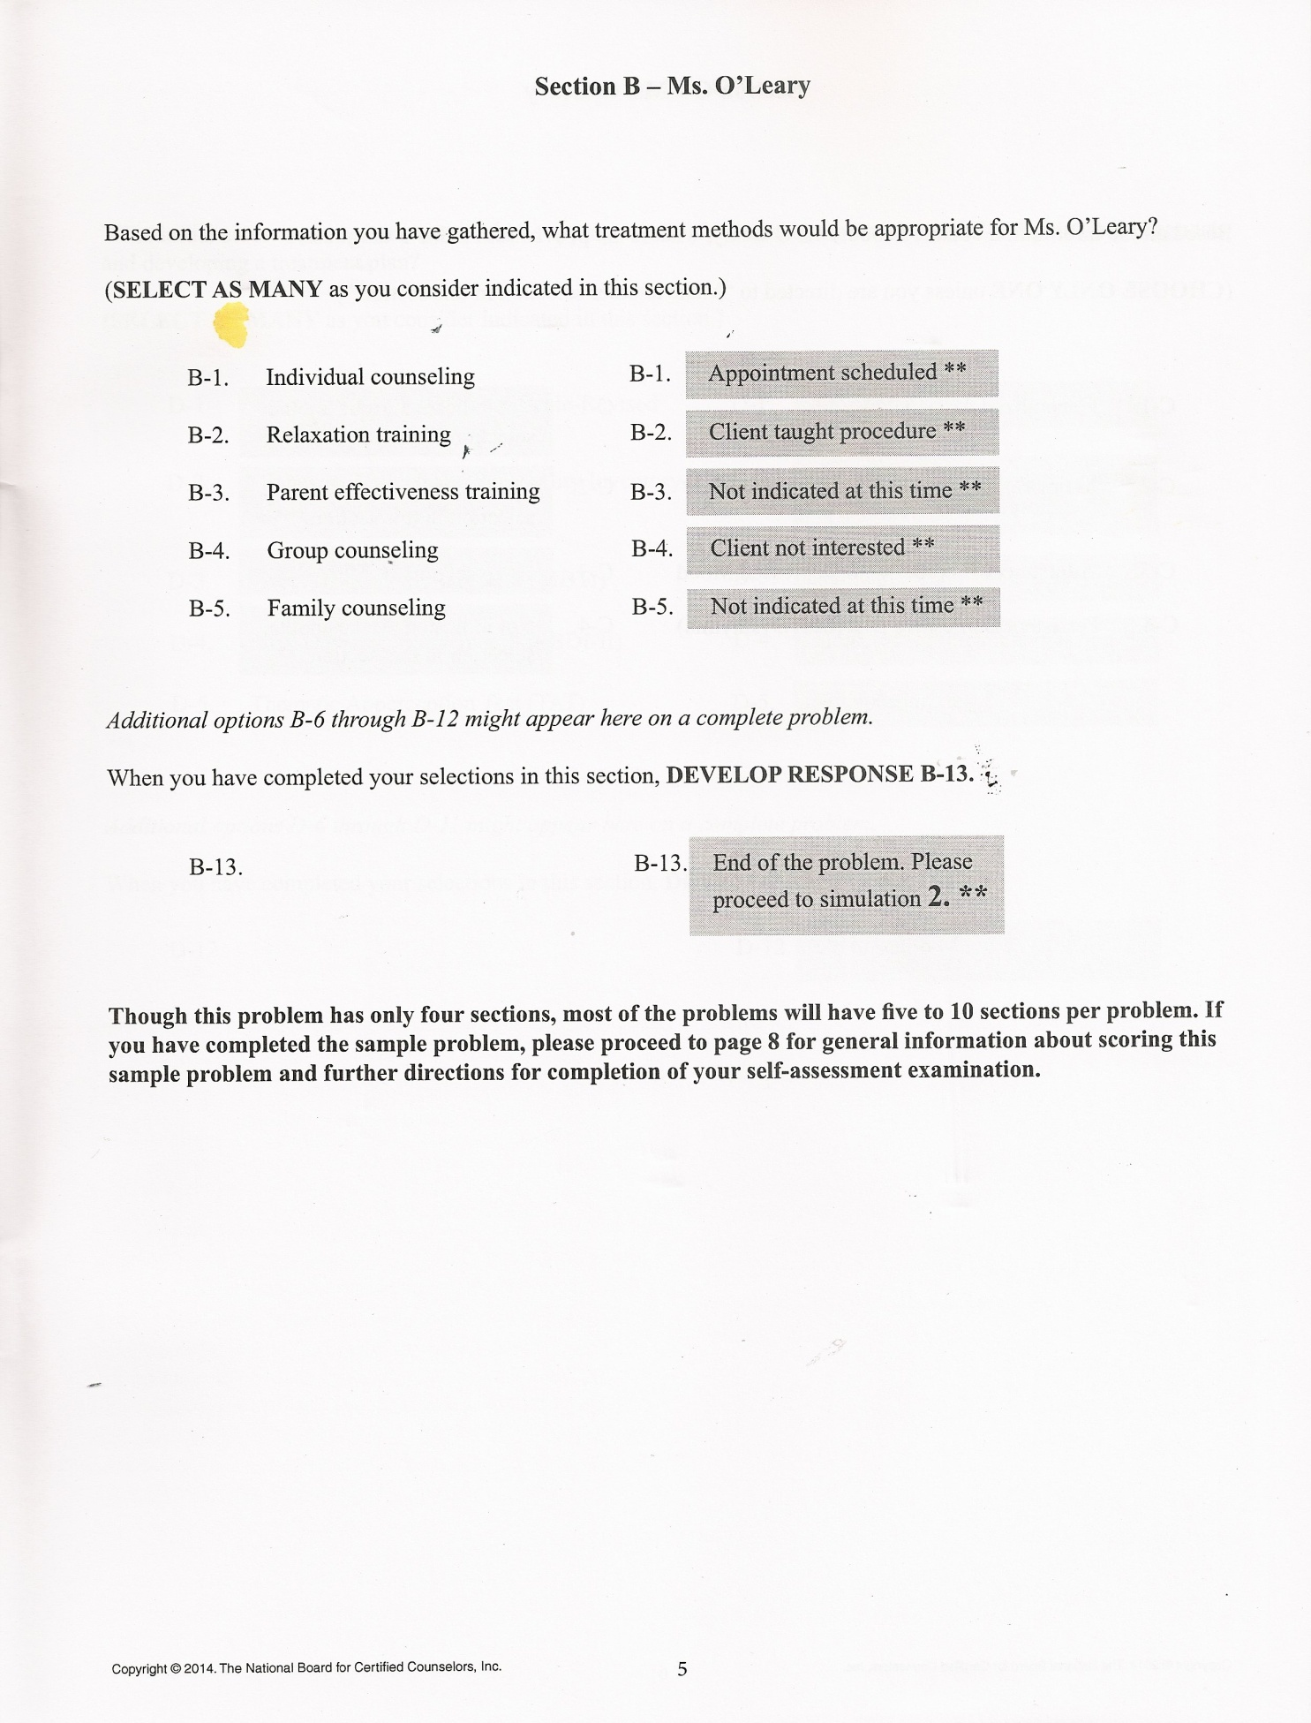

Slide 58
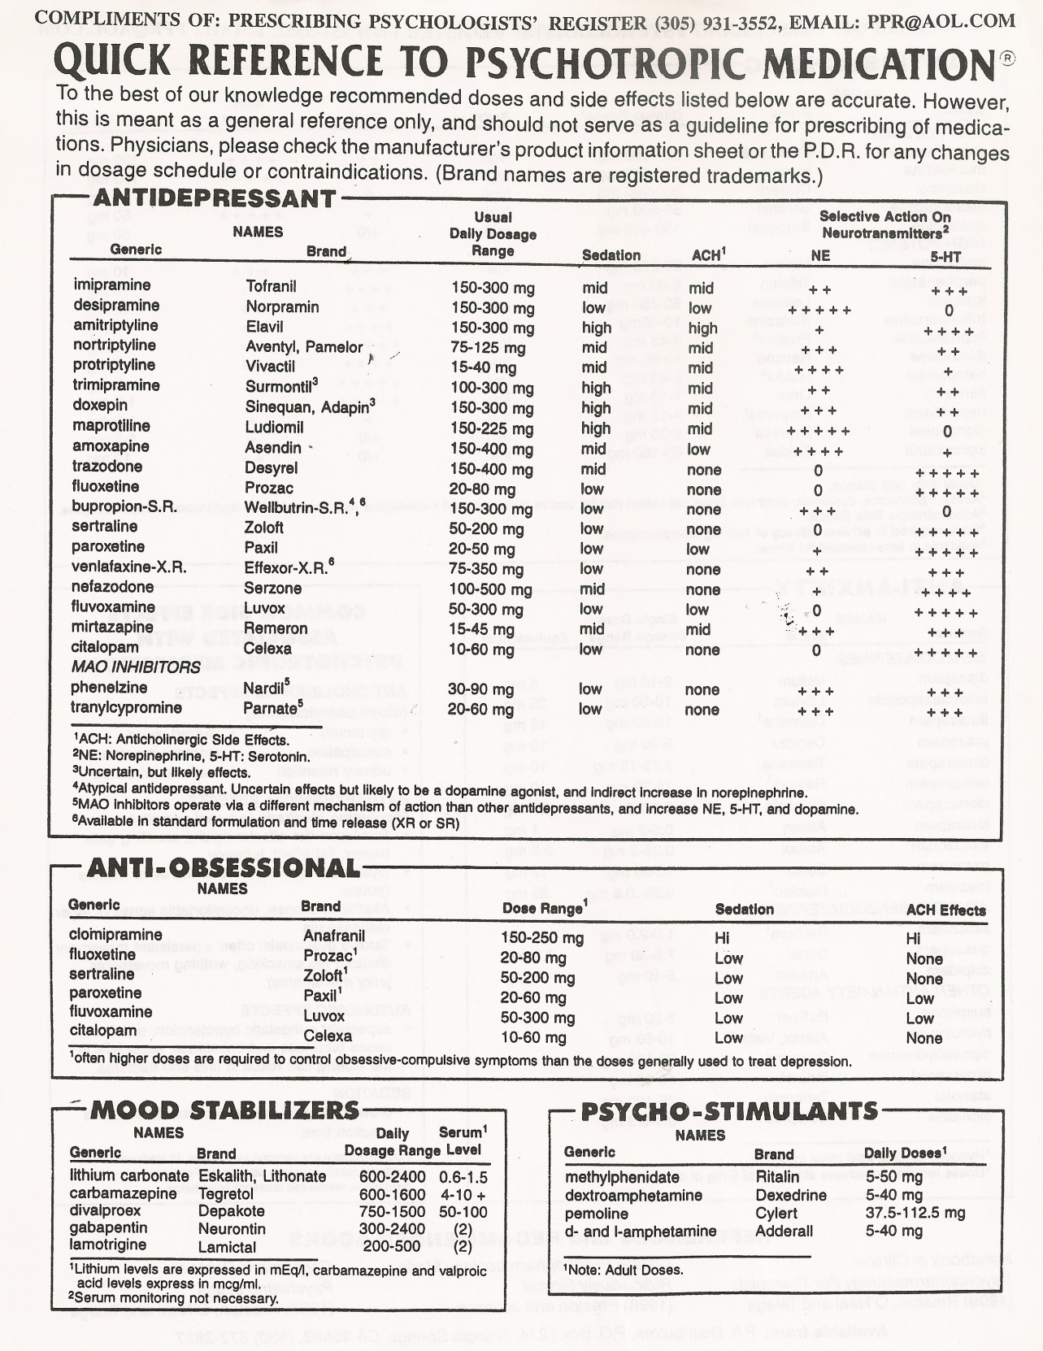

Slide 59
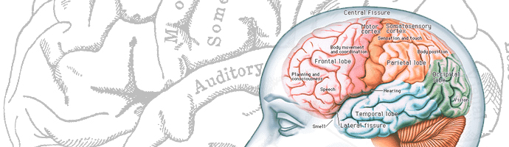
The End
Comments
Question and answer
Thank you!

