Slide 1
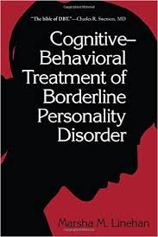
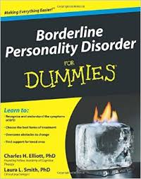
Borderline Personality Disorder PSY6670 Lecture 8

Slide 2
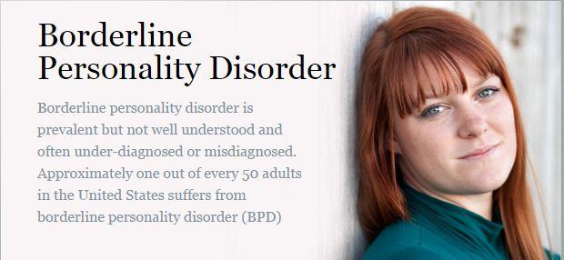

Slide 3
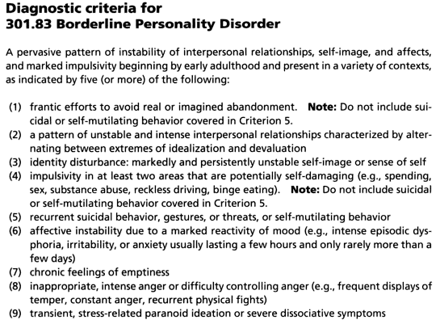

Slide 4
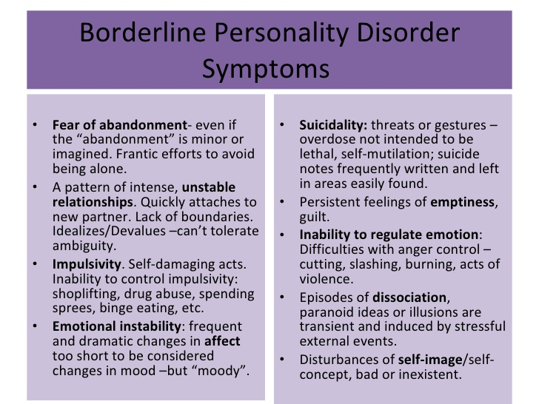

Slide 5
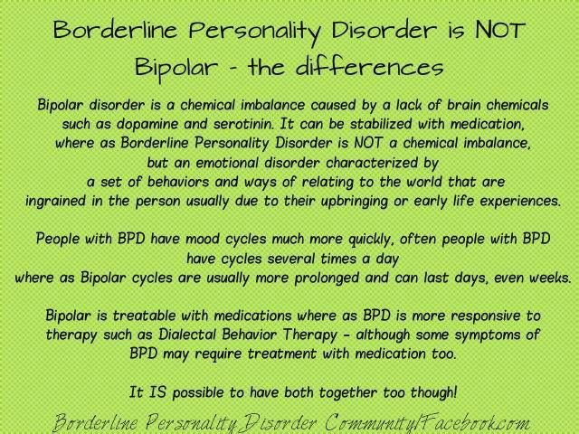

Slide 6
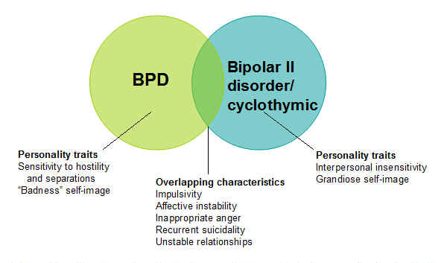
BPD verse Bipolar Disorder

Slide 7
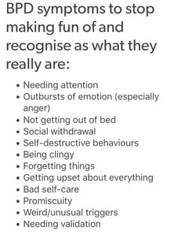

Slide 8
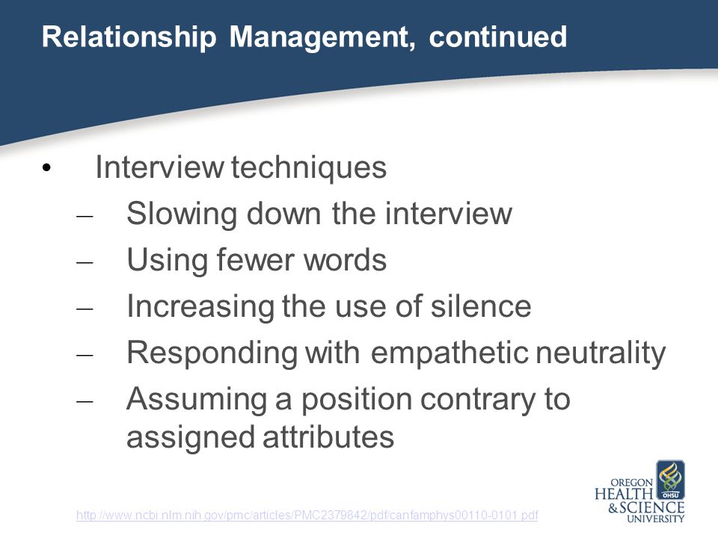

Slide 9
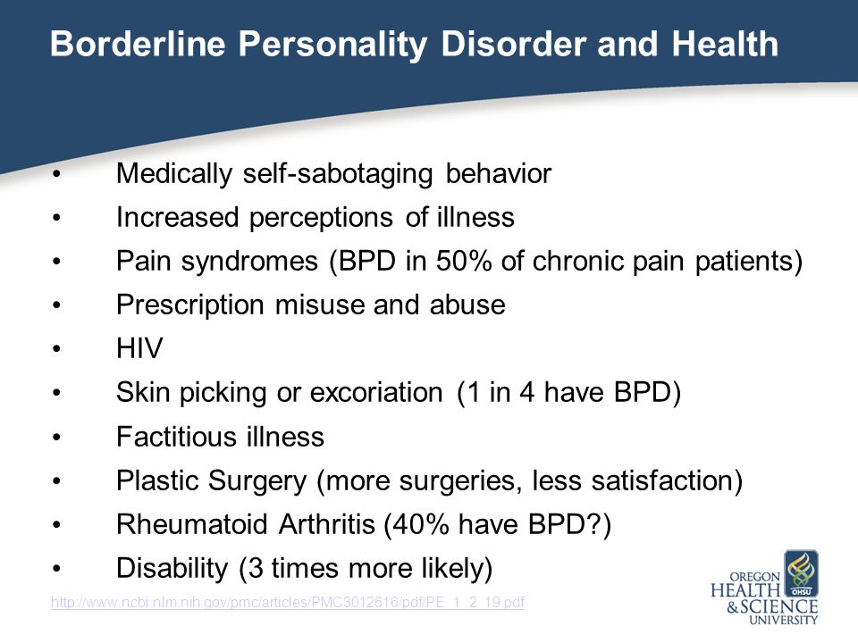

Slide 10
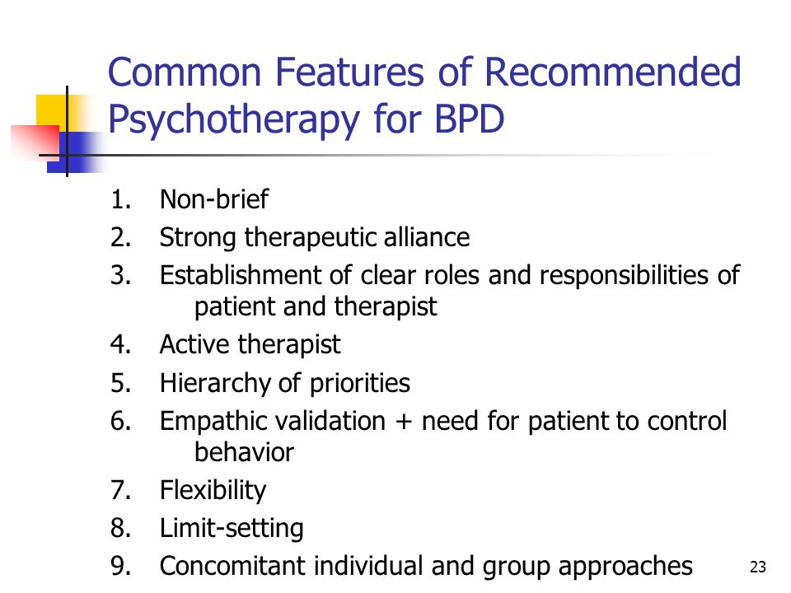

Slide 11
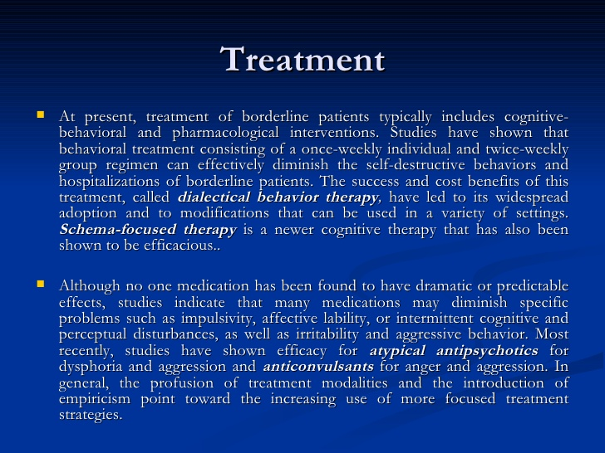

Slide 12
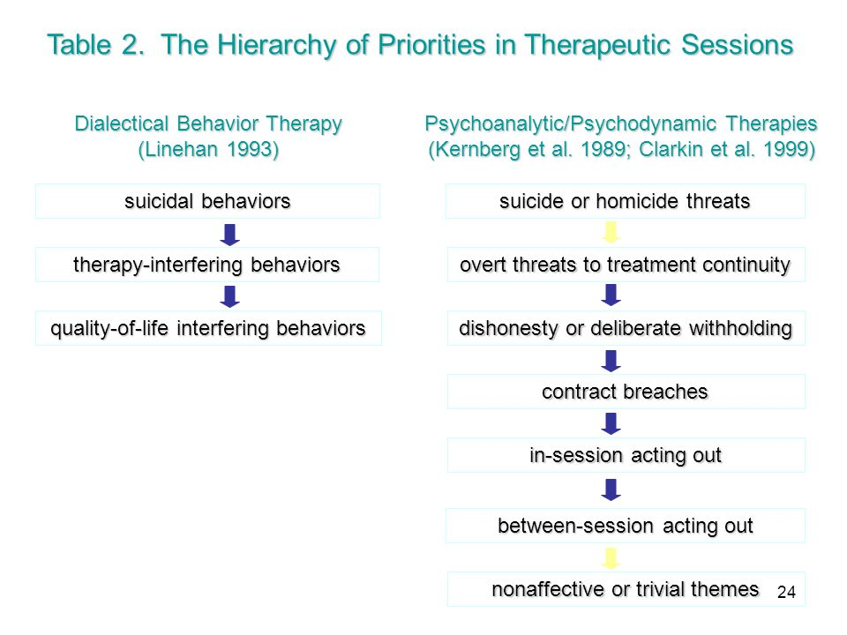

Slide 13
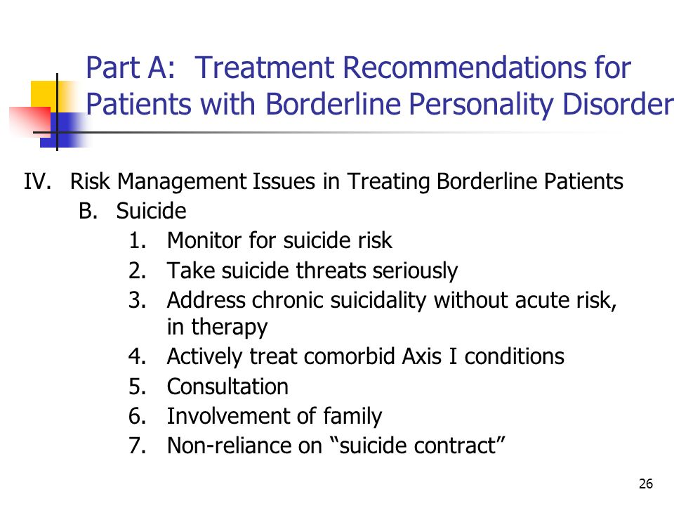

Slide 14
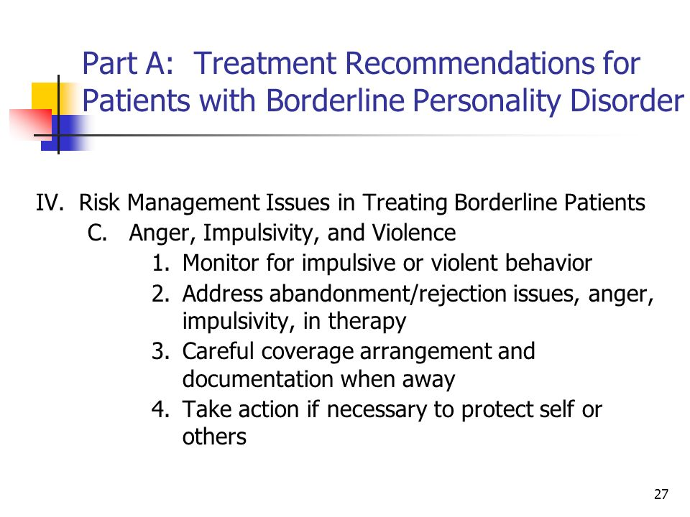

Slide 15
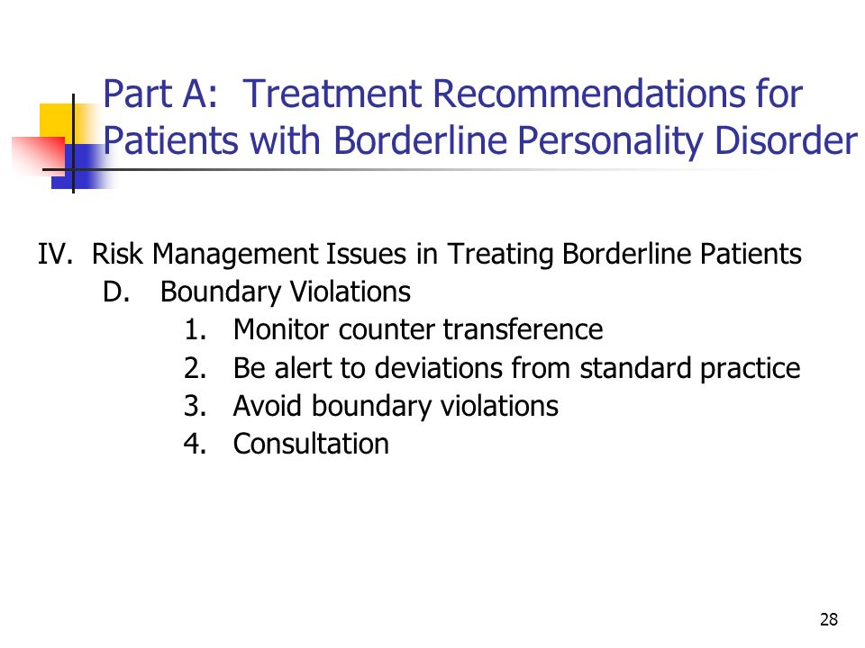

Slide 16
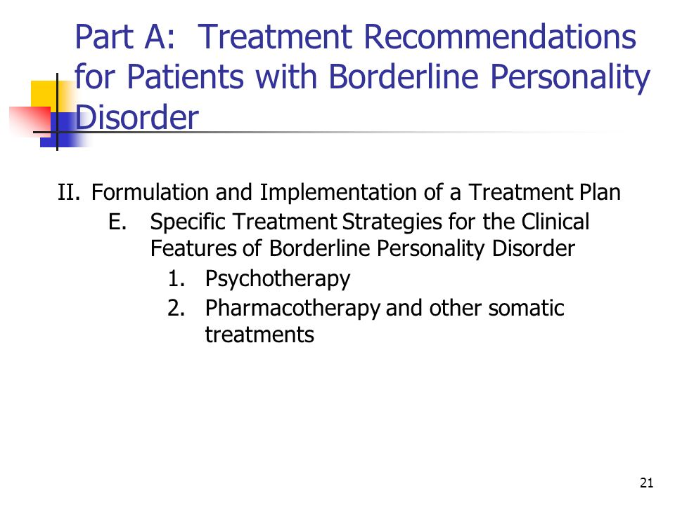

Slide 17
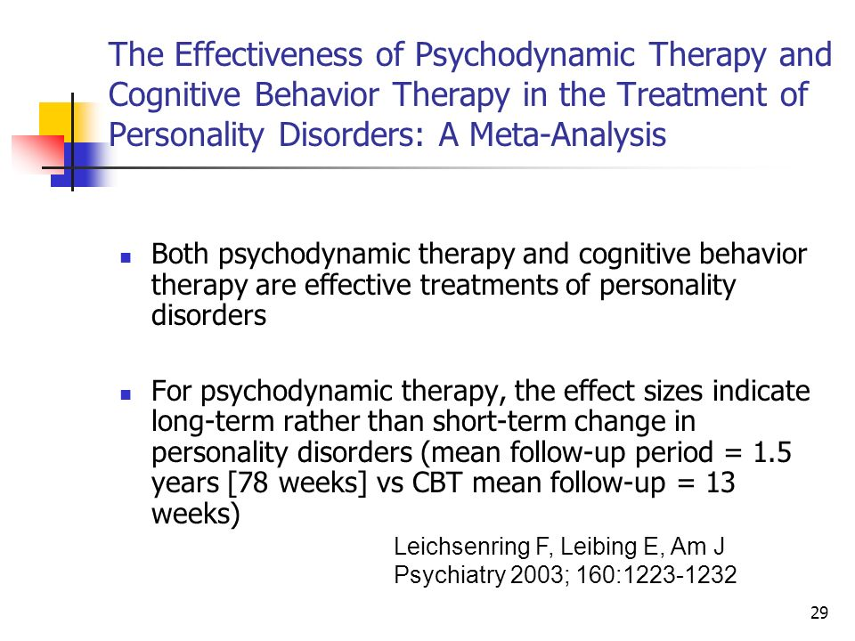

Slide 18
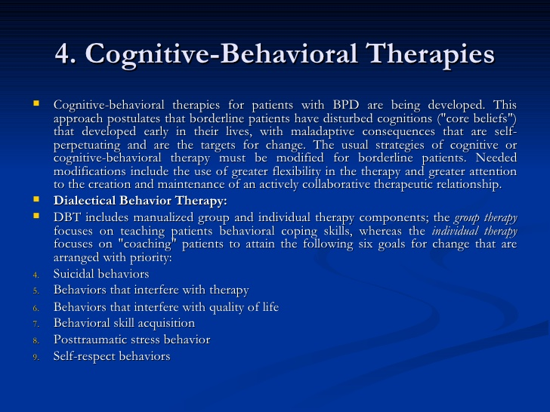

Slide 19
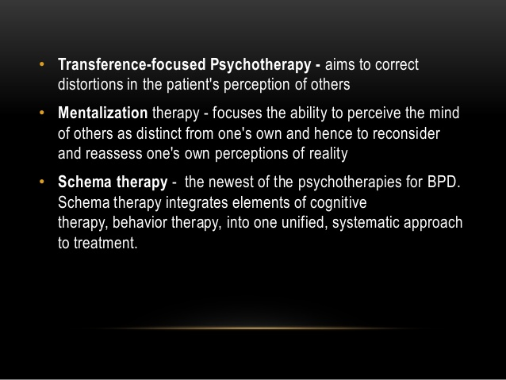

Slide 20
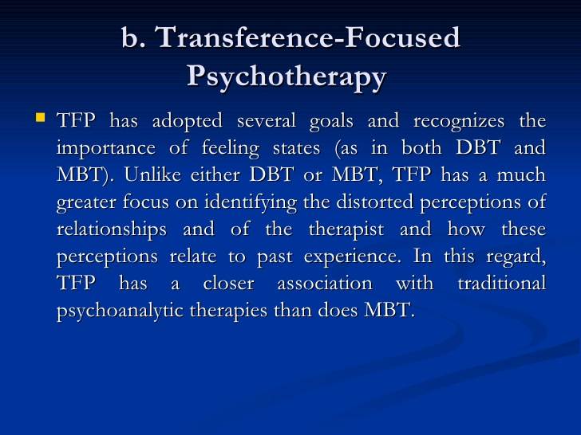

Slide 21
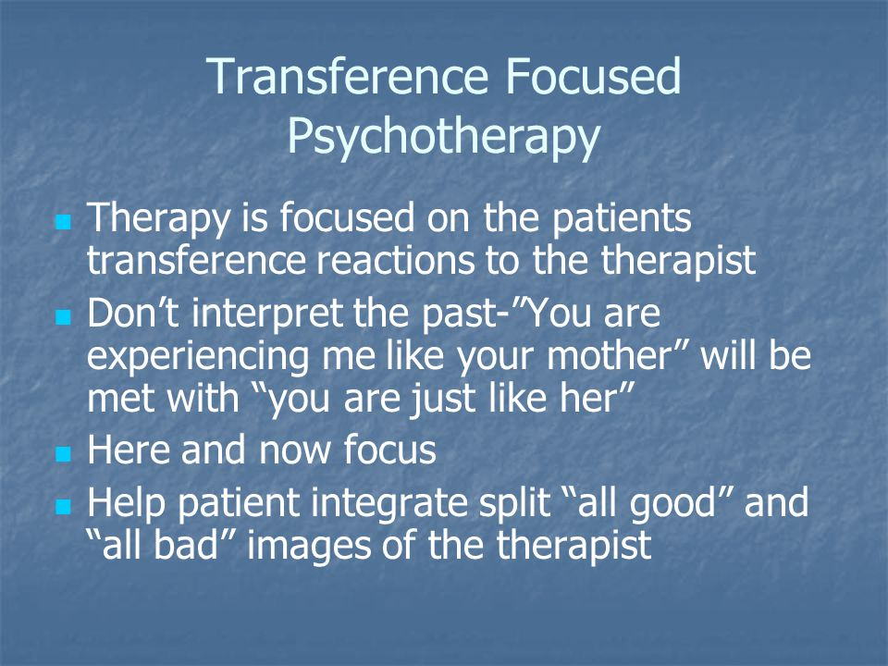

Slide 22
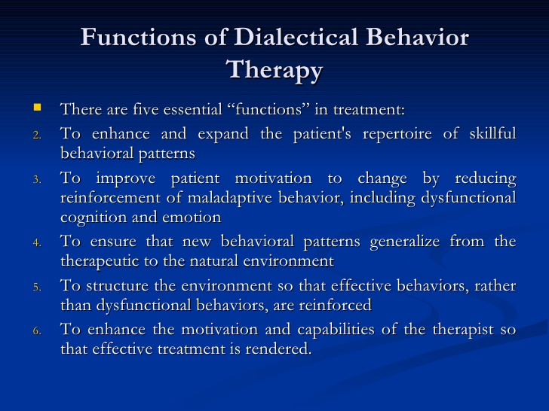

Slide 23
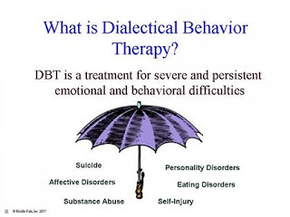

Slide 24
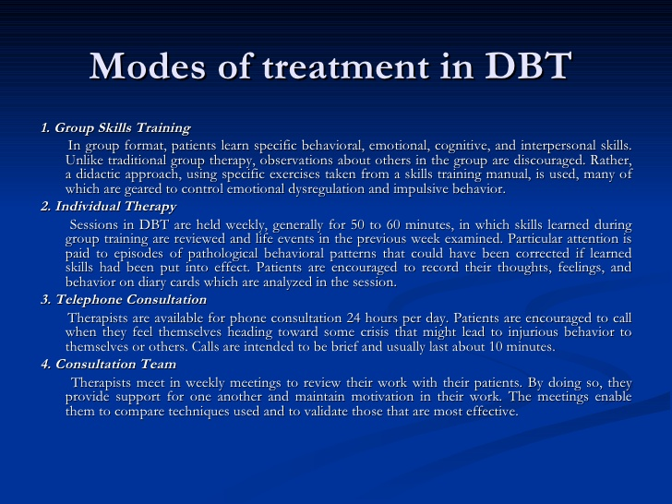

Slide 25
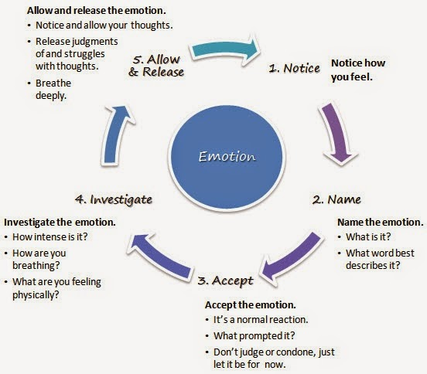

Slide 26
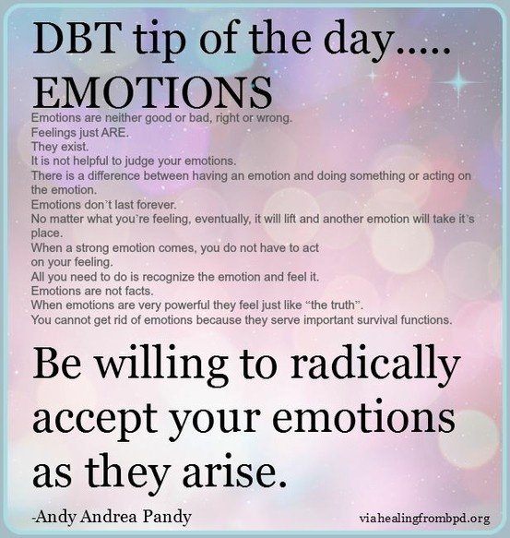

Slide 27
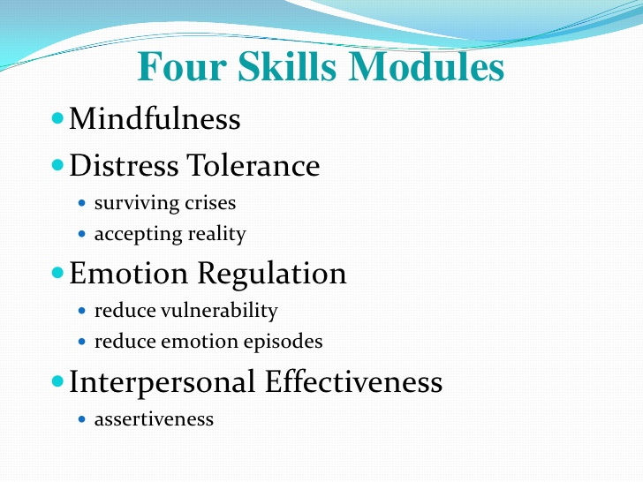

Slide 28
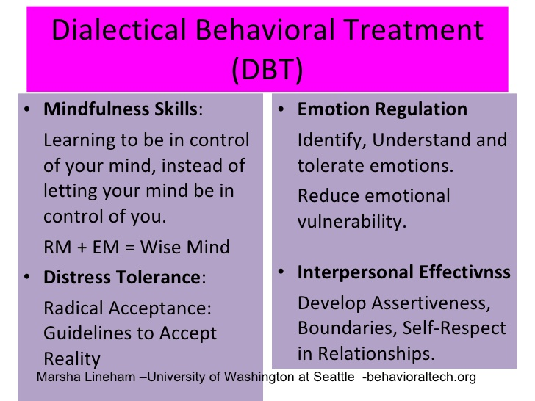

Slide 29
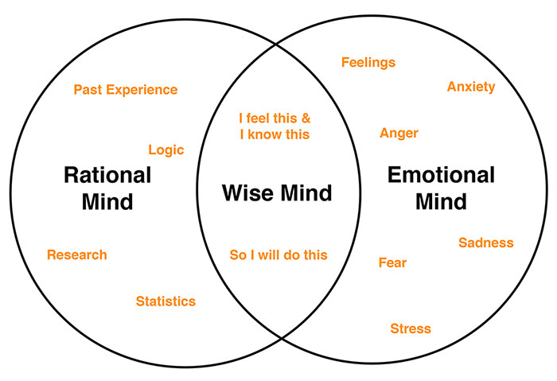

Slide 30
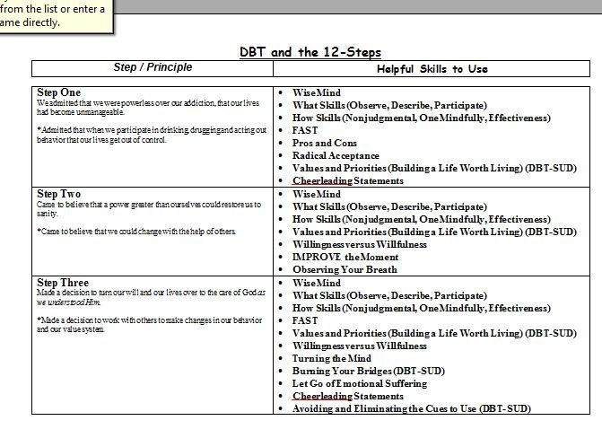

Slide 31


Slide 32
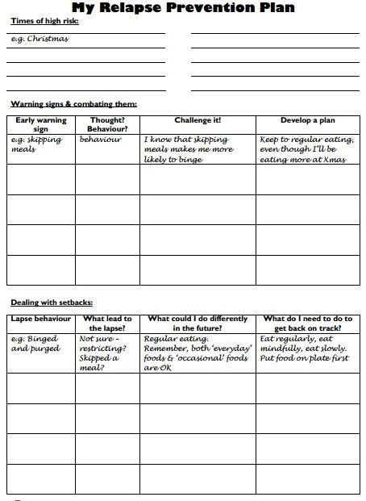

Slide 33
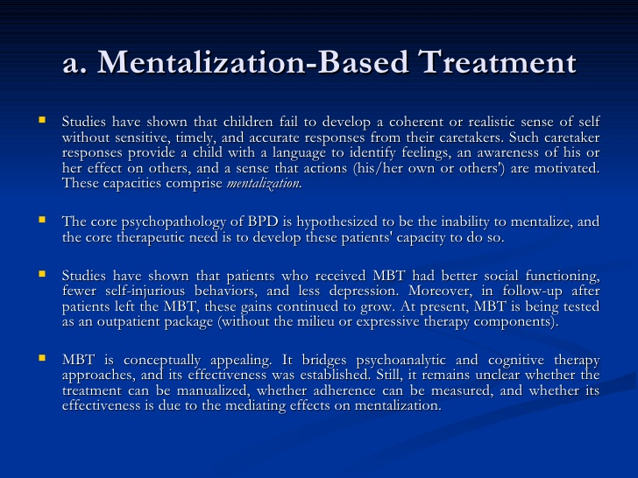

Slide 34
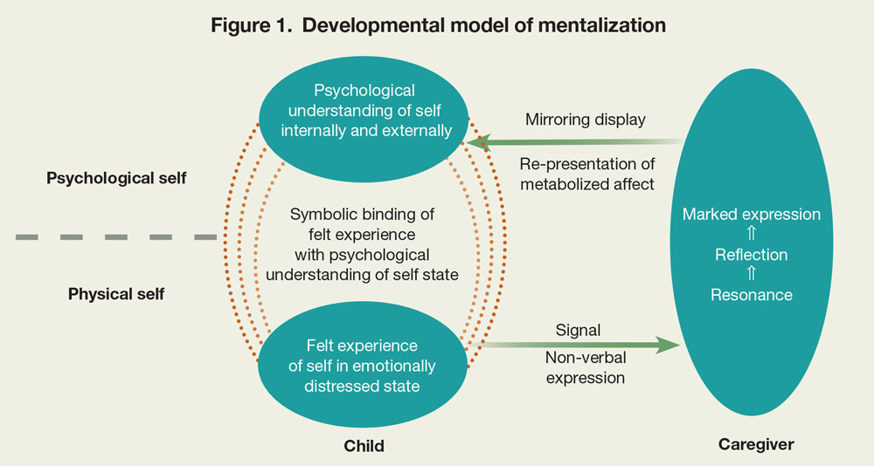

Slide 35
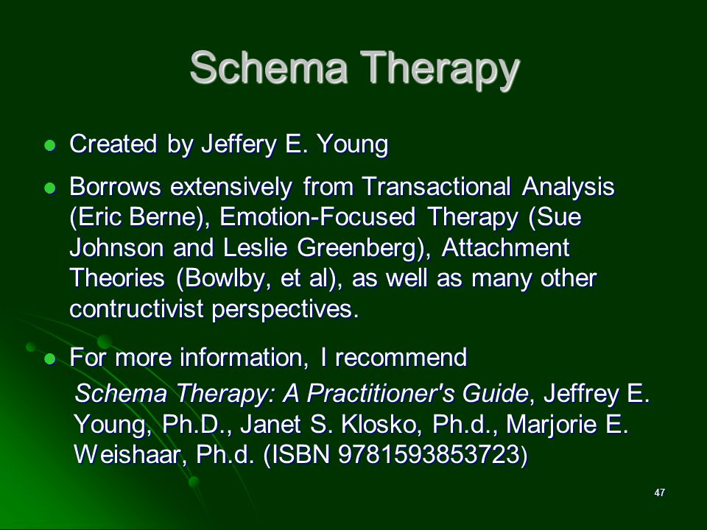

Slide 36
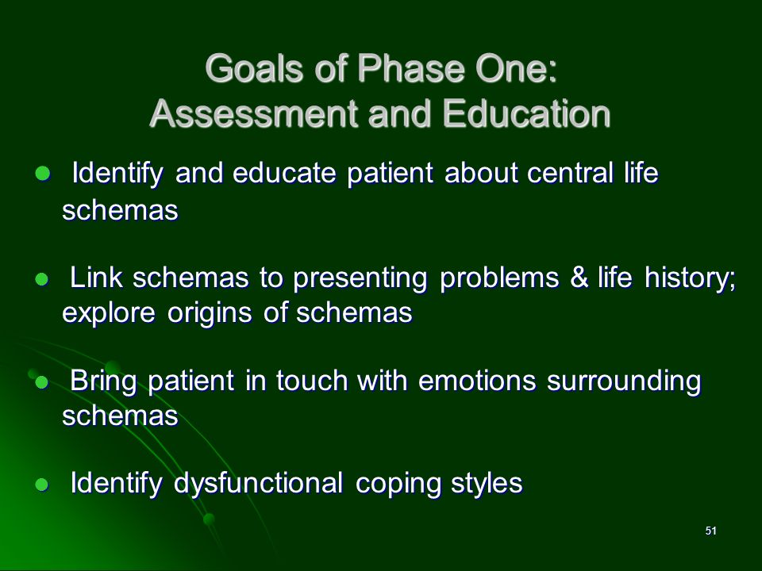

Slide 37
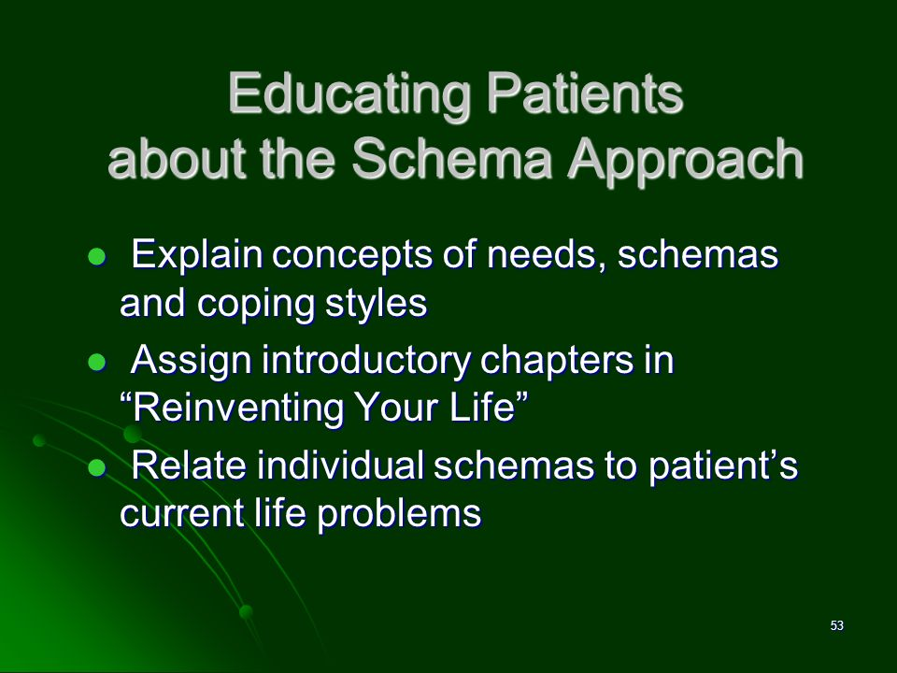

Slide 38
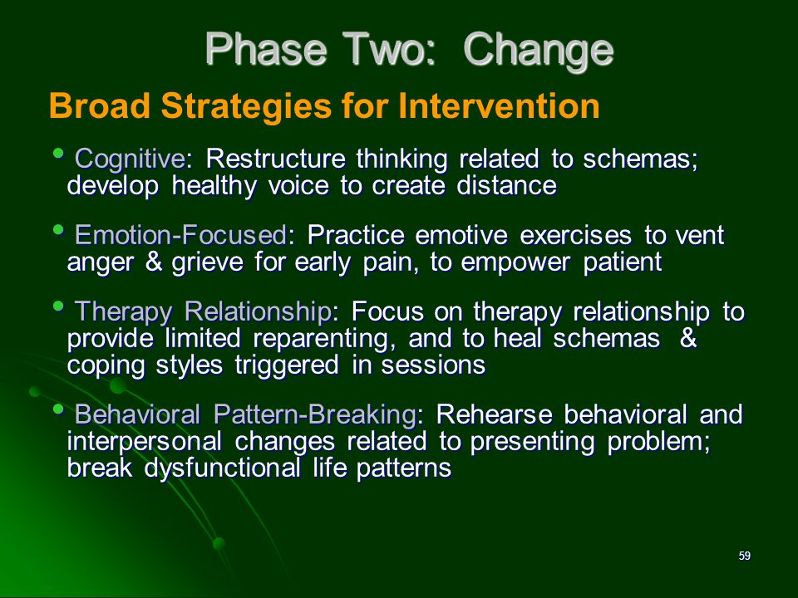

Slide 39
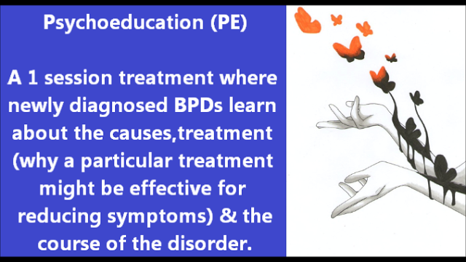
STEPPS follows a manual containing weekly lesson plans for 20 two-hour weekly group meetings led by two co-therapists. It combines cognitive-behavioral elements and skills training (like DBT)with a systematic approach by involving the BPD’s relatives and other treatment provider(therapist…) Each session has a specific emotion and behavior management skill. BPDs monitor thoughts, feelings, and behaviors during the course of the program. This allows them to recognize and (monitor) keep track of changes in their emotional ups & downs. The goals of STEPPS are to educate family members, friends and health care professionals about BPD, giving them guidance on how to interact effectively with the BPD sufferer using the STEPPS approach and terminology (specific STEPPS language).The program is designed to be combined with other treatments, such as medication or individual psychotherapy.

Slide 40
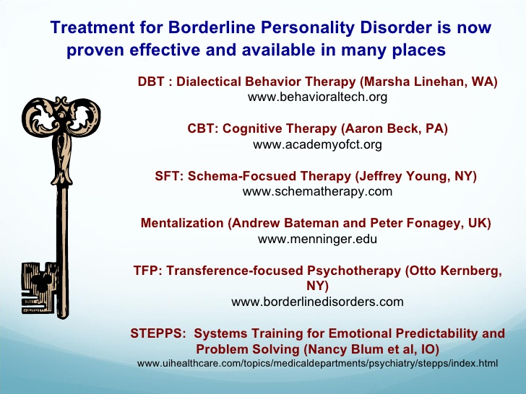

Slide 41
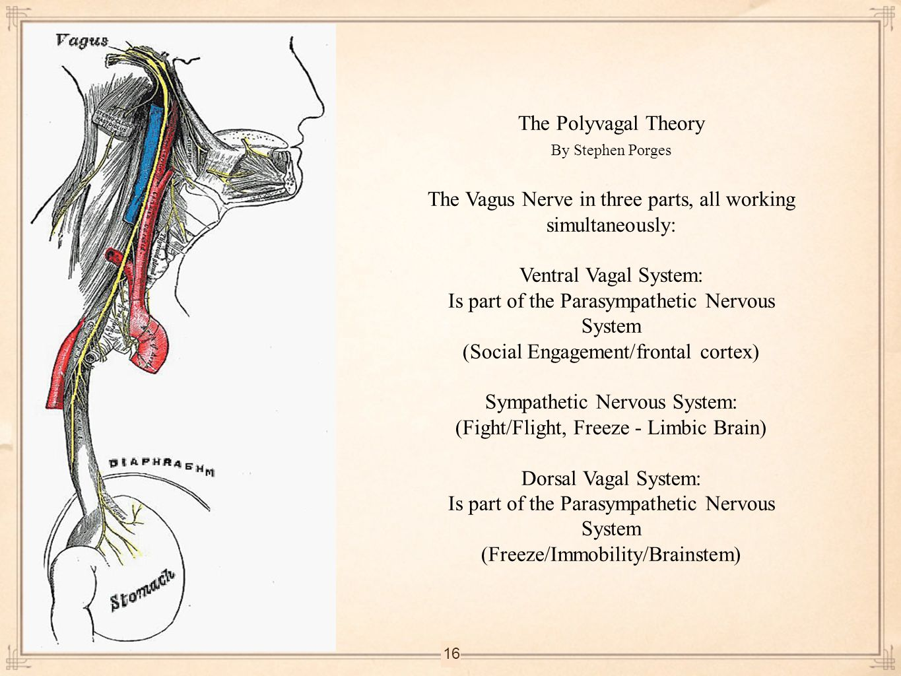

Slide 42


Slide 43


Slide 44
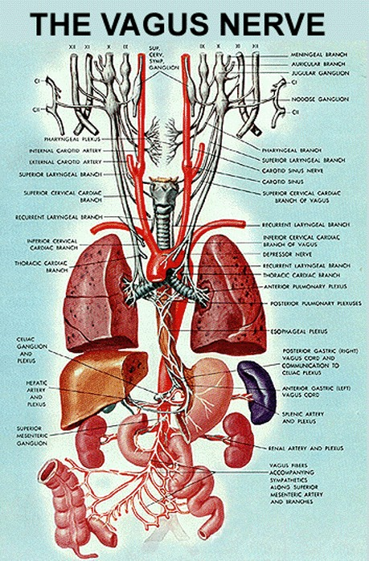

Slide 45
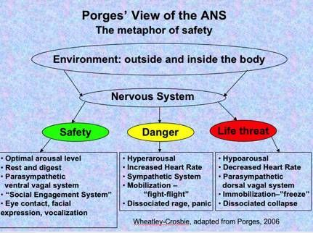

Slide 46
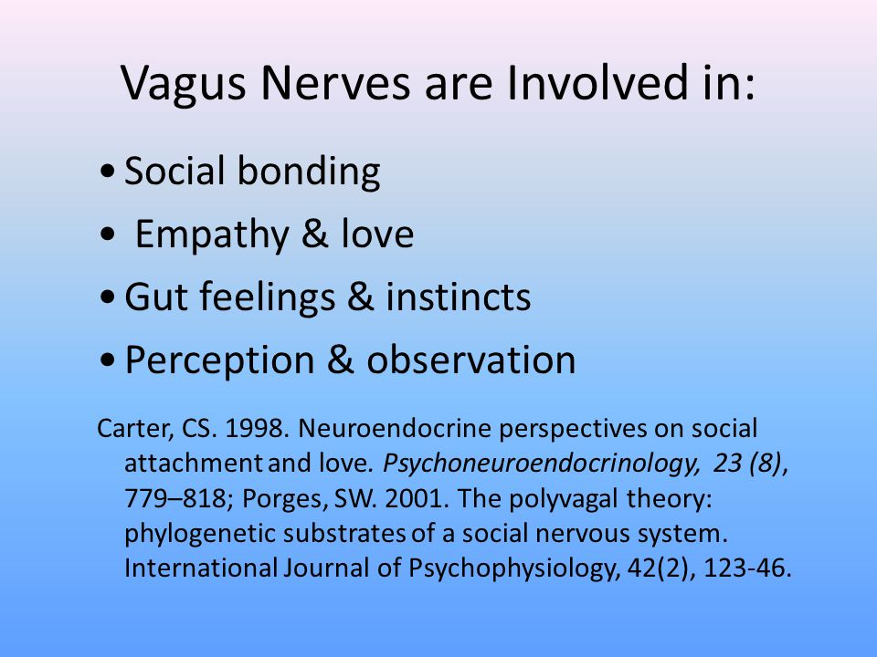

Slide 47
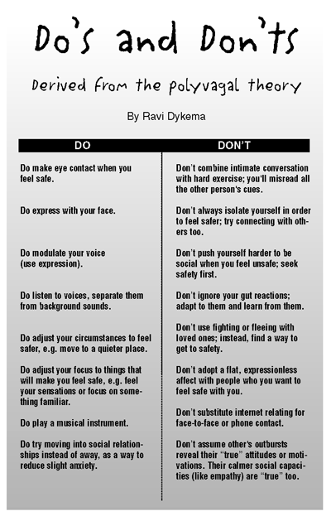

Slide 48
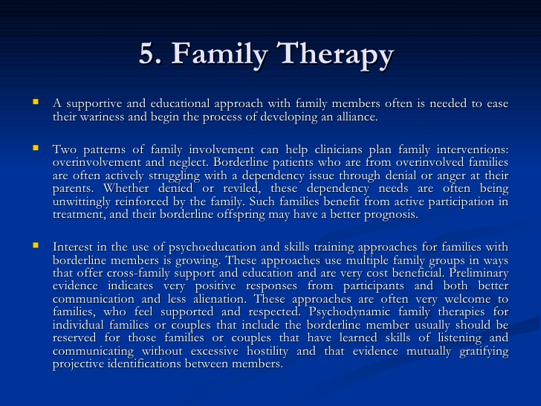

Slide 49
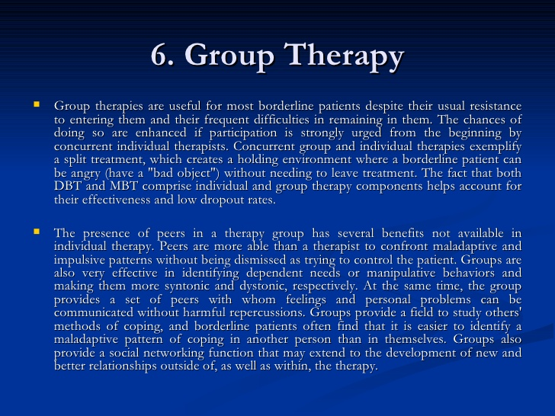

Slide 50
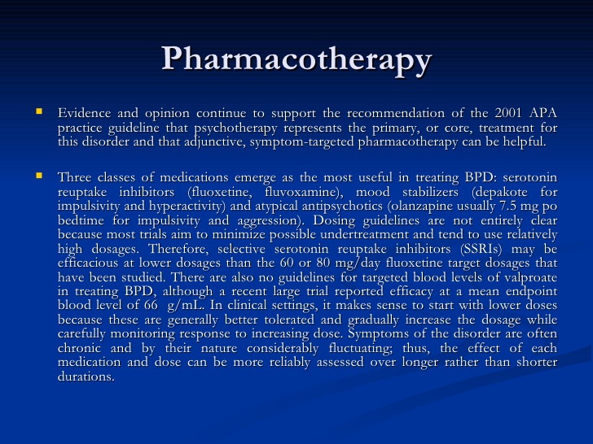

Slide 51
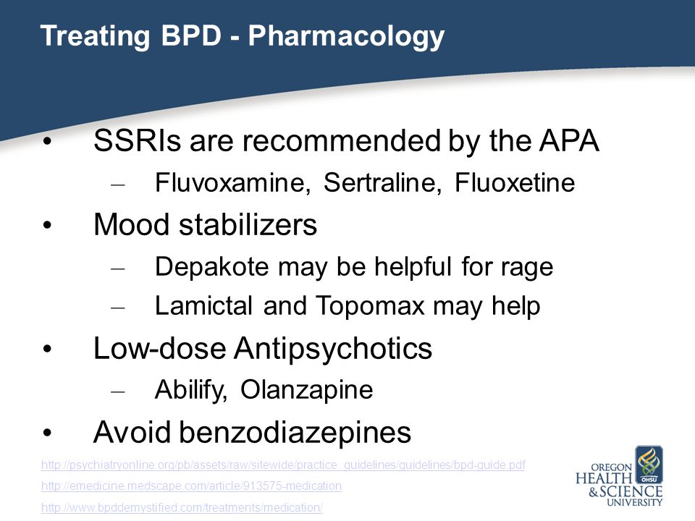

Slide 52
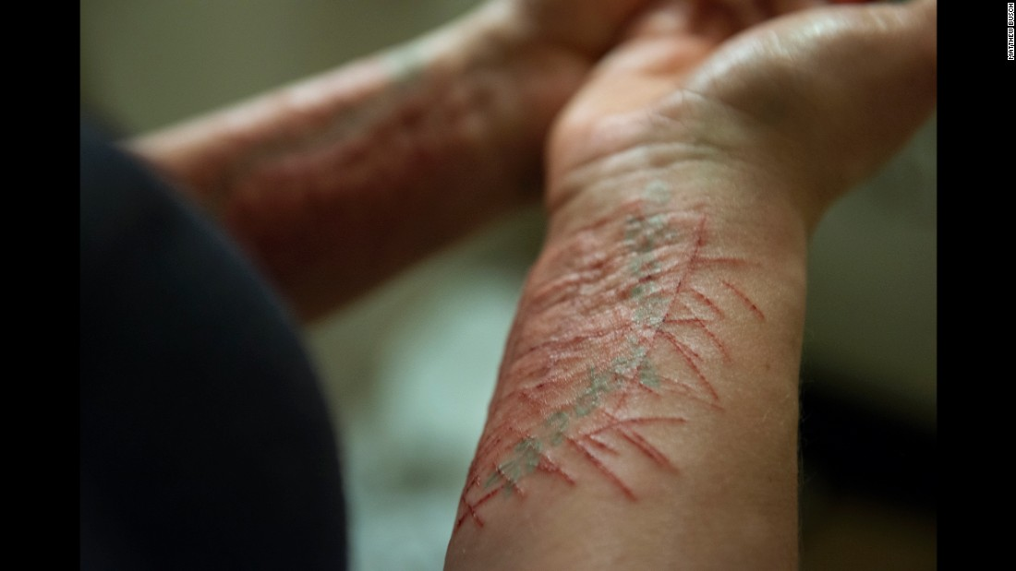

Cutting & Self-mutilating Behaviors

Slide 53


Slide 54


Slide 55


Slide 56


Slide 57


Slide 58


Slide 59


Slide 60

Self - Injurious or Deliberate Self - Harm Behaviors

Slide 61


Slide 62


Slide 63


Slide 64


Slide 65


Slide 66


Slide 67


Slide 68


Slide 69


Slide 70


Slide 71


Slide 72


Slide 73


Slide 74


Slide 75


Slide 76


Slide 77


Slide 78


Slide 79


Slide 80


Slide 81


Slide 82


Slide 83


Slide 84


