Slide 1
PSY 6670 Diagnosis & Treatment Planning Lecture 7: Child & Adolescent Disorders Treatment Planning
Joel Fairbanks, Ph.D.

Slide 2
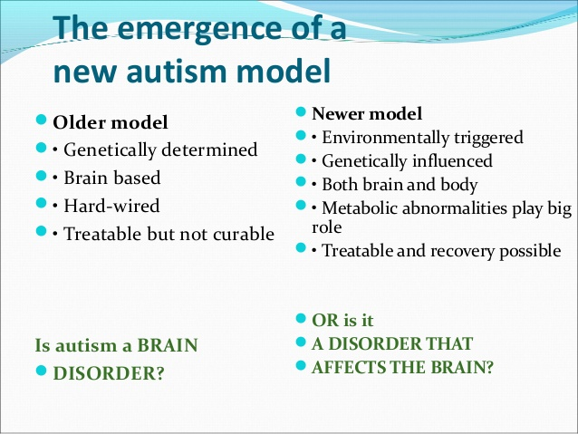

Slide 3
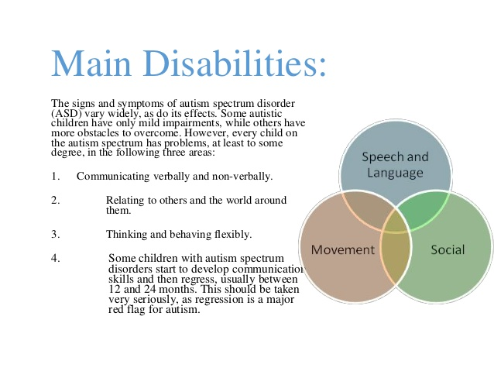

Slide 4
Autism Spectrum Disorder
Estimated in 1.5% of children under 15.
Classic Autism is near 0.25% of youth.
Boys are 3 times more prone than girls.
R/O Speech and Language disorders.
R/O Schizophrenia in childhood.
R/O Reactive Attachment Disorder

Slide 5
Prognosis
15 to 30% of adults with Autism can live and work independently.
Over 25% of children, especially with IQ below 50 exhibit seizures.
Medical illnesses and major stressors can cause regression.

Slide 6


Slide 7
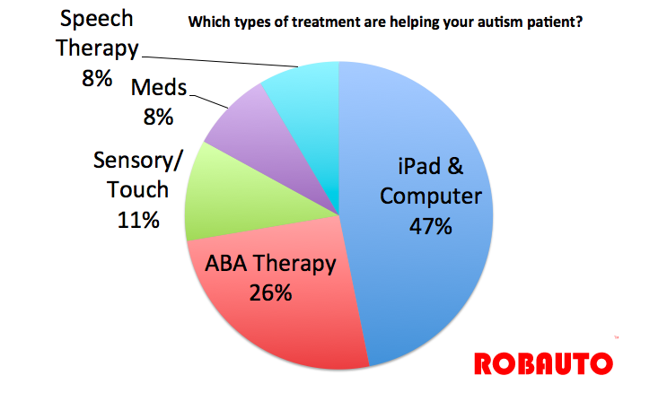

Slide 8
Social Therapies
Picture Schedules
Highly structured activities and routines.
Applied Behavioral Analysis (ABA) and Behavior Modification
Social Skills & Stress Management
Family Therapy (do not neglect “healthy” siblings).

Slide 9
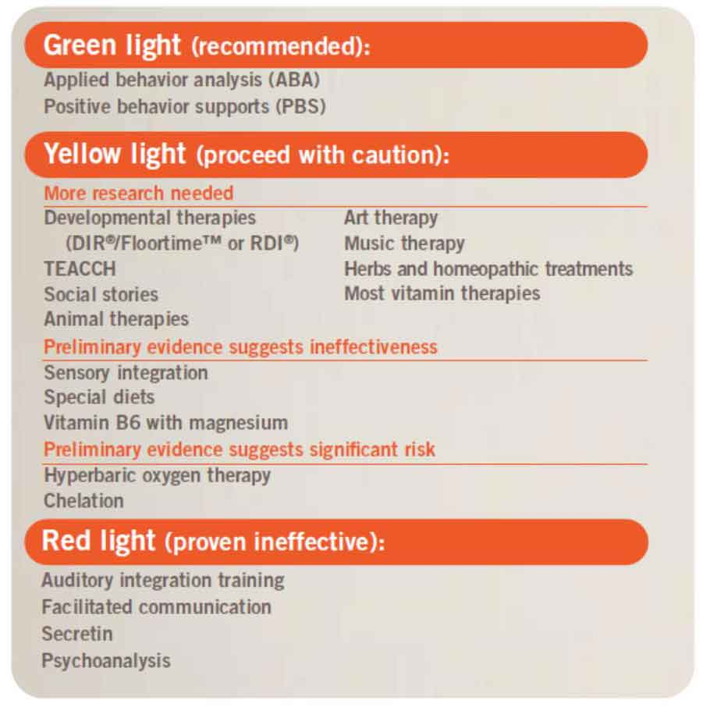

Slide 10
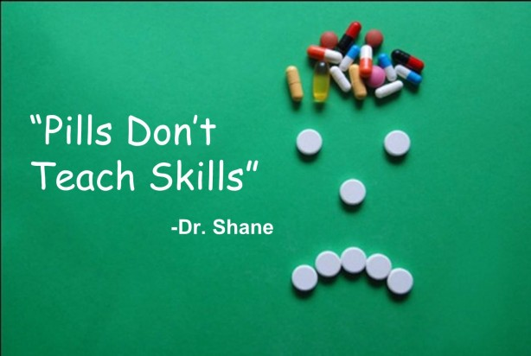
Attention-deficit Hyperactivity Disorder

Slide 11
Attention-Deficit Hyperactivity Disorder
12 % of school population (NYT:11/11/18).
3 to 1 Ratio of boys to girls.
40% of Hyperactive kids also have ODD.
Depression and Anxiety (OCD) are also comorbid with ADHD.
Conduct Disorders misdiagnosed as ADHD.
¼ of Children/teens take prescription medication (NYT:11/11/18)
Risk for Substance Abuse as teens.

Slide 12
Assessment for ADHD
Classroom observations and grades.
Referral for psychological testing.
Referral to Pediatrician (R/O other conditions)
Questionnaires:
Connors’ Rating Scales
Vanderbilt Rating Scale
CBCL or BASC (Behavior Assessment Scale-Children)
Childhood ADHD Rating Scale-Self report

Slide 13
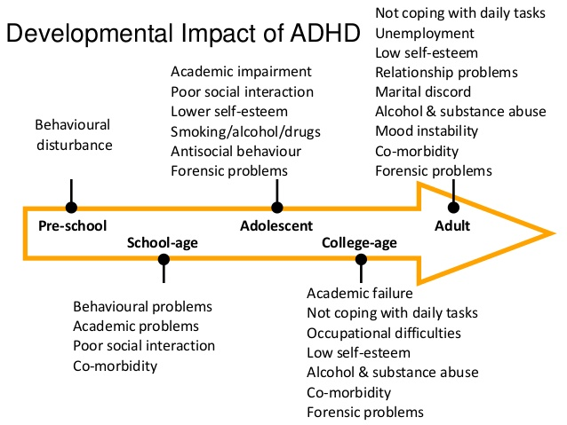

Slide 14
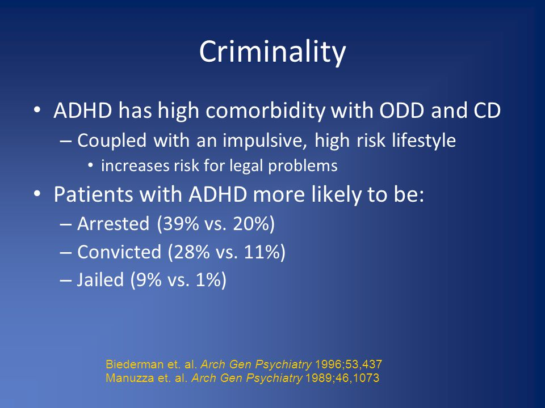

Slide 15
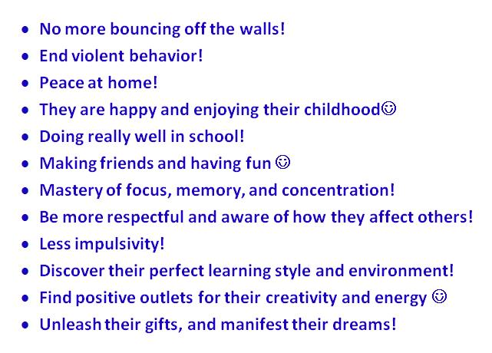

Slide 16
ADHD Medications
Stimulant medications (methylphenidate)
Dexmethylphenidate (Focalin/Dexedrine)
TCAs but risk of cardiac arrhythmias
Buproprion (Wellbutrin XL)
Strattera
Adderall
Vyvanse
Provigil

Slide 17
ADHD Treatment Goals & Interventions
Family Therapy and Parenting Skills Training.
Individual/Group for self-esteem and peer relationships/social skills & empathy training.
Cognitive Therapies; STOP intervention, Verbalize before Acting Training.
Behavior Modification & Token Economies.
Homework Interventions (structure & organization)
Address secondary diagnoses: depression and anxiety (OCD behaviors)

Slide 18

The Monarch external Trigeminal Nerve Stimulation (eTNS) System (NeuroSigma – Theta waves) is approved for patients 7-12 years of age who are not being treated with ADHD medications; the device is intended for use at home under caregiver supervision during periods of sleep. The Monarch eTNS works by delivering a low-level electrical pulse to the trigeminal nerve through a small patch that is placed on the patient’s forehead. Starting price $1,000, not covered yet by insurance companies.

Slide 19
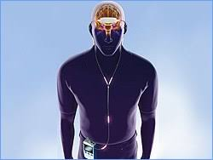
eTNS Unit
Results showed that treatment with the eTNS device led to statistically significant improvement in ADHD symptoms compared with placebo
eTNS: ADHD-RS score decreased from 34.1 points to 23.4 points (0 -56); placebo: ADHD-RS score decreased from 33.7 points to 27.5 points). With regard to safety, drowsiness, increased appetite, sleep disturbance, teeth clenching, headache, and fatigue were the most common adverse reactions associated with eTNS therapy.

Slide 20
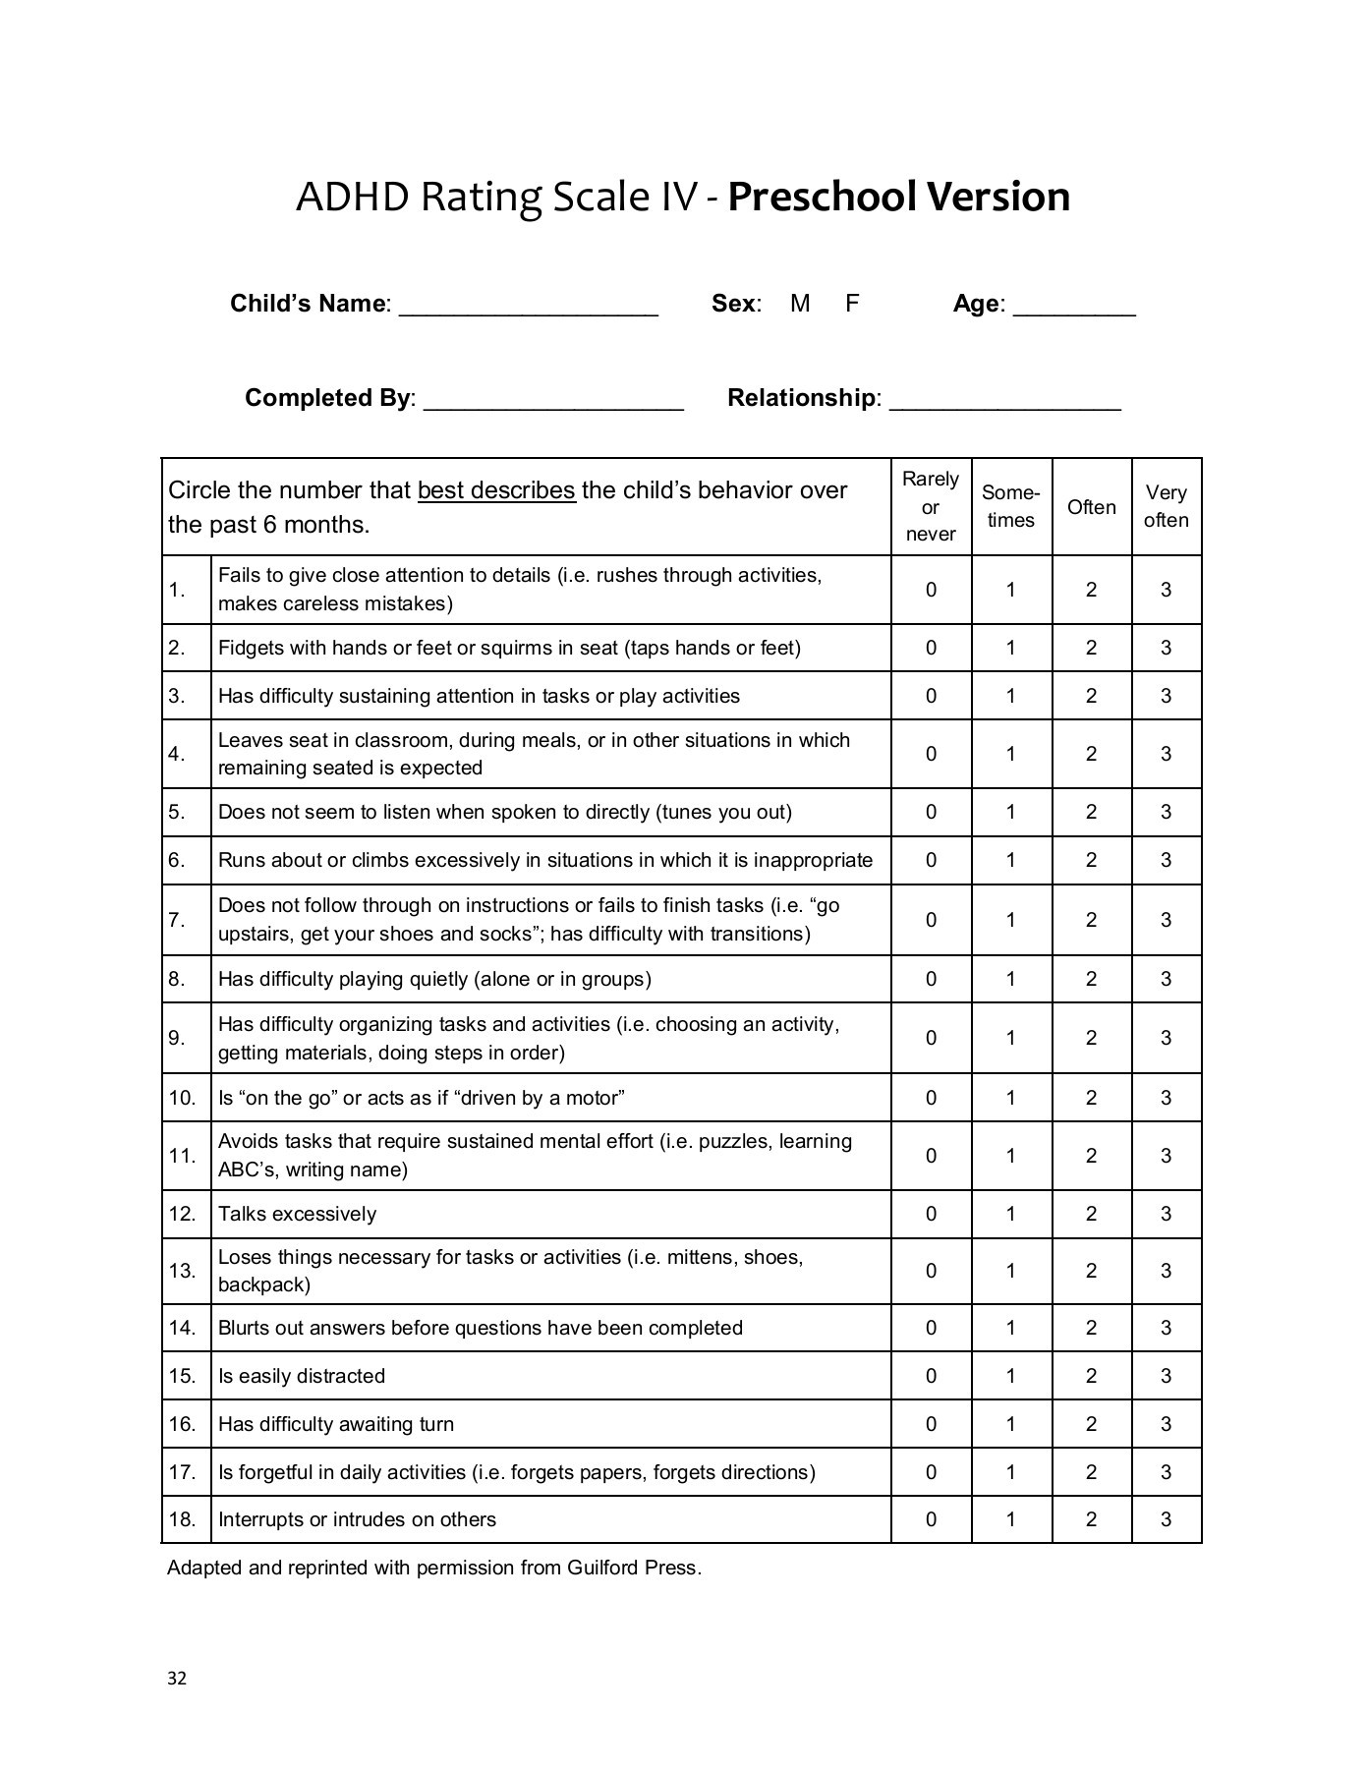
ADHD-Rating Scale Mean = 12, Standard Deviation = 6 Standard Error of Measure +/- 3 Average Range 6 – 18 Borderline 18 - 24 Mild ADHD 24 – 30 Moderate ADHD 30 – 42 Severe ADHD 42 – 54 eTNS Group 34.1 to 23.4 (20.4 – 26.4) Placebo 33.7 to 27.5 (24.5 - 30.5)

Slide 21
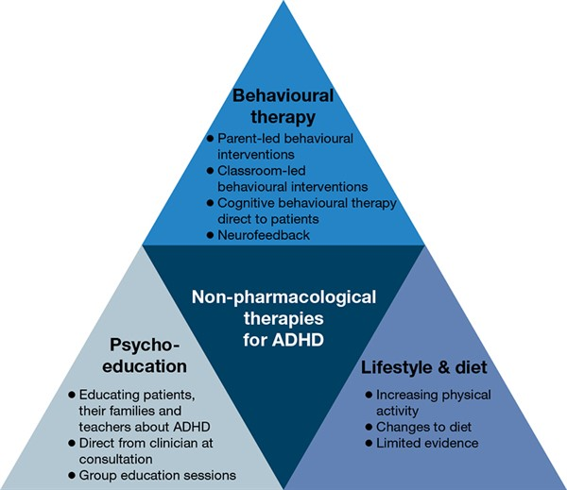

Slide 22
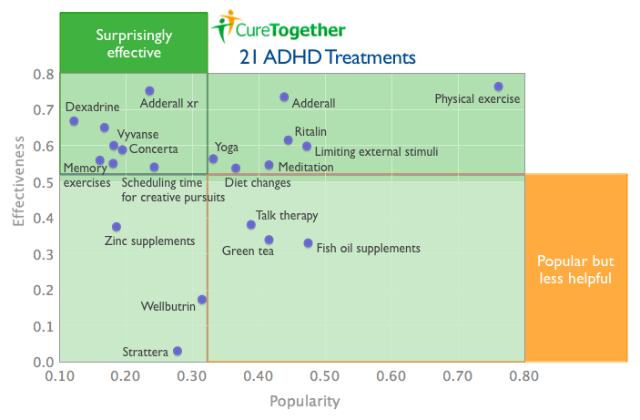

Slide 23
Goal 1. Patient will improve his school academic functioning by one grade level in mathematics (6 weeks)
Objectives:
1. Patient will complete 85% of his weekly math
homework assignments with grade > 70%. (6 weeks)
2. Patient will Utilize the S.T.O.P. technique in
the classroom and at home. (6 weeks)
3. Patient will have his parents review his daily
math homework assignments and quizzes (6 weeks)

Slide 24
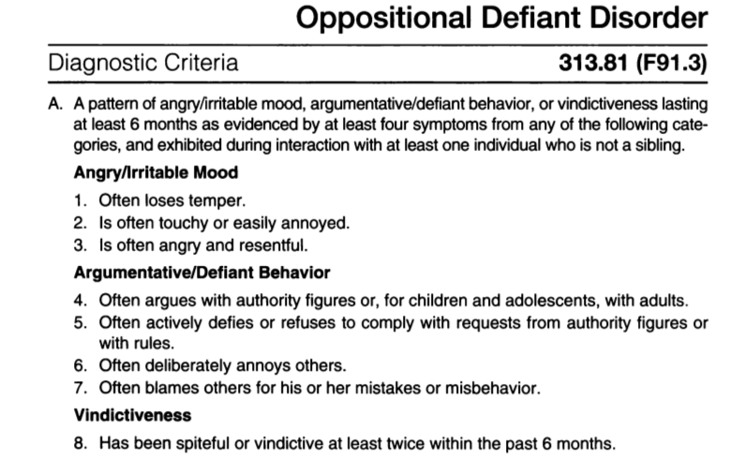

Slide 25
Disruptive and Conduct Disorders
9% of Boys and 2% of Girls.
High risk for substance abuse.
Usually 2 or more grade behind in one or more academic subjects.
Low self-esteem and poor frustration tolerance.
Secondary Diagnosis of ADHD.
R/O “Masked Depression”
Family history of antisocial behavior and substance abuse.

Slide 26

Risk Factors
Male sex
Maternal smoking during pregnancy
Living in poverty during childhood
Parental conditions such as substance abuse disorders and criminal behavior
Exposure to physical or sexual abuse in childhood
Exposure to domestic violence between parents
Family instability
Lower cognitive ability
Association with peers who use substances
Truant from school
Engage in criminal activity
Experience harsh discipline
Have parents with a cruel or rejecting attitude
Have poor health
Not around other children

Slide 27

Differential diagnoses
Opposition Defiant Disorder
Intermittent Explosive Disorder
ADD or ADHD
Disruptive Mood Dysregulation Disorder
Major Depressive Disorder or Persistent Depressive Disorder
Bipolar Disorders
Adjustment Disorders
Substance Use Disorders
PTSD

Slide 28
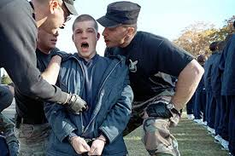
What doesn’t work
Treatment that consistently mimics earlier trauma
Treatment that involves association with other adolescents with antisocial behaviors

Slide 29
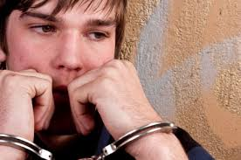
These kids are highly resistant to treatment
Unwillingness to accept anyone who resembles authority
Denial that there is a problem that can and should be addressed
Deeply entrenched core belief system that supports the dysfunctional behavior

Slide 30
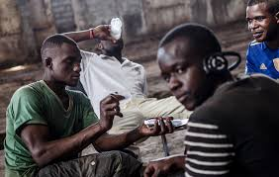
Mode Deactivation Therapy (MDT)
A cognitive-behavioral therapy that combines Dialectical Behavior Therapy (DBT), Acceptance and Commitment Therapy (ACT), and mindfulness
Designed to overcome shortcomings of other cognitive behavioral therapies in treatment of adolescents with multiple diagnoses that are hard to treat, typically results of trauma

Slide 31

How MDT Works
When an event is encountered or anticipated that the adolescent recalls as traumatic, unconscious cognitions activate an associated fear response – fight or flight
This mode activation causes emotional and behavioral responses
Mode deactivation is the intervention by which a mode is deactivated before it results in an aggressive act or other forms of emotional dysregulation

Slide 32
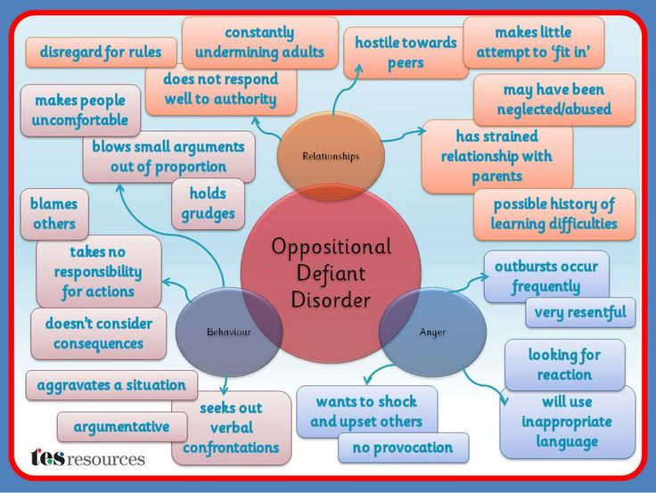

Slide 33
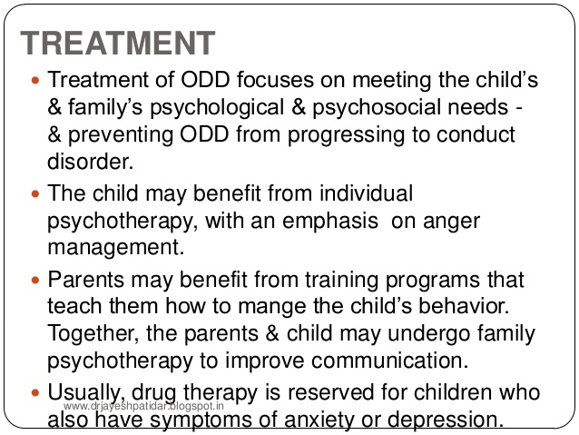

Slide 34
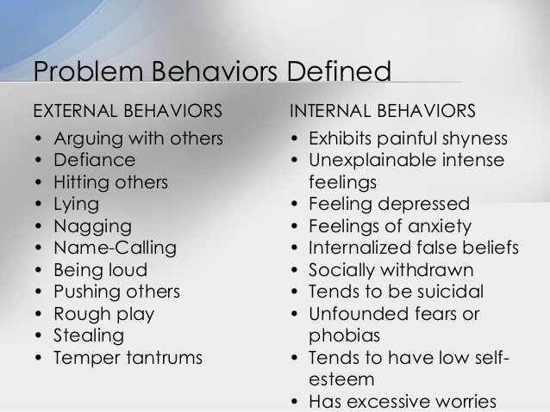

Slide 35
Treatment and Interventions
Multisystemic Therapy (MST)
Reality Therapy; Group or Individual
Family Therapy & Parenting Skills Training.
Tough Love Approach.
Behavior Modification & Token Economies.
Social Skills Training
Anger Management & Impulse Control
Remedial Education to improve performance.
Substance Abuse assessment & treatment.

Slide 36
Goal: Patient will reduce inappropriate verbal outbursts by 75% (2 or less episodes/week at home or school) within 90 days.
Objective 1: Parents will establish a behavior modification program to reward each day of no verbal outbursts (2 weeks)
Objective 2: Patient will learn and demonstrate on at least 3 occasions CBT techniques to appropriately voice his negative emotions/feelings (30 days).
Objective 3: Patient will participate in a 6 week Social Skills group conducted at school. (90 days).

Slide 37
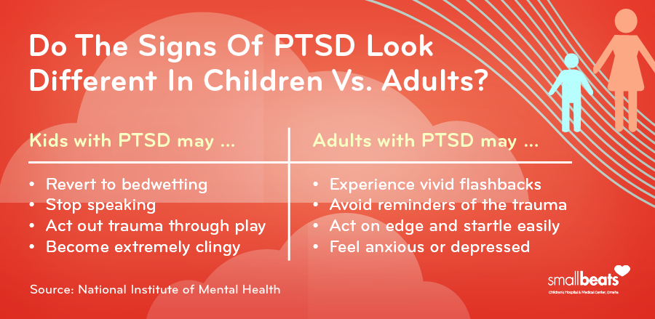

Slide 38
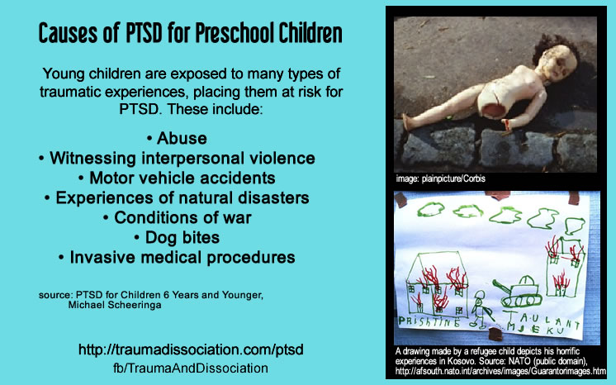

Slide 39
PTSD in Children who are victims of Physical or Sexual Abuse
Also consider natural disasters, DV, MVAs.
They stop thinking of the future.
Demonstrate pessimism, shame, fearfulness, repeated nightmares, and somatic complaints.
Dissociative states or episodes (spacing out).
Self-injurious behaviors & Impulse control problems.
Repetition compulsions (OCD features).
Social Isolation & restricted emotional responses.

Slide 40
Treatment of PTSD in Children and Adolescents
Debriefing and provide Safe Area.
Address fears and security.
Allow for natural discussion of Trauma; art or play therapies can be useful and less threatening.
Family Therapy
Group Therapy and Support Groups
Medications: SSRIs, Wellbutrin/BuSpar.

Slide 41
Elimination Disorders
Enuresis, 7% males and 3% of girls.
Nocturnal enuresis is the most common.
Rule Out medical conditions (infections)
99% out grow the disorder by age 18.
Stressful events can trigger relapse.

Slide 42
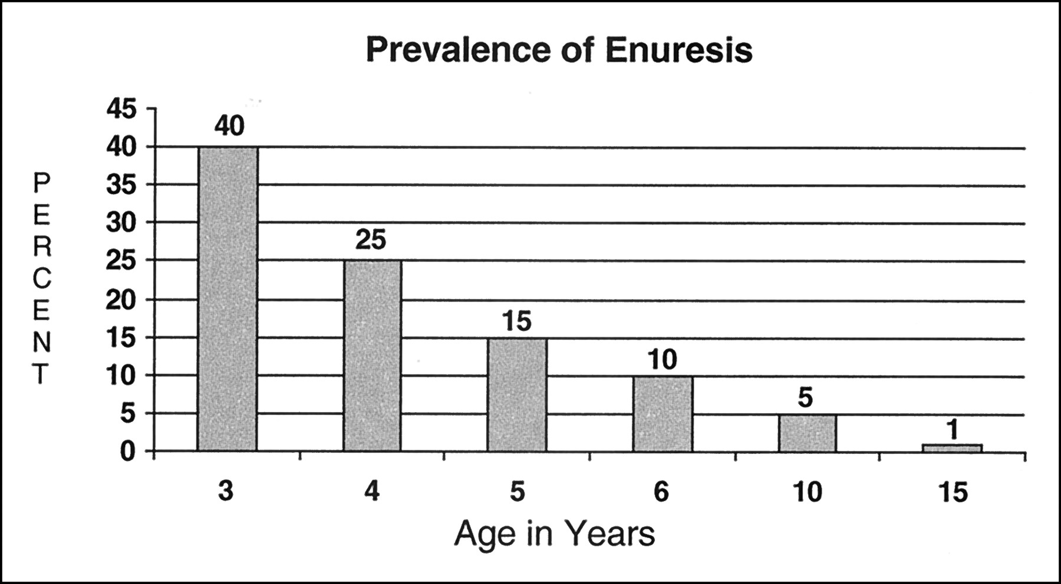

Slide 43
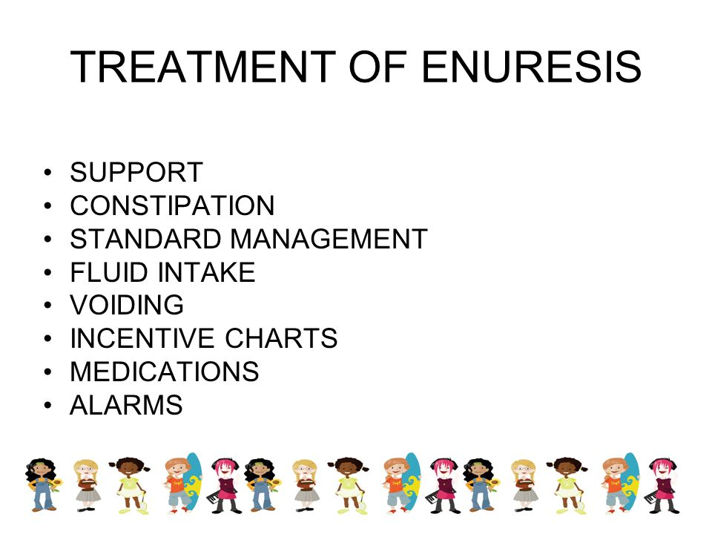

Slide 44
Treatments for Enuresis
Retention Control Training
Behavior Modification, Token economy
Stress Management
Conditioning Devices
TCA medications and DDAVP
Alternatives: Cinnamon, Cranberry Juice, Olive Oil rubs.

Slide 45
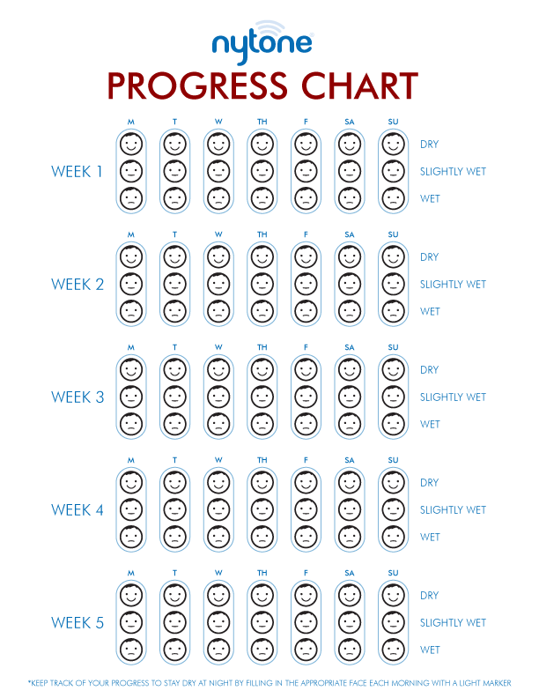

Slide 46
Sleep Disorders in Children
Assessment for Restless Leg Syndrome, Sleep Apnea, and Unusual Behaviors (including nightmares or night terrors).
Initiating, maintaining, restful sleep assessment
Rule out Medical explanation.
Sleep Hygiene and Behavior Modification.
Address possible depression or anxiety.
Address stressors or fears.
Medications for short term.

Slide 47
Goal 1: Child will reduce enuresis episodes to 2 or less per 30 days.
Objective 1: Parents will develop and implement a Behavior Tracking program and provide designated rewards daily (30 days).
Objective 2: Youth will be taught good sleep hygiene practices and maintain a scheduled bedtime Sunday-Friday evenings (30 days).

