Slide 1
PSY 6670
Diagnosis & Treatment Planning
Lecture 6 : Eating, Sleep, and Sex Disorders (not necessarily in that order) & Treatment Planning
Joel Fairbanks, Ph.D.

Slide 2
Eating Disorders:
Anorexia, Bulimia, Binge Eating, Pica
Biological vs. Psychosocial Theories.
Medical assessment and interventions. Anorexia has a 5-10% mortality rate.
Assessments: History, EDI, MMPI, CBCL, BASC, Substance abuse screening.
Inpatient Treatment initially is often required.

Slide 3
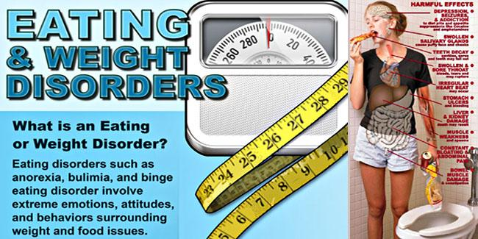

Slide 4

Eating Disorders
Anorexia : Disturbance of Body Image

Slide 5
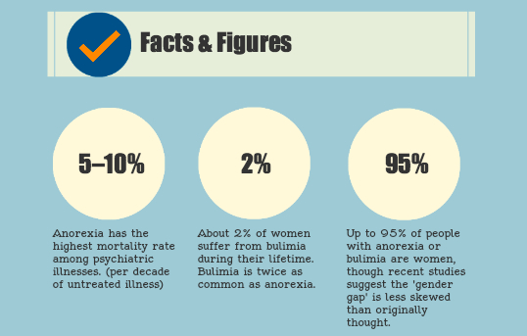

Slide 6
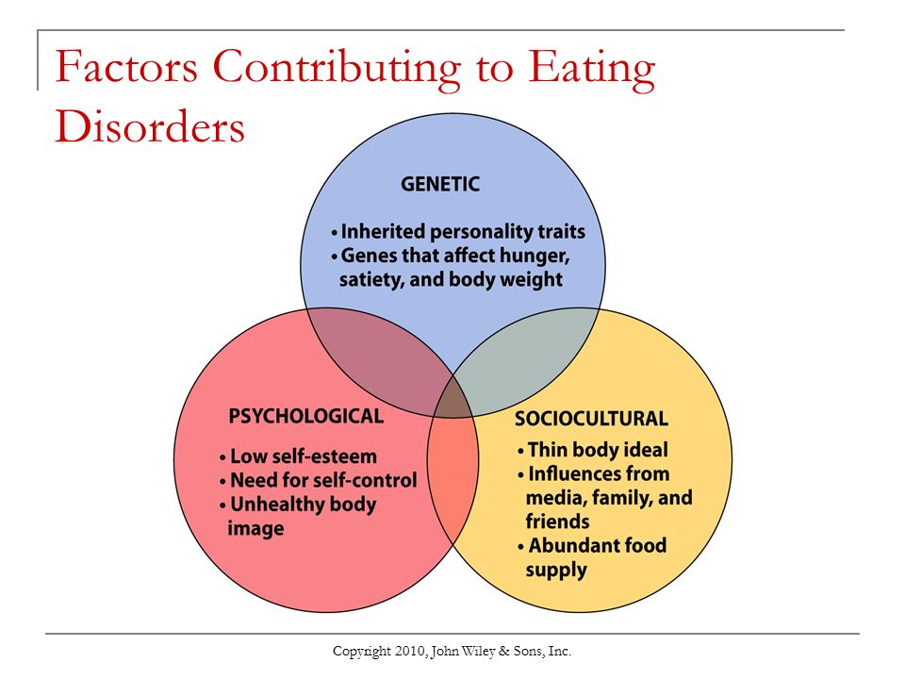

Slide 7
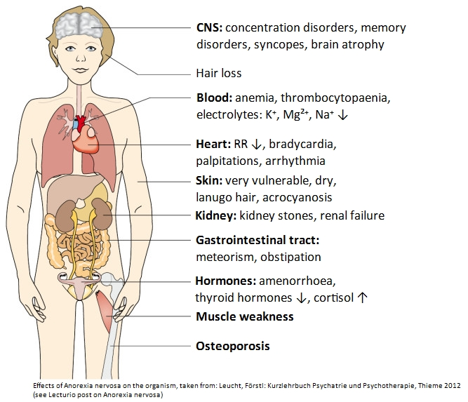

Slide 8
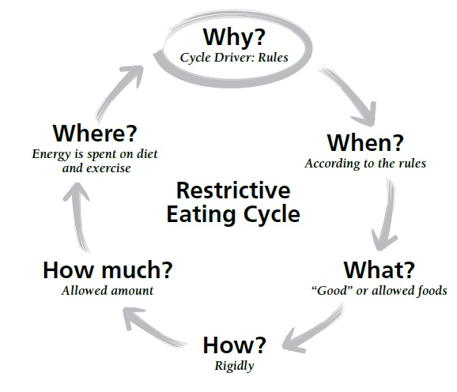

Slide 9
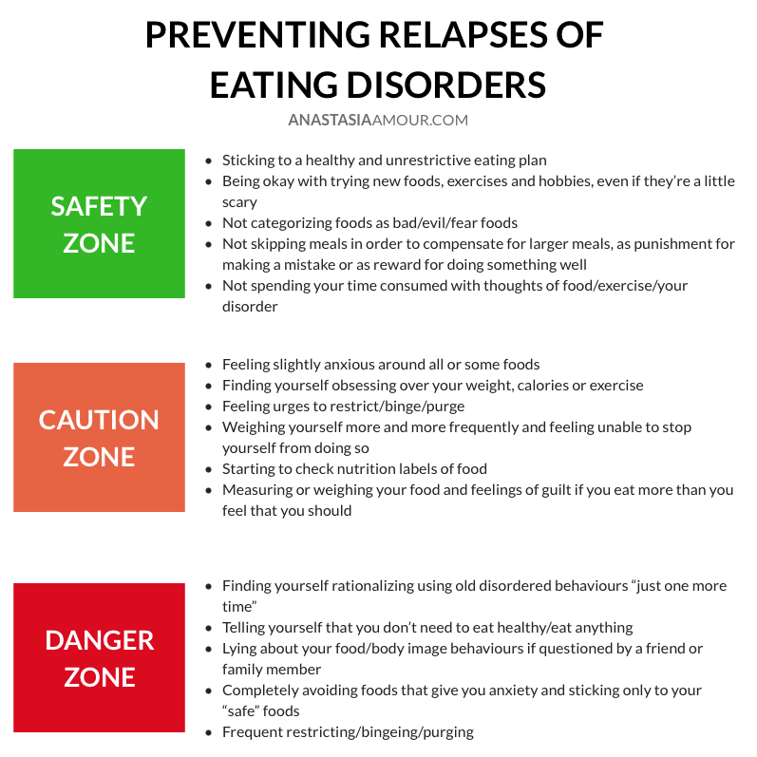

Slide 10
Treatment Goals & Interventions
Keep the patient Alive.
Establish adequate nutrition.
Treat physical complications. (SSRIs & TCAs)
Correct abnormal eating habits.
Supplement family over-involvement.
Enhance self control, identity, and autonomy.
Identify and correct dysfunctional thoughts, attitudes, and beliefs.
Correct deficits in affect and behavioral regulations.

Slide 11
Treatment Plan for Anorexia
Goal: Patient will gain 10% increase in weight (3 months)
Objective 1: Patient will meet with dietitian to create a balanced diet (within two weeks) and follow prescribed diet daily (3 months).
Objective 2: Patient will maintain a daily food log/exercise log (3 months).
Objective 3: Patient will abstain from any purging or compensating behaviors (3 months).

Slide 12


Slide 13
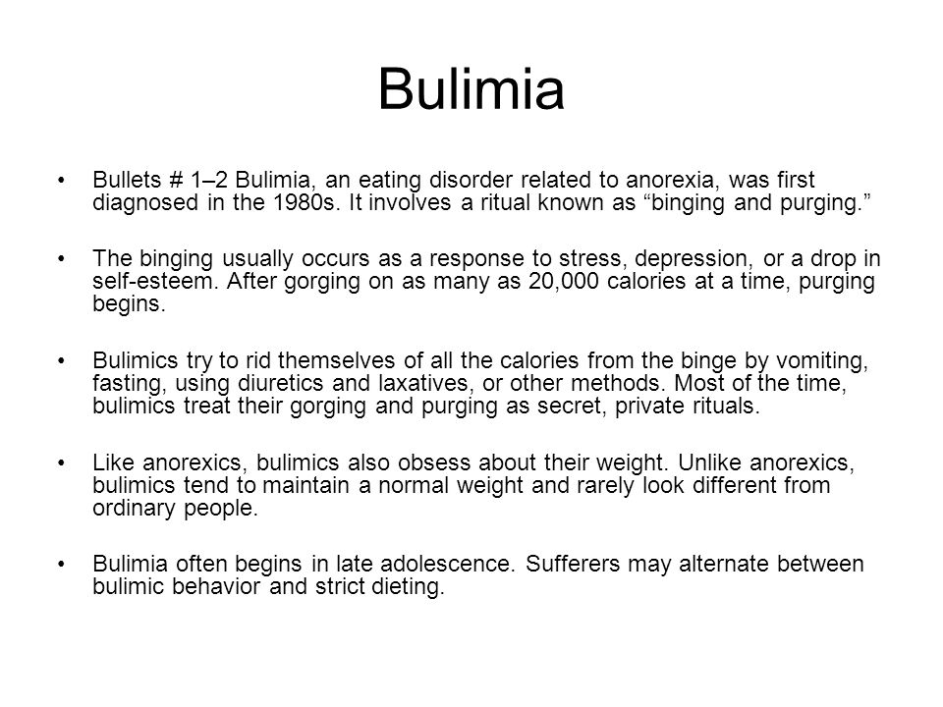

Slide 14
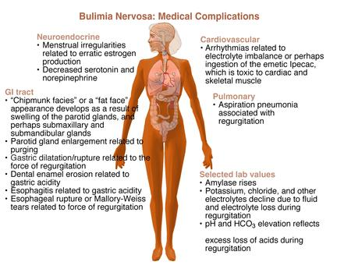

Slide 15
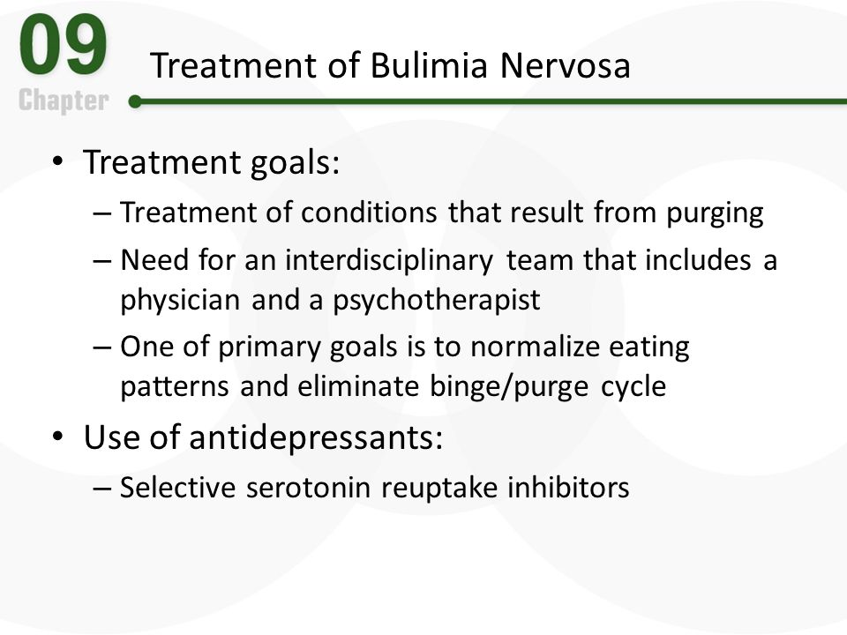

Slide 16
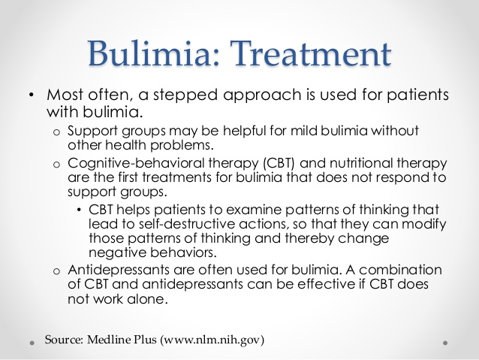

Slide 17
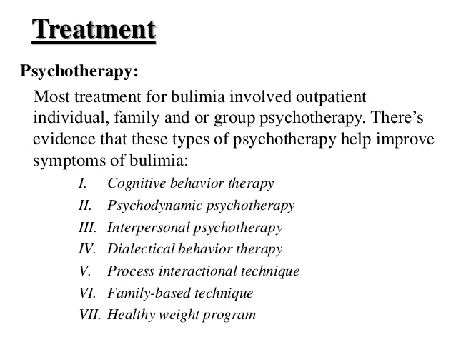

Slide 18
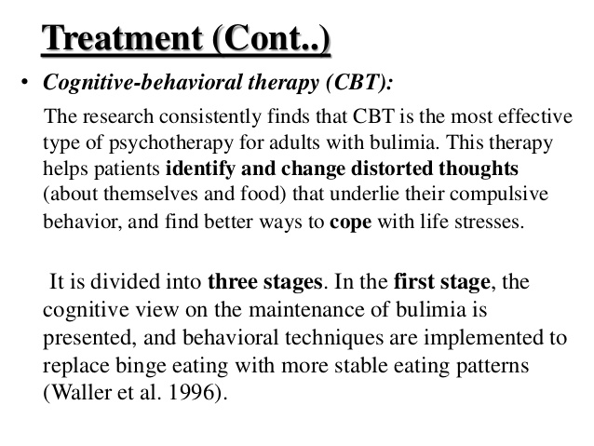

Slide 19
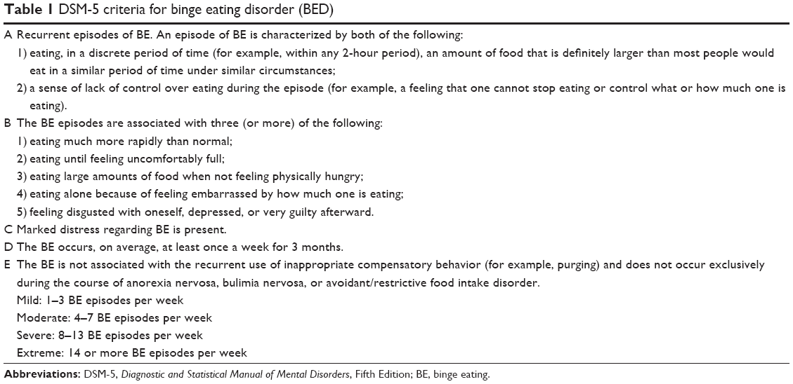


Slide 20
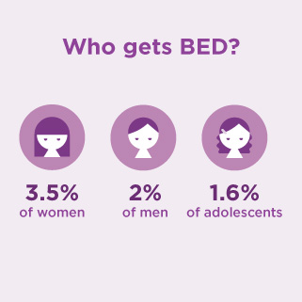
Binge Eating Disorder

Slide 21
Treatment Plan for Bulimia
Goal: Patient will maintain stable weight for 4 consecutive weeks without the use of any purging behaviors. (12 weeks)
Objective 1: Patient will meet with nutritionist and PCP to outline an approved diet for the patient to follow for 3 months. (2 weeks)
Objective 2: Patient will participate in physician approved exercise program 3 times per week (30 minutes/activity) 12 weeks.
Objective 3: Patient will develop a Relapse Prevention Plan if Pt. has the urge to binge eat or engages in bingeing (2 weeks).

Slide 22
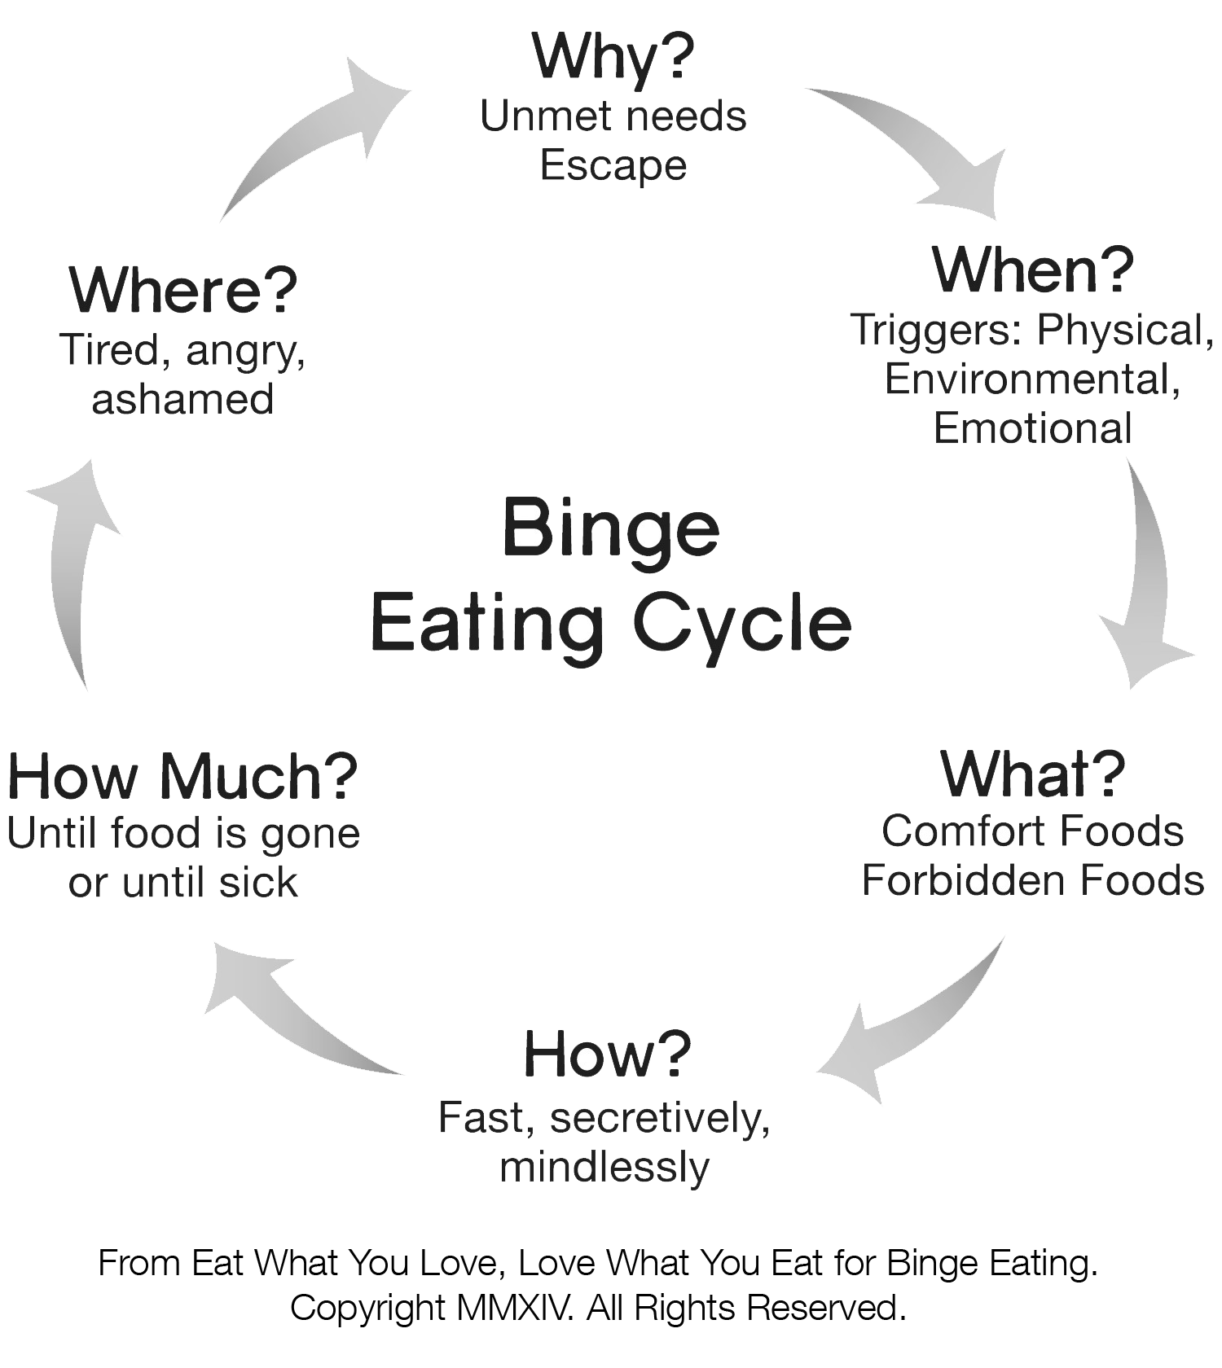

Slide 23
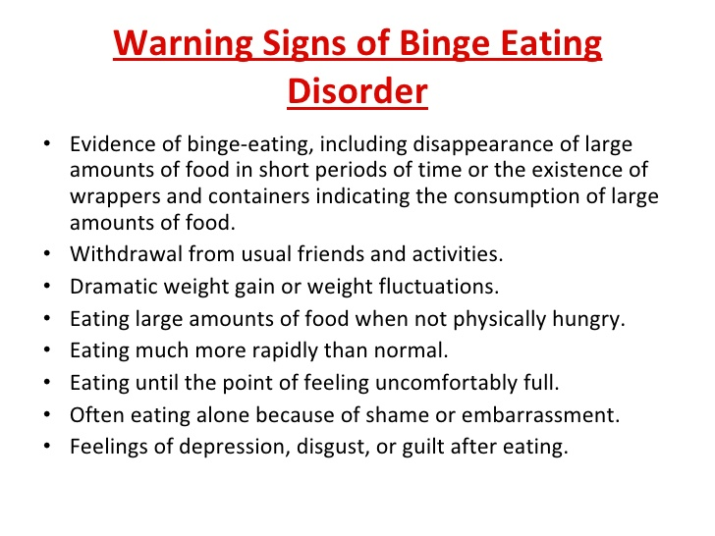

Slide 24
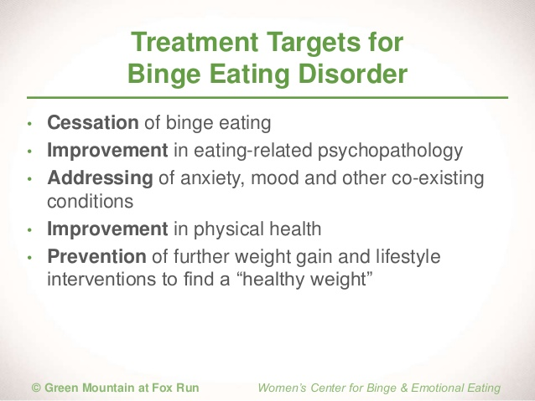

Slide 25
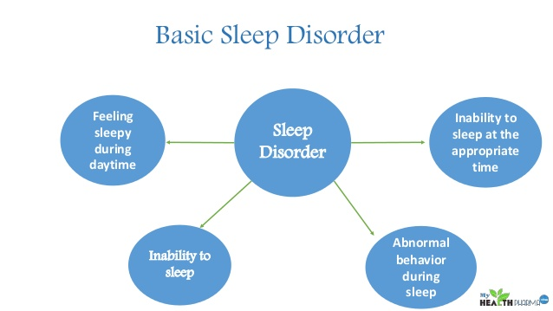

Slide 26
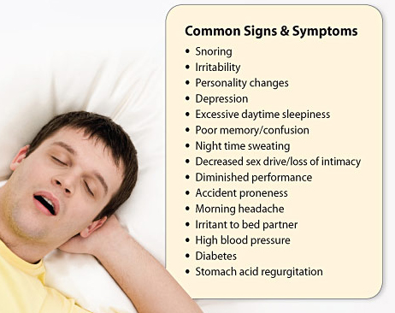

Slide 27
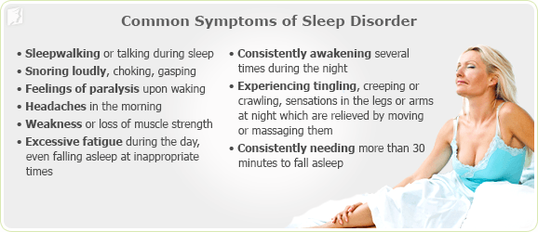

Slide 28
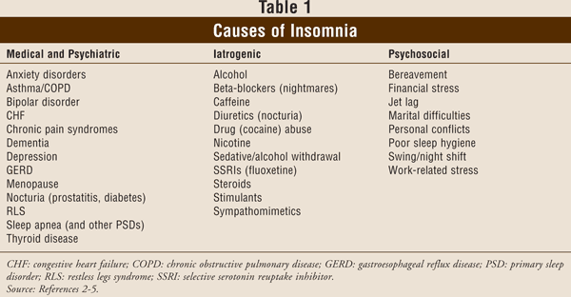

Slide 29
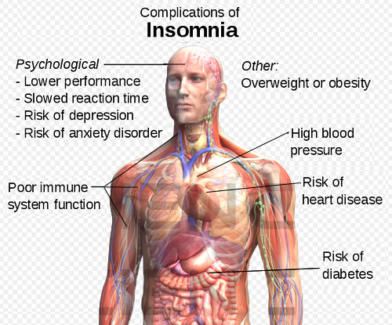

Slide 30
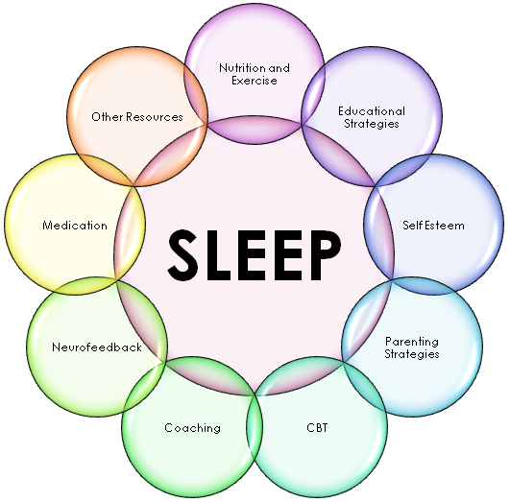

Slide 31
Insomnia Medication prescriptions have increased 30 Times since 1990
(NYT: 11/11/18)

Slide 32
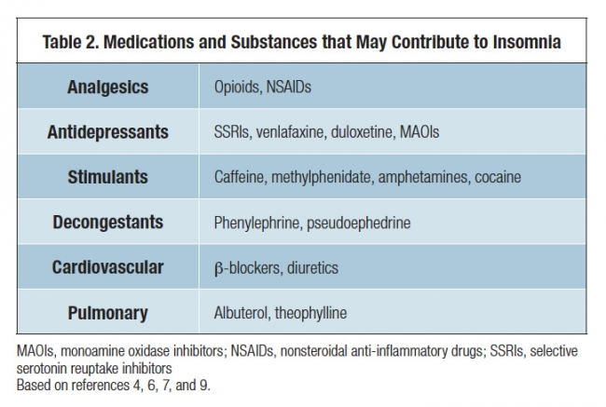

Slide 33
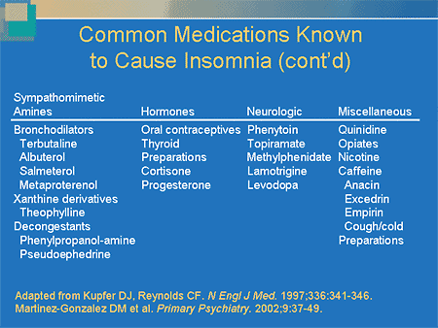

Slide 34
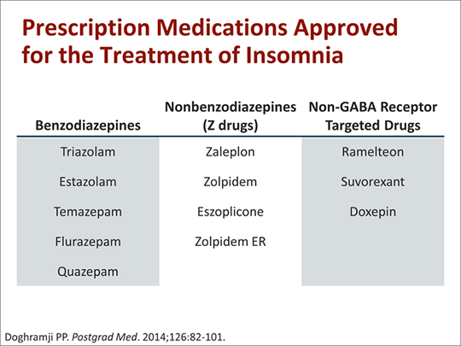

Slide 35
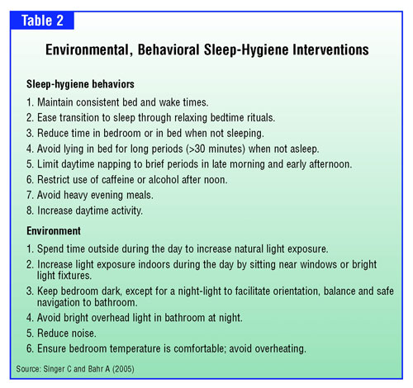

Slide 36
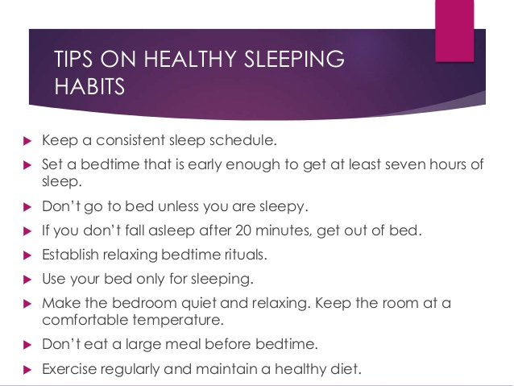

Slide 37
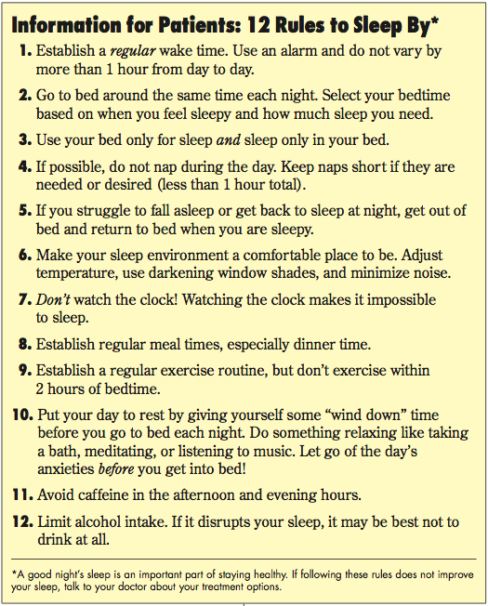

Slide 38
Circadian Rhythm Sleep Disorders
Intrinsic Types Extrinsic Types
Delayed Sleep Phase Shift Work Sleep Disorder
Advanced Sleep Phase Jet Lag Disorder
Irregular Sleep-wake Rhythm Disorder
Non-24 –hour Sleep-wake Disorder

Slide 39
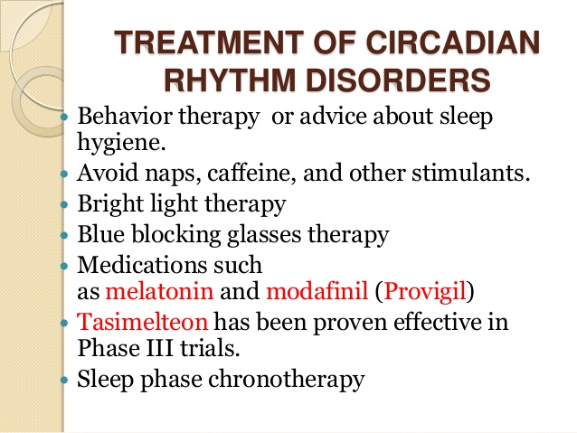

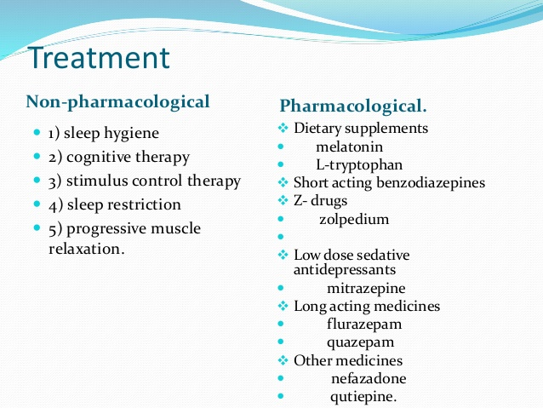

Slide 40

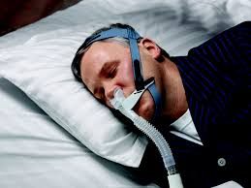
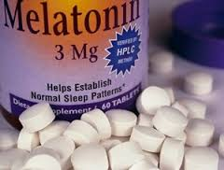
Alternative Sleep Aids and Treatment

Slide 41
Goal : Patient will report obtaining at least 7 hours of restful sleep 12 out of 14 nights (2 months).
Objective 1: Patient will be taught and practice good sleep hygiene practices nightly (2 months).
Objective 2: Patient will participate in physician approved exercise program, 3 times per week (30 minutes per session). (2 months)
Objective 3. Patient will be taught and practice stress reduction techniques (15 minutes/day) (30 days).

Slide 42

Sexual Disorders & Treatment

Slide 43
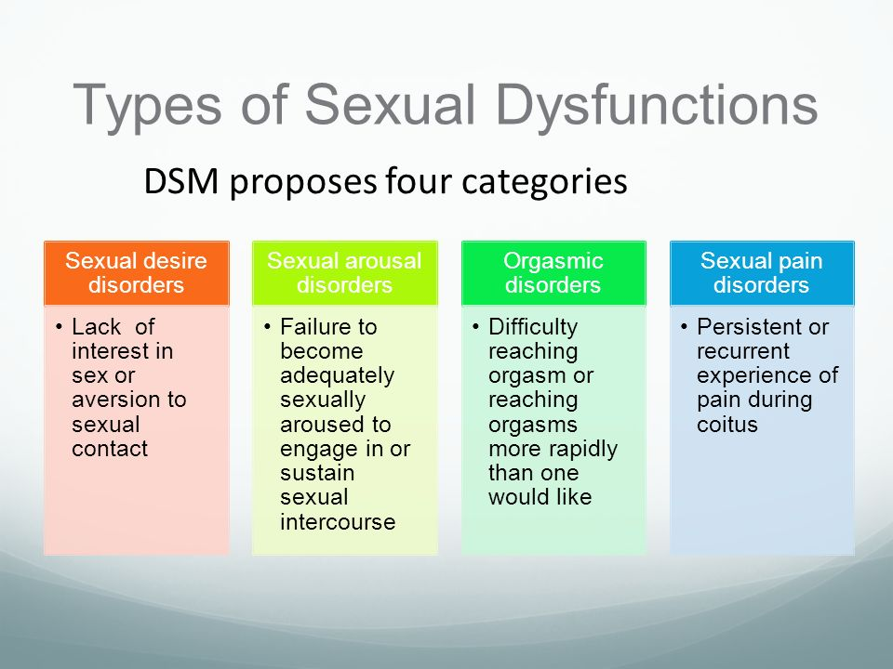

Slide 44
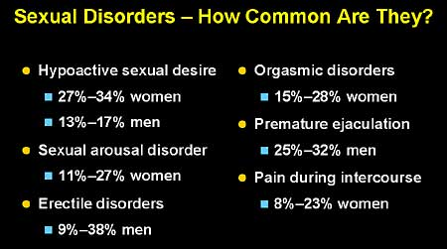

Slide 45
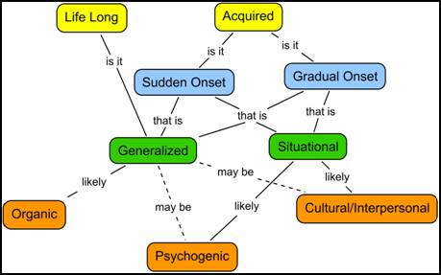

Slide 46
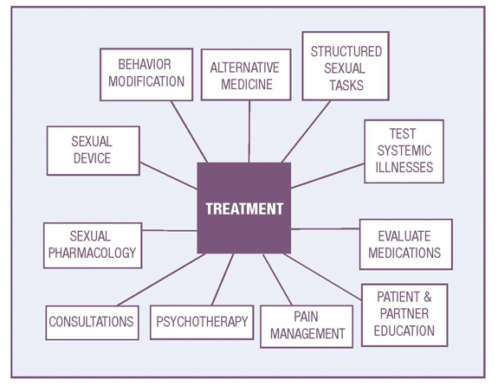

Slide 47
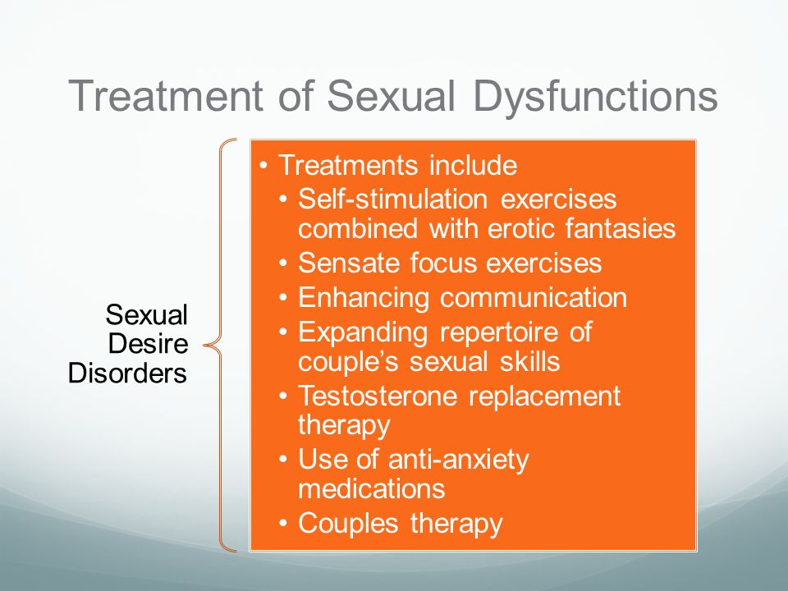

Slide 48
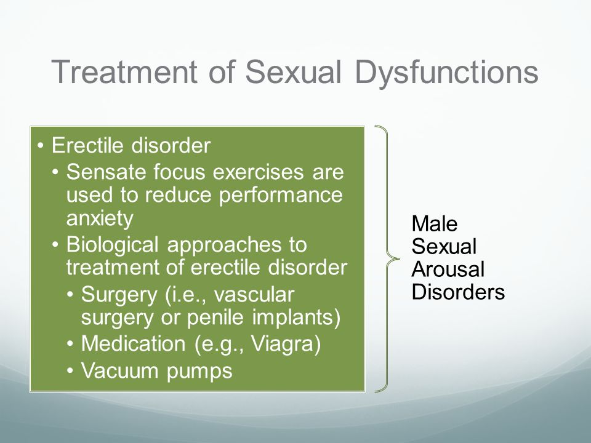

Slide 49
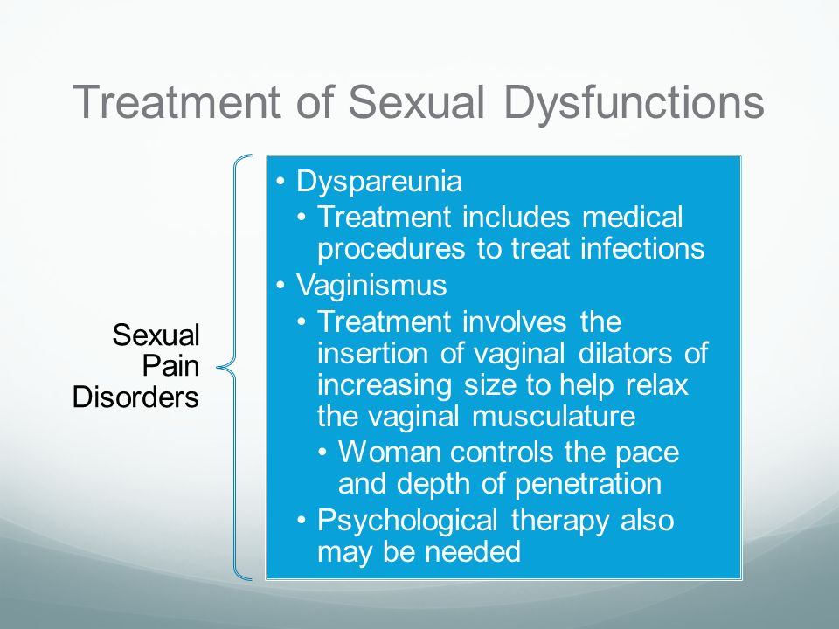

Slide 50
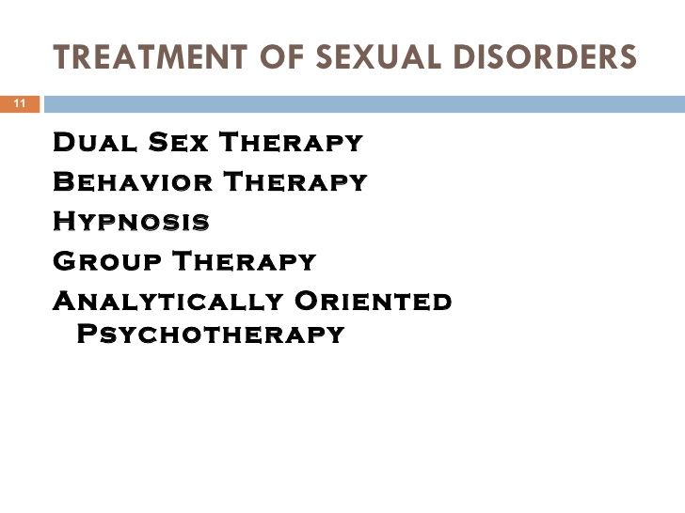


Slide 51
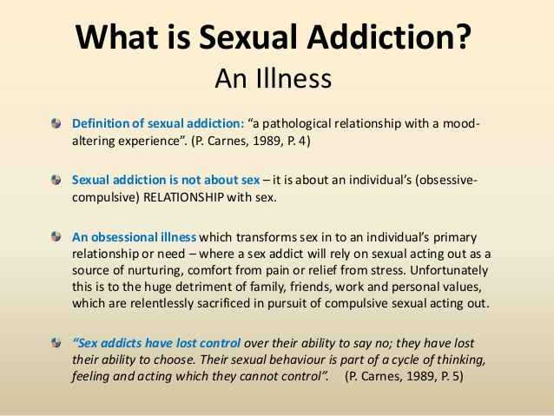

Slide 52
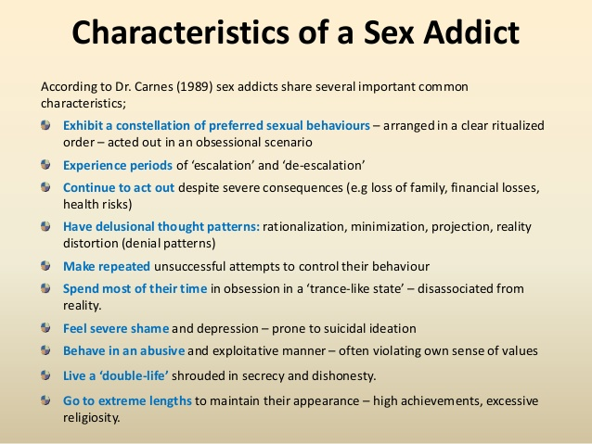

Slide 53


Slide 54
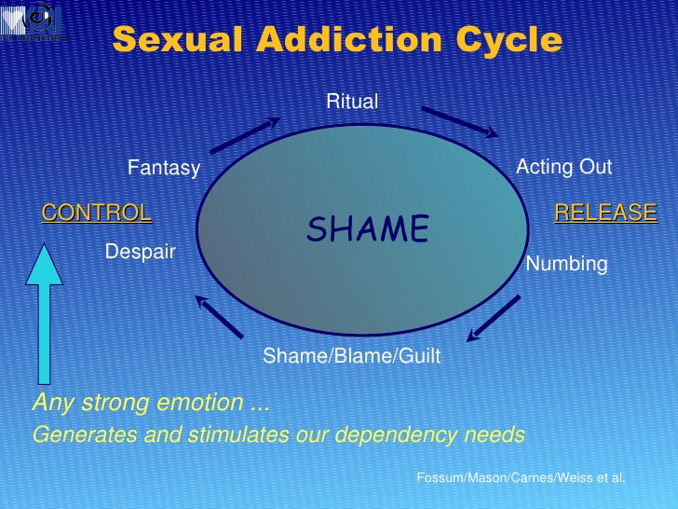

Slide 55
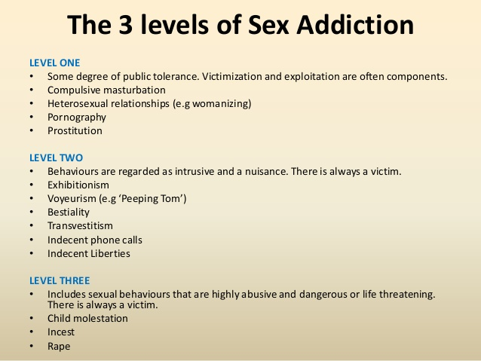

Slide 56
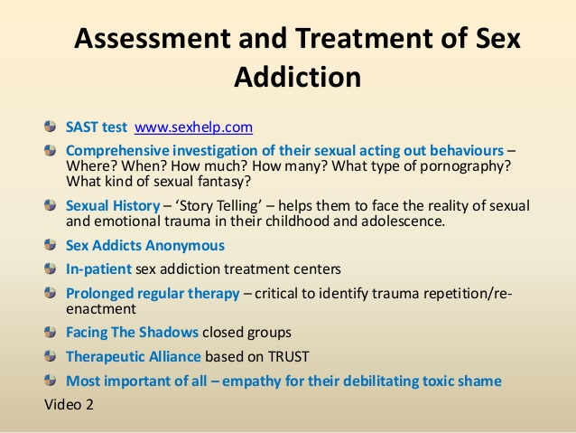

Slide 57
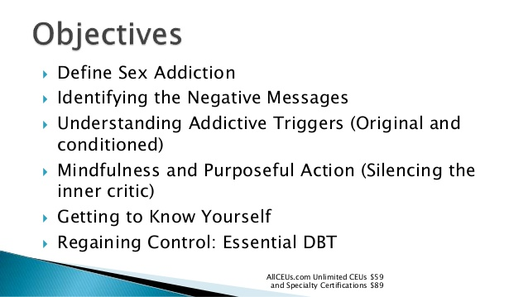
Treatment of Sex Addiction

Slide 58
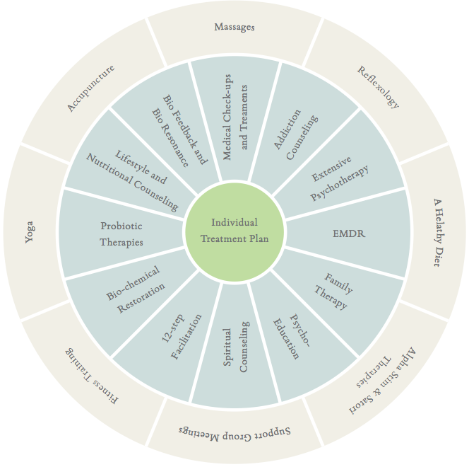

Slide 59
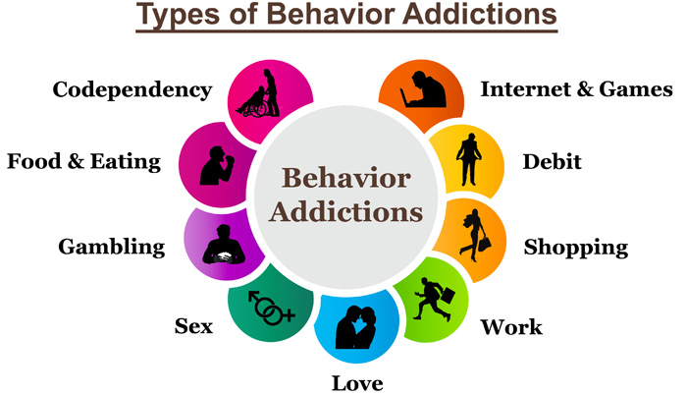
Behavioral Addictions

Slide 60
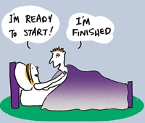
Questions ?

