Slide 1
PSY 6670 Diagnosis & Treatment Planning Lecture 5 : Mood & Anxiety Related Disorders & Treatment Planning
Joel Fairbanks, Ph.D.

Slide 2
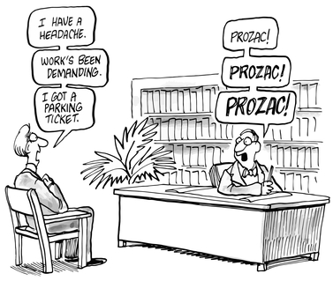
Mood Disorders

Slide 3
Prevalence Rates
Prevalence rate 0.6% Bipolar Disorder.
40% Increase in Bipolar Dx. since 1994.
Prevalence rate 2% to 5% for Disruptive Mood Dysregulation Disorder.
Prevalence rate 7 % for Major Depression.
0.9 – 1.9% for Separation Anxiety
7% to 9% for Phobias and Social Anxiety
2 to 3 % for Panic Disorder
2.9% for Generalized Anxiety Disorder
Less than 20% for ASD and 3.5% for PTSD
1.2 % for Obsessive-compulsive Disorder

Slide 4
DSM-5 Specifiers for Mood Disorders
Current Severity: Mild, Moderate, Severe
Single episode or Recurrent
Rapid Cycling
With Anxious distress
With Mixed features
With Melancholic features
With mood-congruent/incongruent Psychotic features
With Catatonia
With Peripartum Onset
With Seasonal pattern

Slide 5
Early Brain Trauma
Trauma suffered during childhood (including physical or sexual abuse and/or neglect) may cause physical damage to the brain making the individual more susceptible to depression later in life. (2017 study)

Slide 6
Disruptive Mood Dysregulation Disorder Differential Diagnosis
Bipolar Disorders
Oppositional-defiant Disorder
ADHD
Intermittent Explosive Disorder

Slide 7
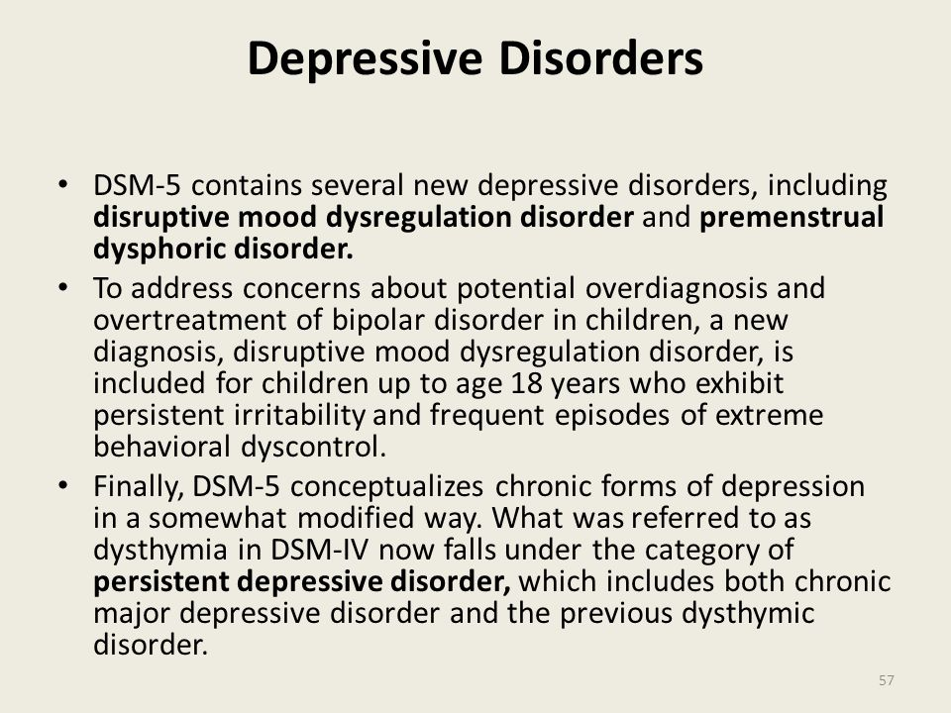

Slide 8
Treatment Plan for DMDD
Family Therapy
Parenting Skills Class
Behavioral Plans
Reality Therapy for teens
Group Therapy for teens

Slide 9
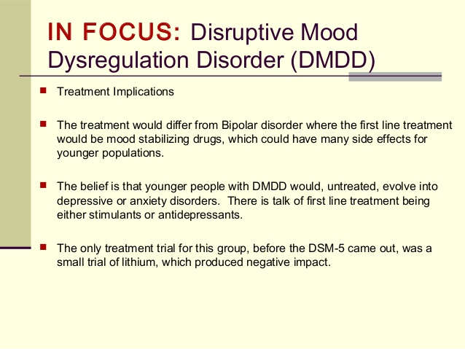

Slide 10
Bipolar Disorders
Bipolar I or Bipolar II Disorders
Cyclothymic Disorder
Bipolar Related Disorder due to Another Medical Condition

Slide 11
Psychosocial Interventions for Bipolar
Patient Care: The primary goal is to control the Manic Episodes.
Secondary is to address other mood symptoms and impairments in functioning.

Slide 12
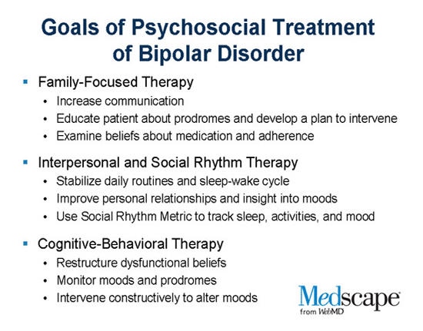

Slide 13
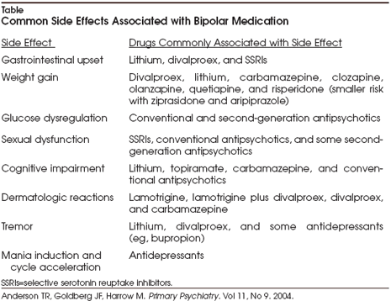

Slide 14
Depressive Disorder
Disruptive Mood Dysregulation Disorder
Major Depressive Disorder, Single episode or Recurrent
Persistent Depressive Disorder
Depressive Disorder due to Another Medical Condition

Slide 15
Psychotherapies.
Interpersonal Psychotherapy (ITP)
Cognitive-Behavioral Therapy (CBT)
Dialectical Behavioral Therapy (DBT)
Polyvagal Therapy
Behavioral Therapies
Group Therapy
Brief Psychodynamic Psychotherapy
Marital and Family Therapy

Slide 16
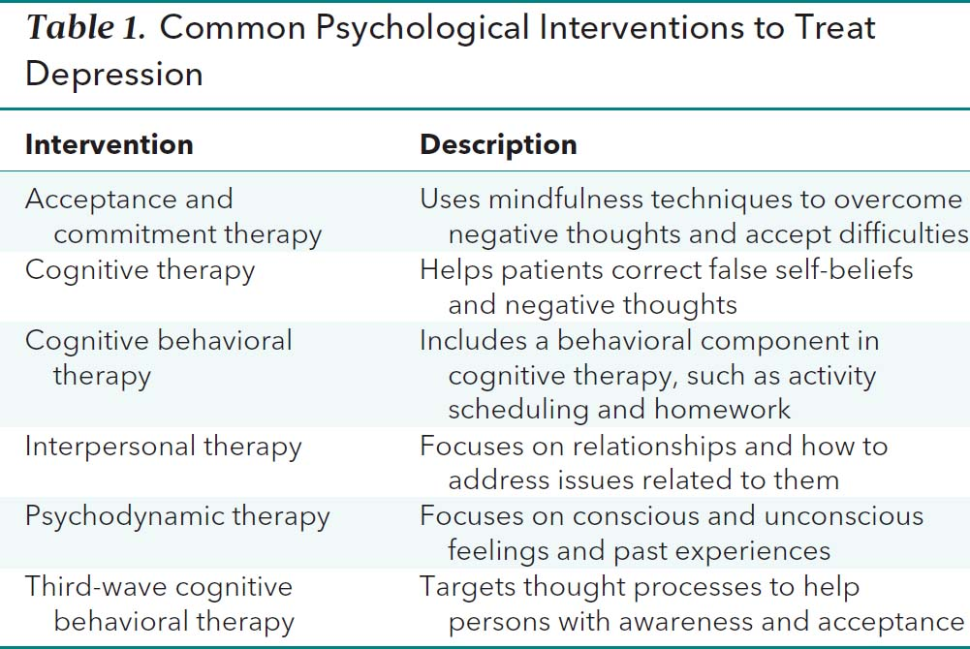

Slide 17
Management & Treatment of Mood Disorders
Suicide Prevention Plan
Family Involvement & Education
Exercise & Social Activities
Psychotropic medications
Psychotherapies:

Slide 18
Suicide Evaluation, Management, and Prevention (pg. 387)
45,000 Deaths per Year
30% rise this century (60% rise for teens)
15 % of patients with Severe Major Depression will eventually die by suicide.
Use questioning sequence to assess risks.
Use of Hospitalization, Baker Act.
Short-term Suicide Contracts.
Breaking the patient’s “Inertia Cycle”.
Suicide is a Permanent solution to a Temporary problem.

Slide 19
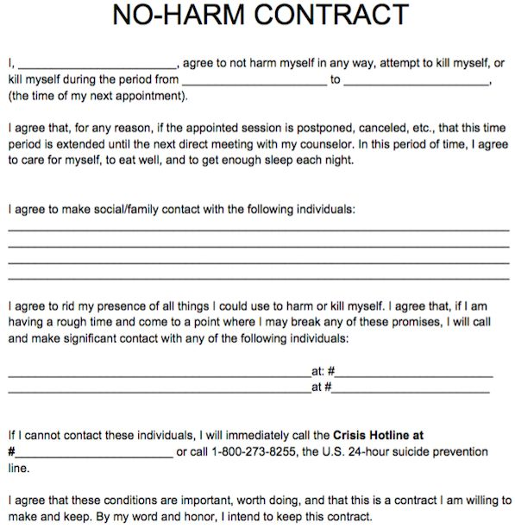
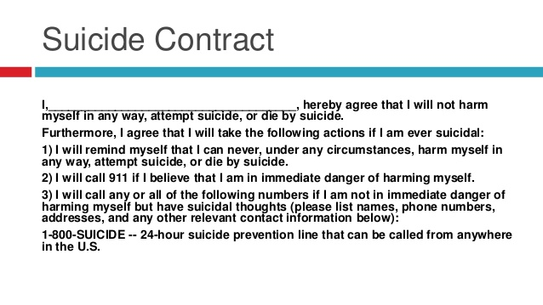
Contracting with Suicidal Risks

Slide 20
Psychosocial Interventions
Family Counseling & Education
Supportive Counseling/Groups
Physical Activities/Stress Management
UK study (2019) 15 minutes/day of aerobic exercise or 60 minutes of light exercise (walking or gardening effective for prevention)

Slide 21
Biological Treatments: Psychotropic Medications
Tricyclic Anti-depressants (TCAs).
MAOIs (Monoamine Oxidase Inhibitors.
SSRIs
Atypical Anti-depressants (Remeron, Trazodone)
Mood Stabilizers
Anti-psychotic Medications
ECT, Vagal Nerve Stimulator, Photo-therapy, TMS and Brief - 3 Minute rTMS Protocol (FDA, 2018)
LSD/Psilocybin (FDA approved 2018)

Slide 22
Pfizer 2018 Annual Report ($ in Millions)
2016 2017 2018
Revenue 52,824 52,546 53,647
Cost Sale 11,428 11,228 12,322 (23%)
Research 7,892 7,683 8,006 (15%)
Selling/Ad 14,455 14,804 14,844 (27%)

Slide 23
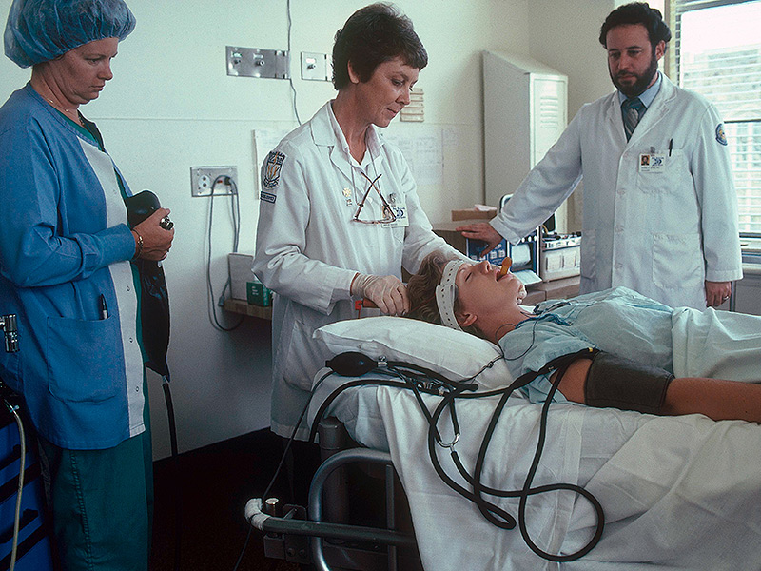
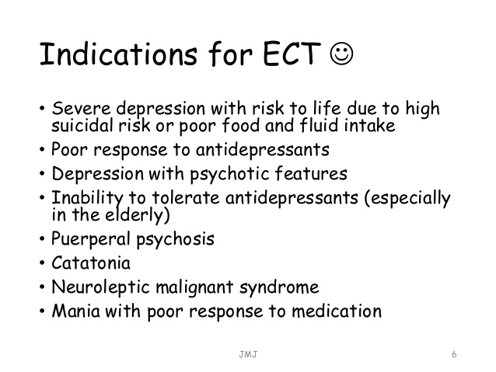

Slide 24
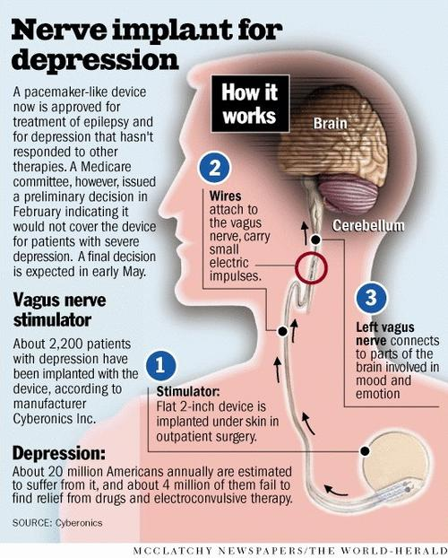

Slide 25
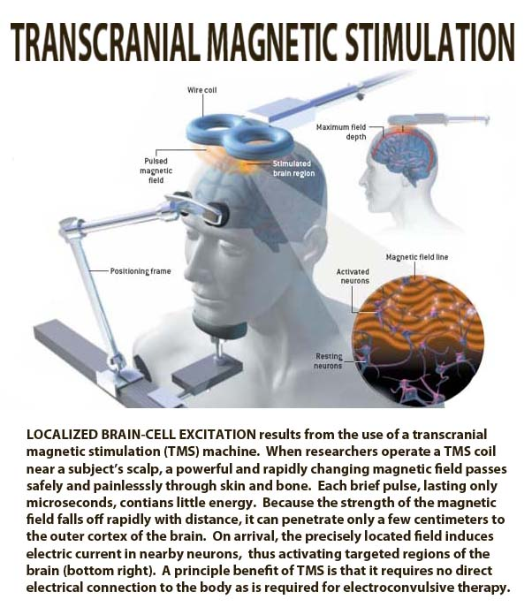
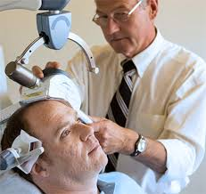

Slide 26
Treatment Outcomes
78 % Improve with ECT
60-70% Improve with medication (although it may take multiple trials)
TCA’s reduce effectiveness about 50%.
SSRI/MOIAs reduce effectiveness 30%.
23% Improve with placebo
Antipsychotics combined with an anti-depressant can boast response rate 65-75%

Slide 27
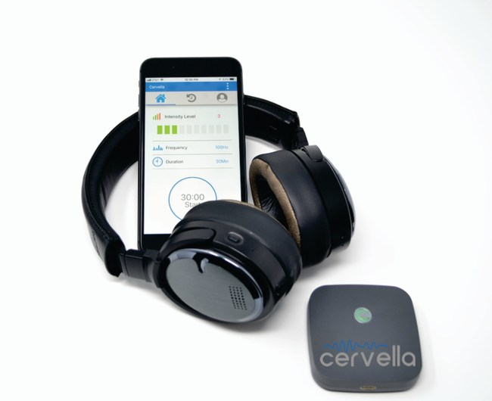
FDA Clears the Cervella Cranial Electrotherapy Stimulator for Treatment of Anxiety, Insomnia, and Depression (April 2019)
Cervella is the world's first Cranial Electrotherapy Stimulator (CES) with proprietary conductive treatment electrodes that have been seamlessly integrated into noise-cancelling Bluetooth-enabled headphones. Patients can use the audio and noise cancelling features of the headphones during treatment, which allows them to use the device during study, work, or play. Furthermore, Cervella is also the first CES device that is managed through an app on a smart device allowing for automated treatment data recording, reminders, and analytics aimed at improving patient treatment outcomes. In sum, Cervella is designed to fit into a patient's lifestyle, not the other way around.

Slide 28
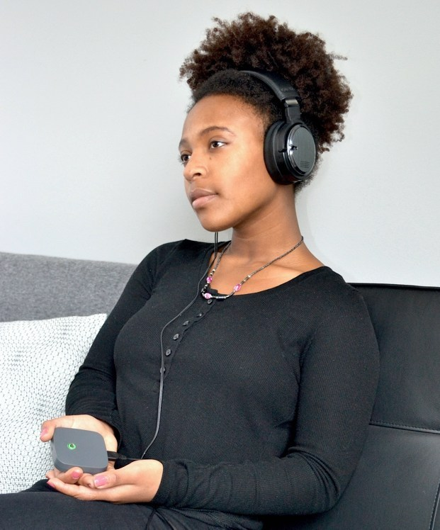

Slide 29


Video Games for Mood Disorders
Celeste
Night In The Woods
Sea of Solitude

Slide 30
Anti-Depressant Medications
Patients should remain on antidepressants until they have been symptom free for at least 16 – 20 weeks and until stressors in their lives are down to manageable levels.
If patients stop to soon, then there is 50% chance of relapse within 6 months.

Slide 31
Chronic Depression
Esketamine approved by FDA 2019.
Nasal spray administered in physician’s office.
(3 – 4 hour in office wait period)
21 point reduction on BDI with 25% relapse
(17 pt drop for placebo with 45% relapse)
Less effective for 65 and older (no difference
compared to placebo).
Cost = $34,000/treatment

Slide 32
Post-partum Depression 1 in 7 pregnancies
Zulresso (Brexanolone), first FDA approved medication for Post-partum depression (2019). 60 hour Infusion treatment with 3 - 4 days hospitalization required at this time.
Modulates GABAA receptors, a hormone that is reduced during pregnancies.

Slide 33
Therapies for Post-partum Depression Prevention Programs:
Mothers & Babies, CBT 8 – 17 sessions.
Reach Out, Stay Strong Program
Essential for New Moms (ROSE) 4 sessions.

Slide 34
NSAIDs May reduce Depression
NSAIDs May Reduce Depression. Nonsteroidal anti-inflammatories (NSAIDs) are often used to treat the pain and inflammation of osteoarthritis, but they may have another effect: relieving depression. Depression is 2 to 3 times more prevalent in patients with osteoarthritis than in other groups.
A new meta-analysis of 36 randomized clinical trials involving nearly 10,000 people found support for an antidepressant effect in patients taking anti-inflammatory drugs. Five of 6 anti-inflammatory agents were associated with improved depression scores in patients taking antidepressants, compared with adjunctive placebo.
“The present findings show that specifically anti-inflammatory add-on treatment to antidepressants may have beneficial effects in patients with major depressive disorder, but also the shown effects on depressive symptoms among patients with a somatic disease are promising,” researchers wrote. “NSAIDs, cytokine inhibitors, statins, glucocorticoids, and minocycline all showed antidepressant effects.”

Slide 35
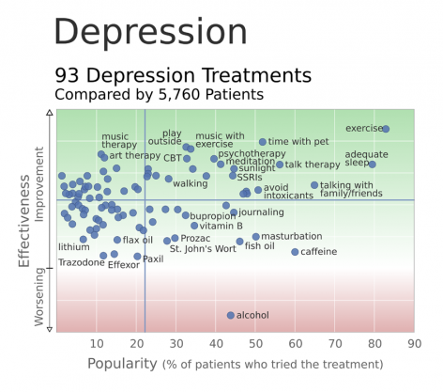

Slide 36
Anxiety Disorders
Panic Disorder
PTSD and Acute Stress Disorder
Phobias
Social Anxiety
Separation Anxiety Disorder
Generalized Anxiety Disorder
Obsessive-Compulsive Disorder

Slide 37
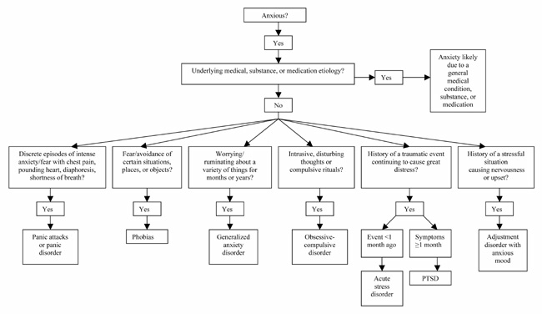

Slide 38
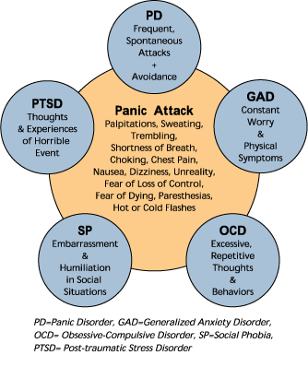
Panic Attack as a Symptom of Anxiety

Slide 39
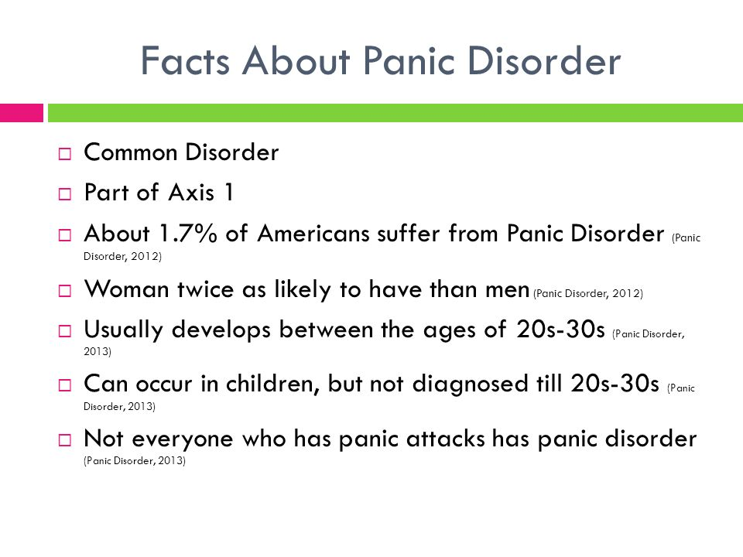

Slide 40
Panic Disorder
Develop reasonable expectations for treatment, fluctuating course.
Multiple medication approach.
Cognitive-behavioral Therapy
Behavioral Stress Management Training
Mindfulness Training & Meditation
Exercise & Yoga/Tai Chi
Family and Patient Education
Long-term Management of Panic Attacks

Slide 41
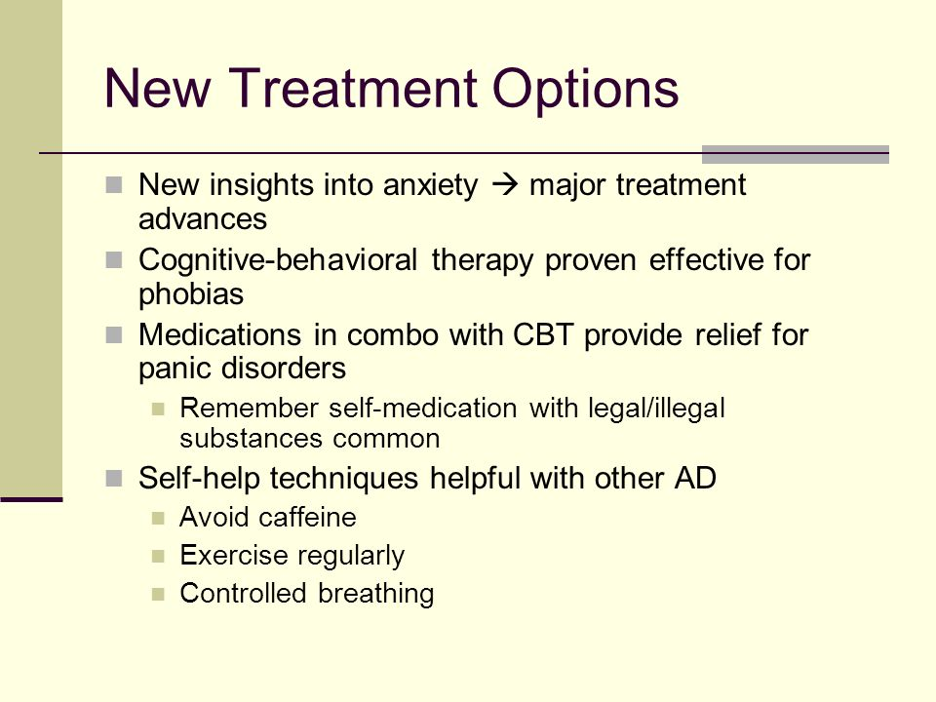

Slide 42
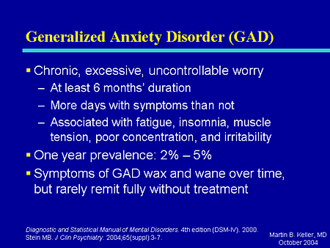

Slide 43
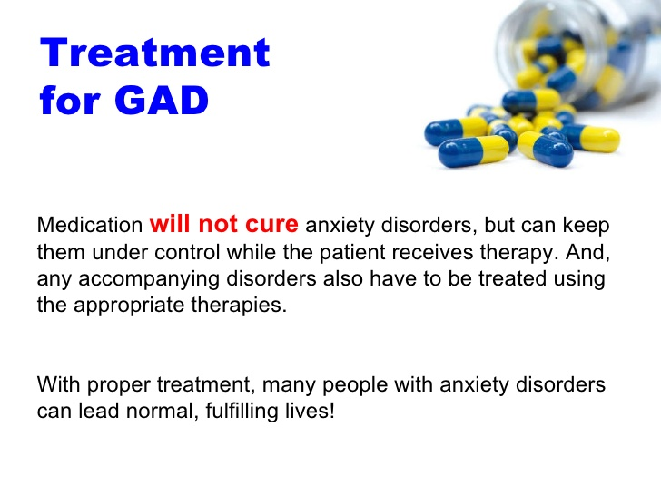

Slide 44
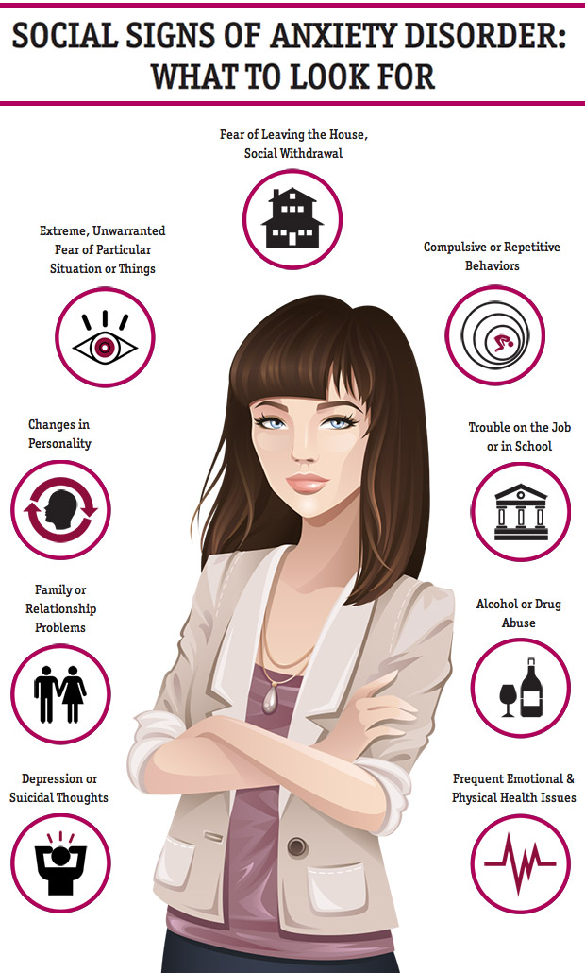
Social Anxiety

Slide 45
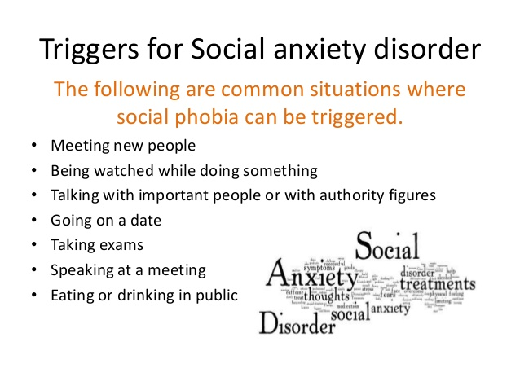

Slide 46
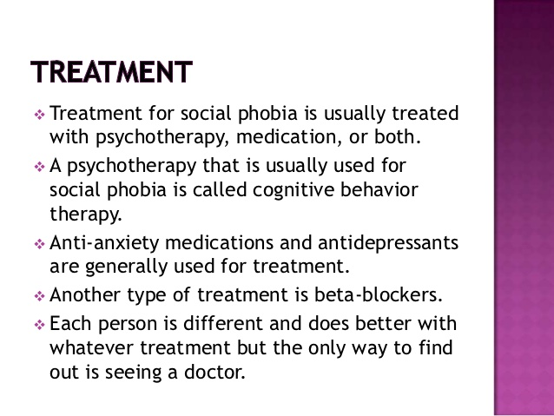

Slide 47
Phobias
Target Original Phobia
Target Avoidant Behaviors
Behavior Therapies: Relaxation Training, Flooding, Systematic Desensitization Training, Modeling, Assertiveness Training, Virtual reality, Biofeedback, Cognitive-behavioral psychotherapy.
Psychotropic Medications

Slide 48
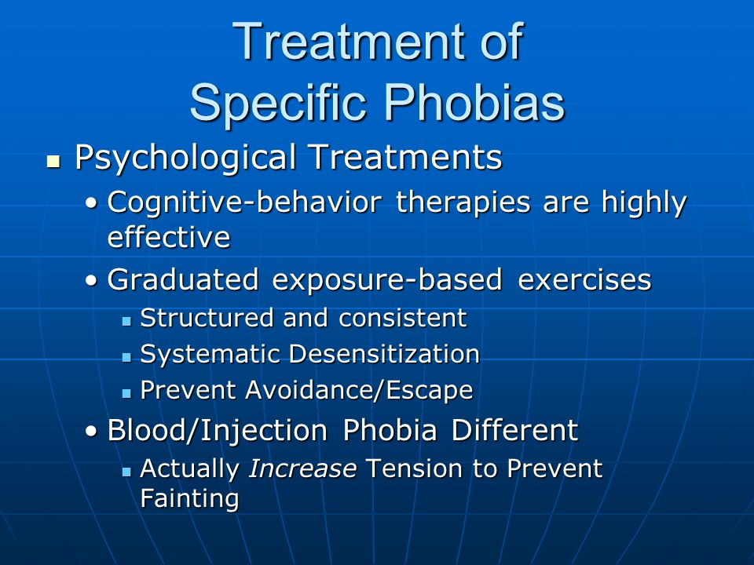

Slide 49

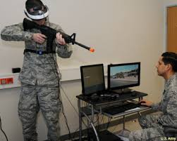
Technology and Treatment of Anxiety, Phobias, and PTSD

Slide 50
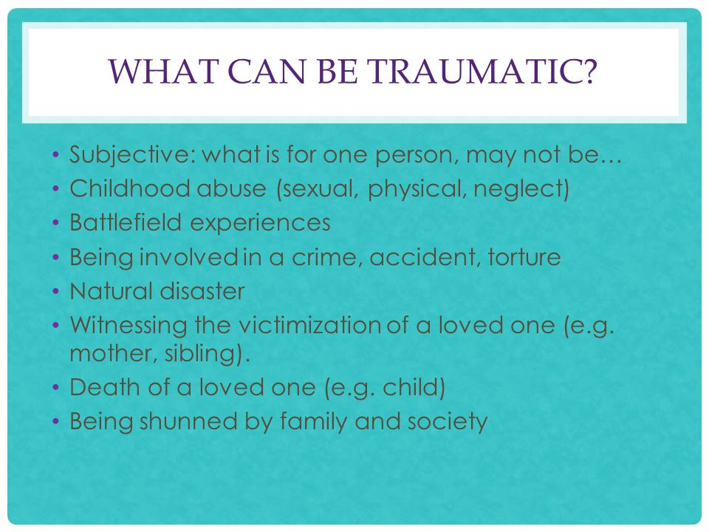

Slide 51
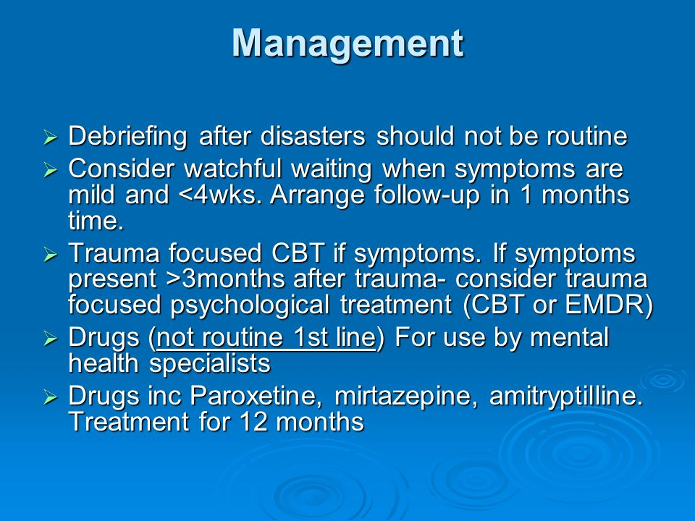

Slide 52
Treatment for PTSD & Acute Stress Disorders
Immediate Debriefing
Cognitive-Behavioral Therapy
Polyvagal Therapy
Exposure Approaches
Support Groups
Medications:
Beta Blockers (long-term management)
Benzodiazepines (PRN use for Breakthroughs)
SSRIs, TCS’s, MAOI’s
Trazodone for sleep disturbance

Slide 53
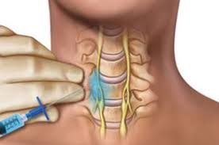
SGB Injections: Stellate Ganglion Block Two shots, one week apart
Local anesthesia is first injected to numb the neck area. The location of the stellate ganglion is then identified under fluoroscopic guidance. ​ A single needle is then placed just above the collar bone and the active medication is injected next to the stellate ganglion. 15 minute procedure, can work within one hour.
Overall success rate is 70-75% over past 10 years and as high as 90%.
Best when coupled with CBT
Cost: $1,500/treatment

Slide 54
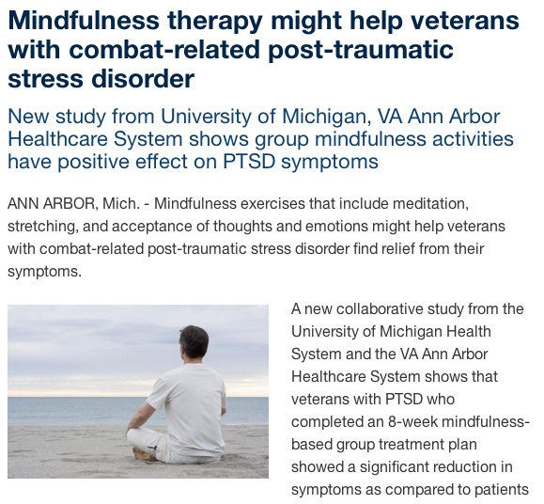

Slide 55
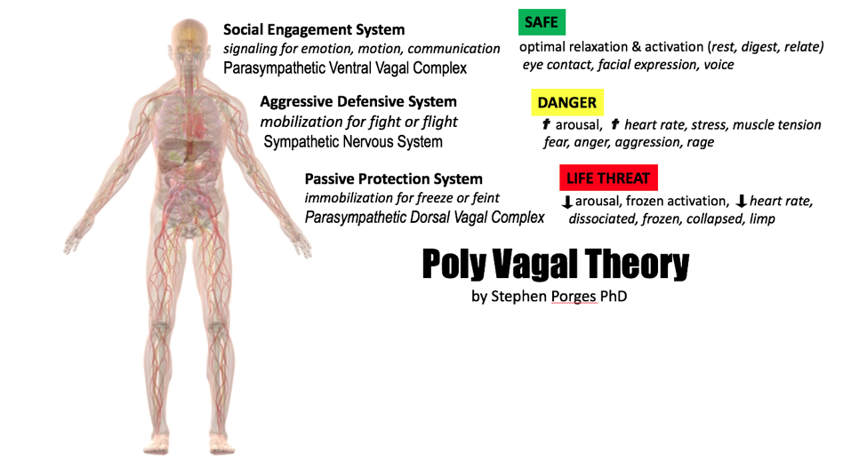

Slide 56
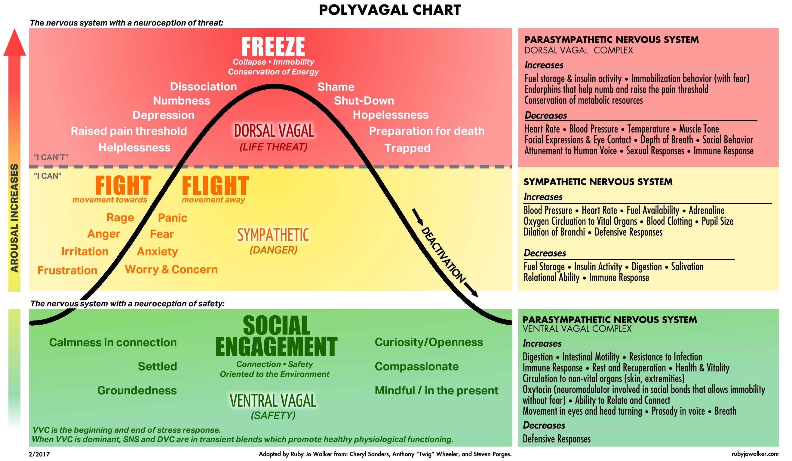

Slide 57
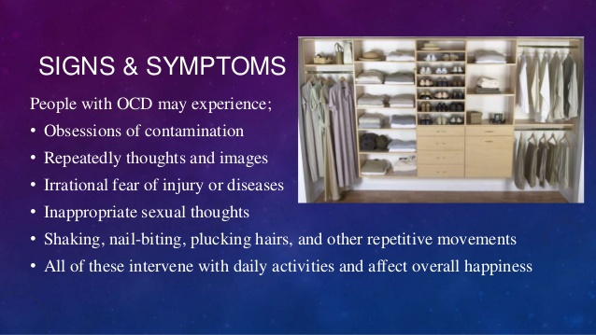
Obsessive-Compulsive Disorder

Slide 58
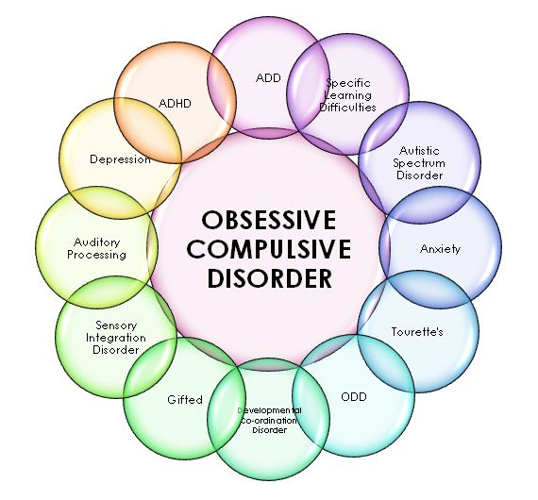

Slide 59
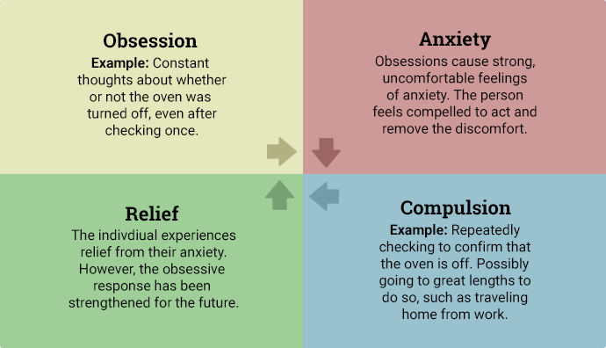

Slide 60
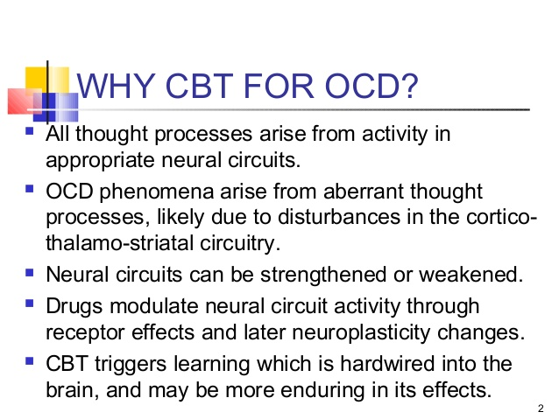

Slide 61
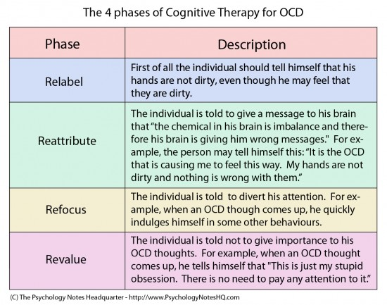

Slide 62
Psychotropic Medications for Anxiety
MAOI’s limited effectiveness with Social Anxiety.
SSRIs, TCA, SNRIs
Wellbutrin or BuSpar
Benzodiazepines
Beta-Blockers
Anafranil
Deep dTMS (FDA 2018)

Slide 63
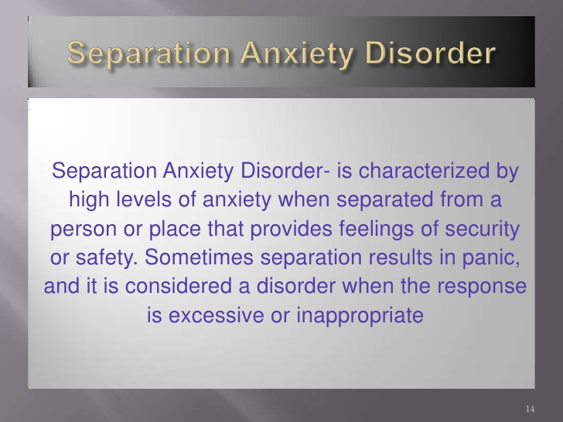

Slide 64
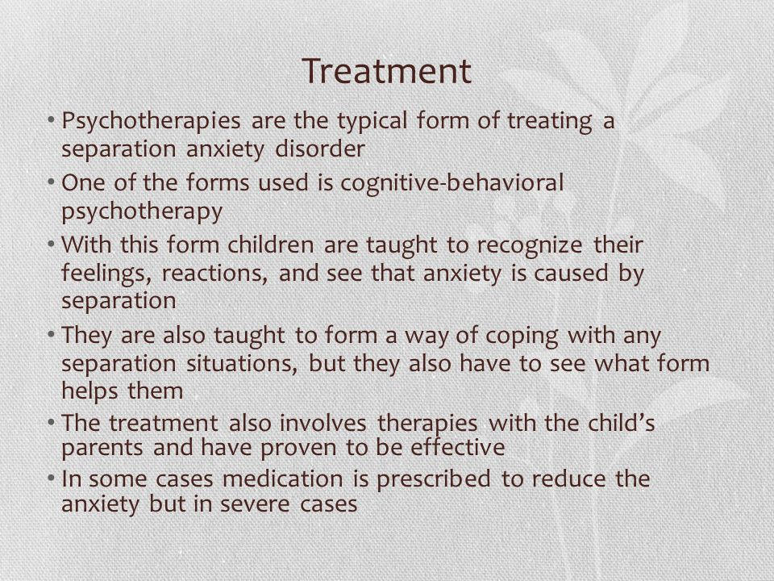

Slide 65
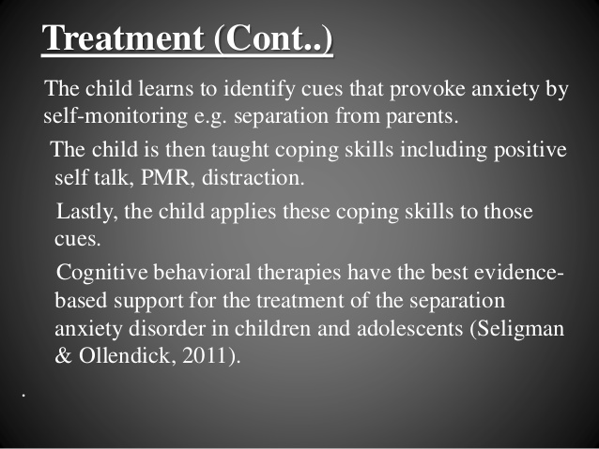

Slide 66
NBCC Guidelines for Anxiety Disorders
Do not use Paradoxical Intent with anxiety symptoms.
In Vivo Desensitization is Only used for Phobias.

Slide 67
Case Study
Video Presentation – Jerry

Slide 68
Jerry’s Case Study
What are Jerry’s:
Symptoms
Impairments in functioning
Treatment Needs
Possible Goals for Treatment

Slide 69
What are Jerry’s “Strengths” and available Resources ?

Slide 70
Who else would you consult regarding the care and treatment of Jerry?
Primary Care Physician
Psychiatry
Family Members/Family Therapist
Educational or Vocational Services
Others ?

Slide 71
What would be 3 Objectives (or short-term goals) for at this time for Jerry?
1.
2.
3.

Slide 72
Goal 1: Reduce depressive symptoms as measured on the Beck’s Depression Inventory (15 or less) for 4 consecutive weeks.
1: Patient will be taught basic sleep hygiene techniques and will report obtaining at least 7 hour of restful sleep per night on at least 5 out of 7 nights (4 weeks).
2: Patient will complete Beck’s CBT Workbook for Depression to help reduce feelings of depression and guilt (8 weeks).
3. Patient will develop a Suicidal Contract with therapist ( 2 weeks) .

Slide 73
Goal 2: Patient will increase self-initiative as evidence by (AEB) returning to full-time employment (8 weeks).
1: Patient will develop a daily schedule and comply with the schedule at least 80 % of the time for 2 consecutive weeks (4 weeks).
2: Will teach patient CBT techniques to address self-motivation and patient will report at least 3 effective uses of these techniques at home/work (4 weeks).

Slide 74
What would be 3 Objectives (or short-term goals) for at this time for Jerry?
1. Patient will participate in physician approved physical exercise at least 3 times per week (duration at least 30 minutes/activity) – 90 days
2. Patient will utilize taught CBT techniques to identify irrational depressive thoughts and replace them with appropriate self-talk on at least 3 occasions (30 days)
3. Patient will be referred to a nutritionist to evaluate his diet and make recommendations for a healthier diet. (30 days)

Slide 75
What Safety Concerns need to be included into his Treatment Plan ?

Slide 76
How would monitor and assess the effectiveness of this Treatment Plan?

Slide 77
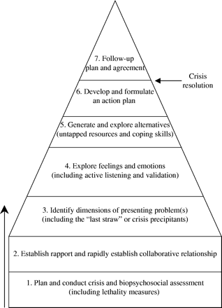
Live Text Assignment # 3
Outline the 7 Stages of Crisis Intervention for a Patient who is voicing Suicidal Ideations (Diagnosis of Major Depressive Disorder).
(due Week 7)

