Slide 1
PSY 6670 Diagnosis & Treatment Planning Lecture 4 : Schizophrenia Spectrum Disorders Treatment Planning
Joel Fairbanks, Ph.D.

Slide 2
Epidemiology
Delusional Disorder, approximately 0.2 %.
Brief Psychotic Disorder, about 9 % .
Schizophreniform Disorder, less than 0.3 %
Schizophrenia Disorder, 0.3 % to 0.7 %
Schizoaffective Disorder, 0.3 %

Slide 3
Schizophrenia
Schizophrenia is the most common of the psychotic disorder and is the most devastating psychiatric disorder.
Two thirds of all psychiatric beds are occupied by Schizophrenic patients (excluding dementia patients).

Slide 4
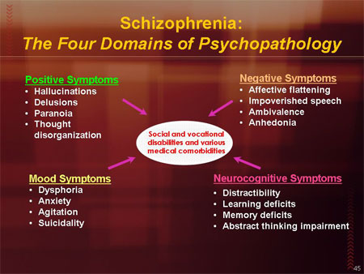

Slide 5
Schizophrenia Cost $62 Billion in the U.S. Annually
$7 Billion for direct Outpatient Services
$5 Billion for pharmaceuticals
$2.8 Billion for hospitalizations
$8 Billion for long-term care
$7.6 Billion of non-mental health care
$32.4 Billion for total Indirect Care &
Services

Slide 6
Comorbidity
Over half also have a Tobacco Use Disorder
Substance Use, usually alcohol, is also common.
Depression and anxiety are frequently reported.

Slide 7
Safety Awareness and Planning
Approximately 5% to 6% of individuals with Schizophrenia die by suicide and about 20 % attempt suicide one or more times during their lives, and many more report suicidal ideation.
Suicides are sometimes in response to command hallucinations to harm themselves or others.

Slide 8
Psychosocial Interventions
Patient Acute Care: Hospitalization for the active psychotic episode or suicidal ideation.
Transitional Care: Chance of relapse and suicide is greatest within the first 6 months. The who have the most stability in their placement fare the best during this period.

Slide 9
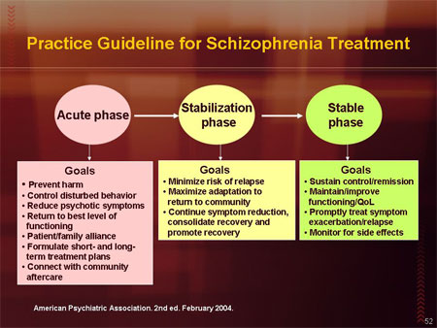

Slide 10
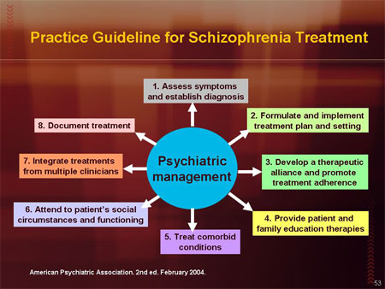

Slide 11
Transitional Care Risks and Treatment Considerations
Failure to take medications as prescribed.
Failure to continue aftercare services.
Inadequate life support (especially housing and income).
Inadequate socialization and recreation.
Effects of high expressed emotion families.
Psycho-educational approach & Family
Therapy

Slide 12
Chronic Care.
Only 14% of patients were functioning “good” or better after a 15 year follow-up study.
Chronically hospitalized patients do better in the community when they are gradually released from the hospital via partial hospitalization, day treatment, halfway houses, or group homes.
Cognitive Remediation shows recent potential for individual counseling.

Slide 13
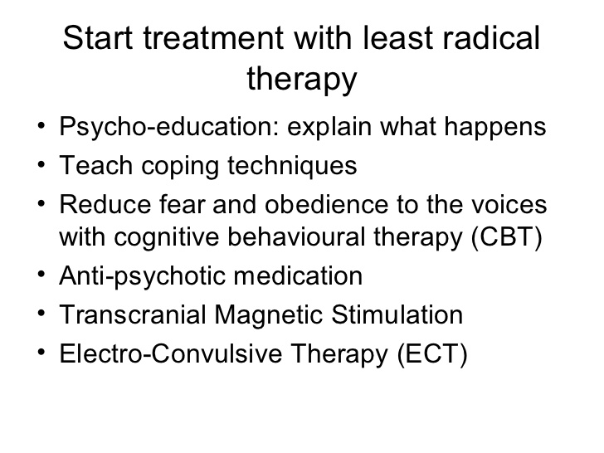

Slide 14
Psychotropic Medications
Anti-Psychotic Medications
Anti-depressants and Mood Stabilizers.
Anti-Anxiety medications

Slide 15
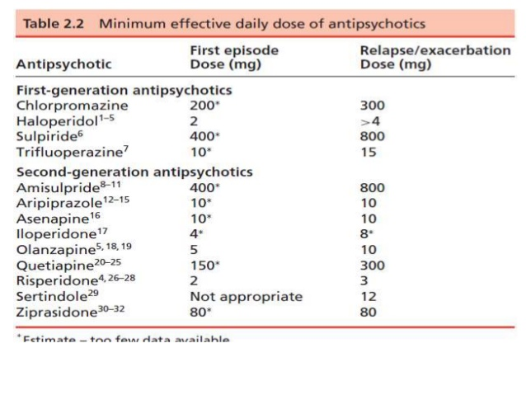

Slide 16
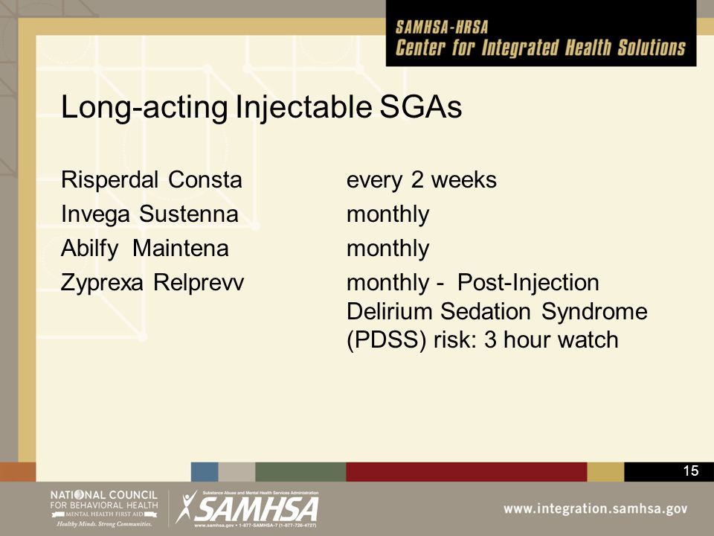

Slide 17
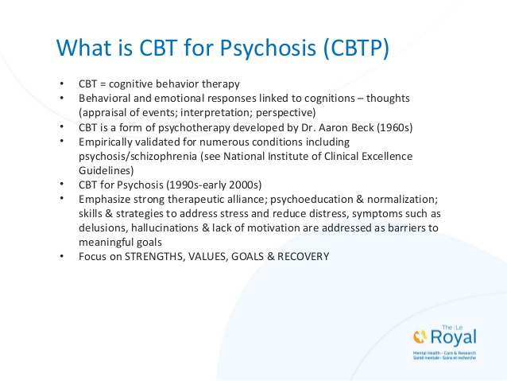

Slide 18
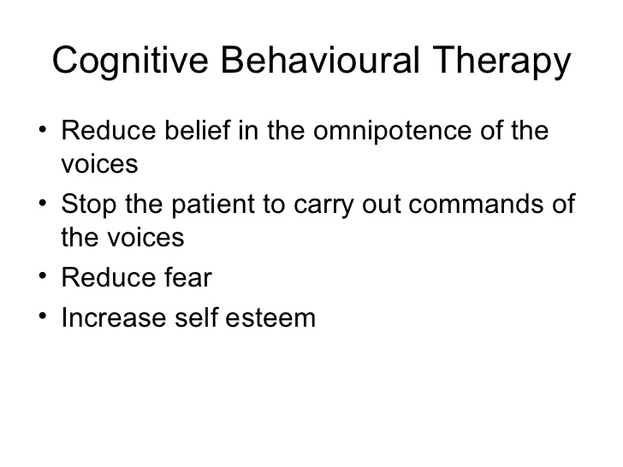

Slide 19
Behavioral Coping Techniques
1. Conversation 73%
2. Singing or Humming 70%
3. Whistling 60%
4. Reading out loud 50%
5. Sleeping 43 %
6. Listening to music (with headphones) 30 %
7. Shouting 28%
8. Reading silently 30 %
9. Chewing gum 25 %
10.Hobbies: games, internet, sports, hiking 16 %

Slide 20
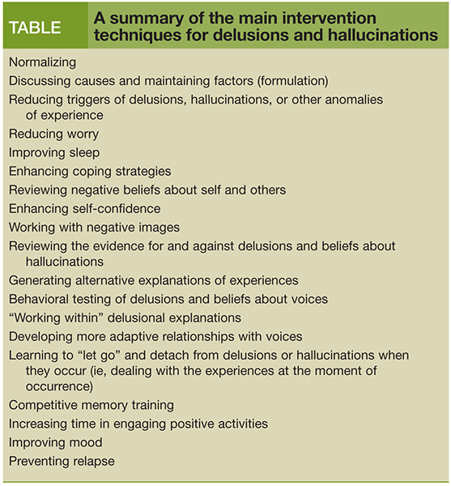

Slide 21
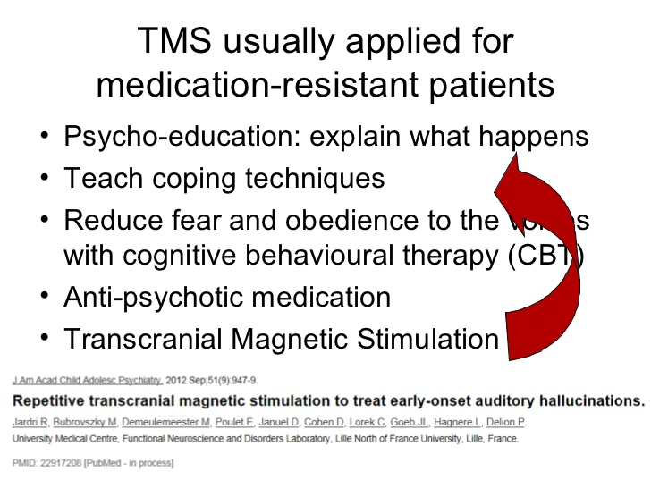

Slide 22
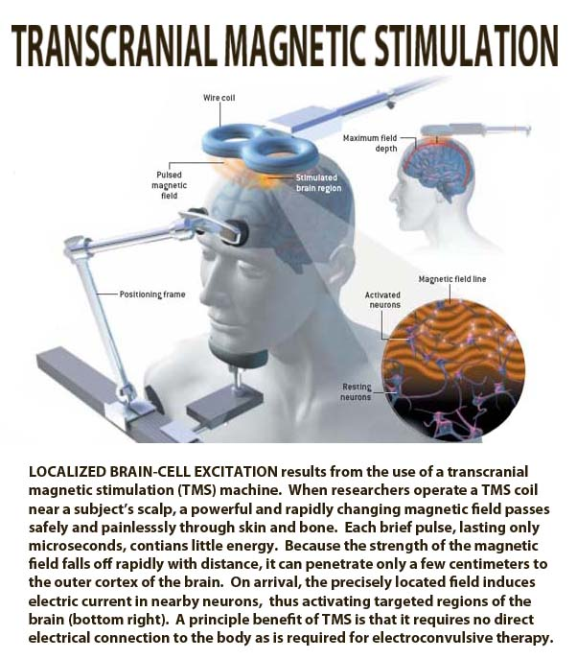
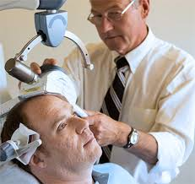

Slide 23


Slide 24

WRAP : Wellness Recovery Action Plan
The Wellness Recovery Action Plan® or WRAP®, is a self-designed prevention and wellness process that anyone can use to get well, stay well and make their life the way they want it to be. It was developed in 1997 by a group of people who were searching for ways to overcome their own mental health issues and move on to fulfilling their life dreams and goals. It is now used extensively by people in all kinds of circumstances, and by health care and mental health systems all over the world to address all kinds of physical, mental health and life issues.
WRAP Will Help You:
Discover your own simple, safe wellness tools
Develop a list of things to do every day to stay as well as possible
Identify upsetting events, early warning signs and signs that things have gotten much worse and, using wellness tools, develop action plans for responding at these times
Create a crisis plan
Create a post-crisis plan

Slide 25

Key Recovery Concepts
Five key recovery concepts provide the foundation of effective recovery work.
Hope – People who experience mental health difficulties get well, stay well and go on to meet their life dreams and goals.
Personal Responsibility – It’s up to you, with the assistance of others, to take action and do what needs to be done to keep yourself well.
Education – Learning all you can about what you are experiencing so you can make good decisions about all aspects of you life.
Self Advocacy – Effectively reaching out to others so that you can get what it is that you need, want and deserve to support your wellness and recovery.
Support – While working toward your wellness is up to you, receiving support from others, and giving support to others will help you feel better and enhance the quality of your life.

Slide 26
Case Study
Video : Greg

Slide 27
Greg Case Study
What are Greg’s:
Symptoms
Impairments in functioning
Treatment Needs
Possible Goals for Treatment

Slide 28
What are Greg’s “Strengths” and available Resources ?

Slide 29
Who else would you consult regarding the care and treatment of Greg?
Primary Care Physician
Psychiatry
Residential Placements
Social Worker, Case Manager, Ombudsman
Vocational Counselor
Community Alliance for Mental Health
Department of Social Security
Community Transportation
Family or neighbors

Slide 30
If the goal is to maintain Greg living “independently” on his own, what would be 3 Objectives (or short-term goals) for at this time ?
1.
2.
3.

Slide 31
If the goal is to maintain Greg living “independently” on his own, what would be 3 Objectives at this time ? Goal 1: Patient will maintain Independent Living for the next 12 months.
Patient will demonstrate daily compliance with medications as prescribed by his
Psychiatrist and PHC (12 months).
Patient will demonstrate on at least two occasions the appropriate use of CBT
techniques to counter visual or auditory hallucinations (30 days).
3. Patient will explore community resources and personal interests to identify at least two prosocial activities that he would like to participate in (30 days)
4. Patient will participate in at least two pro-social activities weekly. (one year).

Slide 32
What Interventions would you employ?
Included in the Objectives

Slide 33
What Safety Concerns need to be included into his Treatment Plan ?

Slide 34
How would monitor and assess the effectiveness of this Treatment Plan?

Slide 35
Live Text Assignment # 2
Create a Care Map for a Patient with the Diagnosis of Schizophrenia.
Diagnosis: F20.0 Schizophrenia, First episode, currently in acute episode
Objectives of Treatment
Assessments as Needed
Clinician Characteristics viewed as therapeutic
Location of treatment
Interventions to be used
Emphasis of Treatment
Nature of Treatment
Timing
Medications needed
Adjunct services
Prognosis

