Slide 1

PSY 6670
Diagnosis & Treatment Planning
Lecture 3 : Substance Related Disorders Treatment Planning
Joel Fairbanks, Ph.D.

Slide 2
LiveText Assignment 1:
Goal & Objective for Major Depression
Goal 1: Patient will report a reduction in depressive symptoms as measured by a BDI score <15 for two consecutive weeks (2 months).
Objective: The patient will learn 2 CBT techniques to reframe depressive thoughts and will report utilizing these techniques at least twice in their environment (30 days).
Goal 2: Patient will improve functioning at school by completing 80 % of her home work assignments with at least 70 % accuracy (30 days)
Objective: Patient will be taught behavioral homework strategies and will schedule at least 60 minute study period each school day (30 days).

Slide 3
Definition of “Substance”
Substance is a general term encompassing alcohol, recreational drugs, and medications. Substance, Chemical, and Drugs are employed interchangeably. Nonpsychoactive drugs (e.g., insulin) are also abused, but the DSM-5 focuses on psychoactive substances. The terms Misuse and Abuse are also interchangeable.

Slide 4
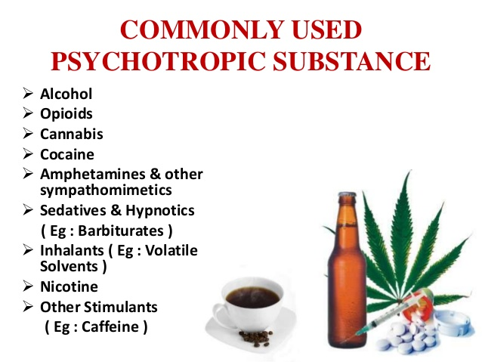

Slide 5
DSM-5 and Substance Use Disorders
The DSM-5 breaks Substance-related Disorders into 10 separate classes of Drugs:
1. Alcohol 2. Caffeine
3. Cannabis 4. Opioid
5. Tobacco
6. Hallucinogens – ingested 7. Hallucinogens- Inhaled
8. Sedatives, hypnotics, anxiolytics
9. Stimulant (amphetamines and cocaine)
10. Other or Unknown Substances

Slide 6
Epidemiology
Prevalence rate 36% for Tobacco Use.
Prevalence rate 8.5% for Alcohol Abuse.
Prevalence rate 9.4% for other Substances.
About 20% With Mood or Anxiety disorder also suffer from Substance Use Disorder
About 78% with Substance Use Disorder also experience another psychiatric disorder.

Slide 7
Prevalence of Substance Use
Individuals 18-24 years of age have a relatively high prevalence rate for virtually every substance.
Alcohol Use Disorder is more common in middle age.
Substances are abused more by men than women. Inner-city more so than country dwellers. More by non-graduates than college graduates.
Different races appear to have the same overall rate of substance abuse, although the substances misused may differ.
After age 44, substance misuse declines for both sexes.

Slide 8
Opioid & Heroin Overdoses
(CDC; 2016)
12.4 Million patients abuse pain medications per year.
7% of teens/young adult abuse opioids (NYT:11/11/18)
1 person dies every 7 minutes by opioid overdose in U.S.
84 Deaths per day from OD in 2015(78/day by Opioid; 162 total)
(64,000 deaths by OD or 175 deaths/day in 2016)
(72,000 deaths in 2017 0r 197/day)
(1999 there were 22,400; an average of 56 deaths per day)
4 out of 5 Heroin users started on pain medications
Carfentanil : synthetic opioid Fentanyl – 1000 times more powerful than morphine.
U. S. consumers 99 % of the World’s Oxycodone pain medications.

Slide 9
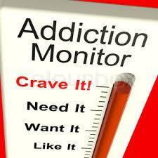
The Addictions also includes a group of repetitive disorders, which some define as Behavioral Addictions including:
Gambling addiction
Sex addiction
Exercise addiction
Gaming (WHO 2018)

Slide 10
Substance Related Disorders are divided into two groups:
Substance Use Disorders: Mild, Moderate, or Severe
Substance Induced Disorders: Including intoxication, withdrawal, and other substance/medication-induced mental disorders (e.g., mood, anxiety, sleep, or sexual disorders)

Slide 11
Definition of Severity
As a general estimate of severity, “MILD” substance use is suggested by the presence of 2 or 3 symptoms and “MODERATE” by 4 or 5 symptoms, with “SEVERE” define as 6 or more symptoms.
Severity may change over time reflecting increases or reductions in frequency of use and the dosage used by the individual.

Slide 12
Use of Multiple Substances
Substance use, intoxication, and withdrawal often involves several substances used simultaneously or sequentially. In these cases, each diagnosis should be recorded separately.
There is no longer a Poly-substance Abuse
Disorder

Slide 13
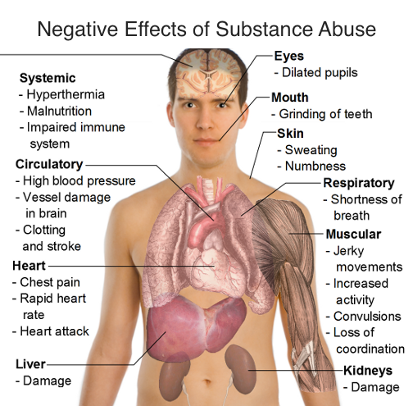

Slide 14
Assessment if Suspected Substance Misuse:
1. History :
Substances used,
Route,
Amount, Patterns of use,
Acquisition,
Network,
Functioning,
Medical/Psychiatric history,
Prior treatment.

Slide 15
Assessment if Suspected Substance Misuse:
2. Common Symptoms & Signs :
A. Prodromal Phase
Increased tolerance
Sneaking alcohol/drugs
Temporary amnesia (black-outs)
Preoccupation with drug use
Avoids talking about personal use
More frequent memory loss

Slide 16
Assessment if Suspected Substance Misuse:
2. Common Symptoms :
B. Crucial or basic Phase
Time lost from work or school
Alibis
Increased extravagance
Aggressive or abusive behavior
Persistent remorse
Periodic abstinence

Slide 17
Assessment if Suspected Substance Misuse:
2. Common Symptoms :
B. Crucial or basic Phase…continued
Losing or changing friends
Losing clients or positions/jobs
Persistent Resentment
Diminished self-care and unhealthy appearance
Slovenly dressed (sunglasses at inappropriate times
Borrowing money (or theft) to buy drugs

Slide 18
Assessment if Suspected Substance Misuse:
2. Common Symptoms :
B. Crucial or basic Phase…continued
Escape: geographic, psychological or social
Protecting supply
Morning use of drugs or alcohol

Slide 19
Assessment if Suspected Substance Misuse:
2. Common Symptoms :
C. Chronic Phase
More-or-less continuous use over 10 hour period
Ethical deterioration
Decreased tolerance
Sleeping at inappropriate times
Indefinable fears
Tangential of incoherent speech
Tremors

Slide 20
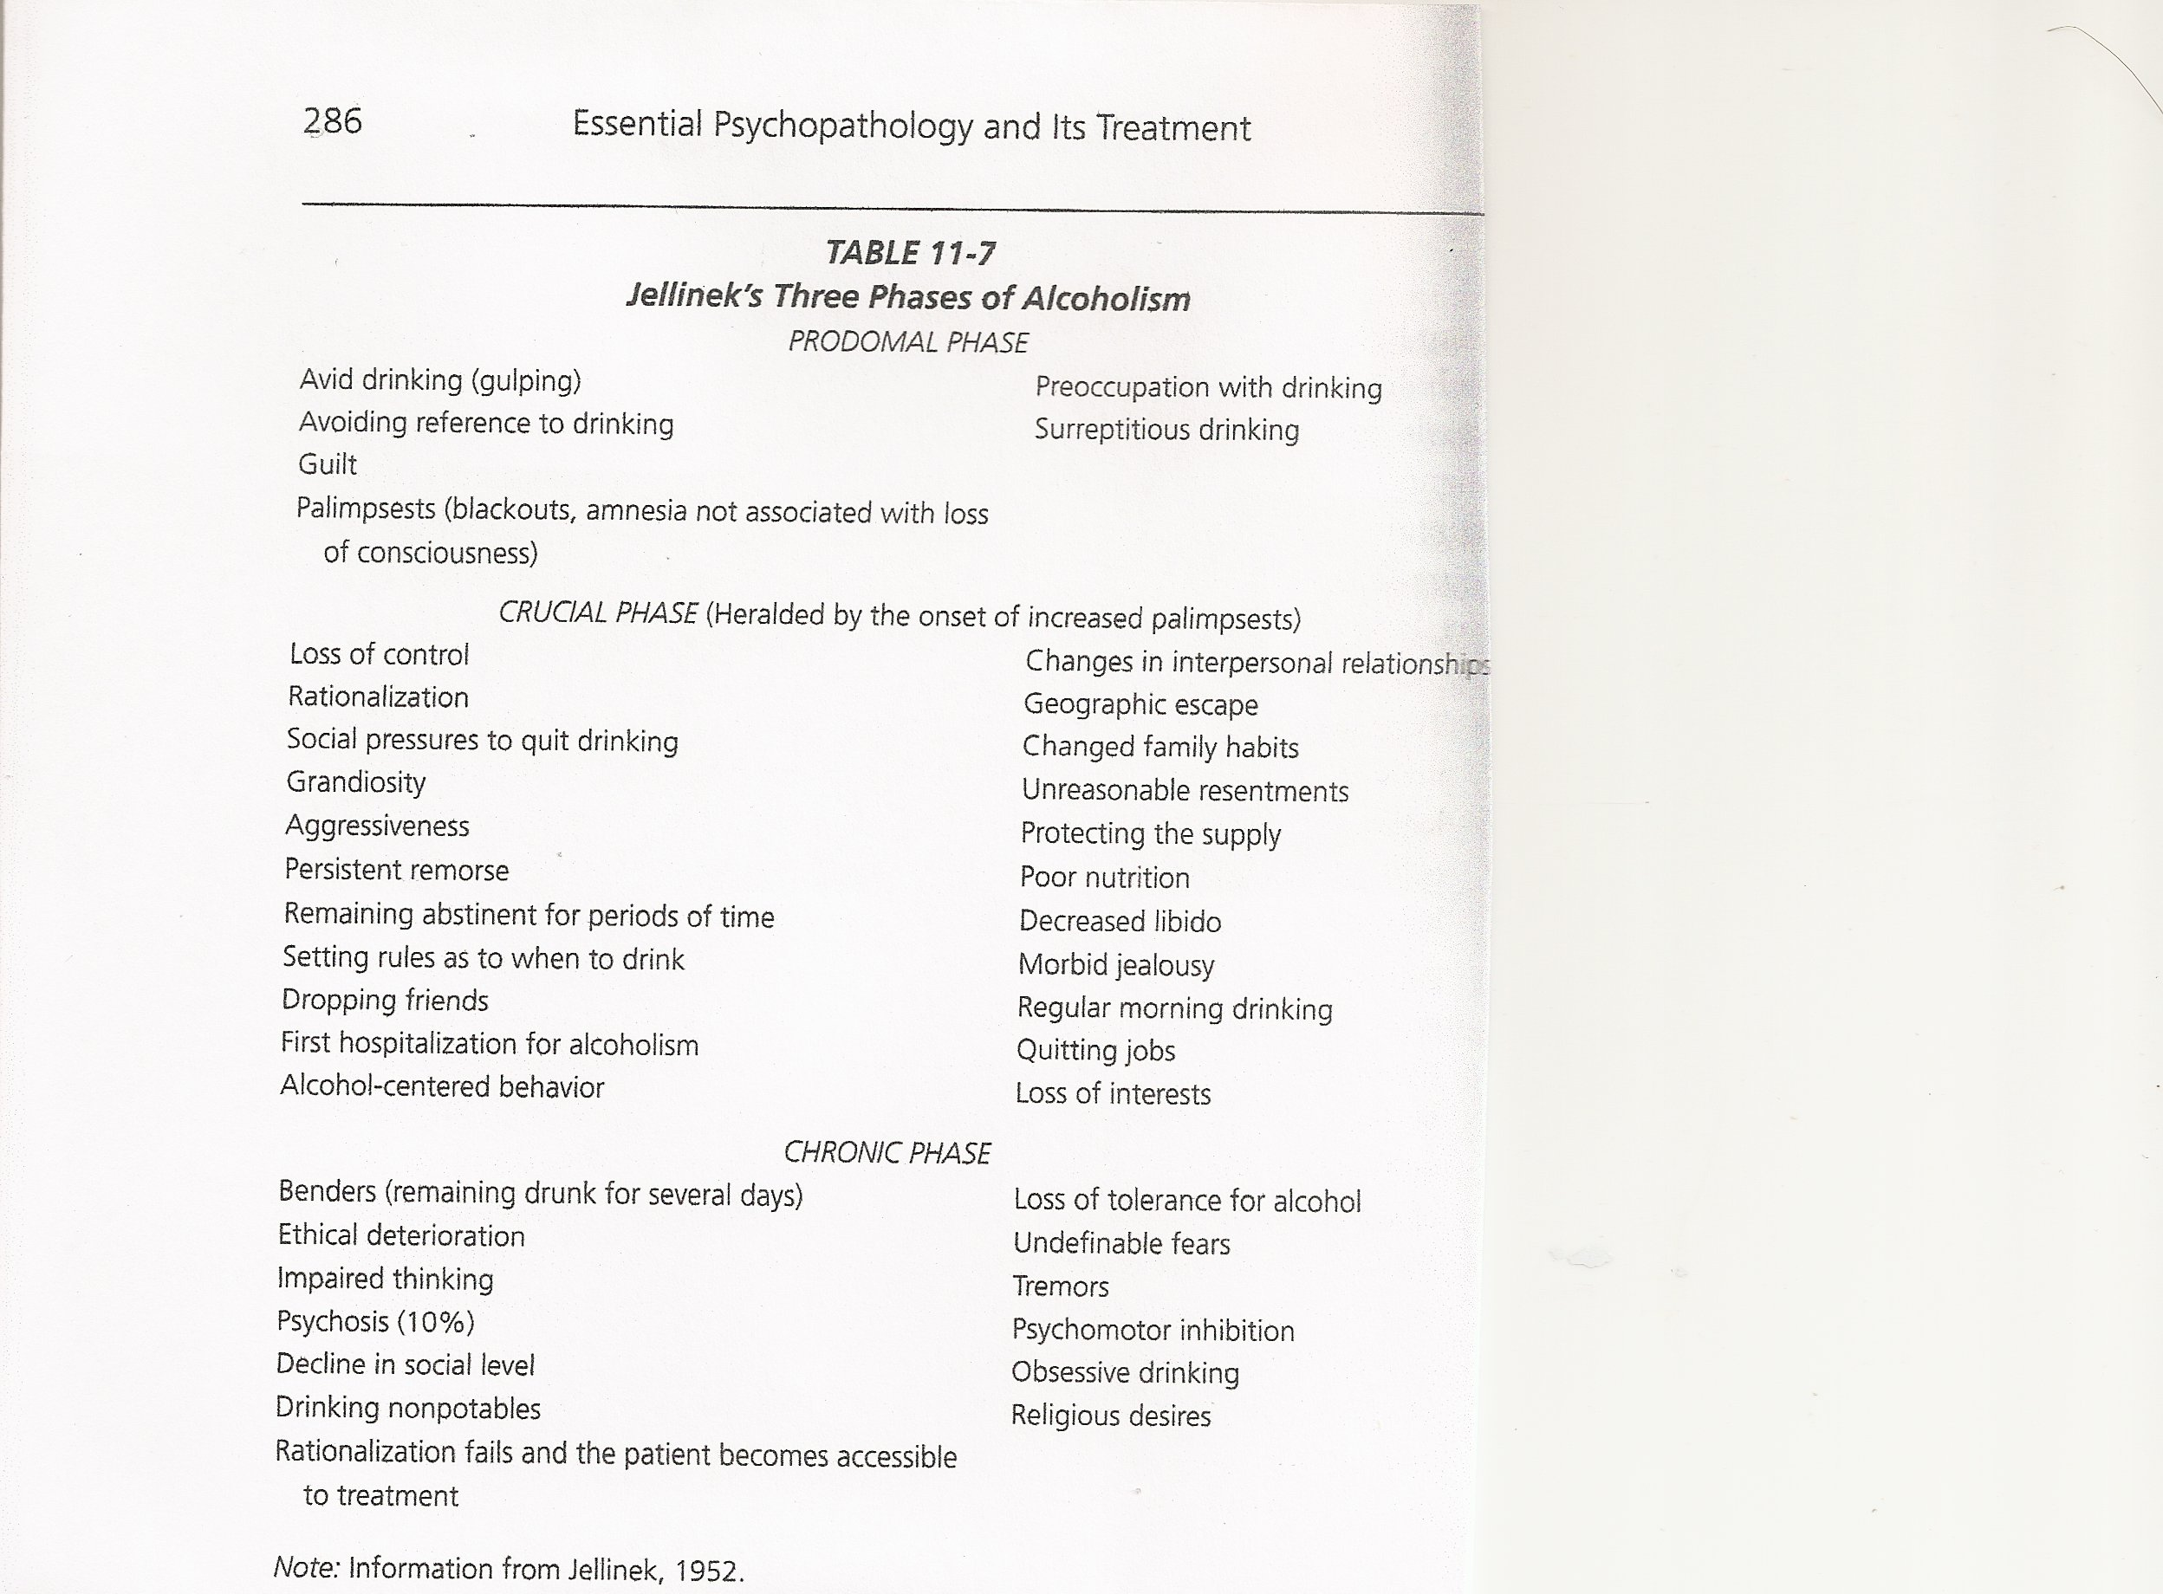

Slide 21
Assessment if Suspected Substance Misuse:
3. Physical Examination :
Physical signs: Marks, Nose, Pupils, Signs of intoxication or withdrawal
Laboratory Examination: Urine screen, Serum levels, Liver and renal functions

Slide 22
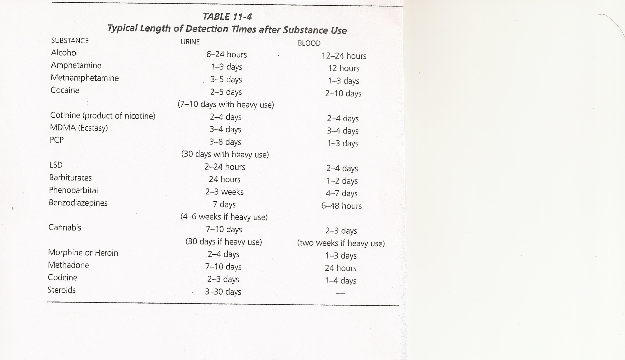

Slide 23
Psychosocial Interventions
Patient Care: The primary goal is Abstinence. Secondary is to address the “needs” that the addiction “fulfilled” as well as secondary mental health issues.
Patient After-Care: Support groups or programs such as AA or NA and assignment of a Sponsor and development of a Relapse Prevention Plan.

Slide 24
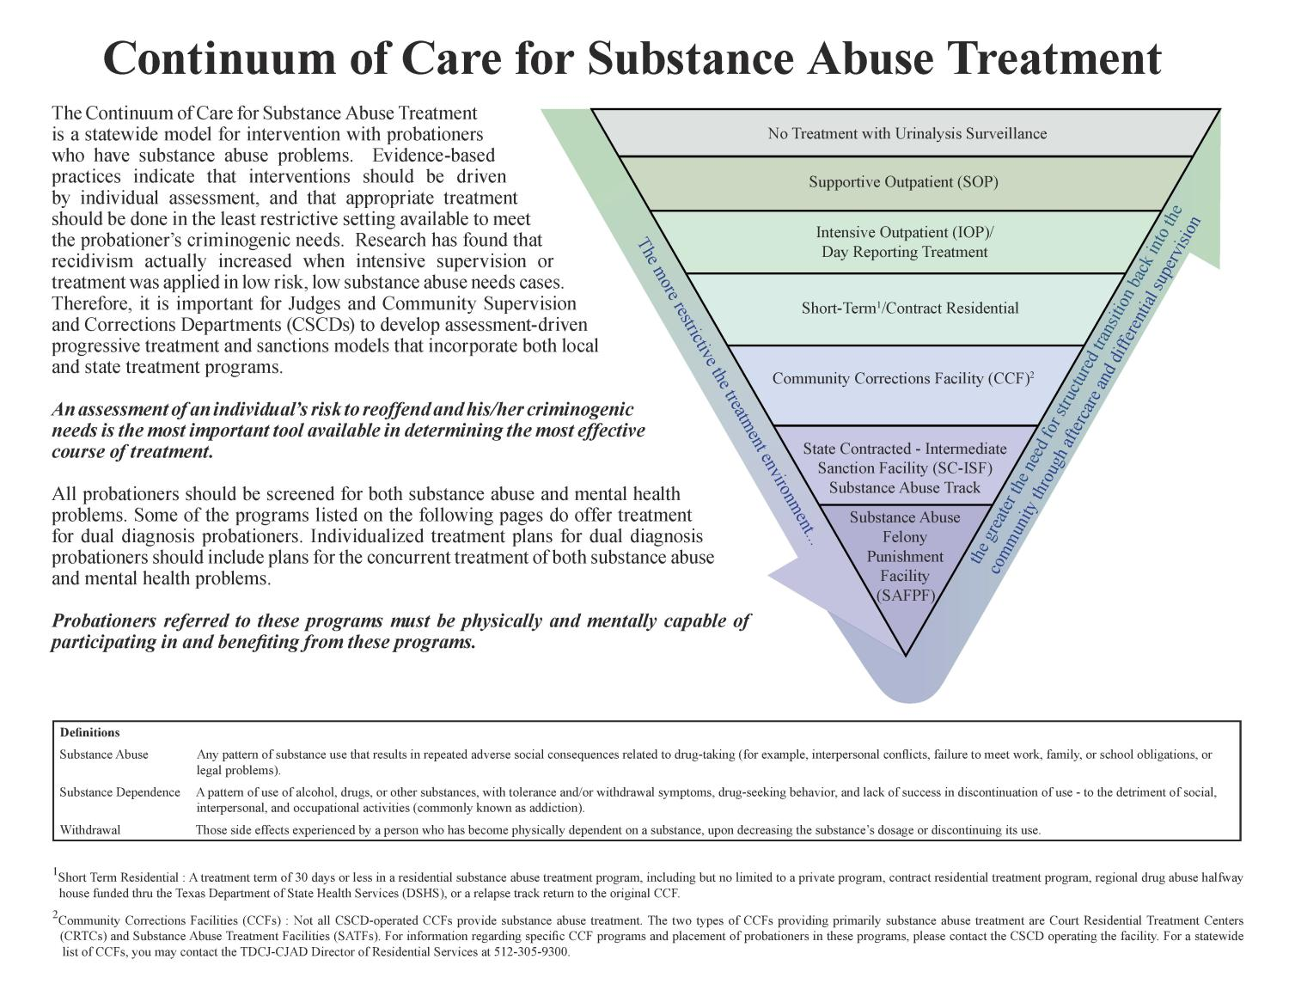

Slide 25
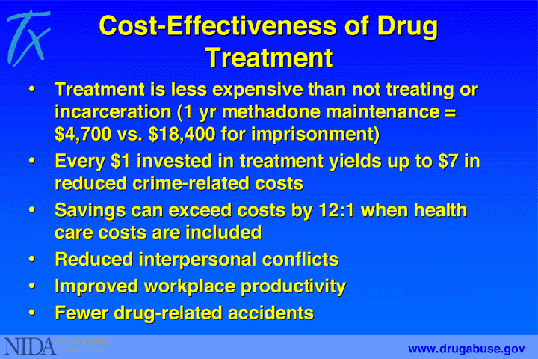

Slide 26
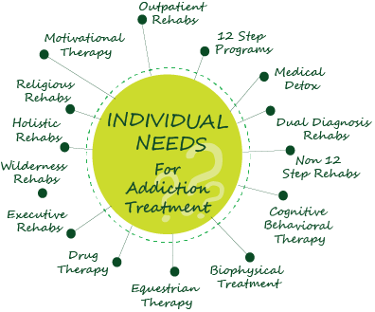

Slide 27
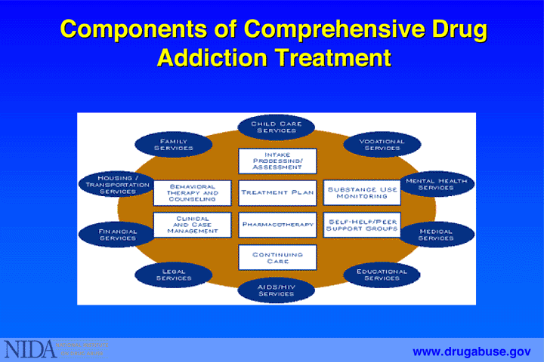

Slide 28
MAT: Medication Assisted Treatment
Methadone, Buprenorphrine, Naltrexon
Psychosocial Treatments:
  Modify underlying behaviors that may lead to abuse of opioids.
  Encourage adherence to their prescribed medications.
  Treat comorbid psychiatric disorders.
  Referrals to community based services.
  Individual & Group therapy (CBT based)
  Connect with family support systems & family therapy services.

Slide 29
MAT continued:
Contingency Management, use of behavior modification and token economy for compliance with treatment interventions
Relapse Prevention Planning.
Mutual help groups/support groups (NA or similar 12-step recovery programs)

Slide 30
Psychosocial Interventions
Family Counseling: Supportive and help to develop Behavioral Interventions for the patient in the home to ensure sobriety.
Vocational Training, Placement, and Supportive Services.
Social-economic Assistance and Benefits.
Assist & Support Legal Obligations/ Requirements.

Slide 31
Safety Awareness and Planning
Removable of risk conditions such as: alcohol use, poor nutrition, exposure to toxins (cleaners), falls, wandering, stoves/ovens, self medication/over medication, and “noncompliance” with medications.

Slide 32
Psychotropic Medications
Anti-Abuse or Antagonist Therapy
Methadone, Suboxone, Naltrexone, Vivitrol Maintenance Therapies.
Psychotropic Medications for other mental disorders.
Medications to manage Withdrawal.

Slide 33
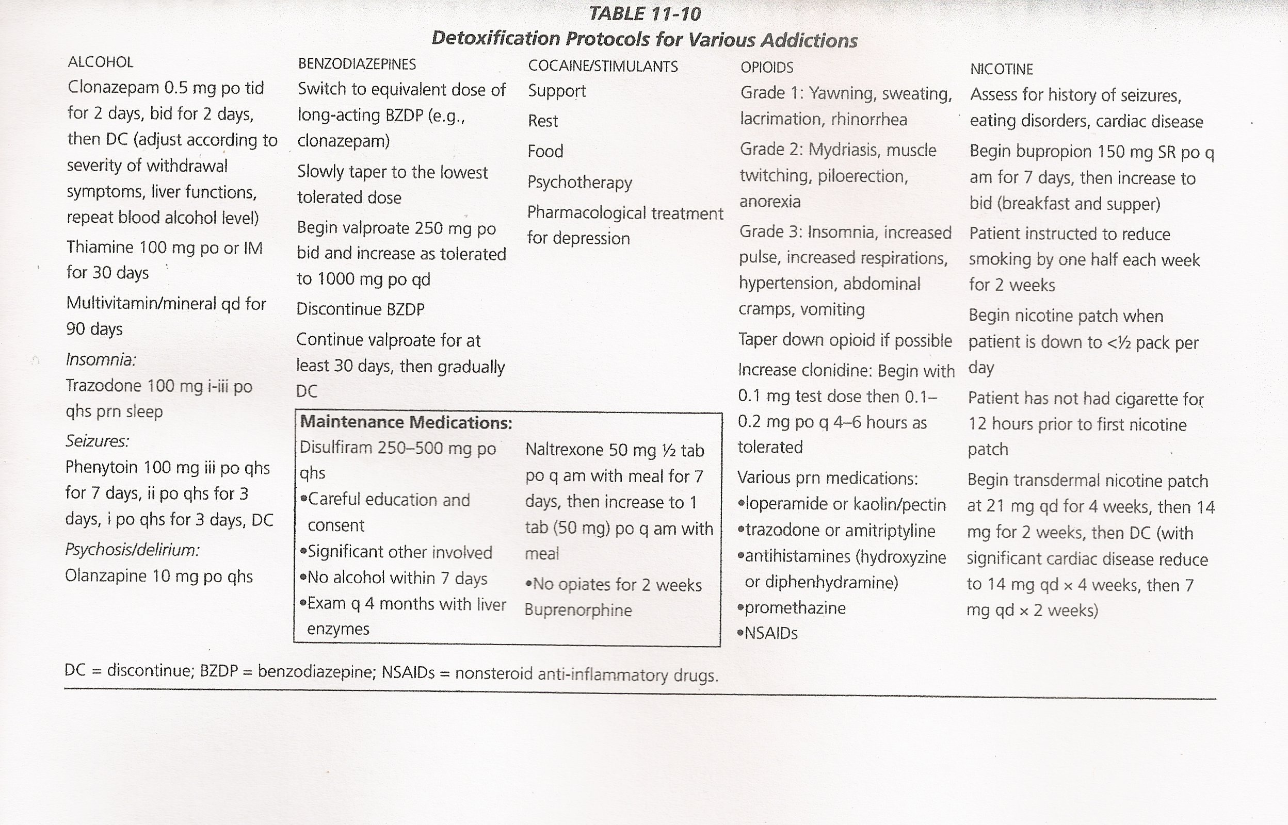

Slide 34
Safety Concerns for Substance Use Disorders
Withdrawal Protocol
Increase in Secondary mental health symptoms
Suicide Precautions
Domestic Violence
Transfer to another Addiction
Medical/Health Concerns

Slide 35
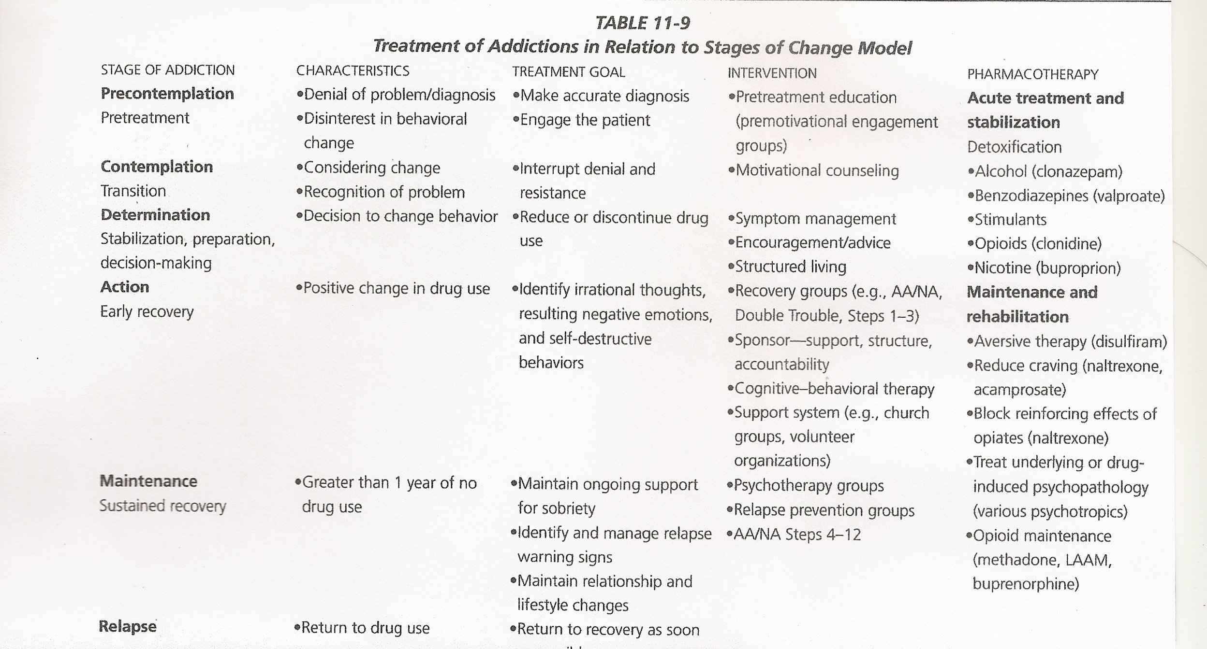

Slide 36
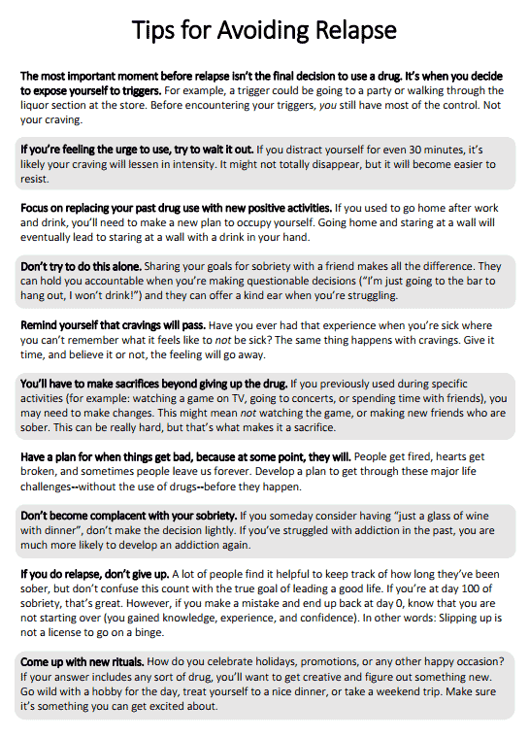
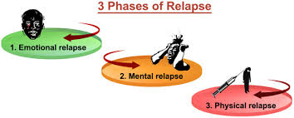
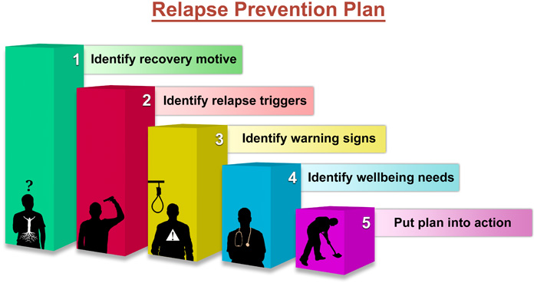

Slide 37
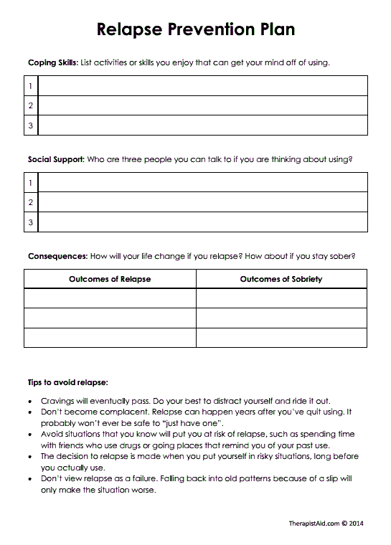
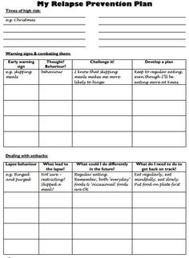

Slide 38
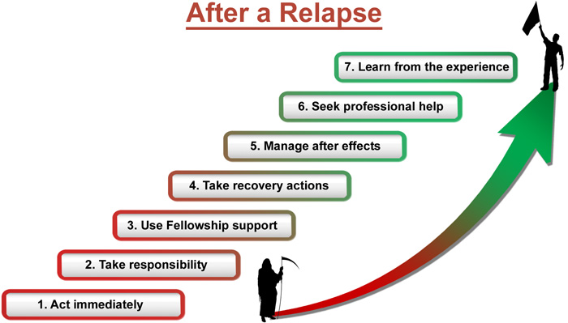

Slide 39
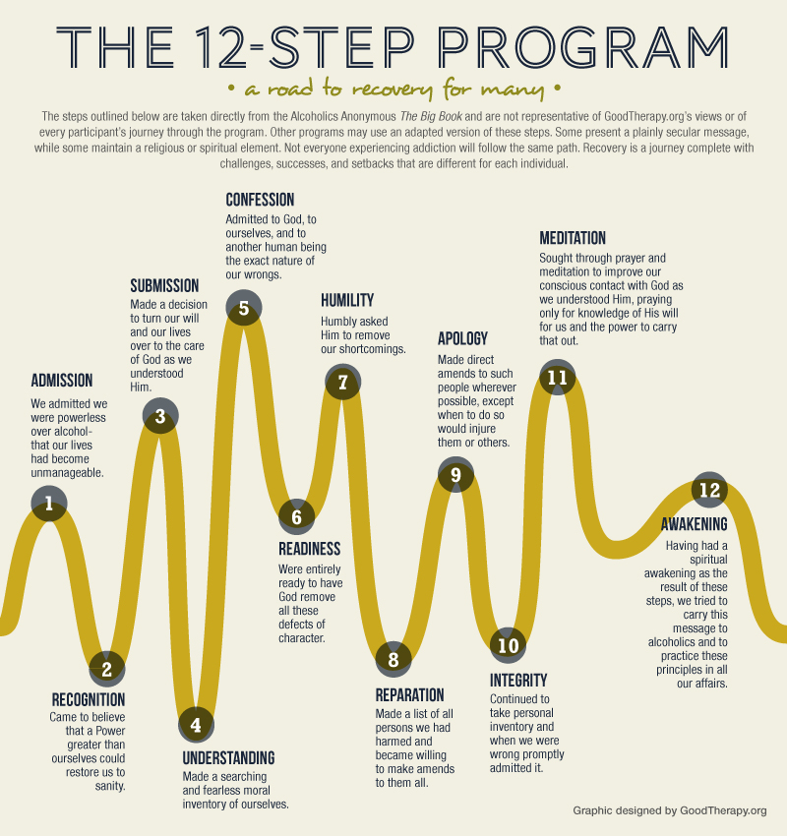


Slide 40
AA Treatment Outcomes ,2020
In 2006, a review of 8 studies utilizing AA program found mixed results with not enough evidence to judge the program.
Recent review of 27 studies including 10,565 participants found that AA not only helped people to stop drinking, but also demonstrated higher rates of sobriety than other treatments, including CBT.

Slide 41

WRAP : Wellness Recovery Action Plan
The Wellness Recovery Action Plan® or WRAP®, is a self-designed prevention and wellness process that anyone can use to get well, stay well and make their life the way they want it to be. It was developed in 1997 by a group of people who were searching for ways to overcome their own mental health issues and move on to fulfilling their life dreams and goals. It is now used extensively by people in all kinds of circumstances, and by health care and mental health systems all over the world to address all kinds of physical, mental health and life issues.
WRAP Will Help You:
Discover your own simple, safe wellness tools
Develop a list of things to do every day to stay as well as possible
Identify upsetting events, early warning signs and signs that things have gotten much worse and, using wellness tools, develop action plans for responding at these times
Create a crisis plan
Create a post-crisis plan

Slide 42

Key Recovery Concepts
Five key recovery concepts provide the foundation of effective recovery work.
Hope – People who experience mental health difficulties get well, stay well and go on to meet their life dreams and goals.
Personal Responsibility – It’s up to you, with the assistance of others, to take action and do what needs to be done to keep yourself well.
Education – Learning all you can about what you are experiencing so you can make good decisions about all aspects of you life.
Self Advocacy – Effectively reaching out to others so that you can get what it is that you need, want and deserve to support your wellness and recovery.
Support – While working toward your wellness is up to you, receiving support from others, and giving support to others will help you feel better and enhance the quality of your life.

Slide 43
WRAP Training (16 hour group/class)
Creating a Wellness Toolbox
Creating a Daily Maintenance Plan
Triggers and Triggers Action Plan
Early Warning Signs and Action Plan
Advance Directive / Crisis Plan
WRAP One-on-One
Key Recovery Concepts
WRAP Values and Ethics: Mental Health Recovery and WRAP

Slide 44
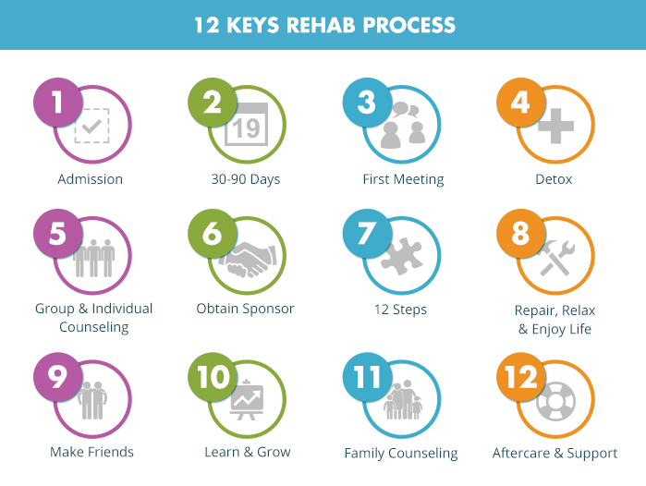

Slide 45
Case Study
Sherlock Holmes (pg 227)

Slide 46
Holmes’ Case Study
What are Mr. Holmes’:
Symptoms
Impairments in functioning
Treatment Needs
Possible Goals for Treatment

Slide 47
What are Mr. Holmes’ “Strengths” and available Resources ?

Slide 48
Who else would you consult regarding the care and treatment of Mr. Holmes?
Primary Care Physician
Psychiatry
Family Members/Family Therapist
NA/AA Group and Sponsor
Educational or Vocational Services
Others ?

Slide 49
If the goal is for Mr. Holmes to live a drug free lifestyle and maintain sobriety, what would be 3 Objectives (or short-term goals) for at this time ?
1.
2.
3.

Slide 50
Goal 1: The patient will maintain a drug free lifestyle for one year.
Objectives:
1. Patient will abstain from all alcohol, non-prescribed
medications, and drugs for 12 months. (same as goal ?)
2. Patient will participate in at least 8 NA meetings, in at least
3 different group settings in 30 days, then maintain weekly NA
participation (12 months)
3. Patient will identify three different “triggers” that have
lead to drug use in the past (0ne month).

Slide 51
Goal 2: Patient will report a score of 70 or higher on the Quality of Life Scale for 4 consecutive weeks (6 months).
Objective 1: Patient will complete an Interests Survey and identify at least two areas that can be used to participate in to relieve episodes of boredom and effectively engage in these activities at least 3 times ( 90 days).
Objective 2: Patient will be taught CBT reframing techniques to address dissatisfied thoughts or boredom and journal these incidents on a weekly basis (90 days).

Slide 52
What Interventions would you employ?

Slide 53
What Safety Concerns need to be included into his Treatment Plan ?

Slide 54
How would monitor and assess the effectiveness of this Treatment Plan?

